Slide 1
gVisor Memory Management Survey and Optimization
Xiaohan Fu, Bili Dong, John Hwang
3/16/2020

Slide 2
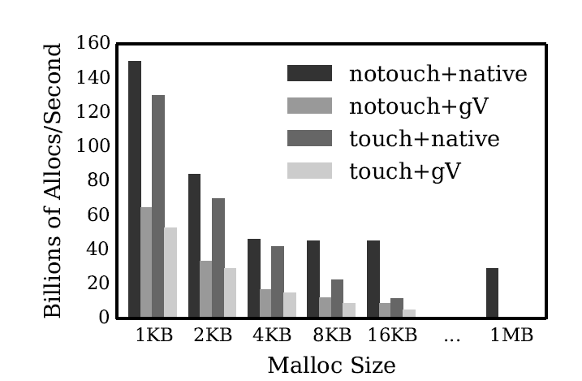
Problem & Motivation
Problem of gVisor
Significant overhead
Decreasing perf. Vs. size
Motivation
Memory allocation is super common in any use case
Source: “The True Cost of Containing: A gVisor Case Study”

Slide 3
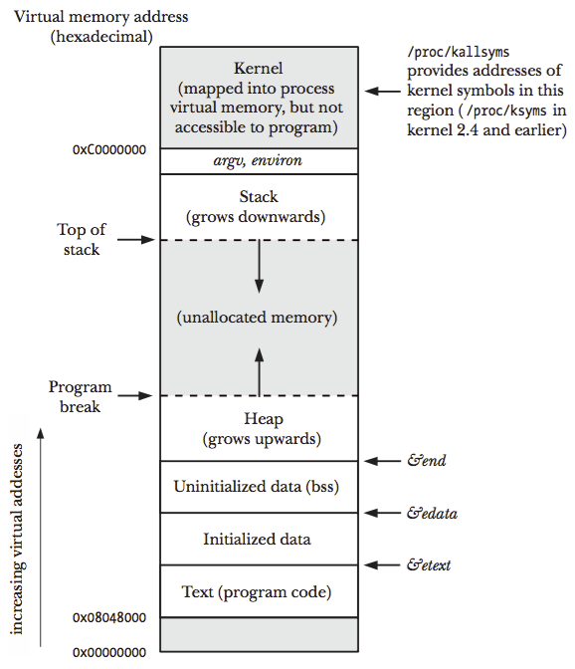
Implementation of Malloc()
Use brk() syscall to enlarge the heap
Move program break
If malloc size larger than MMAP_THRESHOLD(128KB)
Use mmap() syscall to allocate memory as private anonymous mapping
Source: https://github.com/shichao-an/notes/blob/master/docs/tlpi/figure_6-1.png

Slide 4
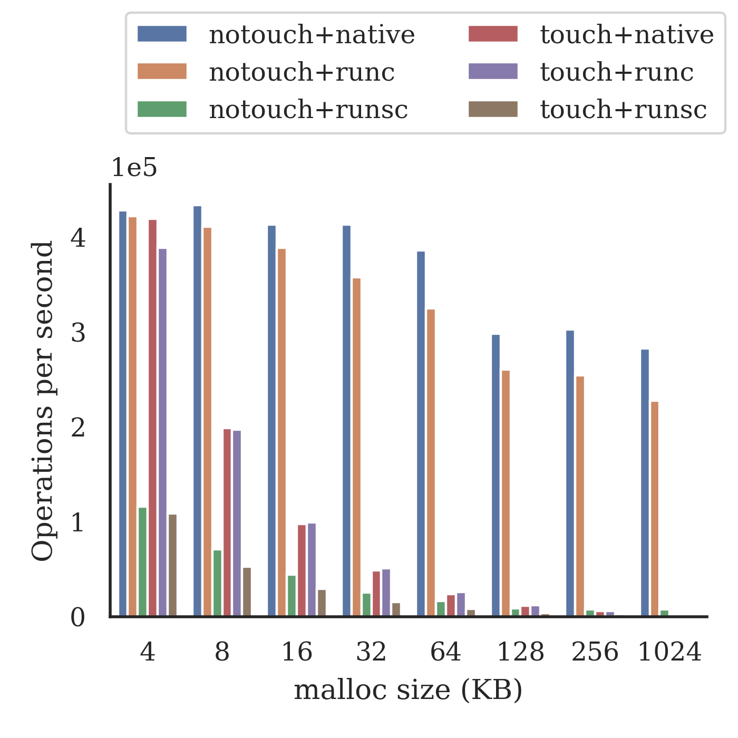
Reproduce the Malloc Benchmark
gVisor has very poor perf. after > 128KB
-> which is implemented by mmap
-> mmap has relatively larger overhead
We decide to focus on mmap optimization

Slide 5
Mmap (file backed) in Linux and in gVisor
Linux
gVisor
Create virtual memory mapping (VA -> file: offset)
E.g. VA: 0x123400 → /tmp/foo:0x0
Create filemap (fileoffset -> PA)
E.g. /tmp/foo:0x0 -> PA:0x2fb00
Create PTE (VA -> PA)
E.g. VA: 0x123400 -> PA:0x2fb00
Create sentry virtual memory mapping (VA -> file: offset)
E.g. VA: 0x123400 → /tmp/foo:0x0
Create sentry filemap (file: offset -> host: memory file) by pgalloc
/tmp/foo:0x0 -> host_memf:0x3000
Create host VMA (VA -> host file offset) by call host mmap syscall
E.g. VA: 0x123400-> host_memf:0x3000
Host page fault takes over
Page Fault

Slide 6
Mmap call in gVisor
Private
Shared
Anonymous
gVisor
Create sentry virtual memory mapping (VA -> file: offset)
E.g. VA: 0x123400 → /tmp/foo:0x0
Create sentry filemap (file: offset -> host: memory file) by pgalloc
/tmp/foo:0x0 -> host_memf:0x3000
Create host VMA (VA -> host file offset) by call host mmap syscall
E.g. VA: 0x123400-> host_memf:0x3000
createVMALocked()
Page Fault
Eagerly create host VMA
getPMAsLocked()
mapASLocked()

Slide 7
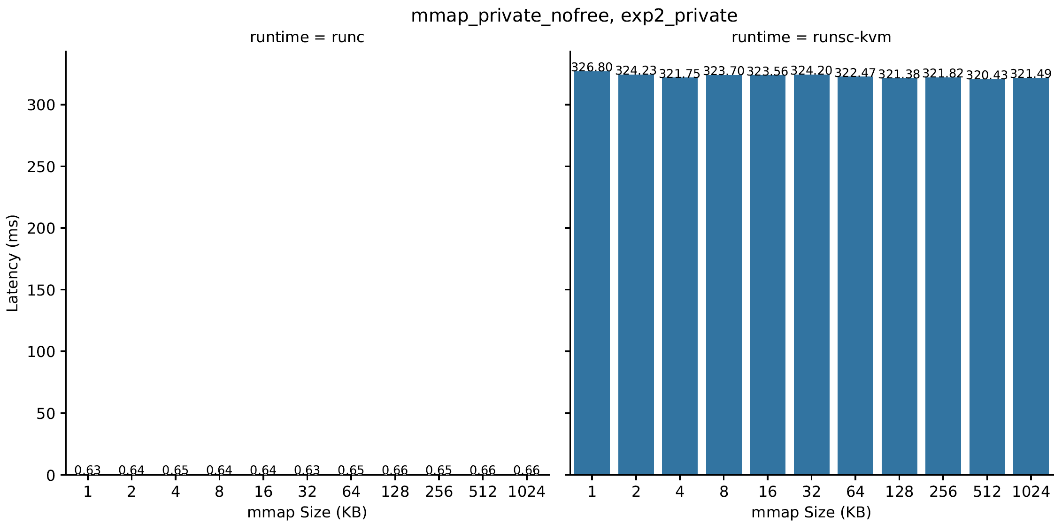
Mmap Latency versus Size (private)
25000 iterations
Super slow ->
Constant for both

Slide 8
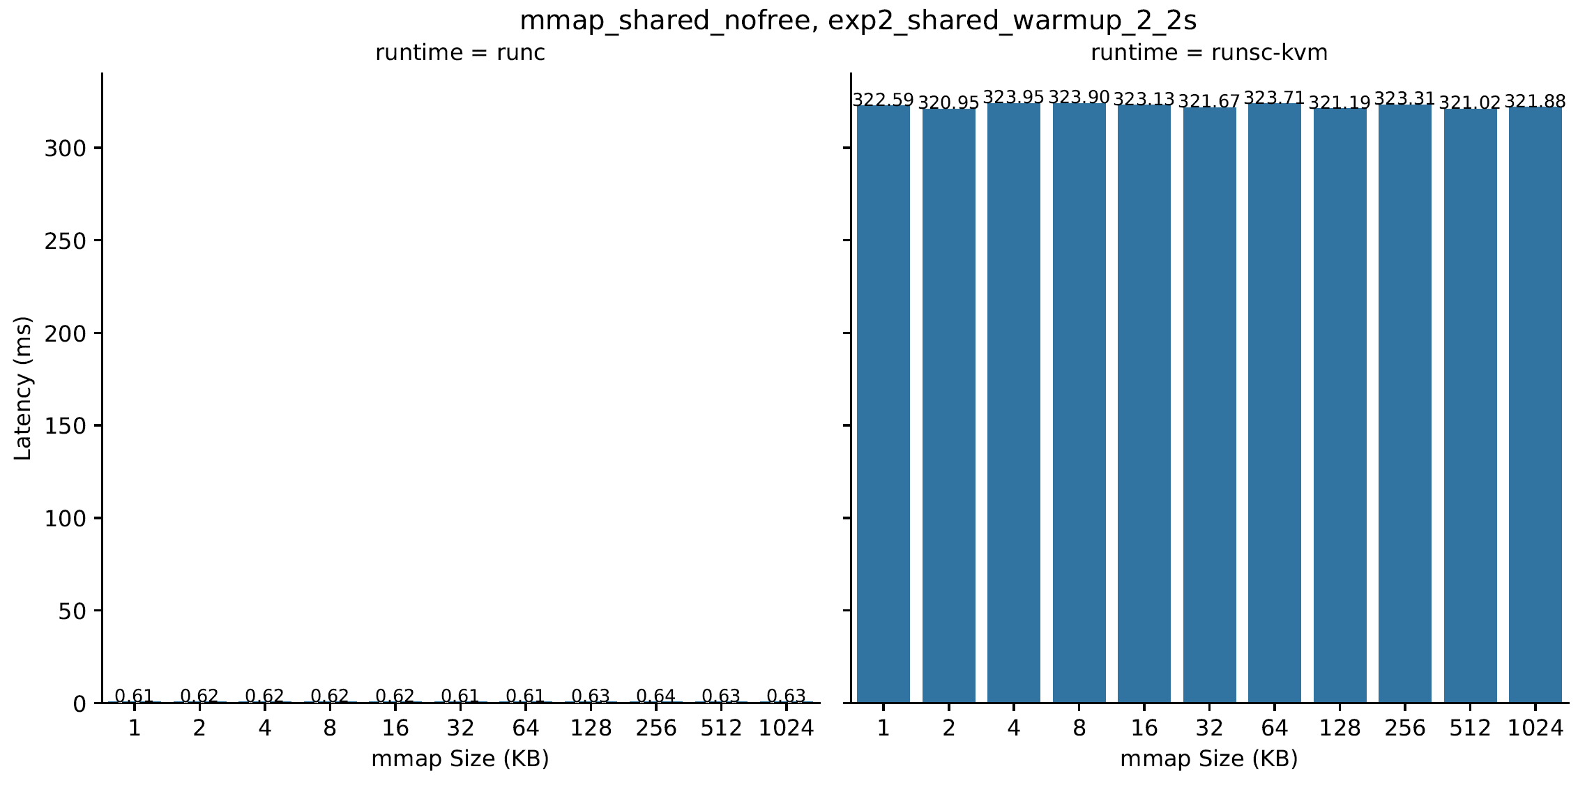
Mmap Latency versus Size (shared)
25000 iterations
Super slow ->
Constant for both

Slide 9
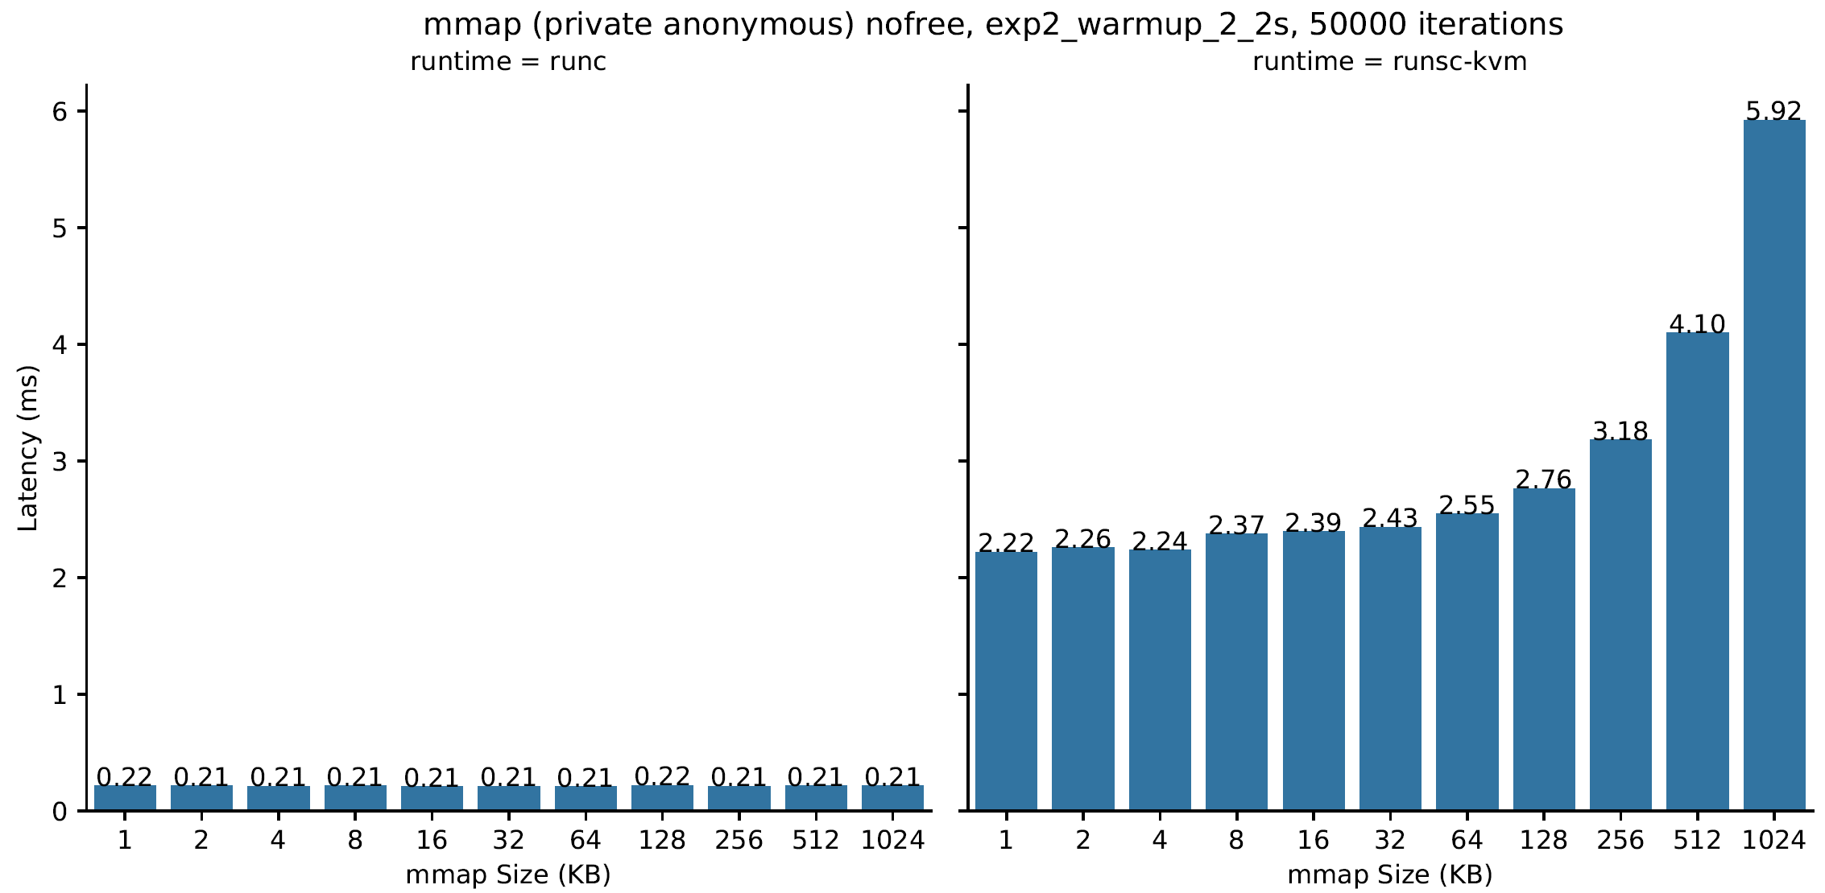
Mmap Latency versus Size (Anon)
Much faster but
increasing by size
Why?
Still constant

Slide 10
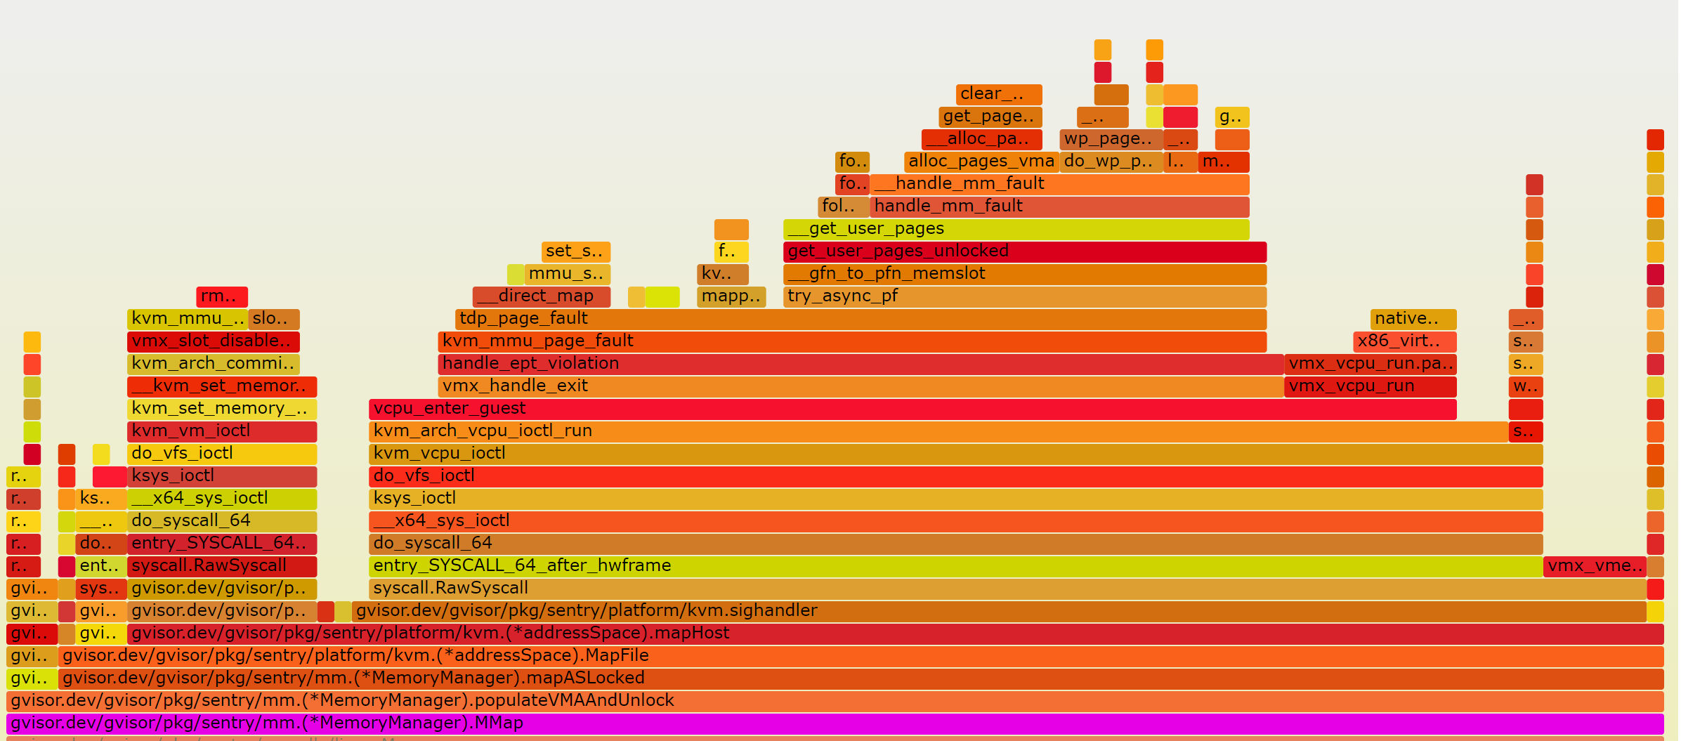
Perf Analysis, size = 4KB (10000Hz)
createVMALocked ~ 0%
getPMAsLocked
mapASLocked
3%
97%

Slide 11
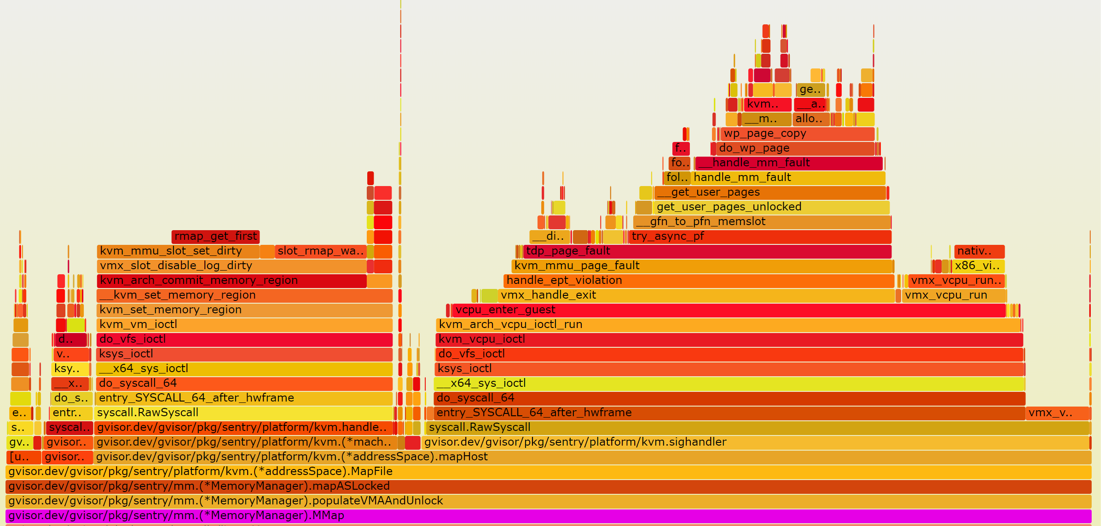
Perf Analysis, size = 512KB (10000Hz)
getPMAsLocked ~ 0%
createVMALocked ~ 0%
mapASLocked
getPMAsLocked
~100%

Slide 12
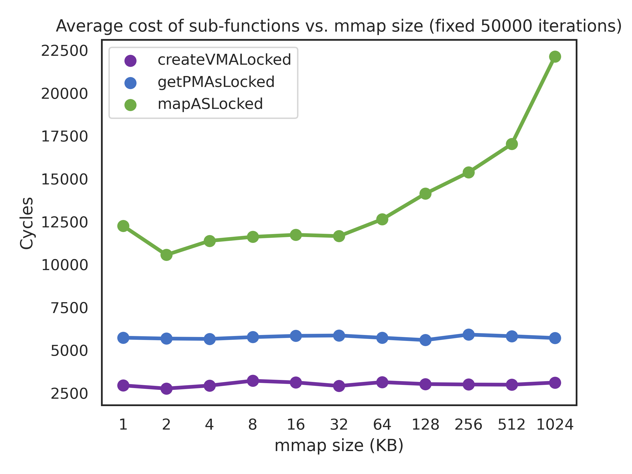
Cycle Measurement for Each function
Insert assembly into gVisor to time each function in cycles
Conclusion:
mapASLocked which calls host MMAP is the dominating cost
increasing overhead with size comes from KVM not gVisor

Slide 13
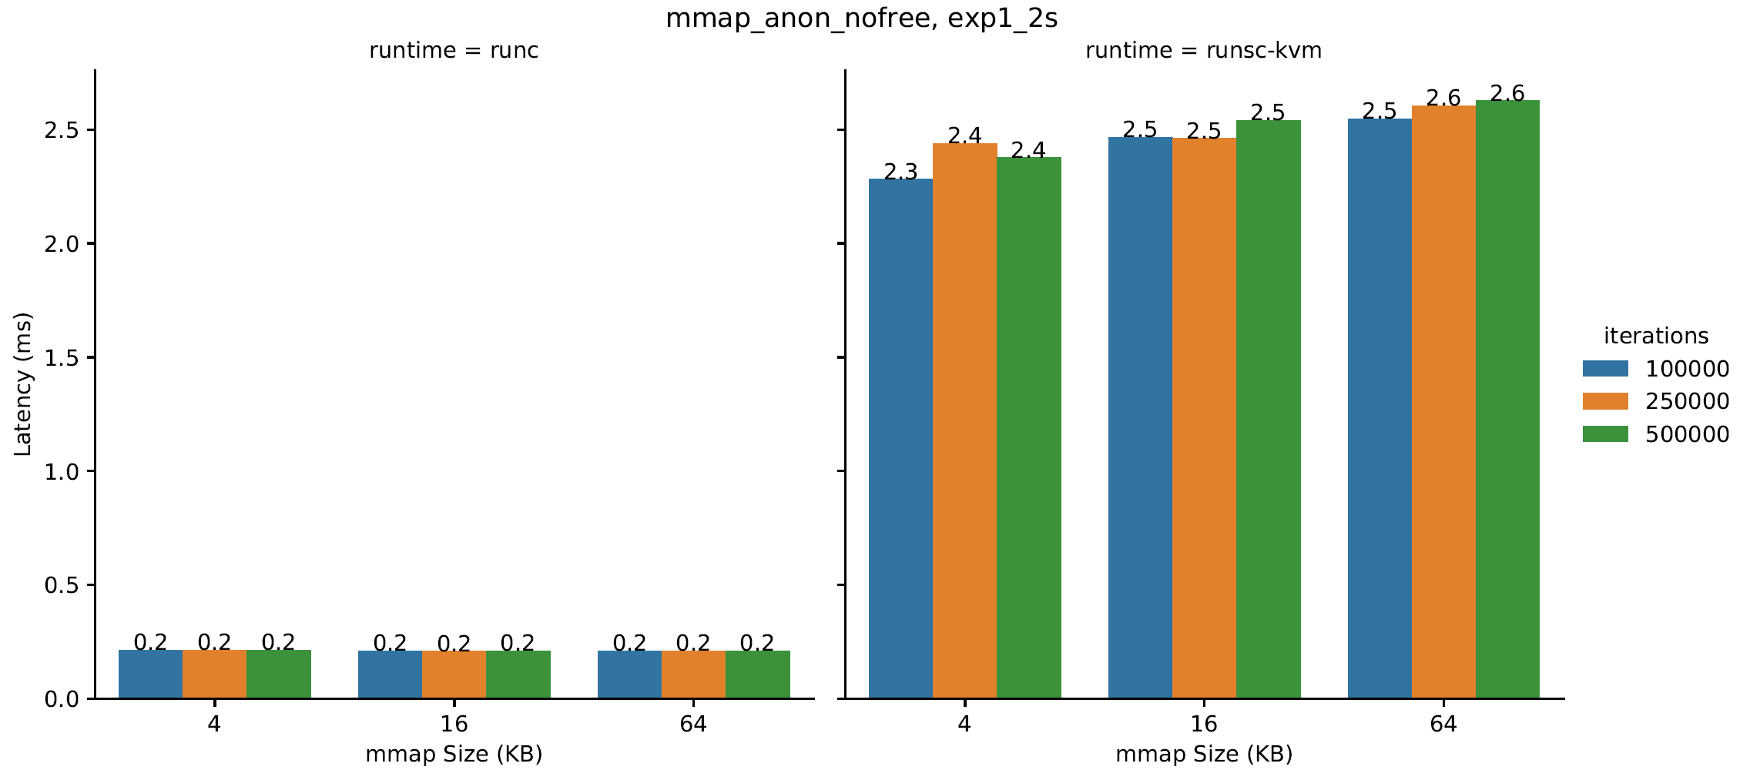
Mmap Latency versus Iterations (Anon)
Almost constant for both

Slide 14
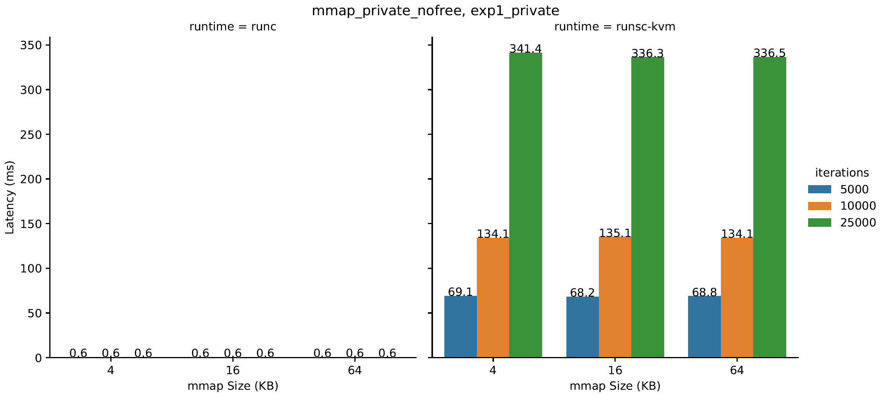
Mmap Latency versus Iterations (Private)
Increasing by iterations
Still constant

Slide 15
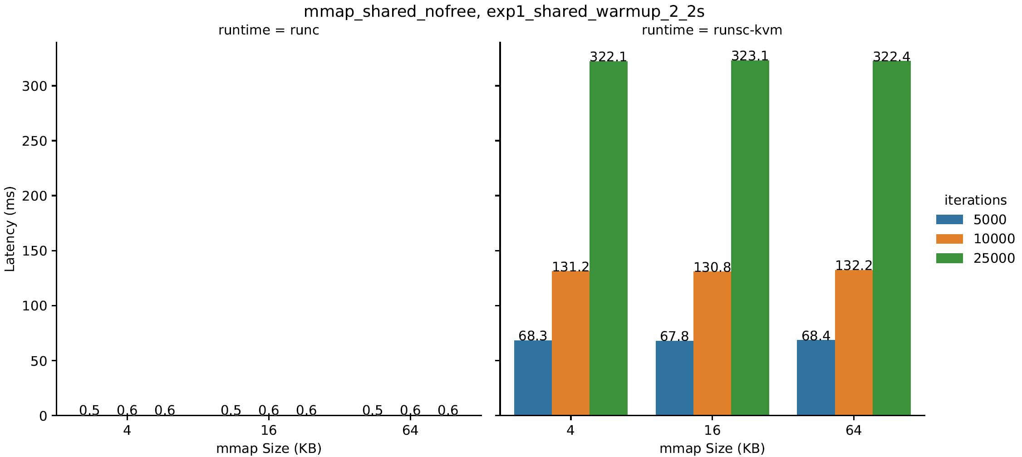
Mmap Latency versus Iterations (Shared)
Increasing by iterations
Why?
Still constant

Slide 16
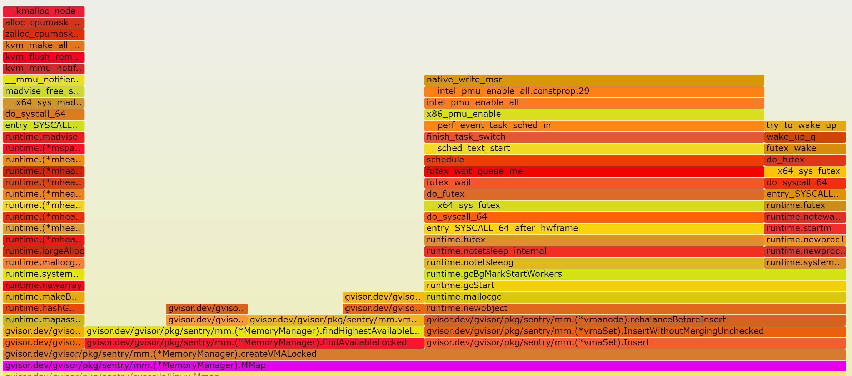
Perf Analysis, iter = 10000 (10000Hz)
createVMALocked(100%)
= AddMapping(10%)
+ Insert(50%)
+ findAvailableLocked(40%)

Slide 17
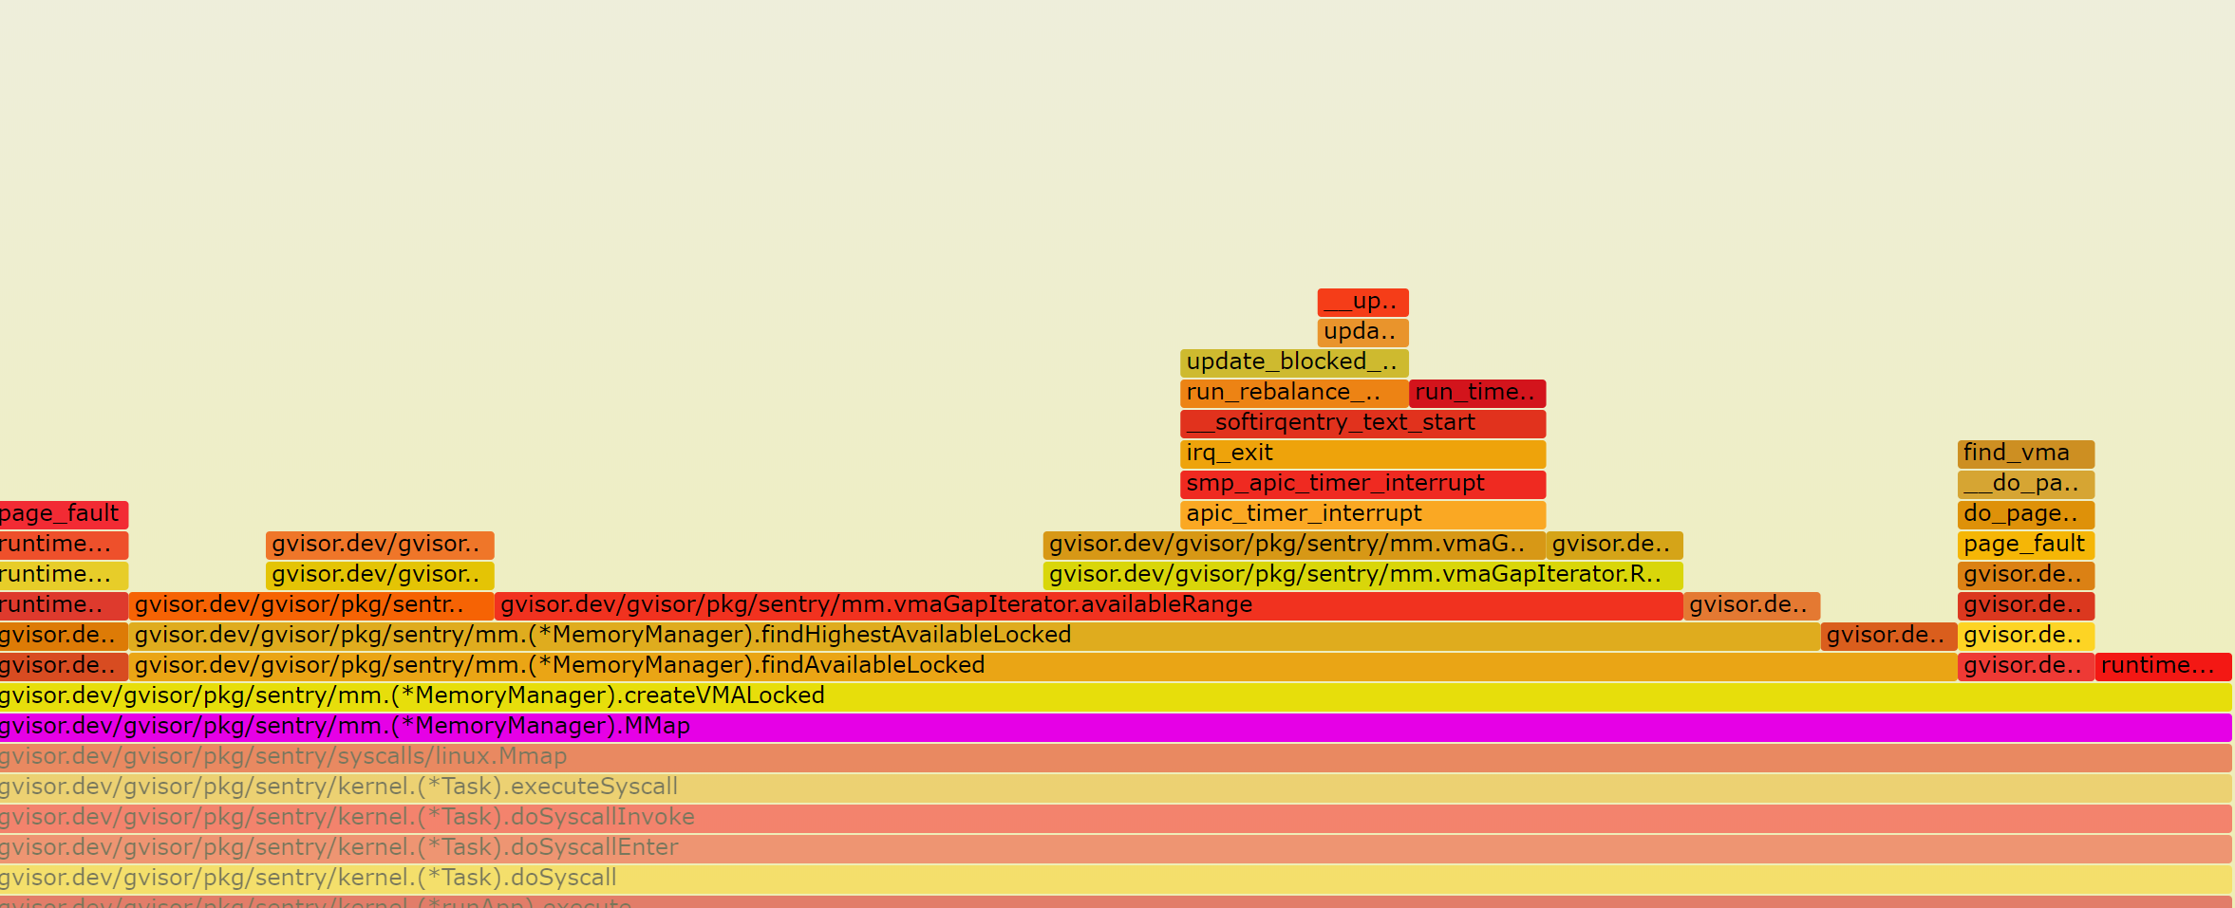
Perf Analysis, iter = 25000 (10000Hz)
createVMALocked(100%)
= AddMapping(6%)
+ Insert(12%)
+ findAvailableLocked(82%)
createVMALocked(100%)
= AddMapping(10%)
+ Insert(50%)
+ findAvailableLocked(40%)

Slide 18
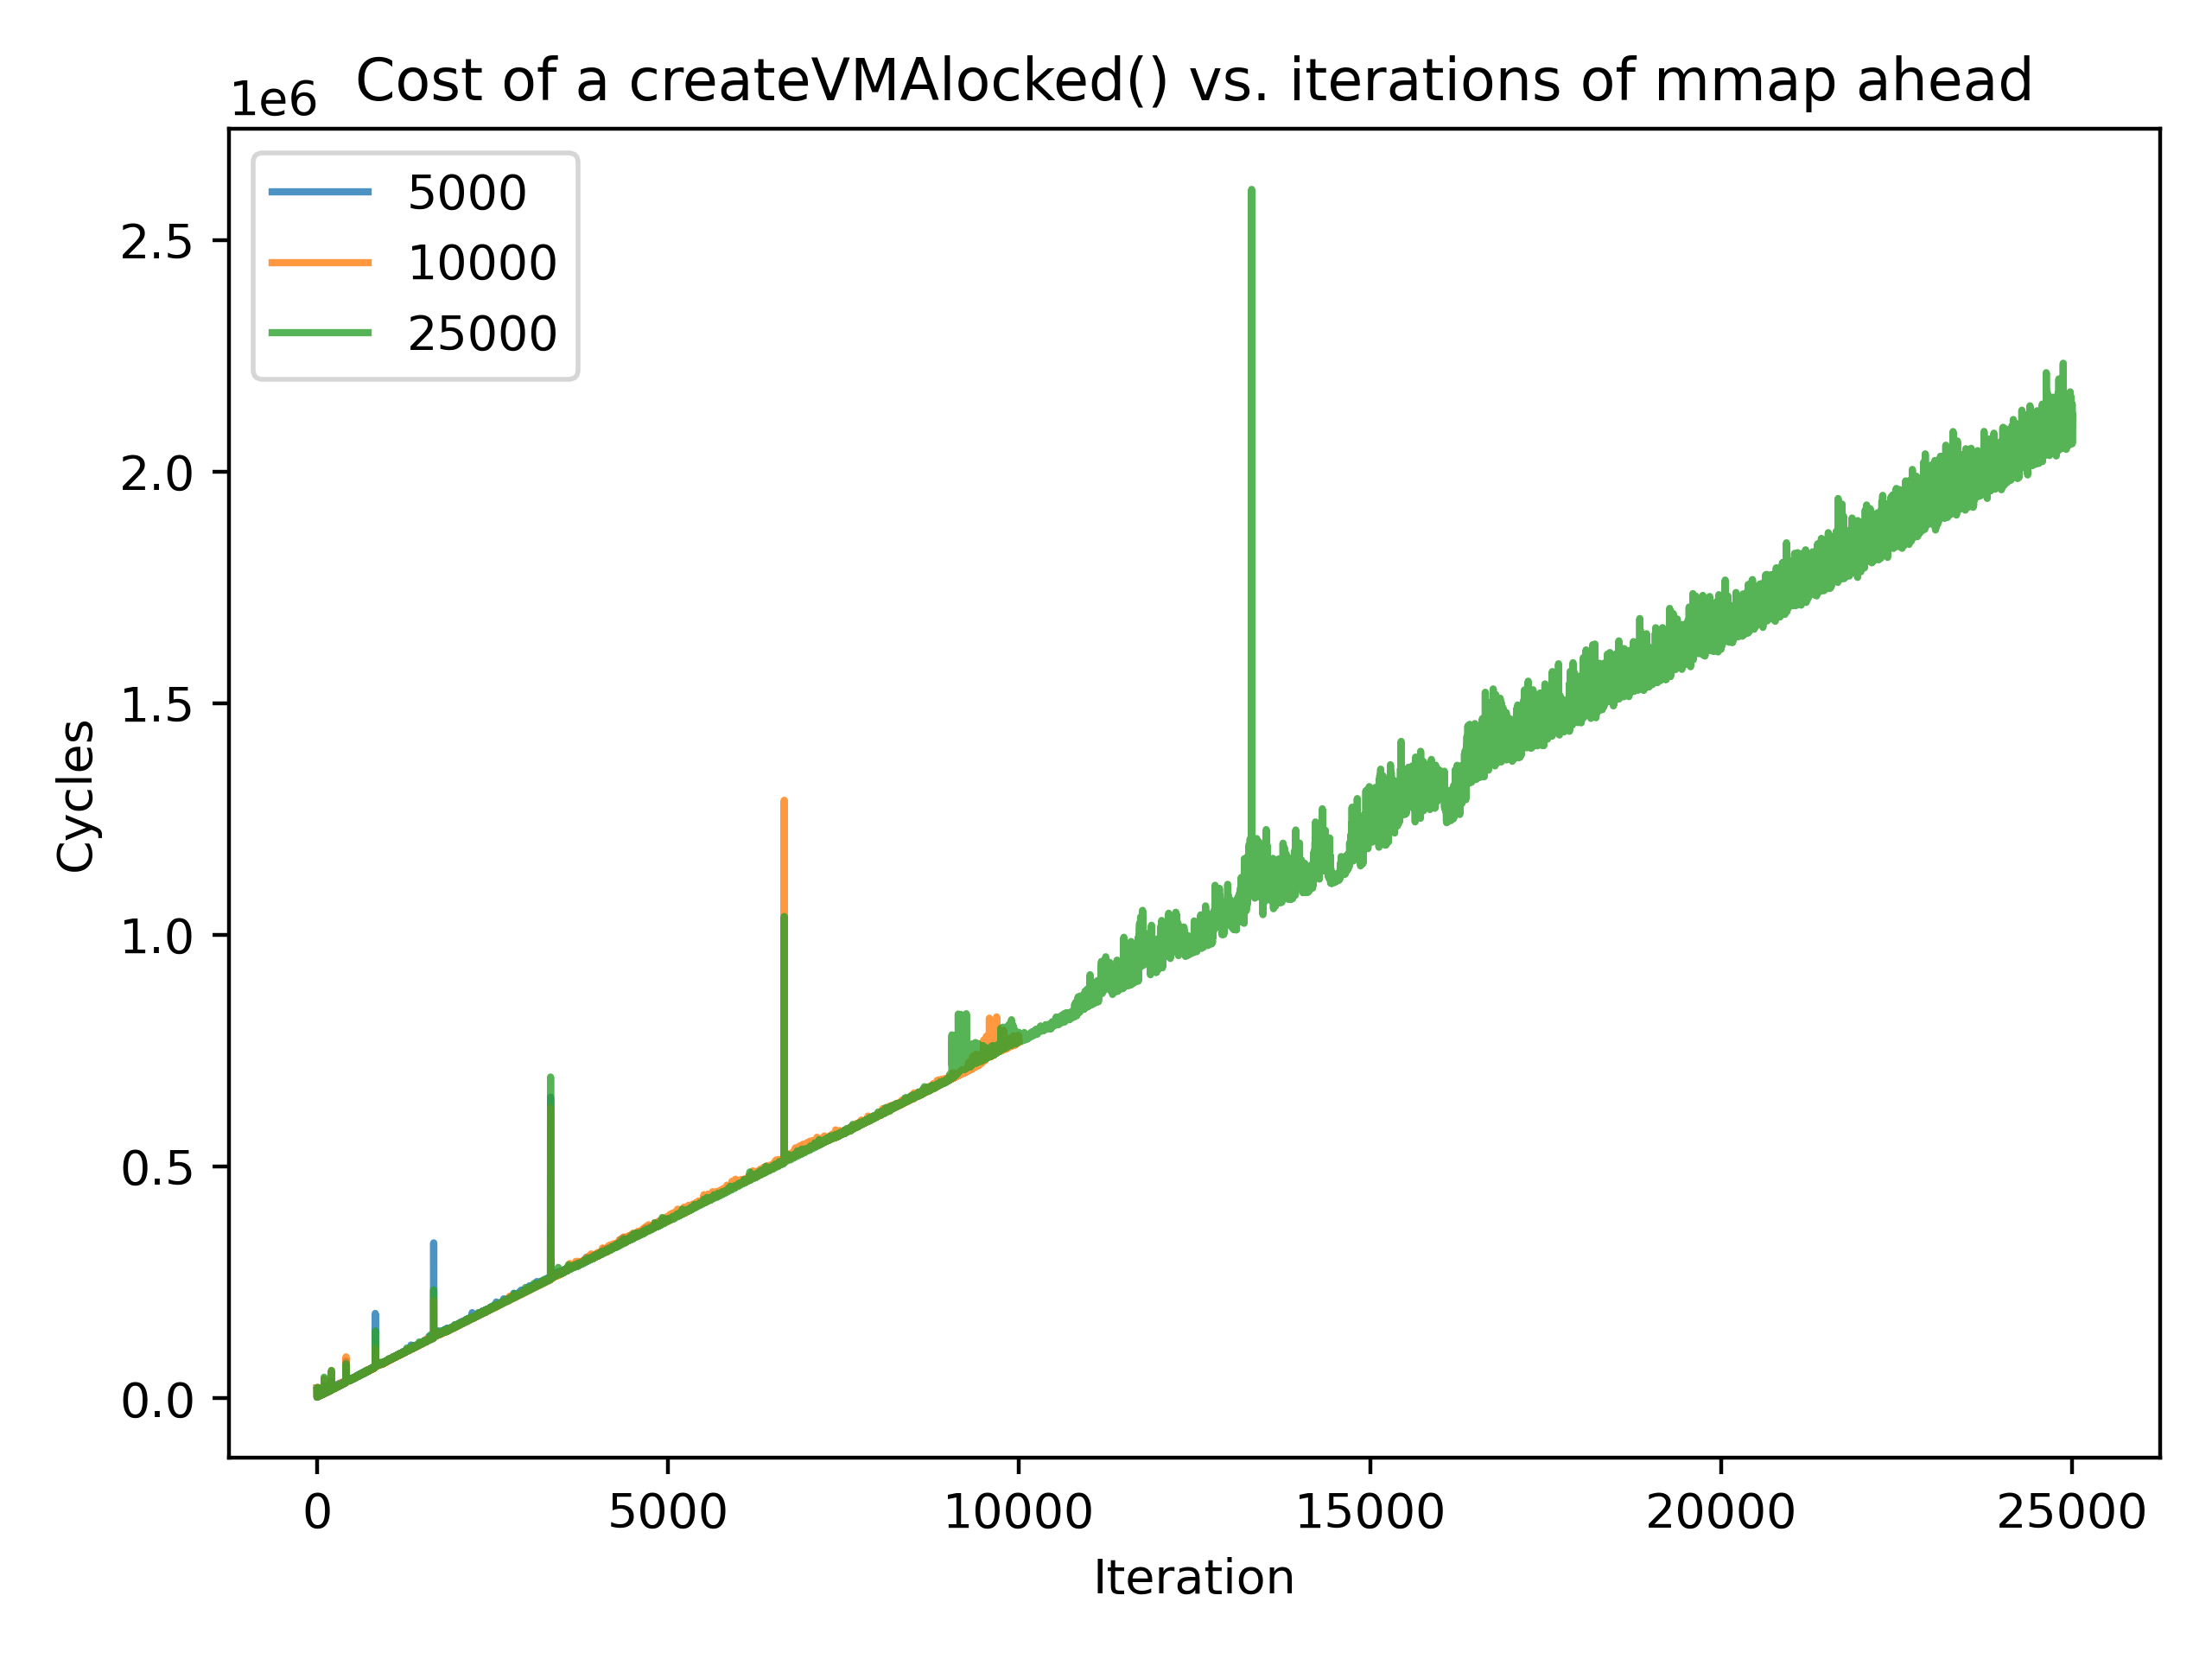
Cycle Measurement for findAvailableLocked
Insert assembly into gVisor to time each function in cycles
Conclusion:
findAvailableLocked is linearly increasing with number of mmaps ahead
Why not linearly increasing in anon case?
findAvailableLocked

Slide 19
Virtual Memory Space Structure in gVisor
B-tree
keys as allocated segments.start
Linear scan from bound to find large enough gap
[0x7f1c392e1, 0x7f1c392e2)
[0x7f1c392f3, 0x7f1c392f4)
[0x7f1c392d0, 0x7f1c392d1)
[0x7f1c392e0, 0x7f1c392e1)
[0x7f1c392e2, 0x7f1c392e3)
[0x7f1c392e9, 0x7f1c392ea)
[0x7f1c392f5, 0x7f1c392f6)
[0x7f1c392f6, 0x7f1c39307)
shared
shared

Slide 20
Why anon case not getting slow linearly?
Adjacent anon mmap merged to one segment
File backed mmap can’t be merged!
Optimization: the maximum gap within each node (in progress)
[0x7f1c392e1, 0x7f1c392e2)
[0x7f1c392f3, 0x7f1c392f4)
[0x7f1c392f5, 0x7f1c392f7)
[0x7f1c392d0, 0x7f1c392d1)
[0x7f1c392e0, 0x7f1c392e1)
[0x7f1c392e2, 0x7f1c392e3)
[0x7f1c392e9, 0x7f1c392ea)
[0x7f1c392f5, 0x7f1c392f6)
[0x7f1c392f6, 0x7f1c392f7)
anon
anon

Slide 21
A Tiny Issue Spotted in Set.go
This part of code to rebalance the tree before insert looks a little weird as it will split the full ancestors even if the leaf to be inserted still has enough space
// rebalanceBeforeInsert splits n and its ancestors if they are full, as // required for insertion, and returns an updated iterator to the position // represented by gap. func (n *node) rebalanceBeforeInsert(gap GapIterator) GapIterator { if n.parent != nil { gap = n.parent.rebalanceBeforeInsert(gap) } if n.nrSegments < maxDegree-1 { return gap }
…

