Slide 1
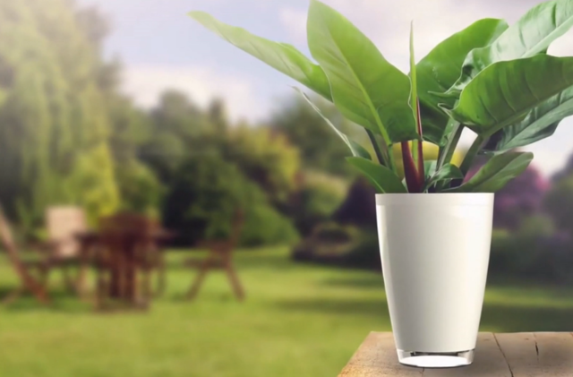
Intelligent Flowerpot
ELEC3300 S2018
Group 11
Fu XiaoHan
Wong Hi Hong

Slide 2

Target Problem
Lacking attention to their plants in modern world
Busy work
increasing travels and business trips
Many inexperienced and busy owners of plants
Insufficient knowledge of planting
Large scale decoration plants may face lack of skilled gardeners

Slide 3

Our Solution
A semi-automatic flowerpot offering two working modes:
Automatically watering the plant inside according to a preset moisture, temperature and illumination threshold.
Manually watering the plant controlled by users through mobile phone remotely. The related data (e.g. moisture, temperature, illumination) would be shown on the LCD screen as well as on users’ mobile phones.

Slide 4

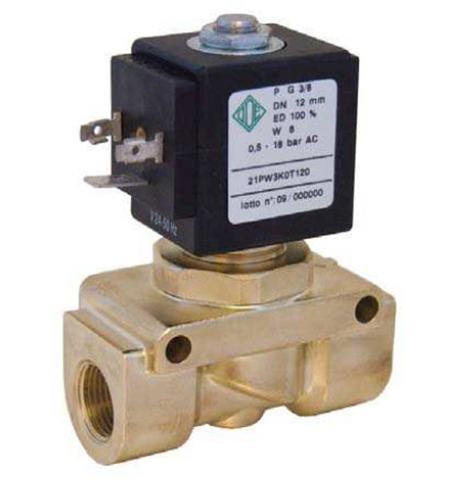
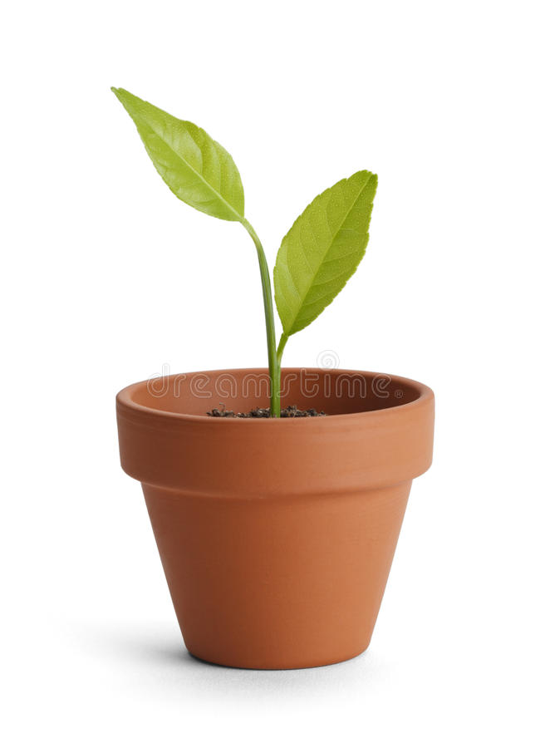

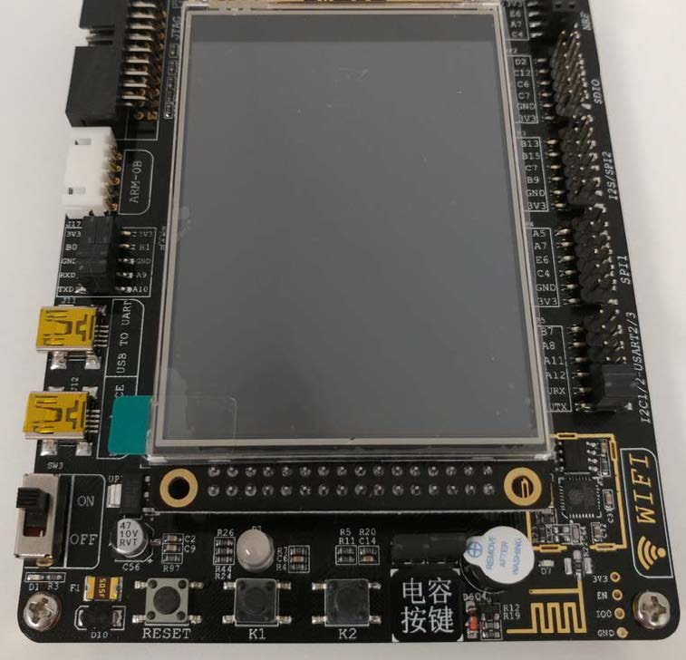

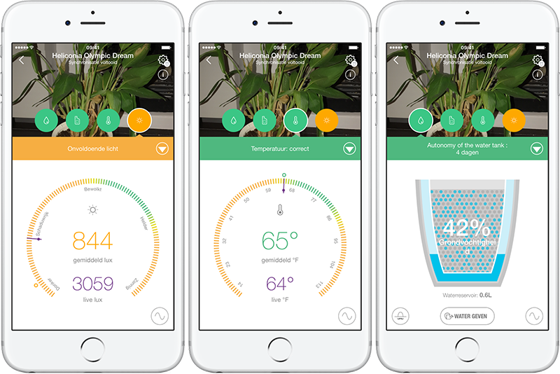
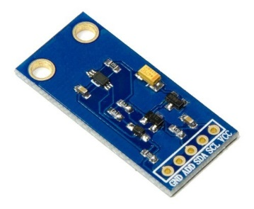
Design Sketch
OV7725 Camera
signal
Solenoid valve
I2C
TCP/IP
BH1750 Illuminance
serial
MCU
（STM32）
Plant
Phone
(A webpage)
DHT11 Moisture & Temp

Slide 5
Limitation
Different plants may require different moisture, temperature and illumination
After implement plants database, it can help user to select different plants
Require electricity
For future development, we may implement solar power system

