Slide 1
Assignment 1:
Object Detection
Tahsin Reasat

Slide 2
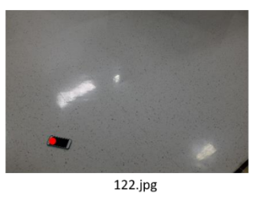
Task
Given an image of a mobile on a background, detect the location of the mobile.

Slide 3
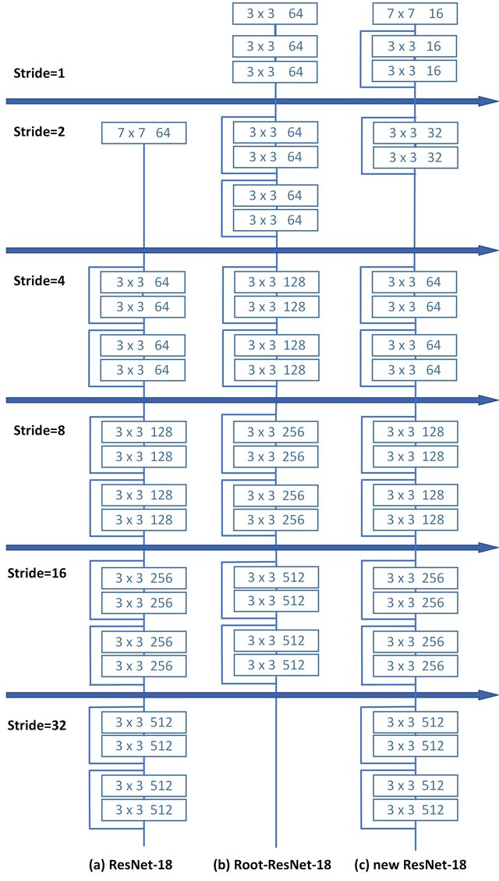
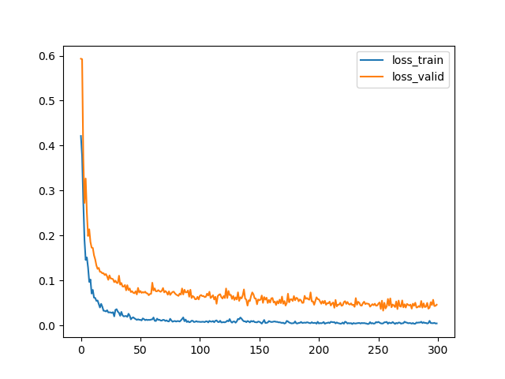
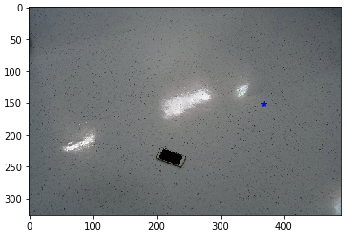
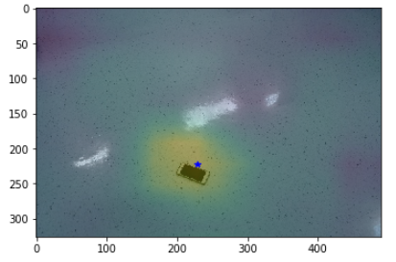
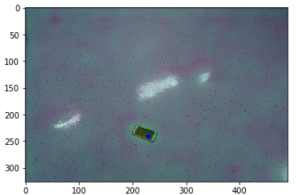
Network Architecture Rationale
326x490x3
326x490x3
16 x 11 activation map
31 x 21 activation map
1x1, 1
1x1, 1
Backbone - ResNet18*
32
32
2
2
Initial Architecture
*Fig from https://arxiv.org/pdf/1901.06651.pdf. In reality, ResNet18 has 20 conv layers and 1 fc layer

Slide 4
Preprocessing
Parameters
Input RGB normalized according to ImageNet standards
mean: (0.485, 0.456, 0.406),
std: (0.229, 0.224, 0.225)
Output x, y coordinates normalized to image dimension
Augmentation: None
Optimizer: Adam
Learning rate : 0.001
Loss function: Mean Square Error
Epoch Number: 400
Batch Size: 32
OS: Windows
Specs: RTX 2070, AMD Ryzen 5 2600

Slide 5
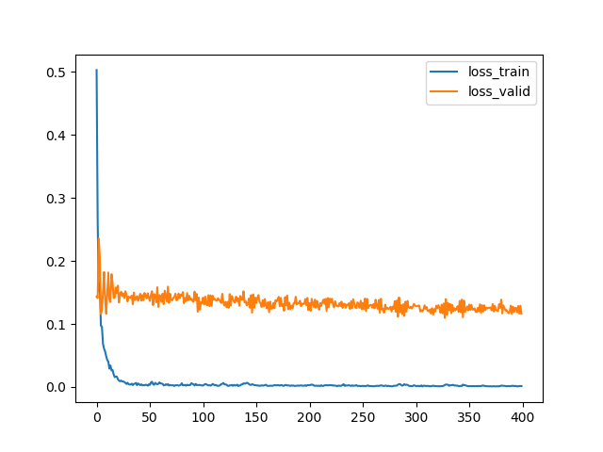
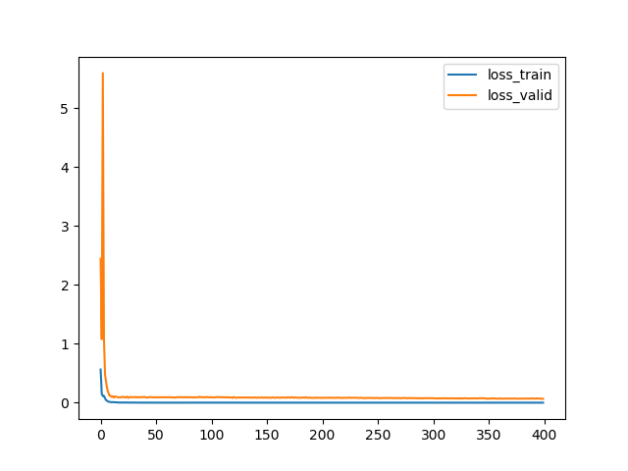
Results: Loss Plots
Loss
Loss
Epoch
Epoch
Trained 400 epochs only updating the last conv+fc layers
Trained Another 400 epochs updating all the layers

Slide 6
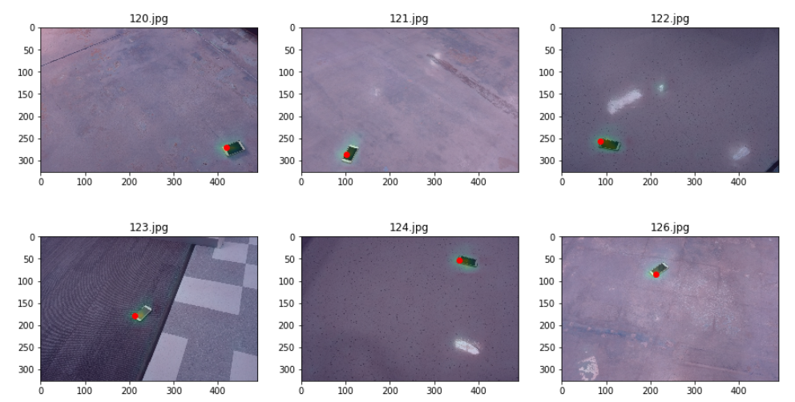
Results: Test Output

Slide 7
Results: Test Coordinates
Name | Coordinate 1 | Coordinate 2
120.jpg | 0.831288 | 0.855102
121.jpg | 0.880368 | 0.208163
122.jpg | 0.785276 | 0.177551
123.jpg | 0.546012 | 0.434694
124.jpg | 0.165644 | 0.726531
126.jpg | 0.260736 | 0.434694

Slide 8
Conclusion
The convolution to the fully connected layer mapping is not working properly. Some sort of centerpooling layer might be better suited for this mapping.

