Slide 1
Assignment 2 Skin Lesion Classification
Tahsin Reasat VUID: reasatt

Slide 2
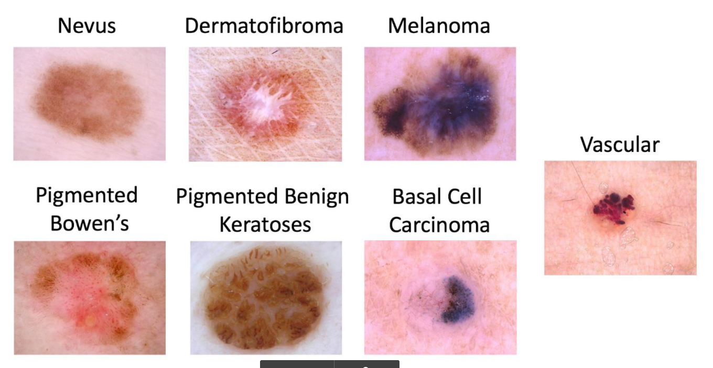
Task - Multi Class Classification

Slide 3
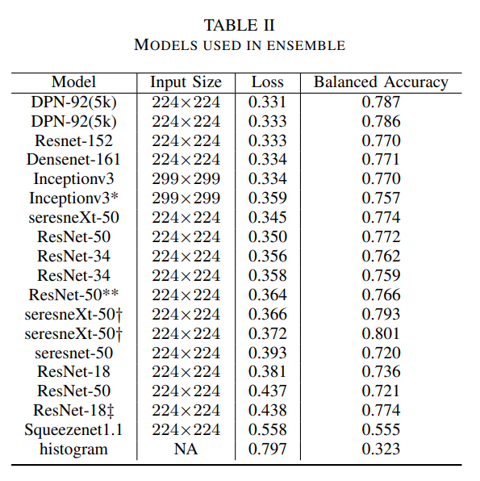
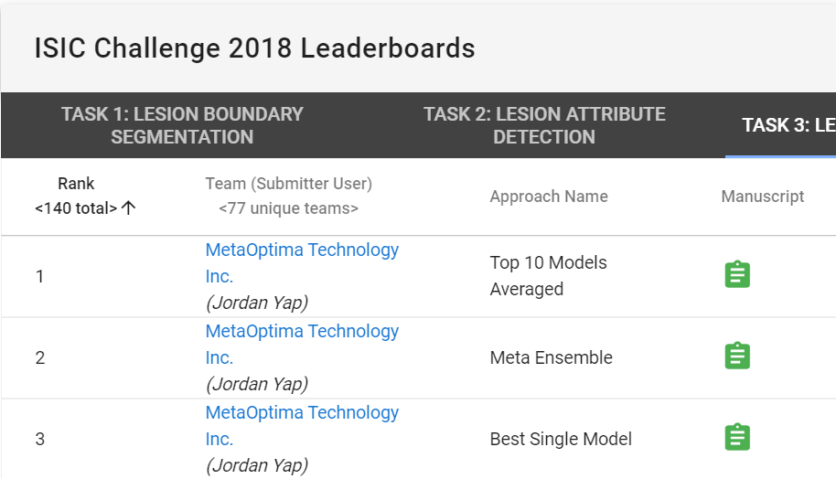
Network Architecture
https://challenge2018.isic-archive.com/leaderboards/

Slide 4
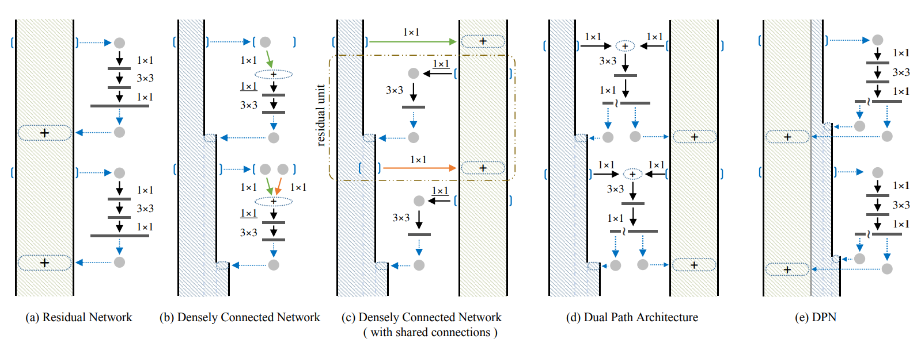
Network Architecture - Dual Path Network (DPN)
The residual path implicitly reuses features, but it is not good at exploring new features.
The densely connected network keeps exploring new features but suffers from higher redundancy.
Paper:
https://arxiv.org/abs/1707.01629
Pretrained model:
https://github.com/Cadene/pretrained-models.pytorch

Slide 5
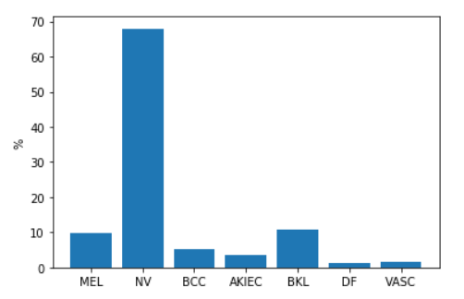
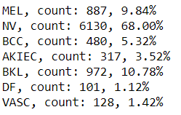
Handling Imbalance
a) Sampling:
Undersampling
Oversampling
Balanced Mini Batch
Batch size 7, 14, or 21 etc.
b) Weighted loss
Train Set Statistics
MEL
NV
BCC
AKIEC
BKL
DF
VASC

Slide 6
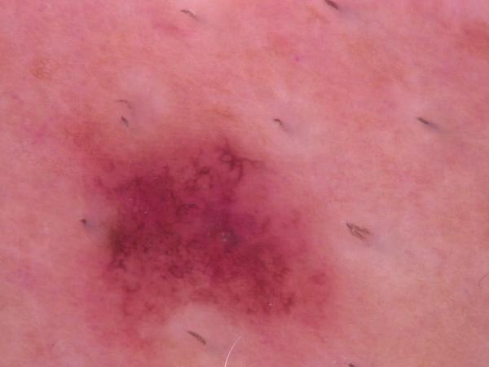
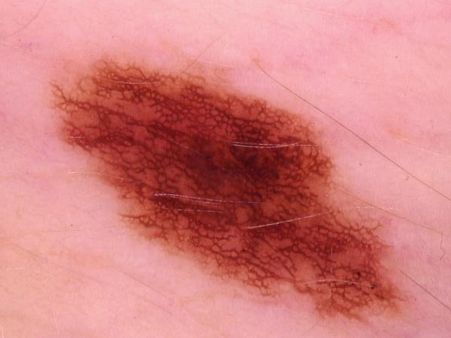
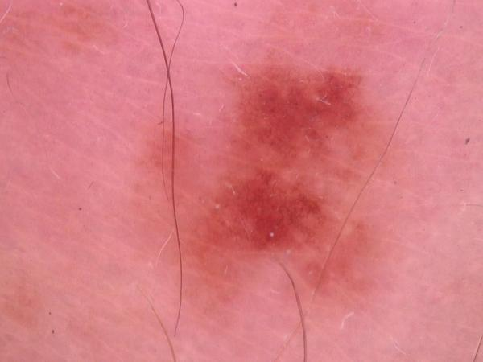
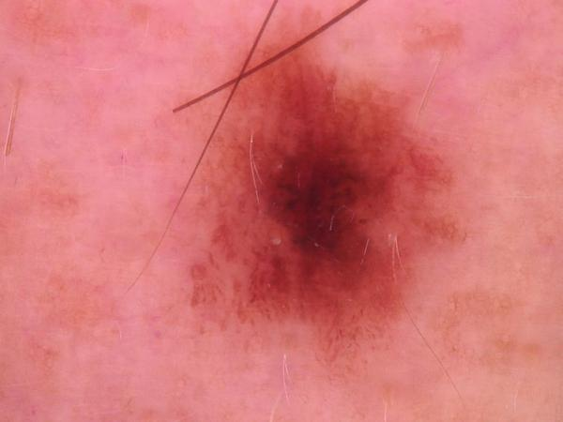
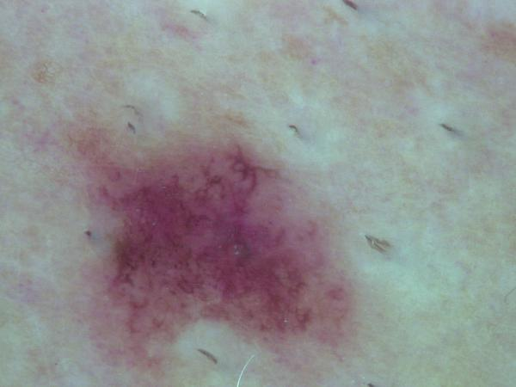
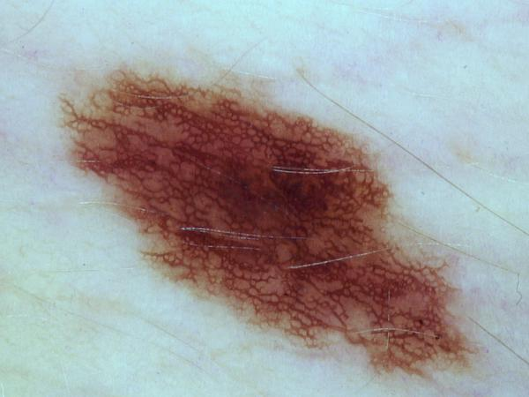
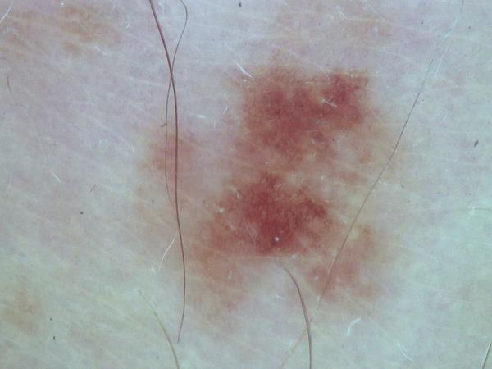
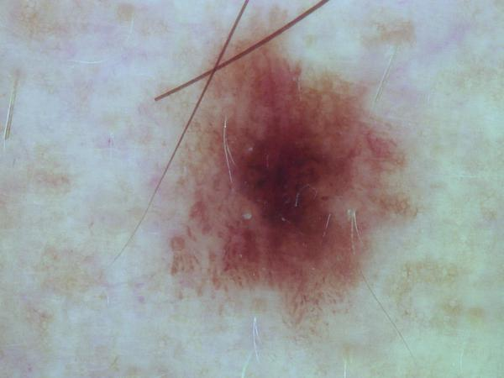
Color Constancy
What would the image look like if it was taken under white light
(Under Gray World Assumption)
https://ieeexplore.ieee.org/document/6866131

Slide 7
Augmentations
Training parameters
HorizontalFlip(),
RandomRotate90(),
RandomBrightnessContrast(
brightness_limit= [-0.2, 0.2], contrast_limit=[-0.2, 0.2] ),
RandomCrop(400, 400, p=0.5),
Resize(256, 256),
Normalize() (mean and std taken from imagenet)
Epoch number : 10
Batch size: 21-24
Learning rate: 0.00001
Loss function: (Weighted) Cross Entropy
Loss weights: [0.8, 0.2, 1.0, 1.0, 0.8, 1.0, 1.0]
Optimizer: adam
Network depth: 92 trainable layers
Input number of channels: 3
Output number of channels: 7
OS: Windows
GPU: RTX 2070

Slide 8
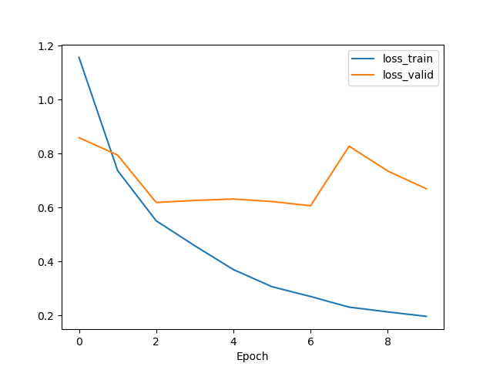
Loss Plot
loss_test

Slide 9
Results - (Accuracy)
Sampling → Random (RS), Balanced Sampling (BS)
Color → Original Color (OC), Color Constancy (CC)
Loss → Weighted Loss(WL), Unweighted Loss (UL)
RS+WL+OC | BS+UL+OC | RS+WL+CC | BS+UL+CC
0.8200 | 0.8260 | 0.8280 | 0.7880
Accuracy measured at minimum test loss

Slide 10
Metrics
Accuracy: 0.8280
Recall: 0.7820
Precision: 0.7720

Slide 11
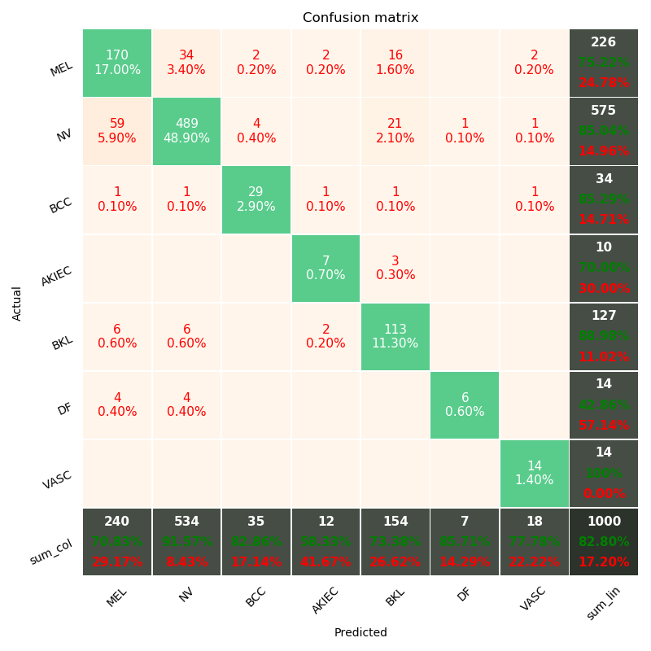
Confusion matrix

Slide 12
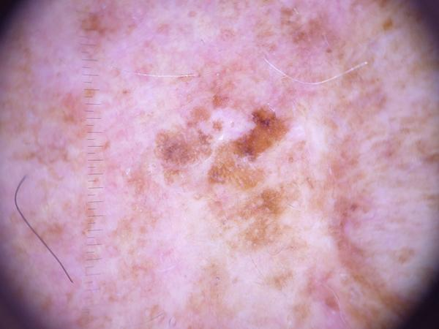
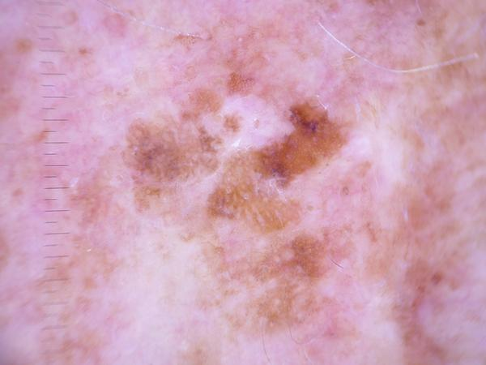
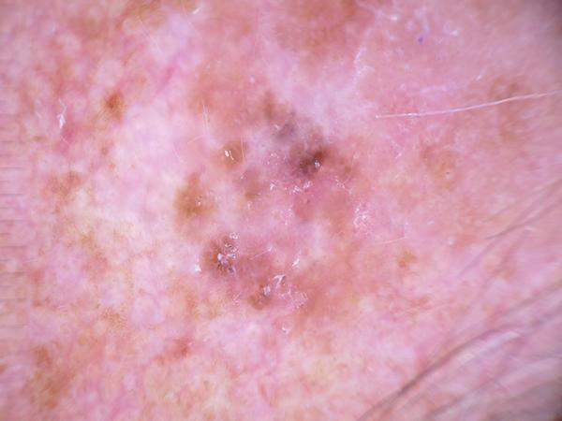
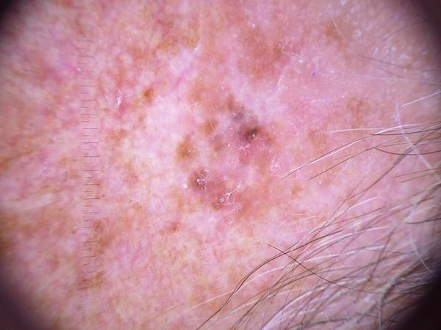
Conclusion
A few duplicate images in the train set.
Better Hyper parameter tuning
Exploring more architectures
More advance techniques, few shot learning or meta learning can be explored for rare diseases.
ISIC_0025030
ISIC_0027419
ISIC_0026769
ISIC_0025661
Duplicates

