Slide 1
CHAPTER 6
QUEUE

Slide 2
QUEUE
  In our daily life, when we stand on a line to get into the bus or to take money from bank counter, we make a queue.
  The man who stands first will get into the bus first, and the man who stands last will get into the bus last.
  That means the elements which is added first will get service first and the element which is added last will get service last.
  Queue is a linear list where all additions are made at one end, called rear, and all deletions (accesses) are made from another end called front of the list.
  So, in a queue there must be two indicators or pointers.
    One is rear that is used to add elements and another is
    front that is used to delete (access) the elements from the queue.

Slide 3
QUEUE
Queue is a FIFO (First In First Out) structure. That means the element that is added first will be deleted (accessed) first.
As stack, queue can be implemented using array and linked list.
Figure 6.1: Graphical representation of queue
1
2
3
4
5
6
7
8
9
10
A
C
F
J
P
front = 1
rear = 5
(a) Array based queue
40
48
59
61
63
frontptr
rearptr
(b) Link based queue

Slide 4
QUEUE
The queue that will be created using an array is called array based queue.
Here, we have to use two indicators (two index identifiers).
One indicator will mark the front element and another will mark the rear element of the queue.

Slide 5
Addition operation
Addition of an element in an array based queue
  We know in a queue element is added at the rear.
  So, to add an item at first we increase rear index and then place the element in the array-based queue using the rear index.
  Operations:
  1) Increase the value of rear index.
  2) Put the element (item) at the rear.

Slide 6
Addition operation
1 2 3 4 5 6
a) An empty queue.
1 2 3 4 5 6
front = rear = 1; que [1] = 35;
b) Addition of the first element to the queue.
que
front = rear = 0; item = 35 (to be added)
35
que

Slide 7
Addition operation [cont..]
1 2 3 4 5 6
frnot = 1 rear = 4
a) A queue with some data.
1 2 3 4 5 6
front = 1 rear = 5
(rear = rear +1)
b) Increment of the value of rear.
1 2 3 4 5 6
front = 1 rear = 5; que [5] = 59;
c) Putting the element at the rear.
que
35 | 48 | 25 | 13
35 | 48 | 25 | 13
35 | 48 | 25 | 13 | 59

Slide 8
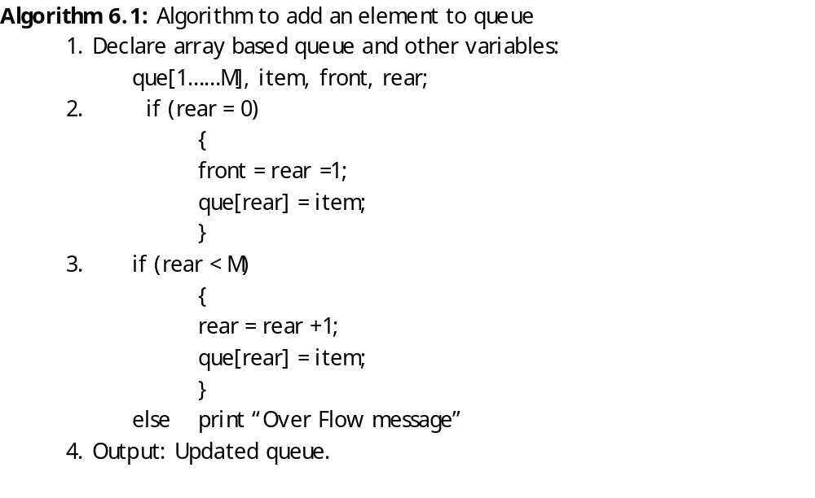
Algorithm
front = rear = 0; item = 35 (to be added)

Slide 9
Deletion of an element from a queue
We know that, the element is deleted from the front of the queue.
So, at first we access the element, and then we increase the front index.
Operations:
Access(read) the front element of the queue.
Increase the value of the front index.

Slide 10
Deletion operation [cont..]
1 2 3 4 5 6
rear = 4
front = 4
a) A queue with one element.
1 2 3 4 5 6
front = 0
rear = 0
b) Deletion of the only element.
que
 |  |  | 13

Slide 11
Deletion operation [cont..]
1 2 3 4 5 6
frnot = 1 rear = 5
a) A queue with some data.
1 2 3 4 5 6
front = 1 rear = 5
item = que[front];
b) Reading of the element.
1 2 3 4 5 6
front = 2 rear = 5
c) Increment of the value of front.
que
35 | 48 | 25 | 13 | 59
35 | 48 | 25 | 13 | 59
35 | 48 | 25 | 13 | 59

Slide 12
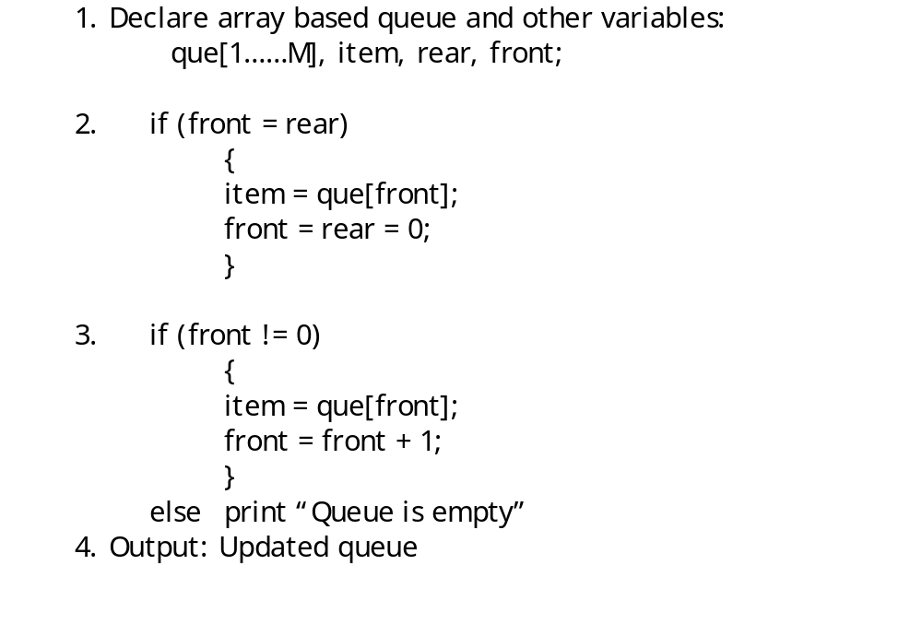
Algorithm 6.2: Algorithm to delete an element from a queue
 |  |  | 13
rear = 4
front = 4

Slide 13
Drawback of array implementation of queue
  In array implementation of queue, some space may be wasted.
  There may be situations, where the rear reaches the highest index value of the array, but free spaces are available at the beginning of the queue.

Slide 14
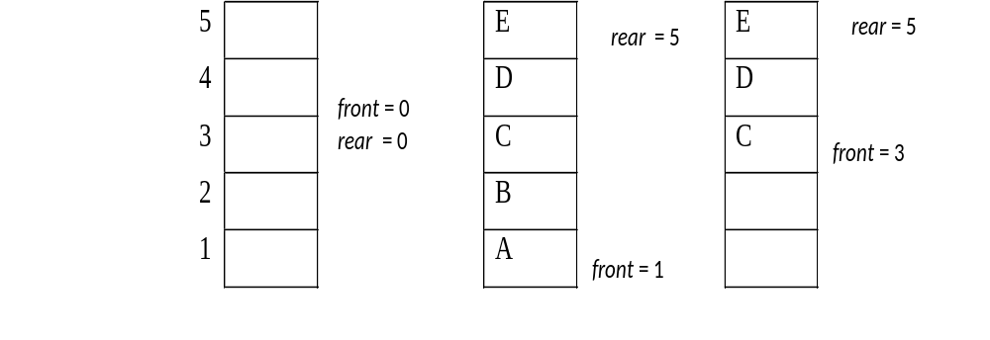
Drawback of array implementation
.
There may be situations, where the rear reaches the highest index value of the array, but free spaces are available at the beginning of the queue.

Slide 15
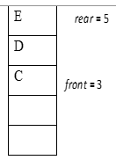
Drawback of array implementation
Figure 6.4(a) shows an empty queue.
Figure 6.4(b) shows the queue after inserting five elements {A, B, C, D, E}.
If we delete two elements from the queue shown in Figure 6.4(b), we get the queue shown in Figure 6.4(c).
Now, let us consider we want to insert F into the queue.
As we have seen in earlier section, to insert F we have to increase the value of rear (rear = rear + 1).
So the value of rear increases to six which is greater than the size of the queue.
In that situation logically we can’t add F into the queue although there are free spaces in the queue.
How to solve this problem?

Slide 16
Solution to drawback
One solution to this problem is to check whether a queue is full or not we have to check the condition in Figure6.4 (b), that is front = 1 and rear = 5 (maximum size of the queue).
In situations where rear is equal to the maximum size of the queue but front is greater than 1 (Figure 6.4(c)), to insert an element we have to reset the value of rear to 1.
Then to insert more elements we shall increase rear. But, the maximum value of rear should be one less than the value of front i.e., front-1.
In that case to check if the queue is full we have to check the condition front = rear + 1 (see Figure 6.5(e) ).
The pictorial view to insert F and G in the queue of Figure 6.4(c) is shown in the next slide.

Slide 17
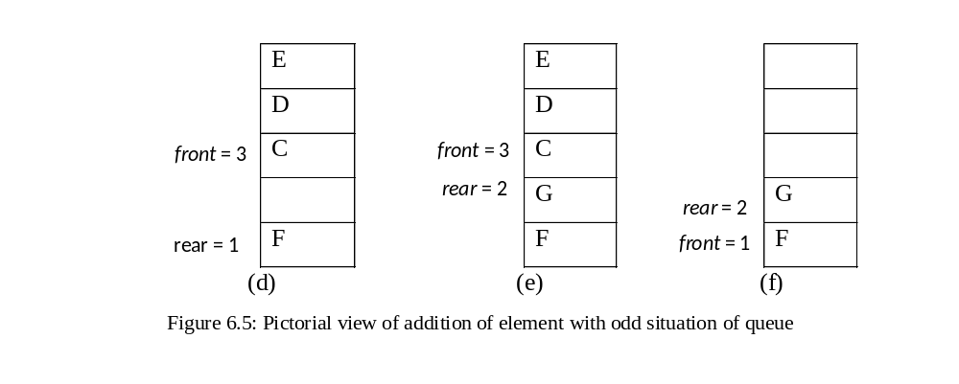
Element addition in odd situation
For the situation discussed above the front will also follow rear that is after deleting the element at the highest position of the queue the value of front should be one.

Slide 18
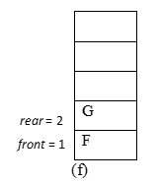
Element addition in odd situation
For the situation discussed above the front will also follow rear that is after deleting the element at the highest position of the queue the value of front should be one.
After the deletion of C, D and E the queue is shown in Figure 6.5(f).
After considering the above situations, we can modify the insertion and deletion algorithm for an array based queue as follows.

Slide 19
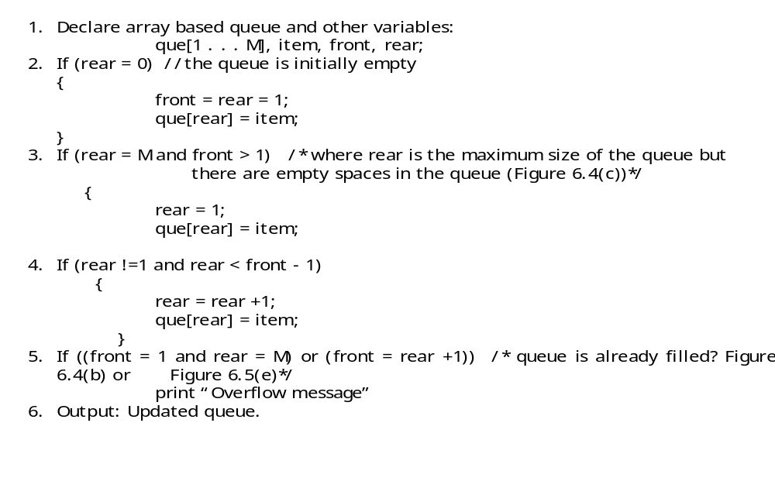
Algorithm 6.3: Algorithm to add an element

Slide 20
Algorithm 6.4: Algorithm to delete an element
1. Declare array based queue and other variables
que[1 . . . M], item, front, rear;
2. If (front = rear)
{
item = que[front];
front = rear = 0;
}
3. If (front = M) /* where front is the maximum size of the queue*/
{
item = que[front];
front = 1;
}
4. If (front !=0 or front != 1)
{
item = que[front];
front = front + 1;
}
else print “Queue is empty”
5. Output: Updated queue.

Slide 21
Linked Queue (Queue as a linked list)
  The queue that is created using a linked list is called linked queue or linked list based queue.
  In a linked queue we use two pointers, one is frontptr that points the front (first) node of the queue and another is rearptr that points the rear (last) node of the queue.
  Figure-6.6: A linked queue
25
12
24
61
78
frontptr
rearptr

Slide 22
Create a linked queue
  In a linked queue, there are two pointers, frontptr and rearptr, so to create a linked queue we have to use these two pointers.
  At first we create an empty (linked) queue.
  That means the frontptr and rearptr both will be null. After that, we create a new node with an external pointer, nptr.
  Now, we shall add this new node to the queue.
  To add the new node, we assign the value of nptr to frontptr and rearptr. That means, frontptr and rearptr both point the new node.
  Thus we have a node in the queue.

Slide 23
Create a linked queue [Cont.]
  To add second node, we create another new node and add this node to the queue.
  To add the node we make link between the existing queue and the new node. Since the new node will be the rear element (node), so the next pointer of the new node will point the rear node (at present only one node) of the existing queue and the rearptr will point the new node.
  That means, at present the frontptr points the front (first) and the rearptr points the rear (second) node of the queue. Thus we can add another node and create the linked queue.

Slide 24
Pictorial view of creation process of liked queue
63
59
frontptr
rearptr
nptr
(a) A linked queue of single node and a new node pointed by nptr.
63
1
59
1. rearptr→next = nptr
2. rearptr = rearptr→next
frontptr
2
rearptr
nptr
(b) Linking of a new node and a queue of single node
63
59
frontptr
rearptr
nptr
(c) Updated linked queue

Slide 25
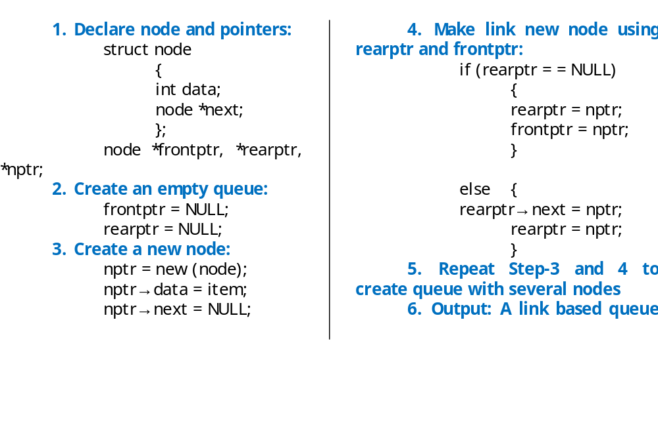
Algorithm 6.5: Algorithm to create a linked queue

Slide 26
Add a new node to linked queue
Addition of new node to the linked list is similar to the creation process where we add a new node at each stage to create linked queue.

Slide 27
Pictorial view of addition of a new node
40
49
32
59
frontptr
rearptr
nptr
(a) A linked queue and a new node
1
40
49
32
59
frontptr
rearptr
2
rearptr
(b) Making link between queue and new node.

Slide 28
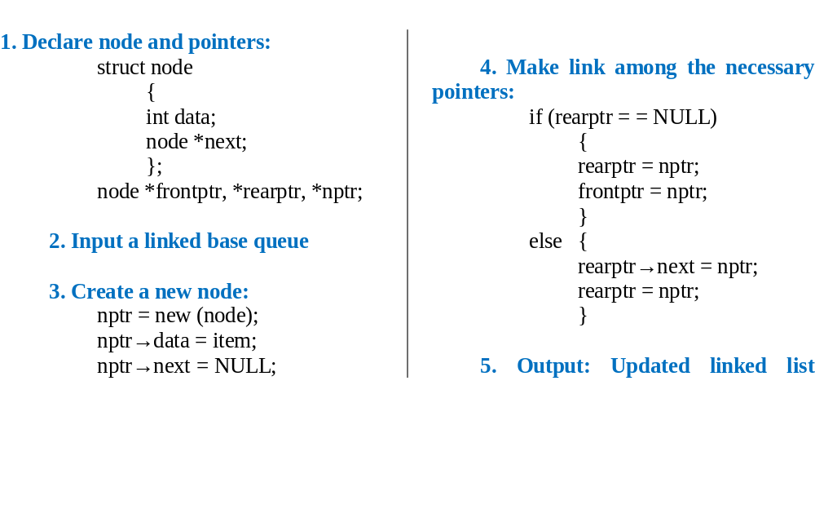
Algorithm 6.6: Algorithm to add a node to linked queue

Slide 29
QUEUE
6.2.3 Delete a node from a linked queue
  As we know in a queue deletion operation must be performed from front of the queue, so to delete the front node of the linked queue, we have to use a temporary pointer that will point the front node.
  After that we advance the frontptr pointer to the next node. Now just delete the node using temporary pointer.

Slide 30
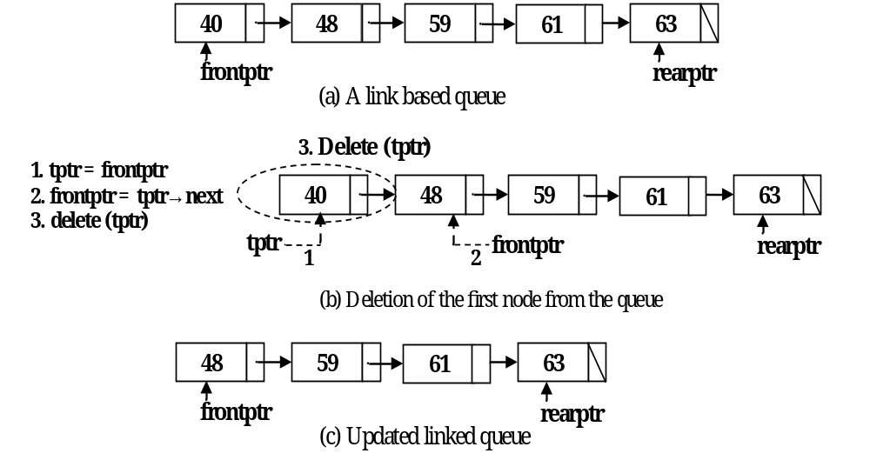
Pictorial view of deletion of a node

Slide 31
Algorithm 6.7: Algorithm to delete a node from a linked queue
  1. Declare node and pointers:
  struct node
  {
  int data;
  node *next;
  };
  node *frontptr, *rearptr, *tptr;
  2. Input a linked base queue
  3. Use temporary pointer, tptr and advance (move forward) the forntptr:
  tptr = frontptr;
  frontptr = tptr→next;
  4. delete (tptr);
  5. Output: Updated linked queue.

Slide 32
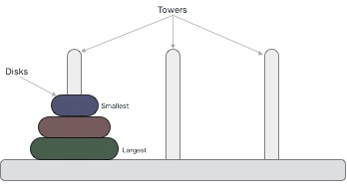
Tower of Hanoi
Tower of Hanoi, is a mathematical puzzle which consists of three towers (pegs) and more than one rings is as depicted −

Slide 33
Tower of Hanoi
These rings are of different sizes and stacked upon in an ascending order, i.e. the smaller one sits over the larger one.
There are other variations of the puzzle where the number of disks increase, but the tower count remains the same.

Slide 34
Rules Tower of Hanoi
The mission is to move all the disks to some another tower without violating the sequence of arrangement. A few rules to be followed for Tower of Hanoi are −
Only one disk can be moved among the towers at any given time.
Only the "top" disk can be removed.
No large disk can sit over a small disk.

Slide 35
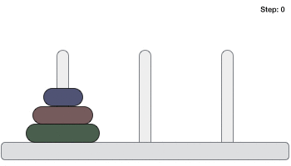
Rules Tower of Hanoi

Slide 36
Algorithm Tower of Hanoi
To write an algorithm for Tower of Hanoi, first we need to learn how to solve this problem with lesser amount of disks, say → 1 or 2. We mark three towers with name, source, destination and aux (only to help moving the disks).
If we have only one disk, then it can easily be moved from source to destination peg.
See page: 6.23

Slide 37
The end of the queue
THANK YOU.

