Slide 1
DATA STRUCTURE FUNDAMENTALS

Slide 2
CHAPTER 7
TREE

Slide 3
TREE
We see tree in nature. The tree has root, branches, sub-branches and leaves. From the concept of natural tree, the computer scientists get the idea of a data structure, which is graphically similar to natural tree.
Natural tree is a bottom-up figure. However, the graphical representation of the data structure tree is a top-down figure.

Slide 4
TREE
A tree is a finite collection of nodes that has one to many relationship among nodes.
A tree is a hierarchical structure.
An ordered tree is a list of nodes that has a specially designated node called root node.
The connection line between two nodes is called edge.
The node that has no child node is called leaf node. The node that has child node is called parent node.
A tree can be implemented (stored in memory) as an array or a linked list.

Slide 5
TREE
Root Node
1
Level -1
15
17
11
Level -2
25
51
25
14
19
Level -3
18
15
12
Level -4
Figure 7.1: A Tree

Slide 6
Binary Tree
  A binary tree is finite set of nodes, where there is a special node called root node and every node (including root node) has at best two children.
  The trees excluding root node are called left sub-tree and right sub-tree.

Slide 7
Binary Tree
Each node can have at most 2 children
Slide 7

Slide 8
Binary Tree
10
Left sub-tree
15
11
Right sub-tree
25
51
25
19
18
15
12
Figure 7.2: A binary tree

Slide 9
Parts of a Tree
nodes
Edges
Slide 9

Slide 10
Parts of a Tree
Root
or
Parent node
Slide 10

Slide 11
Parts of a Tree
parent node
child nodes
Slide 11

Slide 12
Parts of a Tree
parent node
child nodes
Slide 12

Slide 13
Parts of a Tree
root node
Slide 13

Slide 14
Parts of a Tree
leaf nodes
Slide 14

Slide 15
Parts of a Tree
Left sub-tree
Slide 15

Slide 16
Parts of a Tree
Right sub-tree
Slide 16

Slide 17
Parts of a Tree
sub-tree
Slide 17

Slide 18
Parts of a Tree
sub-tree
Slide 18

Slide 19
Array Representation of a Tree
1, 2, 3, . . .are positions or indices
1
E
2
D
H
3
B
K
4
5
6
7
G
8
9
1
2
3
4
5
6
7
8
9
E | D | H | B |  | K |  |  | G
Slide 19

Slide 20
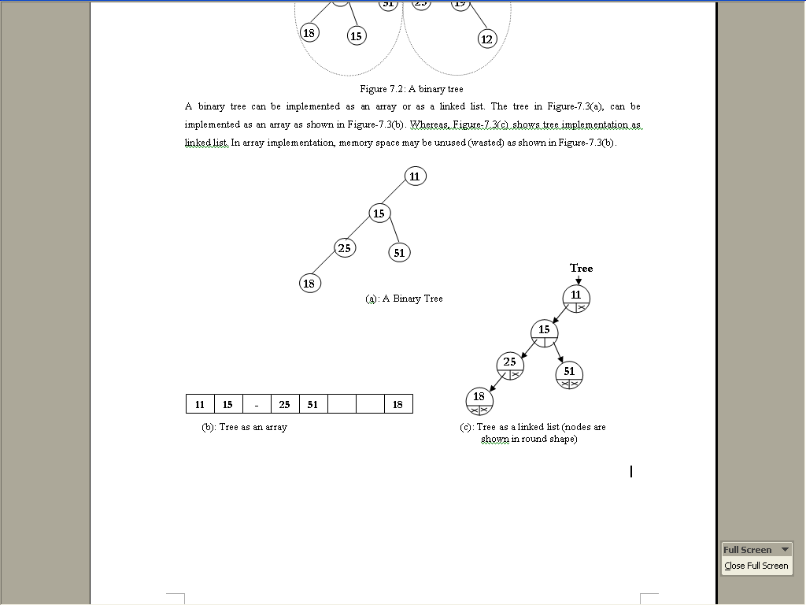
Binary Tree Representation

Slide 21
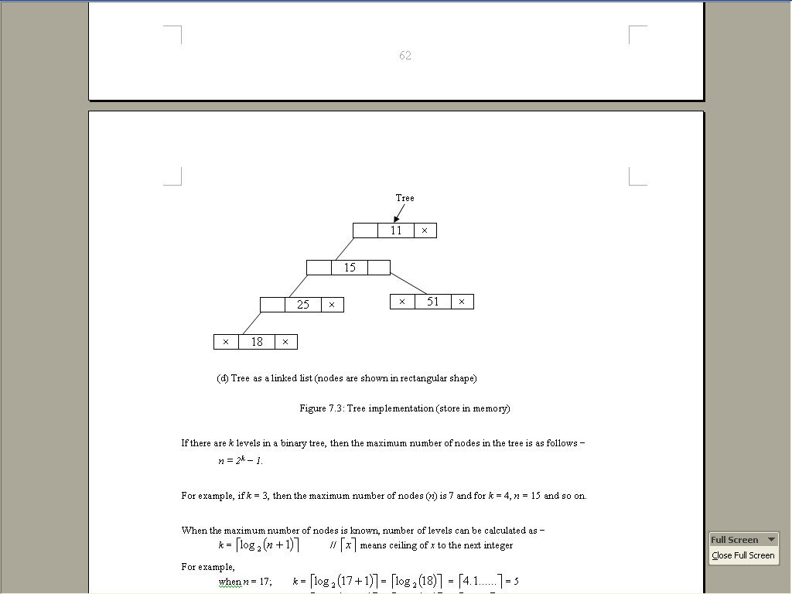
Binary Tree

Slide 22
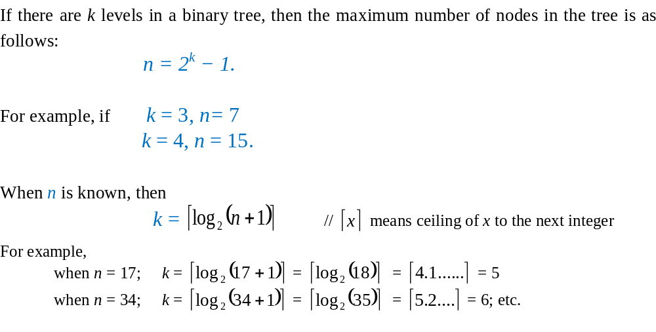
Binary Tree

Slide 23
Binary Tree
Full binary tree:
  If a binary tree contains nodes in such a way that every node has at least two children except the leaf nodes, then the tree is called a full binary tree.
Complete binary tree:
  If a binary tree contains nodes in such a way that every level except the deepest has as many nodes as possible and the nodes of the deepest level are in as left as possible, the tree is called complete binary tree.
  All full binary trees are complete binary trees.

Slide 24
Binary Tree
18
1
7
25
15
11
95
11
28
30
25
51
25
19
33
47
51
13
36
40
66
90
18
15
(a) A Full Tree
(b) A Complete Tree
Figure 7.4: Pictorial view of Full tree and complete tree

Slide 25
Binary Tree in Array
Parent child relationship(from parent to child):
If we consider the root’s position is 1,
Parent’s position(index) = i,
Left child’s position(index) = 2i,
Right child’s position(index) = 2i + 1.

Slide 26
Parent Child Relationship
2
( i )
4
( 2i )
5
( 2i+1 )
Slide 27

Slide 27
Binary Tree in Array
Child parent relationship (from child
to parent):
Child’s position (index): k
Parent’s position: k/2, / denotes
Integer division.
If the binary tree is a complete then array representation is efficient.

Slide 28
Child Parent Relationship
2
(k/2 )
5
( k )
Slide 28

Slide 29
Binary Tree in Array
Parent child relationship(from parent to child):
If we consider the root’s position is 0,
Parent’s position(index) = i,
Left child’s position(index) = 2i+1,
Right child’s position(index) = 2i+2.

Slide 30
Parent Child Relationship
1
( i )
3
( 2i + 1 )
4
( 2i+2 )
Slide30

Slide 31
Binary Tree in Array
Child parent relationship (from child
to parent):
Child’s position (index): k
Parent’s position: (k-1)/2,
Where / denotes Integer division.

Slide 32
Child Parent Relationship
1
(k-1)/2
3
( k )
Slide32

Slide 33
Linked representation of Binary Tree
struct node
{
int data;
node *lchild; //pointer to left child
node *rchild; //pointer to right child
};
If the tree is not complete then linked
representation is efficient.

Slide 34
Traversal Technique of a Binary Tree
There are three main traversal techniques (methods) for a binary tree. Such as
  Pre-order Traversal Method
  In-order Traversal Method
  Post-order Traversal Method

Slide 35
Pre-order Traversal Method
  Visit the root (node).
  Traverse the left sub-tree (in pre-order)
  Traverse the right sub-tree (in pre-order)

Slide 36
Example: Preorder
  Visit the root (node).
  Traverse the left sub-tree (in pre-order)
  Traverse the right sub-tree (in pre-order)
43
31
64
20
40
56
89
28
33
47
59
43
31
20
28
40
33
64
56
47
59
89
Slide 36

Slide 37
Another Example of Preorder
1
A
2
6
B
C
3
5
7
9
D
E
F
G
4
8
10
H
I
J
Figure 7.5: Pre-order traversal method
Visiting sequence:
A B D H E C F I G J

Slide 38
Pre-order Traversal Method
Algorithm 7.1: Algorithm for pre-order traversal
  1. Input a binary tree
  2. preorder (node * curptr)
  {
  if (curptr!= NULL)
  {
  print curptr→data;
  preorder (curptr→lchild);
  preorder (curptr→ rchild);
  }
  }
  3. Output: the information of the nodes.

Slide 39
Inorder Traversal
Traverse the left subtree (inorder).
Visit the root (node).
Traverse the right subtree (inorder).

Slide 40
Example: Inorder
Traverse the left subtree (inorder).
Visit the root (node).
Traverse the right subtree (inorder).
We can see the output is a sorted sequence in ascending order
43
31
64
20
40
56
89
28
33
47
59
20
28
31
33
40
43
47
56
59
64
89
Slide 40

Slide 41
In-order Traversal
5
5
A
A
3
8
3
8
B
C
B
C
2
4
7
9
1
4
7
9
D
E
F
G
D
E
F
G
1
6
10
2
6
10
H
I
J
H
I
J
Fig-(a)
Fig-(b)
Visiting Sequences:
H D B E A I F C G J D H B E A I F C G J

Slide 42
In-order Traversal Method
Algorithm 7.2: Algorithm for in-order traversal
1. Input a binary tree.
2. inorder (node * curptr)
{
if (curptr!= NULL)
{
inorder (curptr→lchild);
print curptr→data;
inorder (curptr→rchild);
}
}
3. Output: the information of the nodes.

Slide 43
Postorder Traversal
Traverse the left subtree (postorder).
Traverse the right subtree (postorder).
Visit the root (node).

Slide 44
Example: Postorder
43
31
64
20
40
56
89
28
33
47
59
28
20
33
40
31
47
59
56
89
64
43
Slide 44

Slide 45
Post-order Traversal Method
Algorithm 7.3: Algorithm for post-order traversal
1.Input a binary tree.
2. postorder (node * curptr)
{
if (curptr!= NULL)
{
postorder (curptr→lchild);
postorder (curptr→rchild);
print curptr→data;
}
}
3. Output: the information of the nodes.

Slide 46
Expression Tree
A Binary Tree built with operands and operators.
Also known as a parse tree.
Use in compilers.

Slide 47
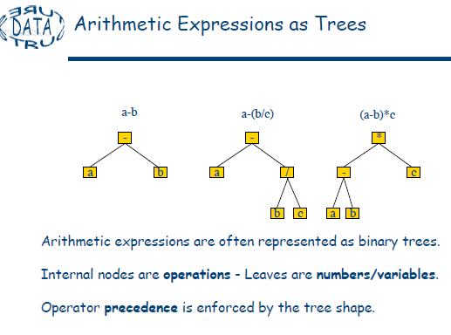

Slide 48
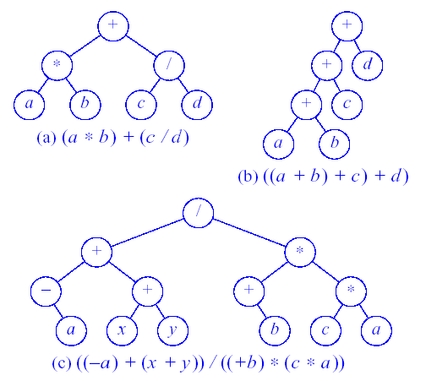
Arithmetic Expressions as trees(cont.)
Figure 11.5 Expression Trees

Slide 49
Arithmetic Expressions as trees(cont.)
  Example 7.2: Algebraic Expressions
  Consider any algebraic expression E involving only binary operations, such as
  E = (a-b) / ((c * d) + e)
  E can be represented by means of the binary tree T pictured in fig. 7.3.
/
-
+
a
b
e
*
c
d
Fig. 7.3: E = ( a – b ) / (( c * d ) + e )
---------------------------------------------------------------

Slide 50
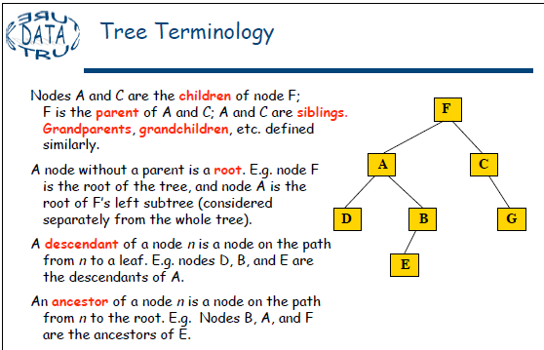
TERMINOLOGY
Terminology describing family relationships is frequently used to describe relationships between the nodes of a tree T. Specifically, suppose N is a node in T with left successor S₁ and right successor S₂ . Then N is called the parent or father of S₁ and S₂. Analogously, S₁ is called the left child or son of N, and S₂ is called the right child or son of N. Furthermore, S₁ and S₂ are said to be siblings or brother. Every node N in a binary tree , except the root, has a unique parent, called the predecessor of N.
---------------------------------------------------------------
Prepared by, Jesmin Akhter, Lecturer, IIT,JU

Slide 51
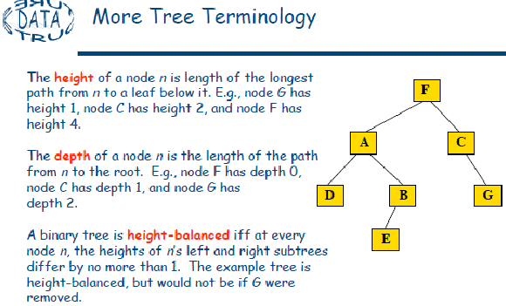

Slide 52
Example: Expression Tree
+
/
/
1
3
*
4
6
7
1/3 + 6*7 / 4
Slide47

Slide 53
Extended Binary Tree
An extended binary tree is a transformation of anybinary tree into a complete binary tree. This transformation consists of replacing every null subtree of the original tree with “special nodes.” The nodes from the original tree are then internal nodes, while the “special nodes” are external nodes.

Slide 55
Extended Binary trees: 2 trees
A binary tree T is said to be a 2 – tree or extended binary tree if each node N has either 0 or 2 children. The nodes with two children are called internal nodes, and the nodes with 0 children are called external nodes.
  Circles for internal nodes.
  Squares for external nodes.
Start with any binary tree and add an external node wherever there is an empty subtree.
Result is an extended binary tree.
A Binary Tree
An Extended Binary Tree
---------------------------------------------------------------

Slide 56
Binary Search Tree(BST)
A BST is a Binary Tree such that:
Every node entry has a unique key or value.
All the values in the left subtree of a node are smaller(less) than the value of the node.
All the values in the right subtree of a node are greater than the value of the node.
Left and rigt sub-trees are also BST.

Slide 57
Example 1:
Key or value is an integer
43
31
64
20
40
56
89
28
33
47
59

Slide 58
Example 1:
key or value is an integer
43
31
64
20
40
56
89
28
33
47
59

Slide 59
Example 2:
Key or value is a string
Fred
Dan
Mary
Alan
Eve
Kate
Sue
Bill
Eric
Greg
Len
Slide 51

Slide 60
Searching a particular node
Compare with the root if equal then found.
Else if the node value is less search the left subtree.
Otherwise (for greater) search the right subtree.
Searching cost is O(log₂n) if BST is a complete.

Slide 61
Searching
Example:
59
43
31
64
20
40
56
89
28
33
47
59
57
found
Searching

Slide 62
Searching
Example:
61
43
31
64
20
40
56
89
28
33
47
59
57
failed
Searching

Slide 63
Searching Algorithm
Algorithm 7.4: Algorithm to find out a particular node value of BST
  Input BST and a node value, x;
  Repeat Step-3 to Step-5 until we find the value or we go beyond the tree.
  If x is equal to root node value, searching is successful (print “Found”) and terminate the algorithm.
  If x is less than root node value, we have to search the left sub-tree (by treating it as a BST).
  Else we have to search right sub-tree (by treating it as a BST).
  Otherwise the node value is not present in BST (print “Not Found”).
  Output: Print message “FOUND” or “NOT FOUND”

Slide 64
Insert or Add
Create new node for the item.
Find the parent node the node.
Add or Attach new node as a leaf.

Slide 65
Insert or Add
57
Example:
43
31
64
20
40
56
89
28
33
47
59
ADD

Slide 66
Insert or Add
57
Example:
43
31
64
20
40
56
89
28
33
47
59
57
Add

Slide 67
Algorithm to Add
Algorithm 7.5: Algorithm to insert (add) a node to a BST
  1. Input BST and a new node;
  2. Repeat Step-3 to Step-5 until we find the value or we go beyond the tree.
  3. If x is equal to root node value, searching is successful and terminate the algorithm.
  4. If x is less than root node value, we have to search the left sub-tree (by treating it as a BST).
  5. Else we have to search right sub-tree (by treating it as a BST).
  6. Make link between the new node and the parent node of the new node.
  7. Output: Updated BST.
Algorithm to Add

Slide 68
Delete a node from BST
  Find or locate the node (searching)
  Case 1:
  if the target node is a leaf node, then we just delete the node.
  Case 2:
  if the target node has only one child, then we make link between the child and parent node of the target node and delete the node.

Slide 69
Deletion from BST
  Case 3:
  if the target node has two children (with grand children also).
  Search left sub-tree of the target node and find the node with maximum value and mark it.
  Replace the node value by the maximum value.
  Delete the marked node (the node with maximum value).
  (We can do it using right subtree also in thet case minimum value will be used).

Slide 70
Deletion from BST
Example of Case 3:
43
31
64
Node to be deleted
20
40
56
89
28
33
47
59
Deletion

Slide 71
Deletion from BST
Example of case 3:
43
31
64
Node to be deleted
20
40
56
89
28
33
47
59
Node with max value
Deletion

Slide 72
Deletion from BST
Example of case 3:
43
31
59
Replaced the value
20
40
56
89
28
33
47
59
Node with max value
Deletion

Slide 73
Deletion from BST
Example of Case 3:
43
31
59
20
40
56
89
28
33
47
Deletion is performed
Deletion

Slide 74
Inorder Traversal of a BST
We can see the output is a sorted sequence in ascending order
43
31
64
20
40
56
89
28
33
47
59
20
28
31
33
40
43
47
56
59
64
89
Slide 66

Slide 75
Next version of tree
is
Heap

