Slide 1
CHAPTER 9
SORTING AND SEARCHING

Slide 2
Sorting
To arrange a list of elements (data) in ascending or descending order is called sorting. There are two types of sorting:
  1. Internal Sorting and
  2. External Sorting

Slide 3
Types of sorting
Internal Sorting:
  The method (algorithm) which sorts list of data that is small enough to fit entirely in primary (internal) memory, is called internal sorting.
External Sorting:
  The method (algorithm) which sorts list (file) of data that can not fit entirely in primary memory, that means to sort the entire list the method uses external memory, is called external sorting.

Slide 4
Classes of Internal Sorting
Classes of Internal Sorting
Exchange Sort:
  Selection sort, Insertion sort, Bubble sort
Divide and Conquer Sort:
  Merge sort, Quick sort
Tree Sort
  :Heap sort, Tournament sort
Non-comparison based Sort
  :Radix sort, Bucket sort etc.

Slide 5
Internal sort
SELECTION SORT

Slide 6
Selection Sort [contd.]
Using steps we can write the method as follows.
  Given a list of data. Find out the smallest data from the list. Place the smallest in first position and the data of the first position in the position of the smallest data.
  Repeat the process for the list except data in first position, and so on.

Slide 7
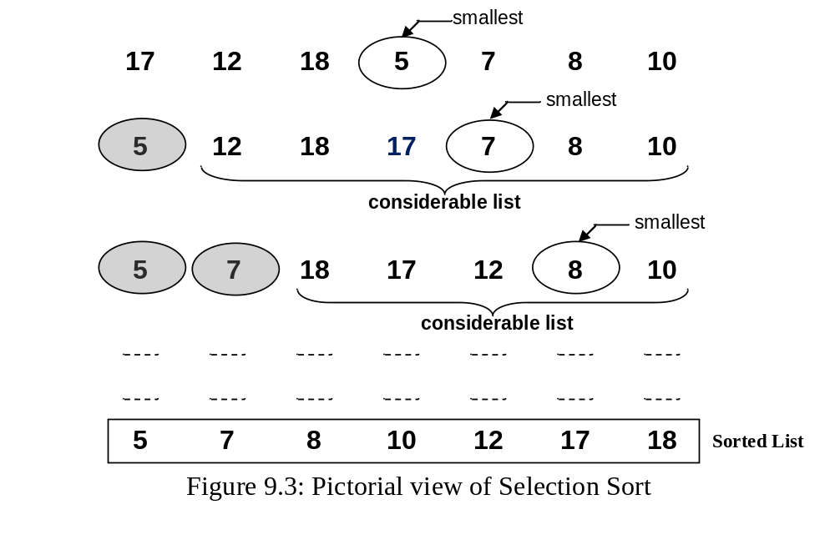

Selection Sort [contd.]

Slide 8
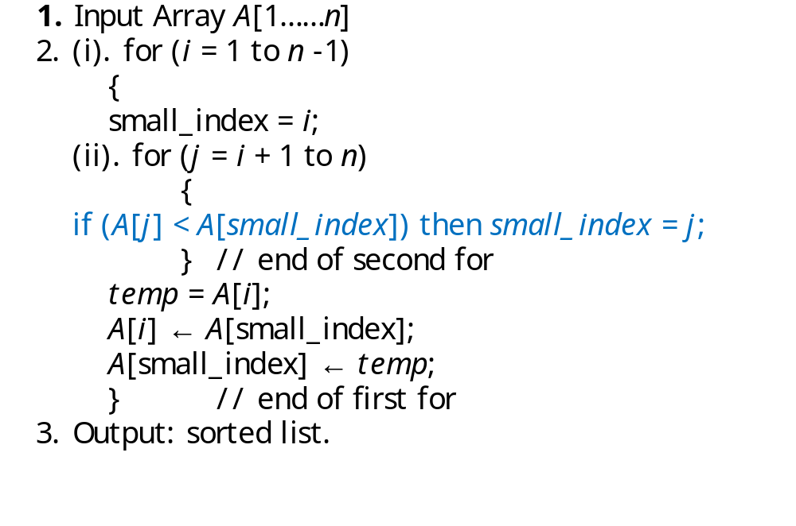
Algorithm for Selection Sort

Slide 9
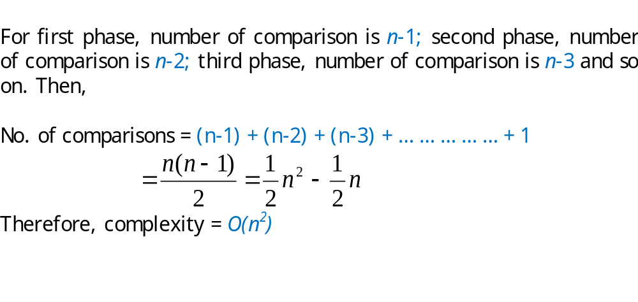
Complexity of selection sort

Slide 10
Internal sort
INSERTION SORT

Slide 11
Insertion Sort [contd.]
Using steps we can describe the process as follows.
  Given a list of elements (data).
  We have to insert a data into its correct position by moving all data (before it) to the right (that are greater than the data which is being considered at this moment).
  By repeating Step-ii for all considerable data we can arrange the whole list in ascending order.

Slide 12
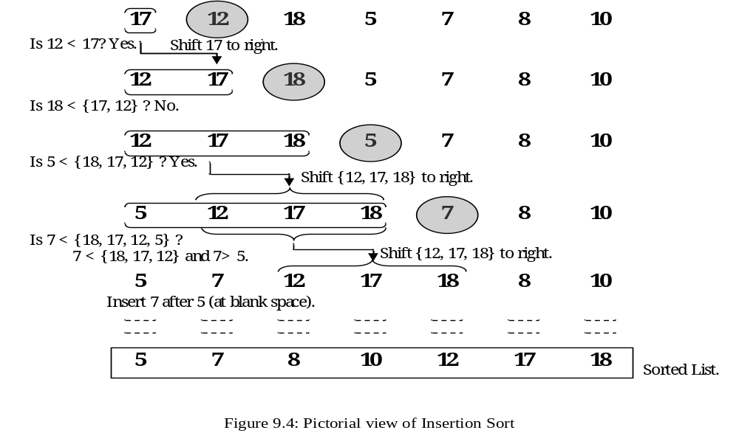
Insertion Sort [contd.]

Slide 13
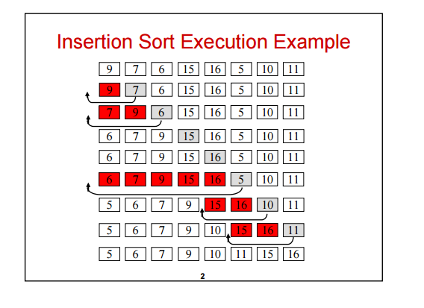

Slide 14
Another Example:
12, 11, 13, 5, 6
Let us loop for i = 1 (second element of the array) to 5 (Size of input array)
i = 1. Since 11 is smaller than 12, move 12 and insert 11 before 12
11, 12, 13, 5, 6
i = 2. 13 will remain at its position as all elements in A[0..I-1] are smaller than 13
11, 12, 13, 5, 6
i = 3. 5 will move to the beginning and all other elements from 11 to 13 will move one position ahead of their current position.
5, 11, 12, 13, 6
i = 4. 6 will move to position after 5, and elements from 11 to 13 will move one position ahead of their current position.
5, 6, 11, 12, 13

Slide 15
/* Function to sort an array using insertion sort*/
void insertionSort(int arr[], int n)
{
int i, key, j;
for (i = 1; i < n; i++)
{
key = arr[i];
j = i-1;
/* Move elements of arr[0..i-1], that are
greater than key, to one position ahead
of their current position */
while (j >= 0 && arr[j] > key)
{
arr[j+1] = arr[j];
j = j-1;
}
arr[j+1] = key;
}
}

Slide 16
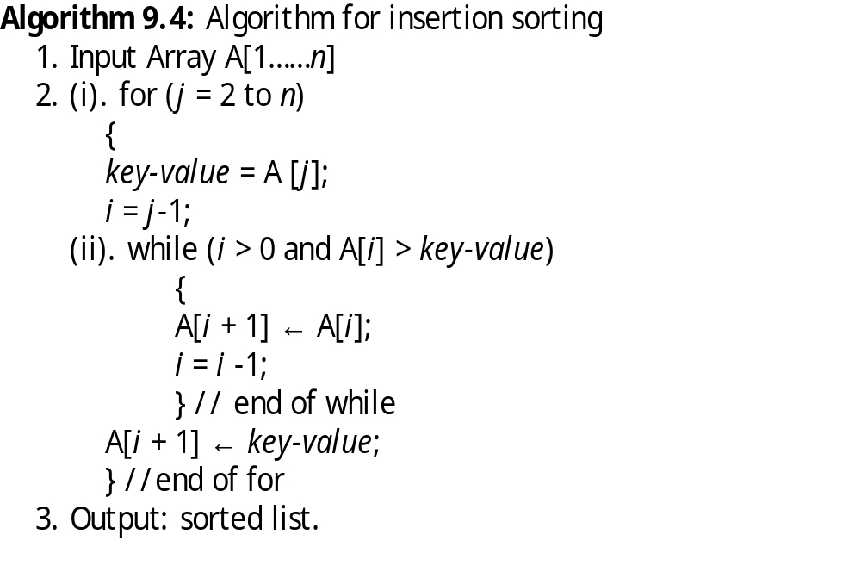
Insertion Sort [contd.]

Slide 17
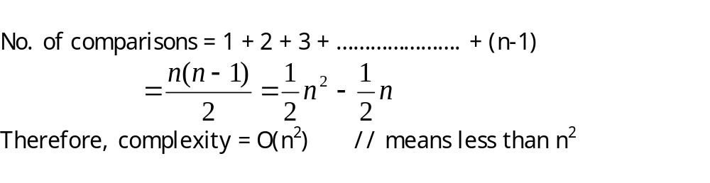
Complexity of Insertion Sort

Slide 18
Internal sort
MERGE SORT

Slide 19
Merge Sort
Merge sort is a divide and conquer method.
It works by dividing the list into two parts, sorts the parts and merges them together.
Merge sort is a recursive procedure (function).
If a function calls itself repeatedly, then the function is called recursive function.
A disadvantage of merge sort is that it requires extra spaces (array) for merging.

Slide 20
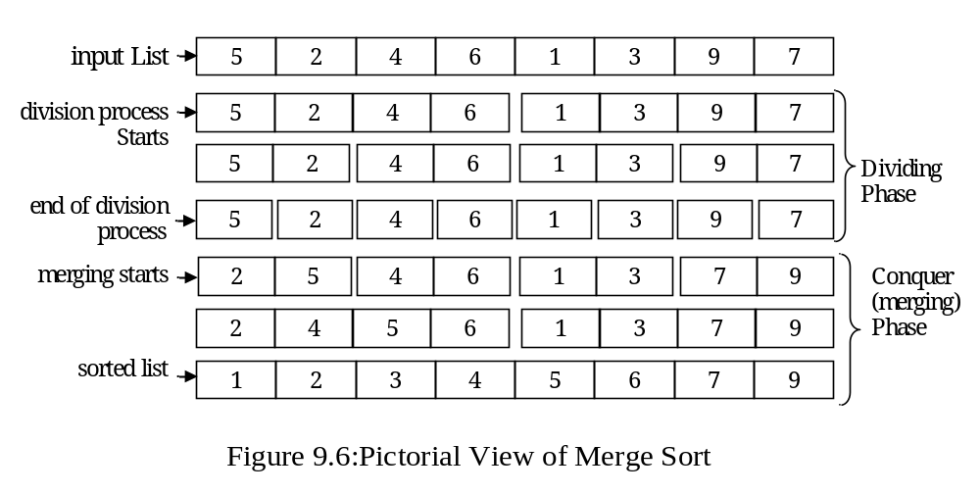
Example of Merge sort

Slide 21
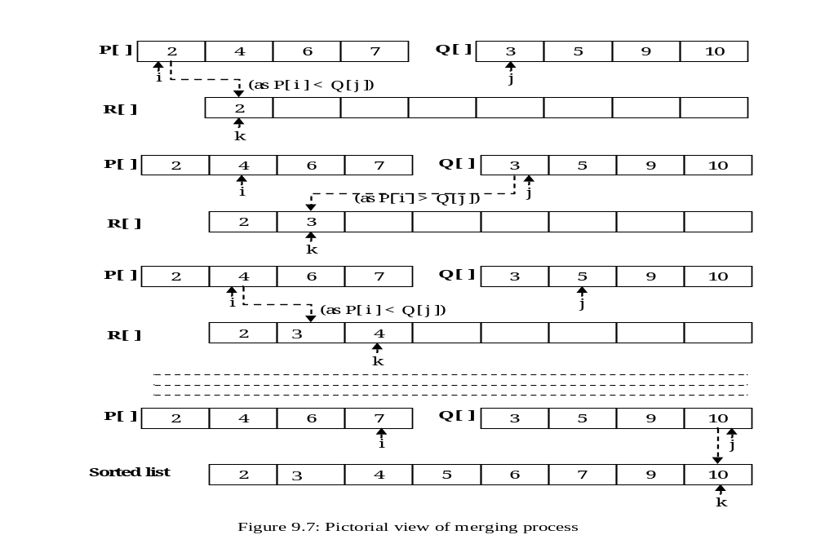
Merging procedure

Slide 22
Algorithm of Merge Sort
Algorithm for merge sort
  merge_sort (A, f, l)
  {
  if (f < l)
  {
  m = (f + l) / 2;
  merge_sort (A, f, m);
  merge_sort (A, m + 1, l);
  Merge (A, f, m, l);
  } // end of if
  }

Slide 23
Merging function
Here A is an array, f is the first index and l is the last index.
  Merge (A, f, m, l)
  {
  Take an array T[1 . . . l];
  i = f; j = m + 1; k = f;
  while (i ≤ m and j ≤ l)
  {
  if A[i] ≤ A[j], then T[k] ← A[i]; i = i +1;
  else T[k] ← A[j]; j = j + 1;
  //end of if
  k = k + 1;
  } //end of while
  //copy rest of the data
CONTINUED >>

Slide 24
Merging function[contd.]
  if (i > m) then
  for (b = j to l) do
  {
  T[k] ← A[b]; k = k + 1;
  }
  else for (b = i to m) do
  {
  T[k] ← A[b]; k = k + 1;
  }
  } //end of function

Slide 25
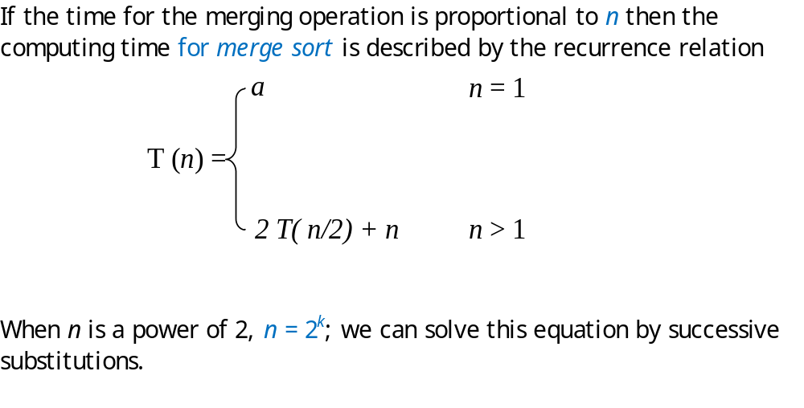
Analysis of Merge Sort

Slide 26
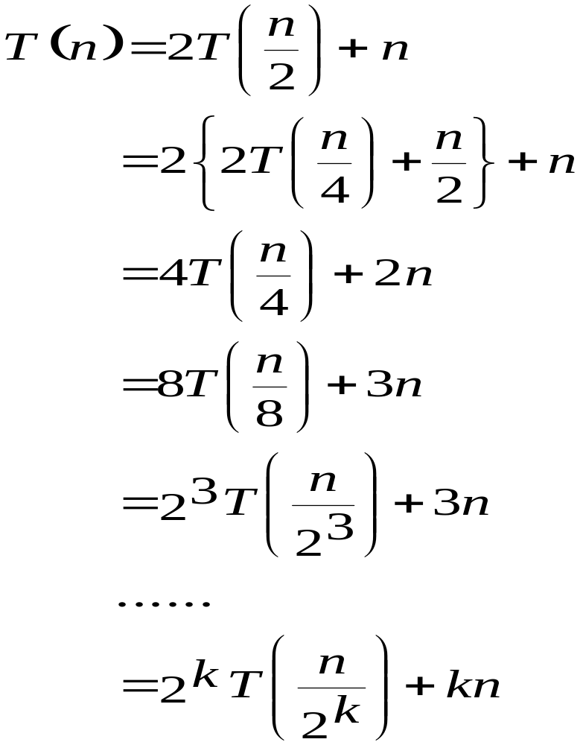
Analysis of merge sort

Slide 27
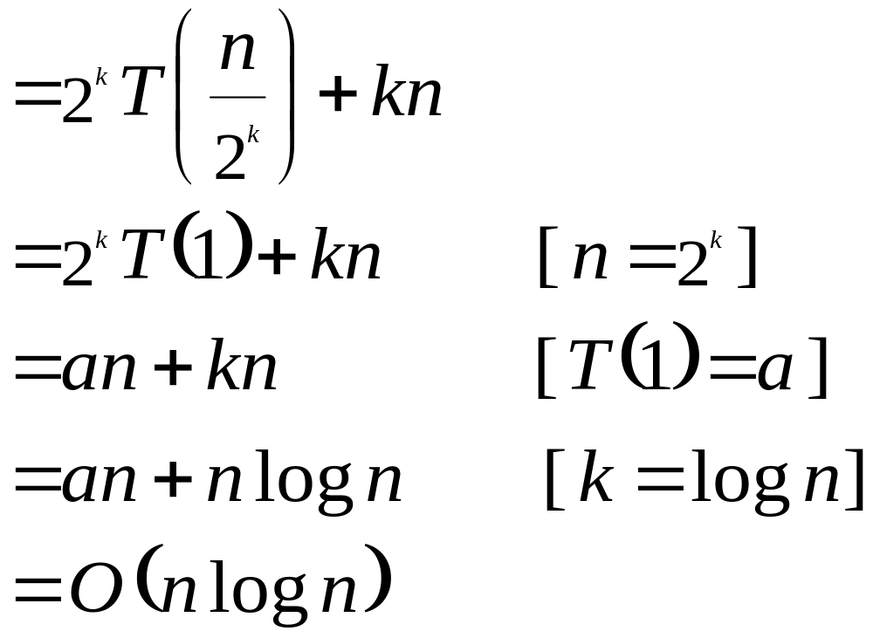
Complexity of merge sort

Slide 28
Internal sort
QUICK SORT

Slide 29
Quick Sort
Quick sort is a divide and conquer method.
In this method one element is to be chosen as partitioning element.
Divide the whole list of data into two parts with respect to the partitioning element.
The data which are less than or equal to the partitioning element, will remain in the first sub-list or first part and the data which are greater than the partitioning element will remain in the second sub-list (second part).

Slide 30
Quick sort
If we find any data (in the first part) which is greater than the partitioning value that will be transferred to the second part.
In the second part, if we find any data which is less than the partitioning element, that will be transferred to the first part.
Transferring of data have been done by exchanging the positions of the data found in first part and second part.
  By repeating the process, we can sort the whole list of data.

Slide 31
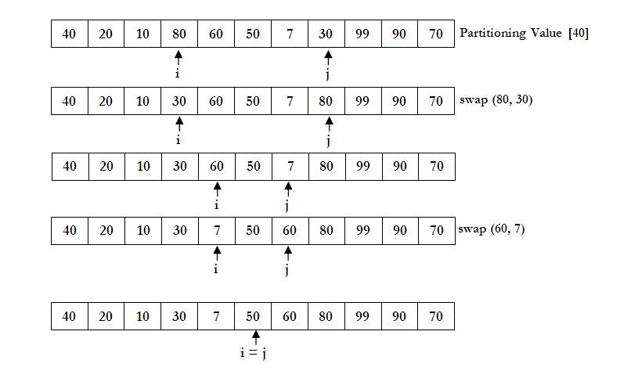
Example of Quick Sort

Slide 32
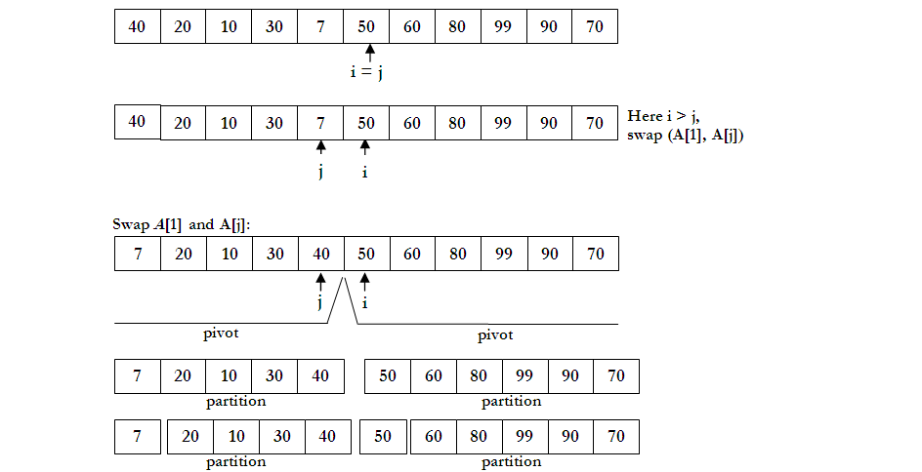
Example of Quick Sort [contd.]

Slide 33
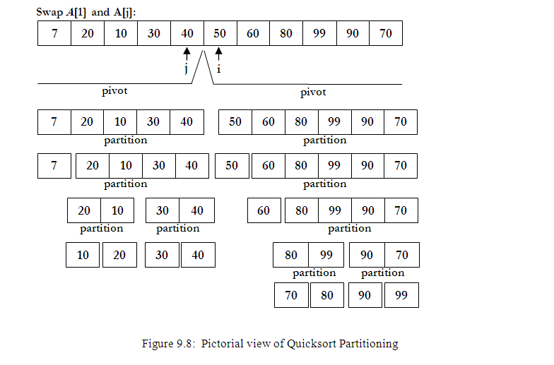
Example of Quick Sort [contd.]

Slide 34
Algorithm of Quick Sort
Algorithm for quick sort
  Quick_sort (f, l)
  {
  if (f < l)
  {
  j = makepart (a, f, l + 1) ;
  Quick_sort (f, j – 1) ;
  Quick_sort (j + 1, l);
  }
  }

Slide 35
Partitioning function
makepart (a, first, last)
{
part_value = a[first]; i = first; j = last;
do
{
do
{
i = i +1;
} while (a[i] ≤ part_value);
do
{
j = j - 1;
} while (a[i] > part_value);
if (i < j) then interchange (a[i], a[j]);
} while (i ≥ j);
a[first] = a[j]; a[j] = part_value;
return j;
}
Here, first is the first index and last is the last index; and a is the array. And part_value is the partitioning element (first element for first iteration).

Slide 36
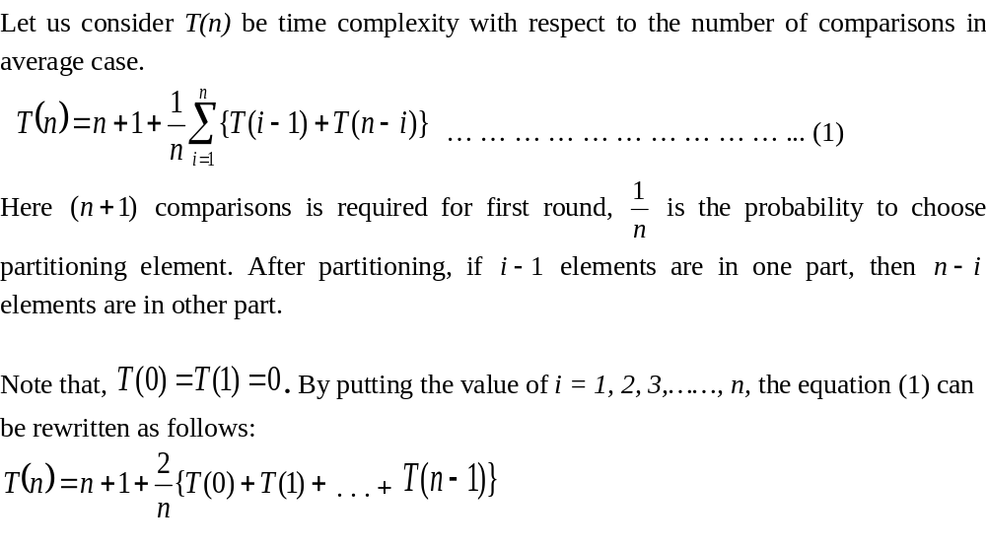
Analysis of Quick Sort

Slide 37
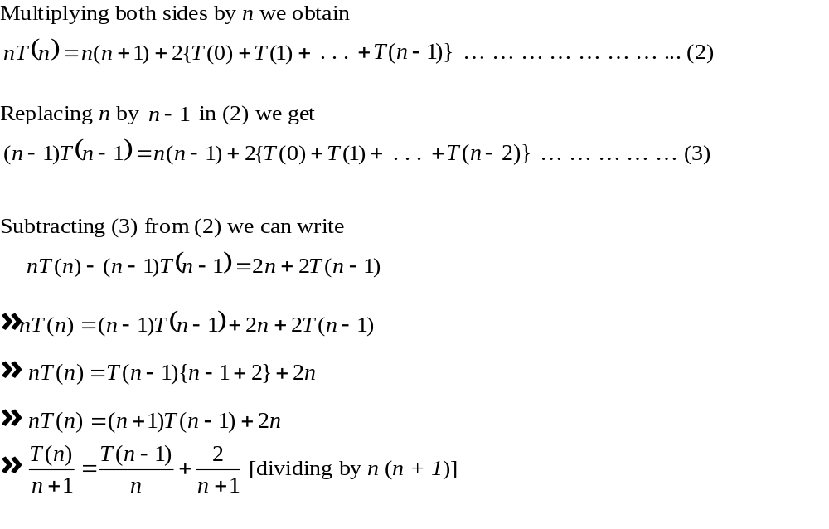
Analysis of Quick Sort [contd.]

Slide 38
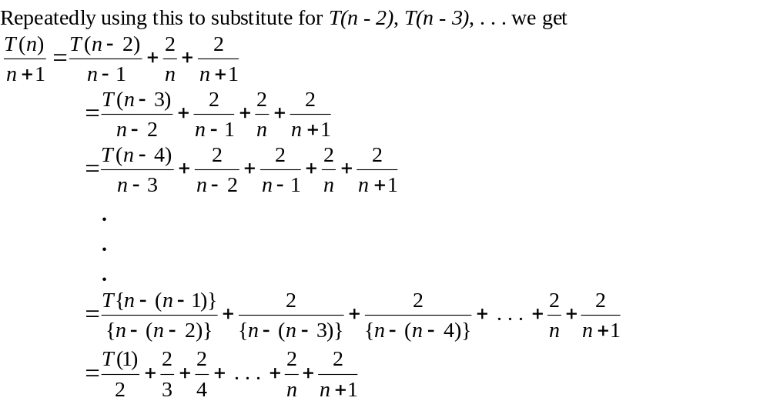
Analysis of Quick Sort [contd.]

Slide 39
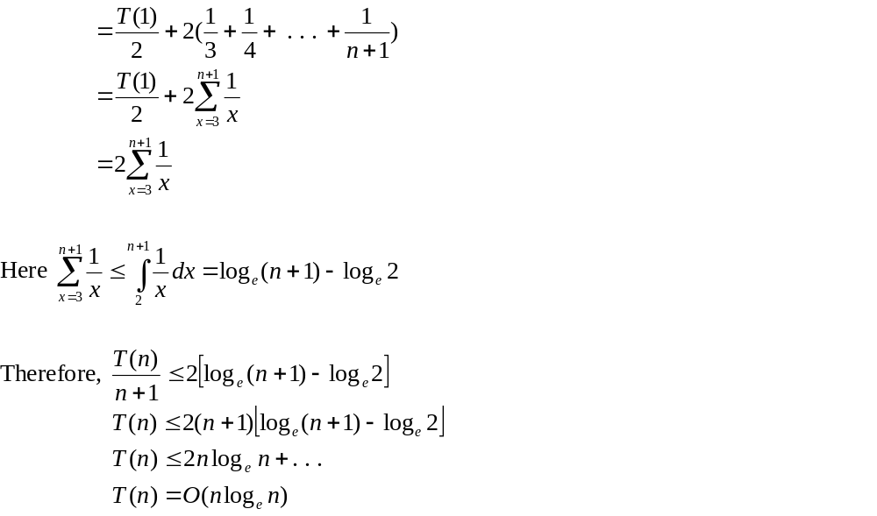
Analysis of Quick Sort [contd.]

Slide 40
Complexity of Quick sort
That means, the quicksort algorithm takes O (n log_{e} n) time in average case. On the other hand the worst case time is O (n²).
Remember that merge sort takes O (n log₂ n) time in average and worst cases, whereas quick sort takes O (n log_{e} n) time in average case and O (n²) time in worst case.

Slide 41
Summary of Complexities
The complexity of searching algorithm:
i) The complexity of linear search is O(n).
ii) The complexity of binary search is O(nlog₂n).
The complexity of sorting algortihm:
The complexity selection sort is O(n²).
The complexity of insertion sort is O(n²).
The complexity of merge sort O(nlog₂ n) both in average and worst cases.
iv) The complexity of quick sort O(nlog_{e} n) time in average case and O(n²) in worst case .

Slide 42
Sorting
EXTERNAL SORT

Slide 43
External Sorting
External sorting is required when the number of records (data) to be stored is larger than the computer can hold in its internal (main) memory.
Now-a-days, to sort extremely large data is becoming more and more important for large corporations, banks and government institutions.
External sorting is quite different from internal sorting, even though the problem in both cases is to sort a given list of data into increasing or decreasing order.
The most common external sorting algorithm used is still the Merge sort.

Slide 44
External Sorting [contd.]
In external sorting method, at first the sorted runs (sorted sub-files) are produced, and then the sorted runs are merged to produce single run which gives us a sorted file (list of data).
The runs can be produced using any internal sorting algorithm like quick sort.

Slide 45
External Sorting [contd.]
Let us consider that we have to sort three thousand records R₁, R₂,………,R₃₀₀₀ and each record is 20 words long.
It is assumed that only one thousand of the records will fit in the internal memory of our computer at a time.
Now this data can be sorted in the following ways. Suppose, the runs are written in different files on a disk.
According to our example there will be three runs and let there are three files as follows
file-1: R₁, R₂, R₃,………,R₁₀₀₀
file-2: R₁₀₀₁, R₁₀₀₂,………,R₂₀₀₀
file-3: R₂₀₀₁, R₂₀₀₂,………,R₃₀₀₀

Slide 46
External Sorting [contd.]
Now, we shall produce a run by merging the file-1 and file-2 and these will write in file-4.
Again we merge the file-3 and file-4 and produce a single run which may be written to file-1.
file-4: R₁, R₂,………,R₂₀₀₀
file-3: R₂₀₀₁,………,R₃₀₀₀
file-1: R₁, R₂,………,R₃₀₀₀

Slide 47
External Sorting [contd.]
During merging phase we shall read some records suppose 500 records from file-1 and 500 records from the file-2 and merge them.
Merging file will be written to file-4.
Again we shall read the last 500 records from the file-1 and 500 records from file-2 and merge them.
The merging records will be written to file-4. Similarly we merge the file-4 and the file-3.

Slide 48
Searching
Searching means to find out or locate any element from a given list of elements.
To identify or locate an element or position of the element from a list of elements is called searching.
Here we shall study two types of searching
>Linear searching
>Binary Searching

Slide 49
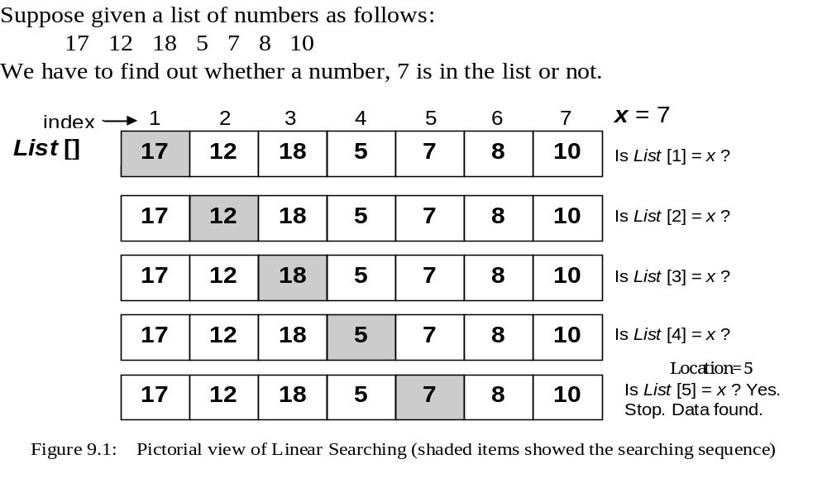
Linear Searching [contd.]

Slide 50
Algorithm for linear searching
  1. Input a list and an item (element to be found)
  A [1…n]; item = x; Location = 0
  2. Search the list to find the target element
  for (i = 1; i ≤ n; i = i + 1)
  {
  if (A[i] = =item)
  {
  print “Found ”;
  location = i
  Stop searching;
  }
  }
  3. if (i > n) print “Not Found ”;
  4. Output : “Found” or “Not Found”.

Slide 51
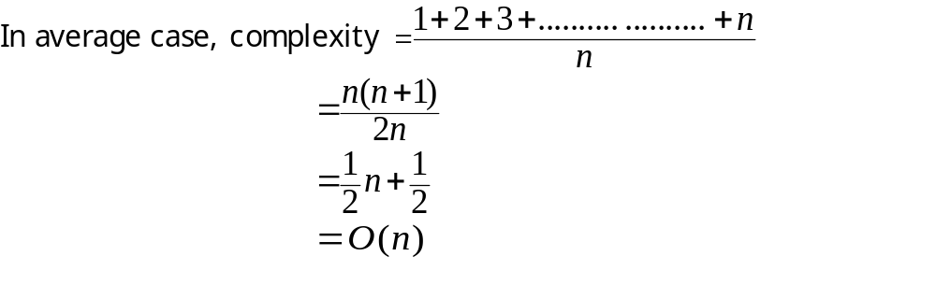
Complexity for linear searching

Slide 52
Binary Searching
prerequisite for binary searching is that the elements must be arranged either in ascending or in descending order.
Problem
  Given list of data elements arranged in ascending or descending order, locate (find the position of) a particular (target) element from the list.
  Remember: It is not Binary Search Tree (BST). BST is a data structure, whereas binary search is a method or technique (not a data structure).

Slide 53
Binary Searching [contd.]
Example:
Suppose we have a list of numbers as follows
17 19 28 30 45 55 58 61 63 67 72 76 80 89 99
And we have to find out 89 from the list
mid = (first + last)/2;

Slide 54
1 2 3 4 5 6 7 8 9 10 11 12 13 14 15
17 19 28 30 45 55 58 61 63 67 72 76 80 89 99
first mid last
9 12 15
17 19 28 30 45 55 58 61 63 67 72 76 80 89 99
first mid last
13 14 15
17 19 28 30 45 55 58 61 63 67 72 76 80 89 99
first mid last
X = 89 Found
index
data

Slide 55
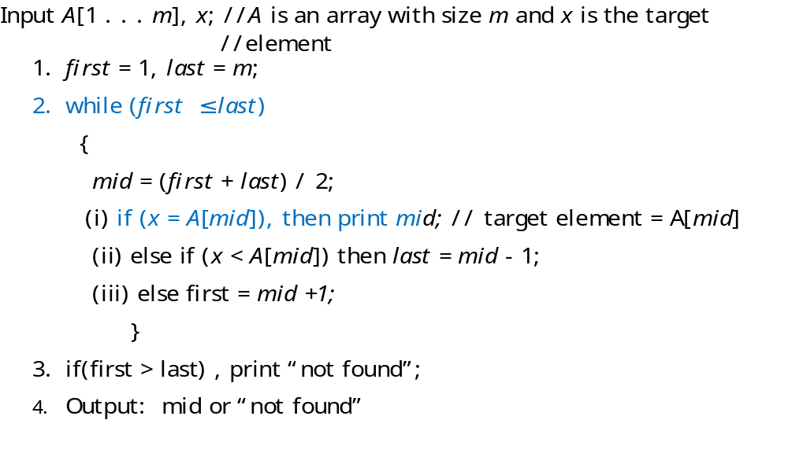
Algorithm for Binary Searching (pseudocode)

Slide 56
Complexity of binary search
Suppose, there are n elements in the list.
Let n = 2^{k}; then k = log₂ n.
Therefore, complexity = O (log₂ n)

Slide 57
THANK YOU.

