Slide 1
Lecture -3 on
Data structures
Array

Slide 2
Array
Data structures are classified as either linear or nonlinear.
A data structure is said to be LINEAR if its elements form a sequence or a linear list.
There are two basic ways of representing such linear structures in memory.
One way is to have the linear relationship between the elements represented by means of sequential memory locations. These linear structures are called arrays.
The other way is to have the linear relationship between the elements represented by means of pointers or links. These linear structures are called linked lists.
Nonlinear structures are trees and graphs.

Slide 3
Linear Arrays
A linear array is a list of finite number n of homogeneous data elements such that :
The elements of the array are referenced respectively by an index set consisting of n consecutive numbers.
The elements of the array are stored respectively in successive memory locations.
The number n of elements is called the LENGTH or size of the array.

Slide 4
Linear Arrays
Three numbers define an array : lower bound, upper bound, size.
a. The lower bound is the smallest subscript you can use in the array (usually 0)
b. The upper bound is the largest subscript you can use in the array
c. The size / length of the array refers to the number of elements in the array , It can be computed as upper bound - lower bound + 1
Let, Array name is A then the elements of A is : a1,a2….. an
Or by the bracket notation A[1], A[2], A[3],…………., A[n]
The number k in A[k] is called a subscript and
A[k] is called a subscripted variable.

Slide 5
Linear Arrays
Example :
A linear array DATA consisting of the name of six elements
DATA
DATA
DATA[1] = 247
DATA[2] = 56
DATA[3] = 429
DATA[4] = 135
DATA[5] = 87
DATA[6] = 156
1 2 3 4 5 6 | 247
 | 56
 | 429
 | 135
 | 87
 | 156
1 2 3 4 5 6 | 247
 | 56
 | 429
 | 135
 | 87
 | 156

Slide 6
Linear Arrays
Example :
An automobile company uses an array AUTO to record the number of auto mobile sold each year from 1932 through 1984.
AUTO[k] = Number of auto mobiles sold in the year K
LB = 1932
UB = 1984
Length = UB – LB+1 = 1984 – 1930+1 =55

Slide 7
Representation of linear array in memory
Let LA be a linear array in the memory of the computer. The memory of the computer is a sequence of addressed locations.
LA
1000 1001 1002 1003 1004 1005
The computer does not need to keep track of the address of every element of LA, but needs to keep track only of the first element of LA, denoted by
Base(LA) Called the Base Address of LA. Using this address Base(LA), the computer calculates the address of any element of LA by the following formula :
LOC(LA[k]) = Base(LA) + w(K – lower bound)
Where w is The Number Of Words per memory cell for the array LA
Fig : Computer memory

Slide 8
In One Dimensional Array location of element A[i] can be calculated using following equation:
LOC (A[i]) = Base_Address + W * (i)
Here,
Base_Address is the address of first element in the array.
W is the word size.
It means number of bytes occupied by each element.
Suppose we want to calculate the address of element A [2].
It can be calculated as follow:
Base_Address = 2000, W=2
LOC (A [i]) = Base_Address + W (i)
LOC (A [2]) = 2000 + 2 (2) = 2004

Slide 9
Representation of linear array in memory
200 201 202 203 204 205 206 207 208 209 210 211 212
LOC(LA[k]) = Base(LA) + w(K – lower bound)
Example :
An automobile company uses an array AUTO to record the number of auto mobile sold each year from 1932 through 1984. Suppose AUTO appears in memory as pictured in fig A . That is Base(AUTO) = 200, and w = 4 words per memory cell for AUTO. Then,
LOC(AUTO[1932]) = 200, LOC(AUTO[1933]) =204 , LOC(AUTO[1934]) = 208
the address of the array element for the year K = 1965 can be obtained by using :
LOC(AUTO[1965]) = Base(AUTO) + w(1965 – lower bound)
=200+4(1965-1932)=332
AUTO[1932]
AUTO[1933]
AUTO[1934]
Fig : A

Slide 10
Traversing linear arrays
Print the contents of each element of DATA or Count the number of elements of DATA with a given property. This can be accomplished by traversing DATA, That is, by accessing and processing (visiting) each element of DATA exactly once.
Algorithm 2.3: Given DATA is a linear array with lower bound LB and upper bound UB .
This algorithm traverses DATA applying an operation PROCESS to each element of DATA.
Set K : = LB.
Repeat steps 3 and 4 while K<=UB:
Apply PROCESS to DATA[k]
Set K : = K+1.
Exit.

Slide 11
Traversing linear arrays
Example :
An automobile company uses an array AUTO to record the number of auto mobile sold each year from 1932 through 1984.
a) Find the number NUM of years during which more than 300 automobiles were sold.
b) Print each year and the sold in that year
number of automobiles
Set NUM : = 0.
Repeat for K = 1932 to 1984:
if AUTO[K]> 300, then : set NUM : = NUM+1
Exit.
Repeat for K = 1932 to 1984:
Write : K, AUTO[K]
Exit.

Slide 12
Inserting and Deleting
Inserting refers to the operation of adding another element to the Array
Deleting refers to the operation of removing one element from the Array
INSERTING an element somewhere in the middle of the array require that each subsequent element be moved downward to new locations to accommodate the new element and keep the order of the other elements.
DELETING an element somewhere in the middle of the array require that each subsequent element be moved one location upward in order to “fill up” the array.
Fig shows Milon Inserted, Sumona deleted.
STUDENT
STUDENT
STUDENT
1 2 3 4 5 6 | Dalia Rahaman
 | Sumona
 | Mubtasim Fuad
 | Anamul Haque
1 2 3 4 5 6 | Dalia Rahaman
 | Sumona
 | Milon
 | Mubtasim Fuad
 | Anamul Haque
1 2 3 4 5 6 | Dalia Rahaman
 | Milon
 | Mubtasim Fuad
 | Anamul Haque

Slide 13
Inserting an Element into an Array:
Insert (LA, N, K, ITEM)
Here LA is linear array with N elements and K is a positive integer such that K<=N.This algorithm inserts an element ITEM into the Kth position in LA.
ALGORITHM
Step 1. [Initialize counter] Set J:=N
Step 2. Repeat Steps 3 and 4] while J>=K
Step 3. [Move Jth element downward] Set LA [J+1]: =LA [J]
Step 4. [Decrease counter] Set J:=J-1
[End of step 2 loop]
Step 5 [Insert element] Set LA [K]: =ITEM
Step 6. [Reset N] Set N:=N+1
Step 7. Exit
Notes:
Using J as a c counter.
the number N of elements in LAS is increased by 1 to account for new element.

Slide 14
Deleting an Element From a Linear Array
Delete (LA, N, K, ITEM)
Here LA is a linear array with N elements and K is a positive integer(k<=N). Delete kth element from LA.
ALGORITHM
Step 1. Set ITEM: = LA [K]
Step 2. Repeat for J=K to N-1( j<N-1)
[Move J+1st element upward] Set LA [J]: =LA [J+1]
[End of loop]
Step 3 [Reset the number N of elements in LA] Set N:=N-1
Step 4. Exit
if many deletions and insertions are to be made in a collection of data elements then a linear array may not be the most efficient way of storing the data.

Slide 15
Deleting an Element From a Linear Array
int LA[N],
K, j, i;
for(i=0; i<N; i++)
scanf("%d", &LA[i]);
scanf("%d", &K);
for(j=K; j<N-1; j++)
LA[j] = LA[j+1];
N--;
for(i=0; i<N; i++)
printf("%d\t", LA[i]);
printf("\n");

Slide 16
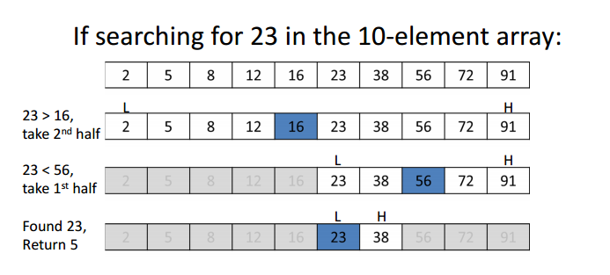
Binary Search Algorithm
Procedure binary_search
A ← sorted array
n ← size of array
x ← value to be searched

Slide 17
Binary Search Algorithm
while right bound > lower bound
  set midPoint = lowerBound + ( upperBound - lowerBound ) / 2
  if A[midPoint] < x
    SET lowerBound = midPoint + 1
  if A[midPoint] > x
    SET upperBound = midPoint – 1
  if A[midPoint] = x
  EXIT: x found at location midPoint
end while

Slide 18
Row Major Order Representation of Array
Row Major Order is a method of representing multi dimension array in sequential memory.
In this method elements of an array are arranged sequentially row by row.
Thus elements of first row occupies first set of memory locations reserved for the array, elements of second row occupies the next set of memory and so on.
Consider a Two Dimensional Array consist of N rows and M columns. It can be stored sequentially in memory row by row as shown below:

Slide 19
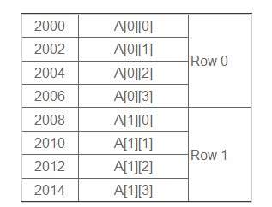
Consider following example in which a two dimensional array consist of two rows and four columns is stored sequentially in row major order as:

Slide 20
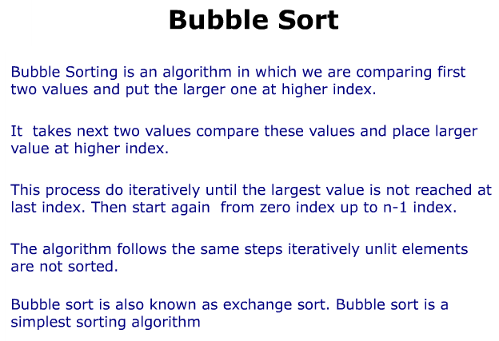

Slide 21
Bubble sort
Bubble sort is one of the easiest sort algorithms. It is called bubble sort because it will 'bubble' values in your list to the top.
Algorithm Bubble_Sort (DATA, N):
Repeat steps 2 and 3 for K = 1 to N-1.
Set PTR: =1.[Initializes pass pointer PTR]
Repeat while PTR<=N-K: [Executes pass]
If DATA[PTR]>DATA[PTR+1],then: TEMP := A[PTR], A[PTR] := A[PTR+1], A[PTR+1] := temp [End of if structure]
Set PTR: =PTR+1 [End of inner loop] [End of step 1 Outer loop]
4. Exit

Slide 22
Sorting : Bubble sort
Sorting takes an unordered collection and makes it an ordered one.
1 2 3 4 5 6
77
42
35
12
101
5
1 2 3 4 5 6
5
12
35
42
77
101

Slide 23
"Bubbling Up" the Largest Element
Traverse a collection of elements
  Move from the front to the end
  “Bubble” the largest value to the end using pair-wise comparisons and swapping
1 2 3 4 5 6
77
42
35
12
101
5

Slide 24
"Bubbling Up" the Largest Element
Traverse a collection of elements
  Move from the front to the end
  “Bubble” the largest value to the end using pair-wise comparisons and swapping
Swap
1 2 3 4 5 6
42
77
77
42
35
12
101
5

Slide 25
"Bubbling Up" the Largest Element
Traverse a collection of elements
  Move from the front to the end
  “Bubble” the largest value to the end using pair-wise comparisons and swapping
1 2 3 4 5 6
Swap
35
77
42
77
35
12
101
5

Slide 26
"Bubbling Up" the Largest Element
Traverse a collection of elements
  Move from the front to the end
  “Bubble” the largest value to the end using pair-wise comparisons and swapping
1 2 3 4 5 6
Swap
12
77
42
35
77
12
101
5

Slide 27
"Bubbling Up" the Largest Element
Traverse a collection of elements
  Move from the front to the end
  “Bubble” the largest value to the end using pair-wise comparisons and swapping
1 2 3 4 5 6
42
35
12
77
101
5
No need to swap

Slide 28
"Bubbling Up" the Largest Element
Traverse a collection of elements
  Move from the front to the end
  “Bubble” the largest value to the end using pair-wise comparisons and swapping
1 2 3 4 5 6
Swap
5
101
42
35
12
77
101
5

Slide 29
"Bubbling Up" the Largest Element
Traverse a collection of elements
  Move from the front to the end
  “Bubble” the largest value to the end using pair-wise comparisons and swapping
1 2 3 4 5 6
101
42
35
12
77
5
Largest value correctly placed

Slide 30
Putting It All Together

Slide 31
Items of Interest
Notice that only the largest value is correctly placed
All other values are still out of order
So we need to repeat this process
1 2 3 4 5 6
101
42
35
12
77
5
Largest value correctly placed

Slide 32
Repeat “Bubble Up” How Many Times?
If we have N elements…
And if each time we bubble an element, we place it in its correct location…
Then we repeat the “bubble up” process N – 1 times.
This guarantees we’ll correctly
place all N elements.

Slide 33
“Bubbling” All the Elements
1 2 3 4 5 6
42
35
12
77
5
101
1 2 3 4 5 6
35
12
42
5
77
101
1 2 3 4 5 6
N - 1
12
35
5
42
77
101
1 2 3 4 5 6
12
5
35
42
77
101
1 2 3 4 5 6
5
12
35
42
77
101

Slide 34
Reducing the Number of Comparisons
1 2 3 4 5 6
77
42
35
12
101
5
1 2 3 4 5 6
42
35
12
77
5
101
1 2 3 4 5 6
35
12
42
5
77
101
1 2 3 4 5 6
12
35
5
42
77
101
1 2 3 4 5 6
12
5
35
42
77
101

Slide 35
Summary
“Bubble Up” algorithm will move largest value to its correct location (to the right)
Repeat “Bubble Up” until all elements are correctly placed:
  Maximum of N-1 times
  Can finish early if no swapping occurs
We reduce the number of elements we compare each time one is correctly placed

Slide 36
Complexity of the bubble sort algorithm
The time for a sorting algorithm is measured in terms of the number of comparisons. The number f(n) of comparisons in the bubble sort is easily computed. Specifically there are n -1 comparisons during first pass, which places the largest element in the last position, there are n -2 comparisons in the second step, which places the second largest element in the next – to - last position, and so on. Thus
f(n) = (n-1)+(n-2)+. . . +2+1 =n(n-1)/2=n²/2+O(n)
In other words, The time required to execute bubble sort algorithm is proportional to n², where n is the number of input items.

