Slide 1
Graphs and their Applications
CHAPTER 8

Slide 2
Graphs
A GRAPH is a pictorial representation of a set of objects where some pairs of objects are connected by links.
The interconnected objects are represented by points termed as VERTICES,
and the links that connect the vertices are called EDGES.
Formally, a graph is a pair of sets (V, E), where V is the set of vertices and
E is the set of edges, connecting the pairs of vertices.

Slide 3
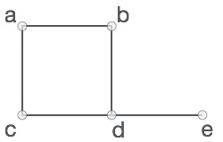
Graphs
In the above graph, VERTICES
V = {a, b, c, d, e} VERTICES
E = {ab, ac, bd, cd, de} EDGES

Slide 4
Basics of Graph
A graph is a set of vertices(nodes) and edges.
The node that holds data is called vertex and the line connecting two vertices is called edge.
1 1 2
1
2
An Edge
3
5
4
A vertex
A graph

Slide 5
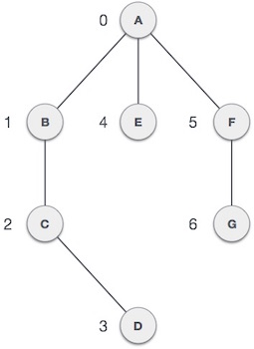
graphs
ADJACENCY − Two node or vertices are adjacent if they are connected to each other through an edge. In the following example, B is adjacent to A, C is adjacent to B, and so on.

Slide 6
Basics of Graph
If G denotes a graph, G = (V, E) where V denotes set of vertices and E denotes set of edges.
V= (v₁, v₂, v₃,…,v_{n}) and E = (e₁, e₂, e₃, …, e_{n}),
where e_{i} = (v_{i}, v_{i+1})

Slide 7
Types of Graph
Directed Graph:
  If each edge of a graph is directed (with direction), the graph is called directed graph.
Undirected Graph:
  If each edge of a graph is undirected (without direction), the graph is called undirected graph.
  The undirected edge is also called unordered edge.
Weighted Graph:
  If the value (cost) of each edge is given, the graph is called weighted graph.

Slide 8

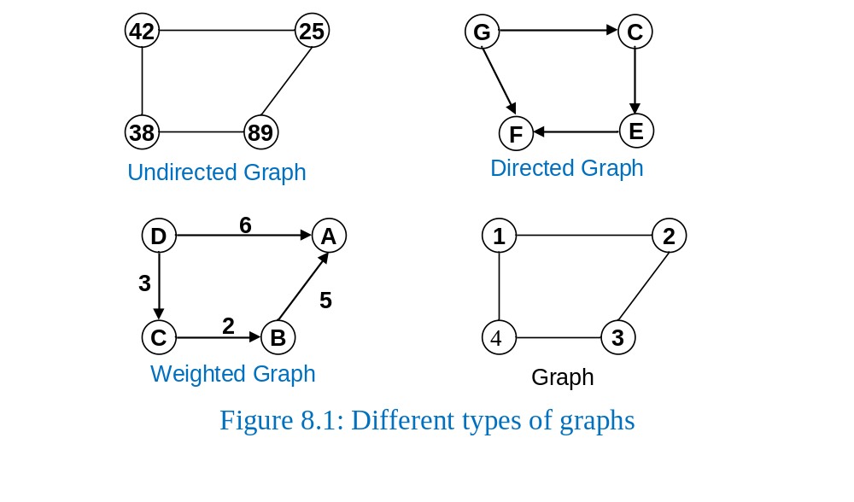
Basics of Graph [contd.]

Slide 9
Basics of Graph [contd.]
Path: A path is a sequence of vertices where each pair of successive vertices is connected by an edge.
Cycle: A cycle is a path where first and last vertices are the same.
A
B
D
1
2
8

Slide 10
Graph Representation
We can represent a graph using an array of vertices and a two-dimensional array of edges.
A graph is stored in the computer’s memory using the matrix (two dimensional array)called ADJACENCY MATRIX.
Two vertices are adjacent to each other if there is an edge between them.
If a vertex is adjacent to other, we put 1 in matrix on their cross point.
If there is no edge, we put 0 in the matrix.

Slide 11
Graph Representation [contd.]
a_{ij} = 1, if there is an edge between the vertices i and j. Otherwise, a_{ij} = 0, where A denotes adjacency matrix.
In case of weighted graphs, we put edge value the adjacency matrix.

Slide 12
Maintaining graph in memory
There are two standard ways of maintaining a graph G in the memory of a computer:
Sequential representation
Linked representation

Slide 13
Adjacency matrix representation
Adjacency matrix representation of G = (V, E)
  Assume vertices are numbered 1, 2, … ⎜V ⎜
  The representation consists of a matrix A _{⎜V ⎜x ⎜V ⎜}:
  a_{ij} = 1 if (i, j) ∈ E
  0 otherwise
1
2
3
4
5
1
0
1
0
0
1
For undirected graphs matrix A is symmetric:
a_{ij} = a_{ji}
A = A^{T}
1
2
3
2
1
0
1
1
1
5
4
3
0
1
0
1
0
4
0
1
1
0
1
Undirected graph
5
1
1
0
1
0

Slide 14
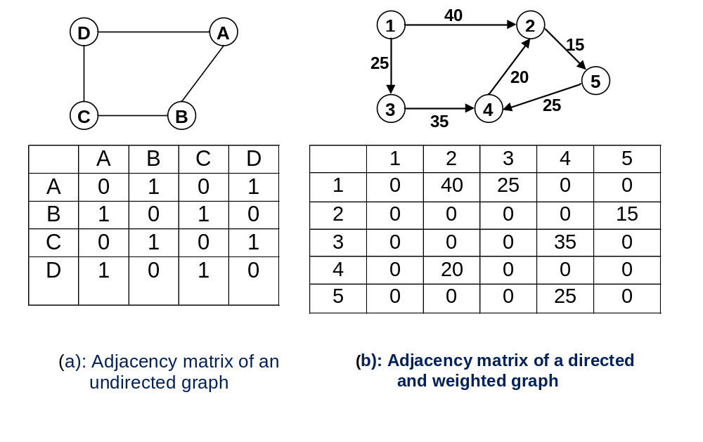
Graph Representation [contd.]

Slide 15
Linked Representation of Graph
An array of linked lists is used. Size of the array is equal to number of vertices. Let the array be array[].
An entry array[i] represents the linked list of vertices adjacent to the ith vertex. This representation can also be used to represent a weighted graph.
The weights of edges can be stored in nodes of linked lists.

Slide 16
Linked Representation of Graph
Adjacency list representation of G = (V, E)
  An array of ⎜V ⎜lists, one for each vertex in V
  Each list Adj[u] contains all the vertices v such that there is an edge between u and v
    Adj[u] contains the vertices adjacent to u (in arbitrary order)
  Can be used for both directed and undirected graphs
1
2
5 | /
1
2
2
1
5
3
4 | /
3
3
2
4
5
4
4
2
5
3 | /
5
4
1
2
Undirected graph

Slide 17
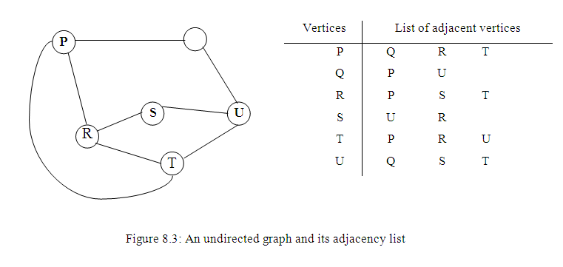
Graph Representation [contd.]

Slide 18
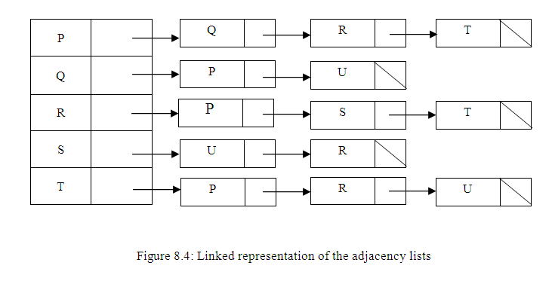
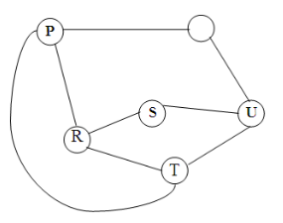
Graph Representation [contd.]

Slide 19
Linked Representation of Graph

Slide 20
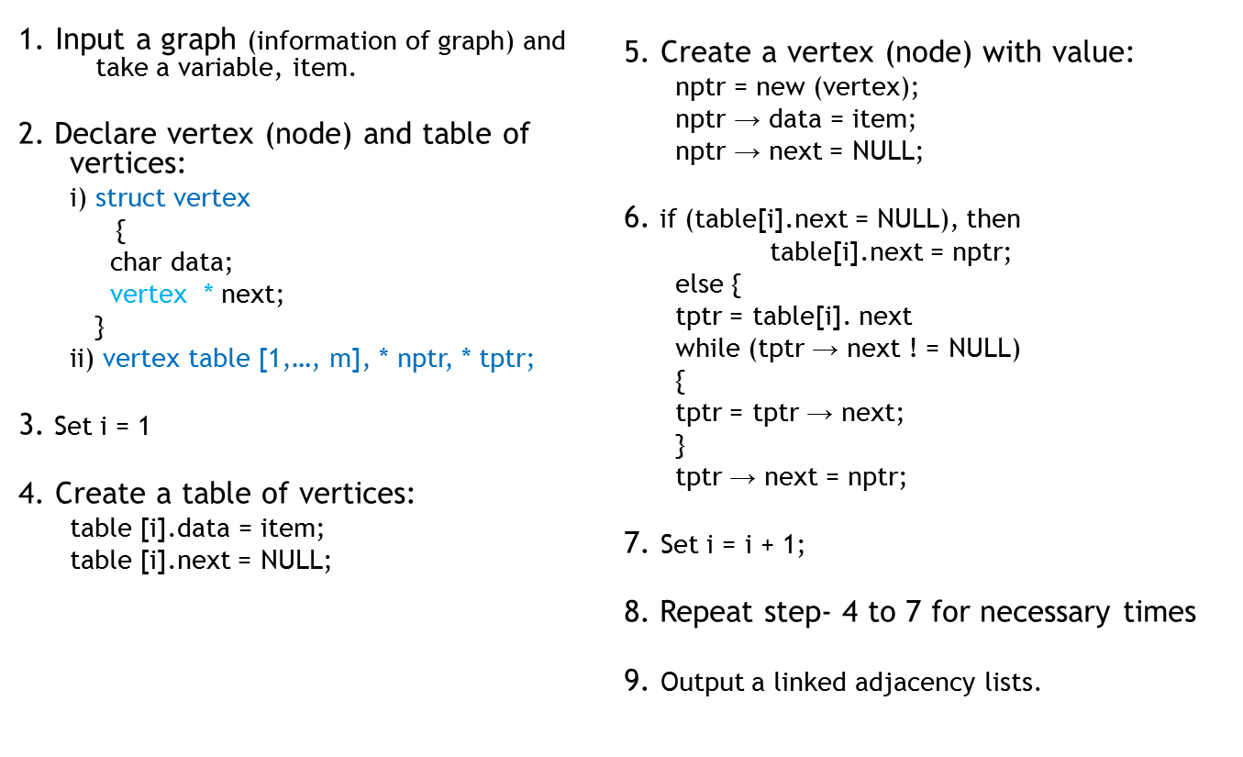
Algorithm to create adjacency list of a graph

Slide 21
Searching
Graph Traversal (Search) Methods

Slide 22
Graph Traversal Methods
There are two principal methods for graph traversal, which are as follows:
  Breadth First Search (BFS)
  Depth First Search (DFS)

Slide 23
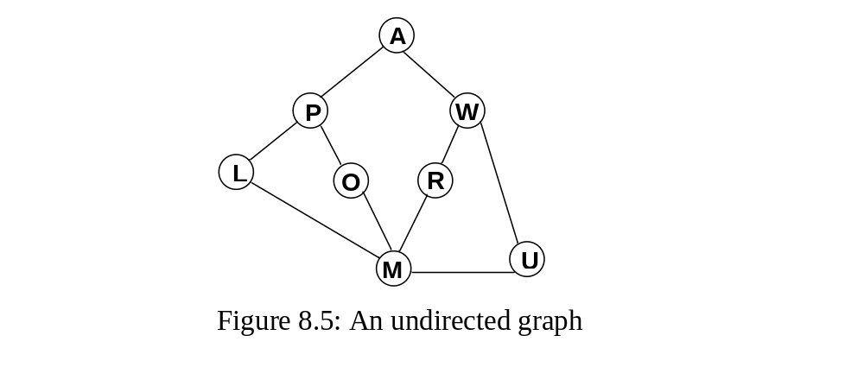
Graph Traversal Methods
Example:

Slide 24
Breadth First Search (BFS)
In breadth-first search, we visit a vertex first and search for the vertices that are adjacent to this vertex.
  Take the adjacent vertices in a queue.
The we visit (access) a vertex from queue and add the adjacent vertices of the vertex to queue.
We shall continue this process until (the queue is empty) we visit every vertex in the graph.
Remember a queue is FIFO stucture.

Slide 25
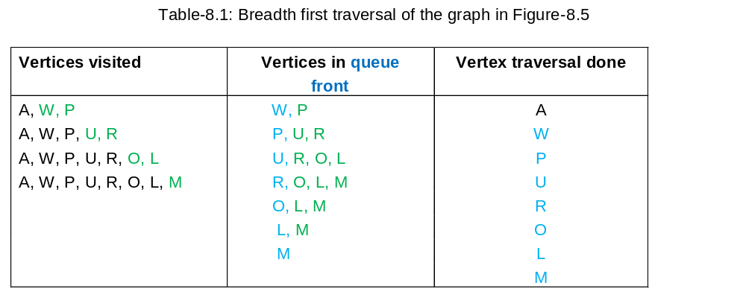
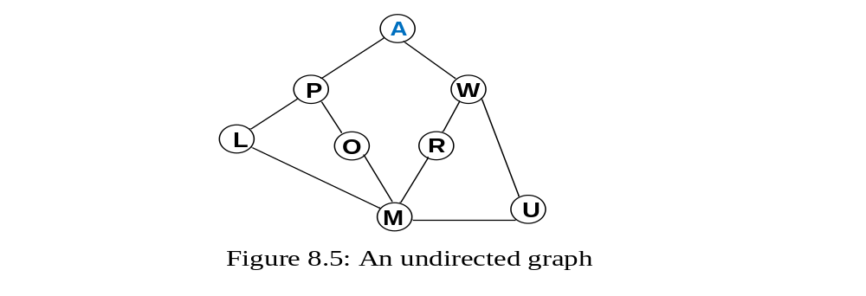
Breadth First Search (BFS) [contd.]

Slide 26
Algorithm for breadth first search
  1. Input a graph, G
  2. Create two empty lists L and T
  3. Create an empty queue Q
  4. For each vertex of G do
    i) Take a vertex v from G
    ii) Place the vertex v and its adjacent vertices in L
    iii) Add the adjacent vertices of the vertex v to Q
    iv) Place the vertex v in T
  5. Repeat the steps 6 to 7 until Q is not empty.
  6. Access a vertex w from Q
  7. For each adjacent vertex of w, do
    i) If it (adjacent vertex of w) is not in L, place it in L and add it to Q
    ii) Place vertex w in T
  8. Output the traversal list in T

Slide 27
Depth First Search (DFS)
In depth-first search, we visit a vertex and search for the vertices that are adjacent to the starting vertex. Add (push) the adjacent vertices to a stack.
Then pop a vertex from the stack and push the adjacent vertices of the vertex to the stack.
We shall continue the process until the stack is emply.
Remember a stack is LIFO structure.

Slide 28
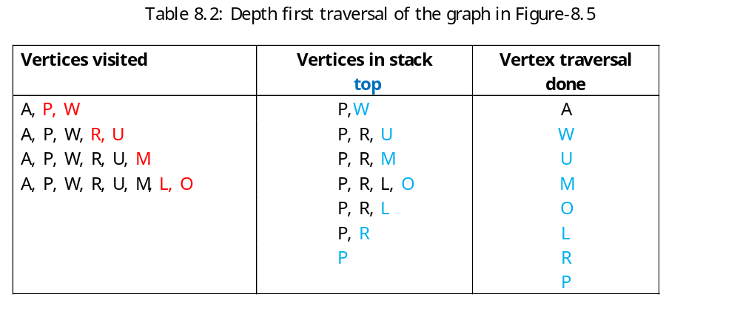
Depth First Search (DFS) [contd.]

Slide 29
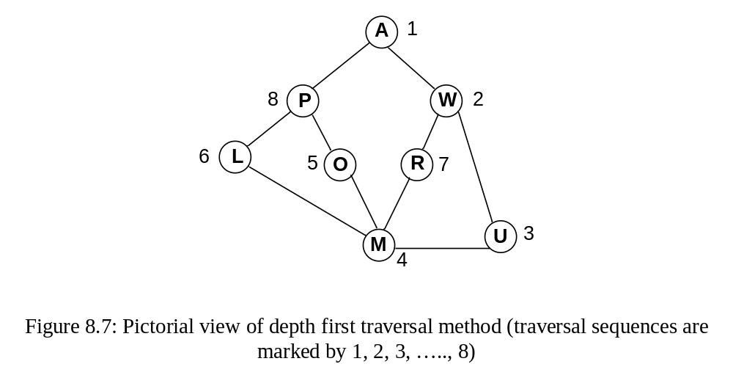
Depth First Search (DFS) [contd.]

Slide 30
Algorithm for depth first search
  1. Input a graph, G
  2. Create two empty lists L and T
  3. Create an empty stack S
  4. For each vertex of G do
    i) Take a vertex v from G
    ii) Place the vertex v and its adjacent vertices in L
    iii) Add the adjacent vertices of the vertex v to S
    iv) Place the vertex v in T
  5. Repeat the steps 6 to 7 until S is not empty.
  6. Access a vertex w from S
  7. For each adjacent vertex of w do
    i) If it (adjacent vertex of w) is not in L, place it in L and add it to S
    ii) Place vertex w in T
  8. Output the traversal list in T

Slide 31
Spanning tree
Of
a Graph

Slide 32
Minimum cost spanning tree
Spanning tree:
  A spanning tree is a sub-graph of a graph that contains all the vertices and has no cycle.
Minimum cost spanning tree:
  It is a spanning tree whose cost is minimum. That is, the total weight of the edges will be minimum.

Slide 33
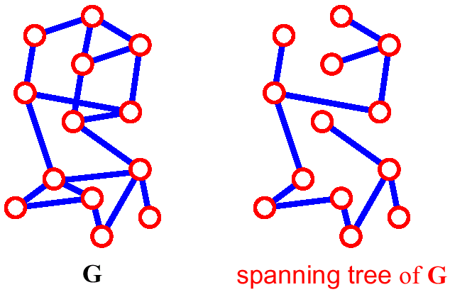
Spanning Tree
A spanning tree of G is a subgraph which
  is a tree
  contains all vertices of G
How many edges are there in a spanning tree, if there are V vertices?

Slide 34
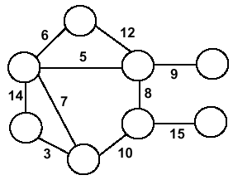
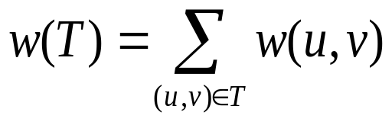
Minimum Spanning Trees
Undirected, connected graph
G = (V,E)
Weight function W: E → ℜ (assigning cost or length or other values to edges)
Spanning tree: tree that connects all vertices
Minimum spanning tree (MST): spanning tree T that minimizes

Slide 35
Algorithms
We can construct minimum cost spanning tree using:
1) Prim’s algorithm
2) Kruskal’s algorithm

Slide 36
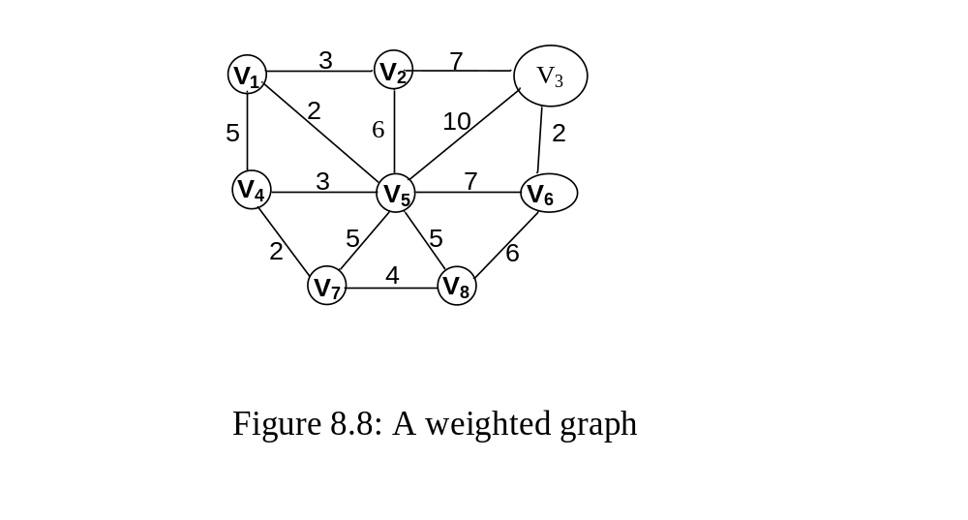
Example of Prim’s algorithm

Slide 37
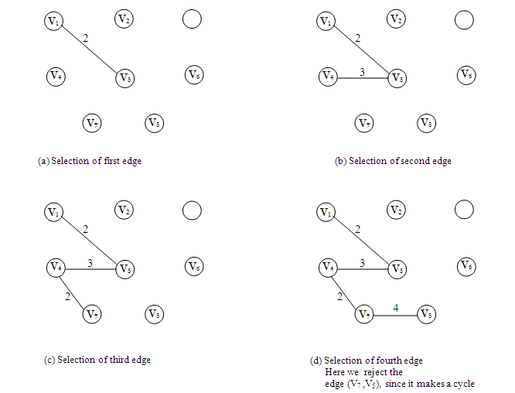
Prim’s algorithm [contd.]

Slide 38
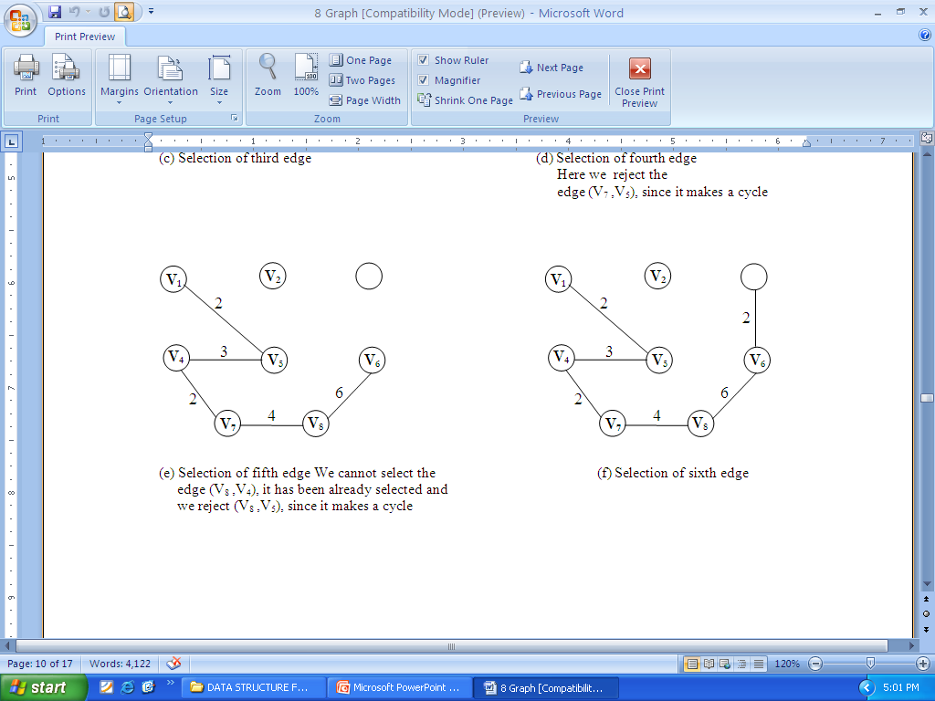
Prim’s algorithm [contd.]

Slide 39
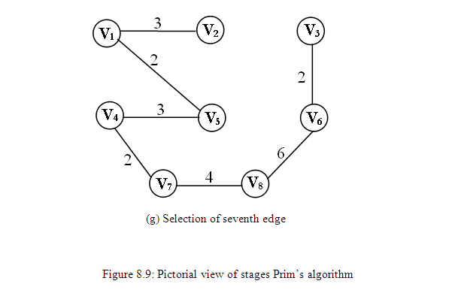
Prim’s algorithm [contd.]

Slide 40
Prim’s algorithm [contd.]
Algorithm 8.4: Prim’s Algorithm
Input a weighted connected graph, G = (V, E). V is the set of vertices and E is the set of Edges
Create an empty list E_{T}
Create a list V_{T} which will initially contain the starting vertex, i.e V_{T} = { v₀ }
for each vertex i of G do
  {
  find a minimum-weight edge e′ = (v′ , u′) among all edges (v, u)
  such that v is in V_{T} and u is in V - V_{T}.
  V_{T} = V_{T} U {u′};
  E_{T} = E_{T} U {e′};
  }
Output edge list of the spanning tree E_{T}.

Slide 41
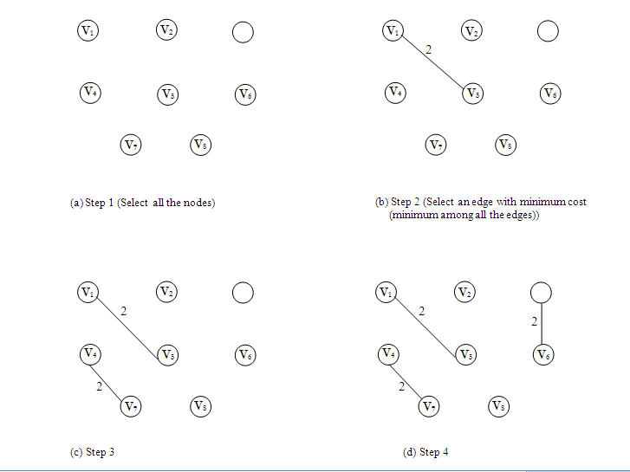
Example of Kruskal’s algorithm

Slide 42
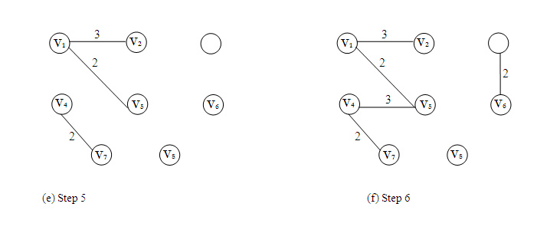
Kruskal’s algorithm [contd.]

Slide 43
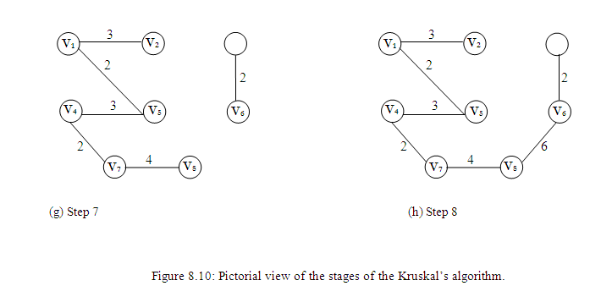
Kruskal’s algorithm [contd.]

Slide 44
Kruskal’s algorithm [contd.]
Algorithm 8.5: Kruskal’s Algorithm
Input a weighted connected graph, G = (V, E). V is the set of vertices and E is the set of Edges
Create an empty list E_{T}
Sort E in nondecreasing order of the edge weights w(e_{i1}) ≤ w(e_{i2}) ≤ … ≤ w(e_{iE})
Set ecounter = 0; k = 0;
while (ecounter < number of vertices - 1)
  {
  k = k + 1;
  if (E_{T} U { e_{ik} } is acyclic)
  E_{T} = E_{T} U { e_{ik} };
  ecounter = ecounter +1 ;
  }
Output edge list of the spanning tree E_{T}.

Slide 45
THANK YOU.

