Slide 1

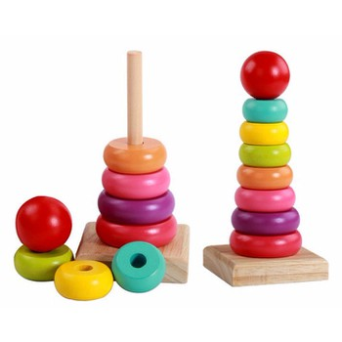
Data Structure
CHAPTER 6
STACK

Slide 2
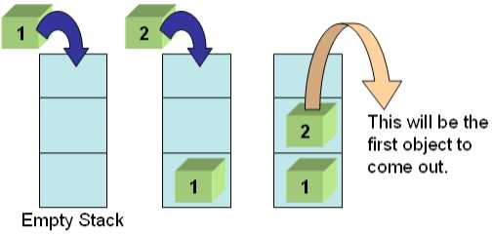
Stack in our environment
  In our daily life we see stack (pile) of plates in cafeteria or restaurant, stack of books in book-shop.
  Even a packet of papers is also a stack of paper-sheet. A book is also a stack of written papers.
  Operations:
  When anybody takes a plate from a stack of plates, he takes it from the top.
  On the other hand, the man who cleans the plates, he puts it on the top of the stack.

Slide 3
Definition of stack
  Stack is a linear list where any element is added at the top of the list and any element is deleted (accessed) from the top of the list.
  That means for stack an indicator or pointer must be used that indicates or points the top element of the stack.
  Add operation for a stack is called push operation and deletion operation is called pop operation.
  Stack is a LIFO (Last In First Out) structure.
  So, the element which was added last will be deleted or accessed first.

Slide 4
Operation on stack
Mainly the following three basic operations are performed in the stack:
Push: Adds an item in the stack. If the stack is full, then it is said to be an Overflow condition.
Pop: Removes an item from the stack. The items are popped in the reversed order in which they are pushed. If the stack is empty, then it is said to be an Underflow condition.
Peek or Top: Returns top element of stack.
isEmpty: Returns true if stack is empty, else false.

Slide 5
Operation on stack
The elements of a stack are added from bottom to top means push operation is performed from bottom to top.
The elements are deleted from top to bottom. That is pop operation is performed from top to bottom.
Stack can be implemented in two ways; Using
  Array
  Linked list

Slide 6
Graphical representation of Stack
.
8
7
6
5
1923
Top = 5
4
1452
3
2315
2
1245
1
1025
(a) An array based Stack
(bottom node)
40
48
59
59
63
top
(b) A link based stack

Slide 7
Array based stack
  The stack, which is implemented using array is called array based stack. To create an array based stack, at first we have to declare an array with required size.
Push Operation
  Add an element to a stack.
  Here, we shall use array based stack means an array will be treated as a stack.
  We need an indicator or index identifier to add element to the stack and this indicator will mark the top of the stack.
  To add an element we have to check whether the array is already full or not.
  If the array is already full, then we can not add any element, otherwise we can.

Slide 8
Push operation [Pictorial view]
Figure 5.2: Pictorial view of push operation
6
5
H
top
4
D
top
D
(top = 5)
3
Q
(top = 4)
Q
2
F
F
1
A
A
(a): Before push
(b): After push

Slide 9
Push operation [Cont..]
Here, top is an indicator which indicates the top element of the stack and item is an element to be added to the stack, M is the size of the stack (array).
Overflow occurs when we try to insert an element into the stack, which is already full.

Slide 10
Algorithm 5.1: Algorithm to add an element to a stack
  1. Input the stack and top:
  stack[1 . . . M], top;
  2. Add an item in the stack:
  a) if (top < M)
  {
  top = top +1;
  stack [top] = item;
  }
  b) else print “Over Flow”;
  3. Output will be the updated stack.

Slide 11
Pop Operation
  Delete (access) an element from a stack
  Here, top is an indicator which indicates the top element of the stack,
  M is the size of the array and
  x is a variable where we access top element of the stack.
    Figure 5.3: Pictorial view of pop operation
6
H
top
5
D
(top = 5)
4
D
top
Q
3
Q
(top = 4)
F
2
F
A
1
A
(a): Before pop
(b): After pop

Slide 12
Algorithm to delete an element from a stack
  1. Input the stack and top:
  stack[1 . . . M], top;
  2. Access the top element:
  a) if (top = = 0) print “stack is empty”;
  b) else {
  x = stack[top];
  top = top – 1;
  }
  3. Output updated list.

Slide 13
Linked stack [Liked list based stack]
The stack that is created or implemented using a linked list is called a linked stack or linked list based stack.
top
(bottom node)
40
48
59
59
63
A linked stack

Slide 14
Creation Process of a Linked stack
The major tasks to be performed:
Create an empty stack as linked list.
Create a node with data.
Include (Add) the node to the stack.
Repeat step 2 and 3 as require.

Slide 15
Linked Stack Creation Precess [Cont..]
For an empty stack, the pointer to the stack (suppose top) will points null.
Node creation process is same as the node creation of linked list.
Here node will be added before the top node (the node pointed by the top). Make necessary link for this.

Slide 16
Creation process of linked stack
top
top
Figure 5.5: Pictorial view of linked stack (creation process).
63
63
nptr
(a) A linked stack of single node
nptr
top
63
59
nptr
(b) A new node (nptr) and a stack of single node
63
top
2
1
59
nptr
(c) Addition of a new node

Slide 17
Algorithm to create a linked stack (pseudocode)
1. Declare a node:
struct node
{
int data;
node *next;
}
2. Declare necessary pointera:
node *top, *nptr;
3. Create a new node:
nptr = new(node);
nptr->data= item;
nptr->next = NULL;
4. Make link:
a) if (top == NULL)
top = nptr;
b) else
{
nptr -> next = top;
top = nptr;
5. Repeat Step 3 and Step 4 as required.
6. Output: a linked stack.

Slide 18
Push operation on lined stack
  Push operation in a linked stack can be performed simply by adding a new node to the stack, which is already discussed when we create a linked stack.

Slide 19
Push operation on liked stack [pictorial view]
top
2
48
59
59
63
1
40
nptr
(a) Push operation
top
40
48
59
59
63
(b) After Push operation

Slide 20
Deletion of node (Pop operation)
  Pop operation in the linked stack is very simple. Pop operation means to delete top node from the linked stack.
  As we know the top (pointer), points the top node of the stack, so to delete top node, we use a temporary pointer that will point the top node and advance the top (pointer)to the next node (using next pointer).

Slide 21
Deletion of a node [Cont…]
The Steps to delete a node from a linked stack:
Take a temporary pointer (temp).
Assign the value of top pointer to temporary pointer.
Move the top pointer forward.
Delete the node using temporary pointer.

Slide 22
Pop operation on liked stack
.
Figure 5.7: Deletion of an item from the stack (pictorial view)
top
1
40
48
59
59
63
tptr
2
Delete (tptr)
(a): Pop operation
top
48
59
59
63
(a): After pop operation

Slide 23
Algorithm to delete a node from a linked stack (pseudocode)
1. Input a linked stack.
2. Declare pointers:
node *top, *temp;
3. Use temporary pointer:
temp= top;
4. Move the top pointer forward:
a) if (top->next !=NULL)
{
top = top->next;
}
b) else top = NULL;
5. delete(temp);
6. Output: an updated linked stack.

Slide 24
Applications of Stack
Checking the validity of an arithmetic expression:
  Using stack we can check the validity of an arithmetic expression.
  In a valid expression the parenthesis, brace or bracket must occur in pairs.
    That is when there is an opening parenthesis; brace or bracket, there should be the corresponding closing parenthesis.
  Otherwise, the expression is not a valid one.

Slide 25
Arithmetic expressions
POLISH NOTATION (PREFIX) :
INFIX NOTATION
POSTFIX NOTATION

Slide 26
Arithmetic expressions: POLISH NOTATION (PREFIX)
Polish notation, also known as prefix notation, is a form of notation for logic, arithmetic, and algebra.
Its distinguishing feature is that it places operators to the left of their operands.
Lacking parentheses or other brackets.
Syntax : operator operand1 operand2
Example : -*+ABC/D+EF
For example, +ab. This is equivalent to its infix notation a + b

Slide 27
Arithmetic expressions: INFIX NOTATION
Infix notation is the conventional notation for arithmetic expressions. It is called infix notation because
  each operator is placed between its operands,
operands (as in the case with binary operators such as addition, subtraction, multiplication, division,……).
When parsing expressions written in infix notation, you need parentheses and precedence rules to remove ambiguity.
Syntax: operand1 operator operand2
Example: (A+B)*C-D/(E+F)

Slide 28
Arithmetic expressions: Postfix notation
In postfix notation, the operator comes after its operands.
Postfix notation is also known as Reverse Polish
Reverse Polish notation (RPN) and is commonly used because it enables easy evaluation of expressions.
Syntax : operand1 operand2 operator
Example : AB+C*DEF+/-
ab+. This is equivalent to its infix notation a + b.

Slide 29
Q an arithmetic expression involving constants and operations
The binary operation in Q may have different levels of precedence :
Highest : Exponentiation(↑)
Next highest : Multiplication(*) and division(/)
Lowest : Addition (+) and subtraction (-)
Ex :
2 ↑ 3 + 5 *2 ↑ 2 – 12 / 6
Evaluating the Exponentiations :
8 + 5 * 4 -12 / 6
Evaluating the Multiplication and division
8 + 20 -2
Evaluating the Addition and subtraction
26

Slide 30
Polish notation
Infix expressions into polish notation :
(A+B)*C = [+AB]*C = *+ABC
A+(B*C) = A +[*BC] = +A*BC
(A+B)/(C-D) =[+AB]/[-CD] = /+AB-CD
Fundamental property of polish notation is that the order in which the operation are to be performed is completely determined by the positions of the operators and operands in the expression.

Slide 31
Checking of validity of an arithmetic expression using stack
  Whenever an opening parenthesis is encountered, it is pushed on to the stack.
  Whenever a closing parenthesis is encountered, the stack is examined.
    If the stack is empty, the closing parenthesis does not have an opening parenthesis and the expression is therefore invalid.
    If the STACK is not empty, we POP the stack and check whether the popped item corresponds to the closing parenthesis.
    If a match occurs, we continue. Otherwise the expression is invalid.
  When the end of the expression is reached, the stack must be empty; otherwise one or more opening parenthesis does not have corresponding closing parenthesis and the expression is invalid.

Slide 32
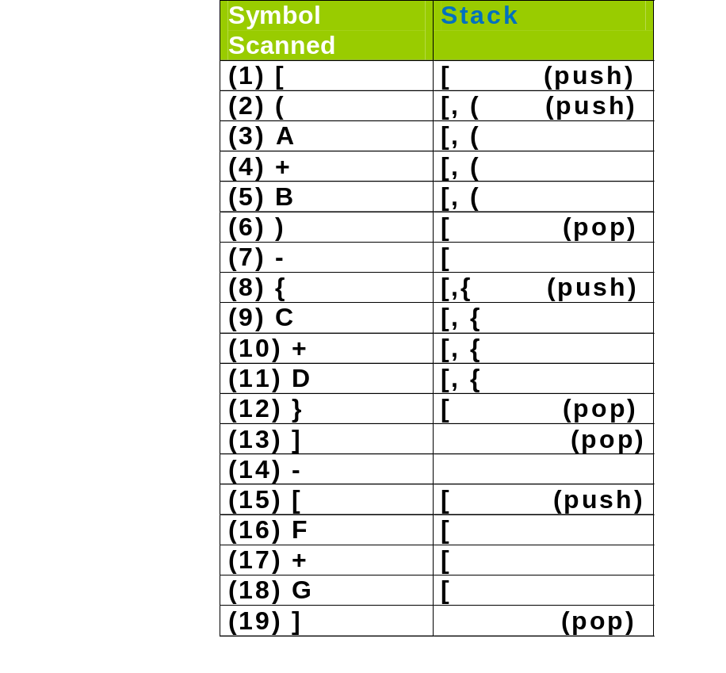
Validity of an arithmetic expression
Exp:
  [(A + B) – {C + D}] – [F + G]
  In the above example we see the stack is empty at the end, so the expression is valid.

Slide 33
Conversion of an infix expression to postfix
Using stack we can perform infix to postfix conversion.
  An arithmetic expression can be represented in various forms such as prefix, infix or postfix.
  The prefixes “pre-”, “in-”, and “post-” refer to the relative position of the operator with respect to its operands.
  1. If the operator is placed before its two operands then the expression is in prefix form.
  2. if the operator is placed in the middle it is known as infix.
  3. if it is placed after the two operands it is known as postfix form.

Slide 34
Infix to postfix conversion
  Let us consider a simple example with an
  operator “+” and two operands “A” and “B”.
1. Prefix: + A B (operator before its operands)
2. Infix: A + B (operator in the middle of its
operands).
3. Postfix: A B + (operator after its operands)

Slide 35
Precedence Rules of operators
1. Highest:
  Exponential (^ or ↑)
  Multiplication (* or ×)
  Division (/ or ÷)
2. Lowest:
  Addition (+) or
  Subtraction (-)
Moreover if parenthesis is present in the expression then we have to consider the operations within the parenthesis first.
  Precedence rules of operators are applied within the parenthesis.
Operators with the same precedence (*, / or +, -) are evaluated according to their order of occurrence in the expression.

Slide 36
Precedence Rules of operators [Cont..]
  This precedence of operators and parenthesis are
  important to convert an arithmetic expression to
  various forms (prefix, infix or postfix).
  Let us consider the following expression:
    5 + (10 * 2 +5)*8 / 2.
The operations will be performed as follows:
10*2 = 20, (Here parenthesis is considered first.)
20 + 5 = 25,
25*8 = 200,
200 / 2 = 100,
5 + 100 = 105.

Slide 37
Evaluation of an expression
To Evaluate an Arithmetic Expression:
1) Convert the expression from infix to postfix form.
2) Evaluate the postfix expression.
In both the cases we will use stack.

Slide 38
Infix to postfix conversion
Let us consider the following expression:
Expression: 5 * (6 + 2) - (12/4)

Slide 39
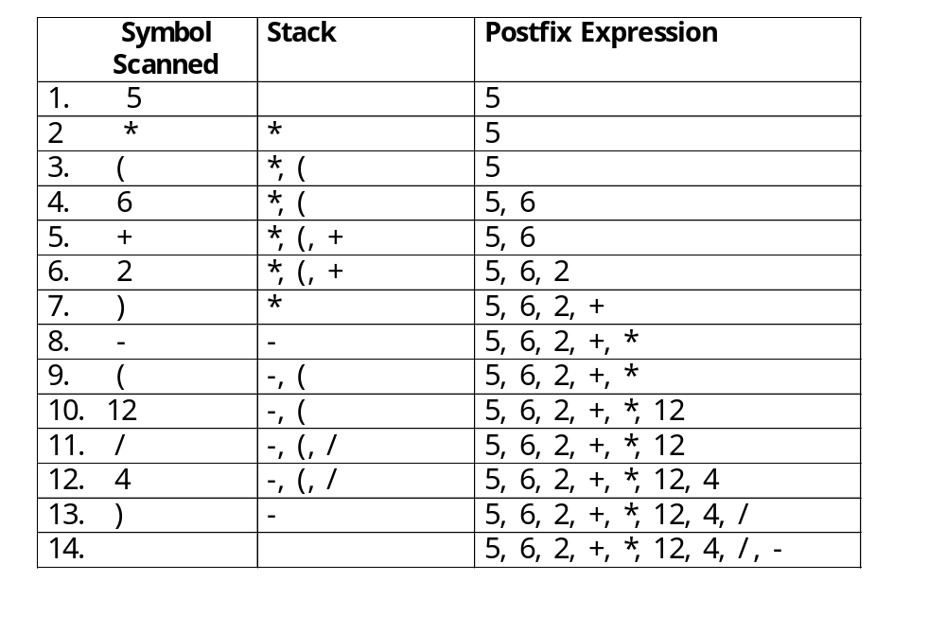
Infix to postfix conversion:
5 * (6 + 2) – (12 / 4)
.

Slide 40
Evaluation of a Postfix Expression
  We can evaluate a postfix expression using stack. Let us consider the postfix expression we obtain in the previous section.
    5, 6, 2, +, *, 12, 4, /, -
To evaluate the expression we scan the expression from left to right. The steps involved in evaluating a postfix expression are:
  If an operand is encountered, push it on STACK
  If an operator ‘op’ is encountered
    Pop two elements of STACK, where A is the top element and B is the next top element.
    Evaluate B op A.
    Push the result on STACK.
The evaluated value is equal to the value at the top of STACK.

Slide 41
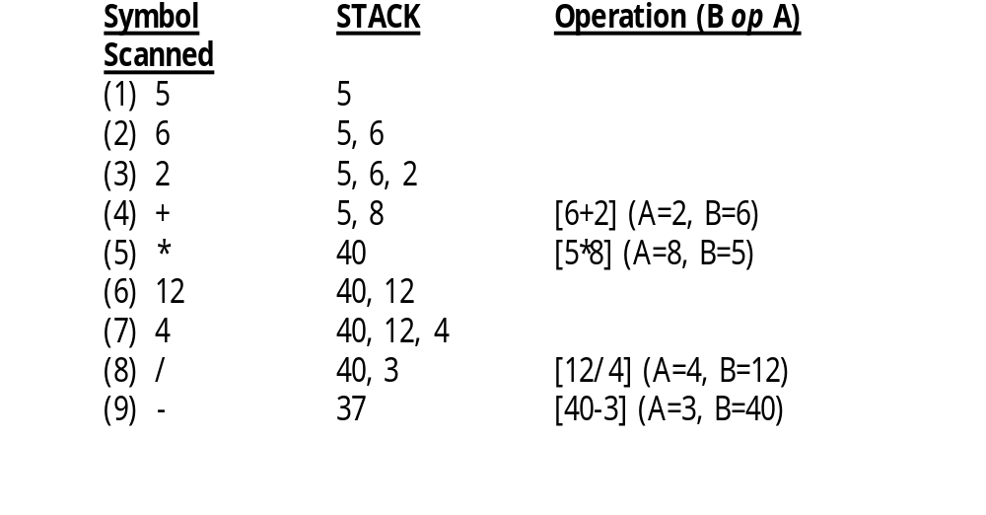
Evaluation of postfix expression
.

Slide 42
This is the end
Of
Stack.

