Slide 1
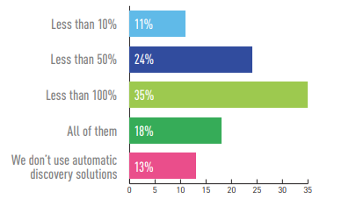
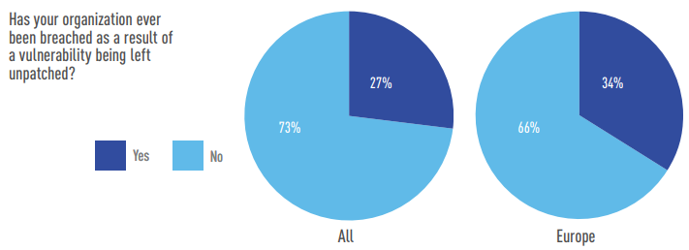
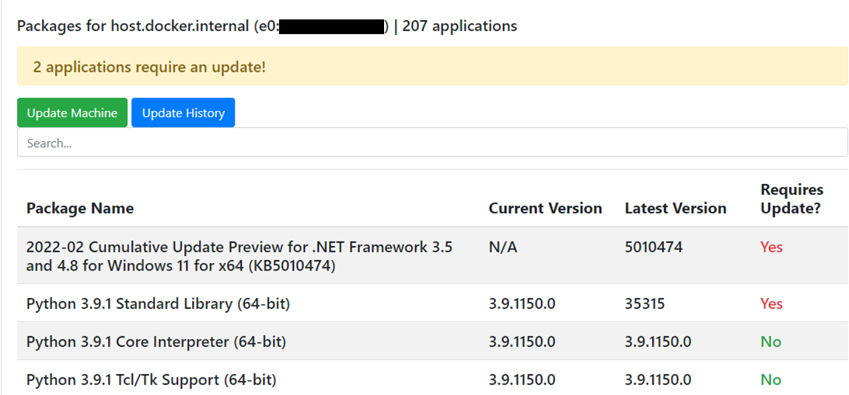

Robert Wilson
Robert.Wilson-7@students.plymouth.ac.uk
Supervisor: Professor Nathan Clarke
BSc (Hons) Computer & Information Security 2018
Problem
What percentage of hardware and software assets are automatically discovered?
Solution
Keeping all your Windows and Linux devices up to date nowadays is a chore, especially if you’re not so tech-savvy. Many security breaches are caused by unpatched software and the majority of the software for patch management systems is aimed at commercial consumers as opposed to domestic. Organisations use patching policies but at home it is chaotic with no control.
LANMan is a lightweight application bundle which consists of two main components; a website and an agent. It’s so lightweight, it can run on a Raspberry Pi. The website is powered by Python and Flask, using Bootstrap 4 to provide a beautiful user interface.
The agent is also powered by Python and has the ability to run on both Windows and Linux systems. For Windows, it utilises PowerShell to interact with the Windows update service. For Linux, it utilises the package repository manager directly to query for updates.
Source: Tripwire Dimensional Research VM Survey 2019
Project Vision
Percentage of breaches due to unpatched vulnerabilities in organisations
Need help with patching at home? This is where LANMan (Local Area Network Manager) comes in. The vision of this project is to help the not-so-technical keep their home systems up to date in the simplest way possible. By providing a familiar and minimalistic user interface, the user can view installed software packages and update them across Windows and Linux devices; this makes updating an easy experience. Protecting your home devices from cyber threats is just as important as a company protecting theirs.
Source: Tripwire Dimensional Research VM Survey 2019
Future Work
Mobile support for the web interface is partially developed but will not be complete by final submission.
This project could be adapted to be integrated into the cloud to provide a managed patch automation service.

