Slide 1

Sentiment Analysis
Dynamic Tigers
Gonzalez Guerra Rebeca Sarai
Kooshkjalali Navid
Bodonyi Dániel
Supervisor: Nagy Attila

Slide 2

Our Task
Sentiment analysis – three type- negative, neutral , positive
Decide if a product review neutral ,positive or negative
So the sentiment

Slide 3
Dataset
Amazon Reviews ---- English----
A few million Amazon reviews in fastText format
From here: https://www.kaggle.com/bittlingmayer/amazonreviews
Trainset (~ 500MB)
Testset: 400 000 reviews. (50MB) only used 200 000

Slide 4
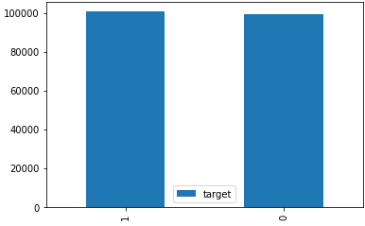
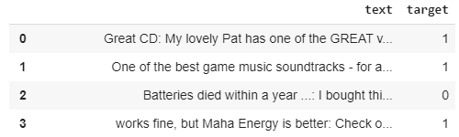
Pre-preprocess and exploring the data
Decode utf-8 string from bytes
Creating target variable
__label__1 >> 0 >> negative
__label__2 >> 1 >> positive

Slide 5




Balancing and exploring the dataset
Unbalanced little difference
Rebalancing
The balanced df shape No NaN

Slide 6
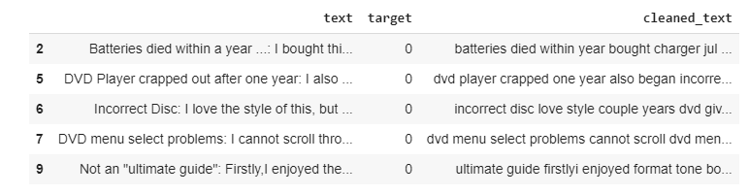
Preprocessing the review text
Removes all digits
Removes all non word chars
Eliminate stop word

Slide 7
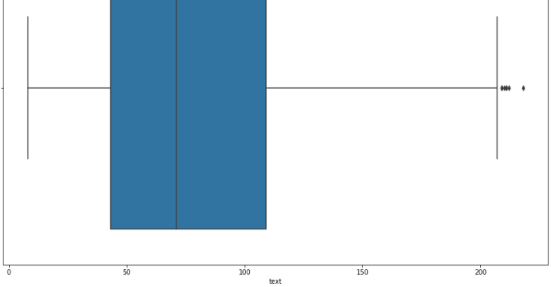
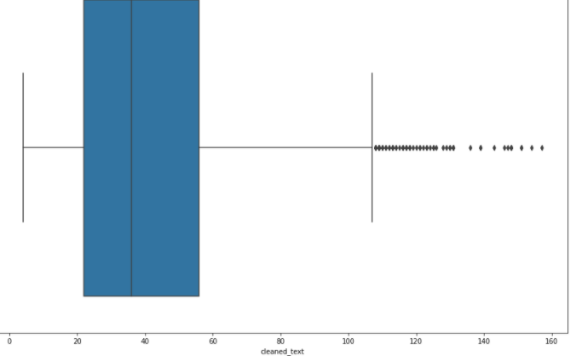
How review text size distribution changes after preprocessing?
Most of the reviews were between 40 and 120 words
Our review text size distribution changed

Slide 8
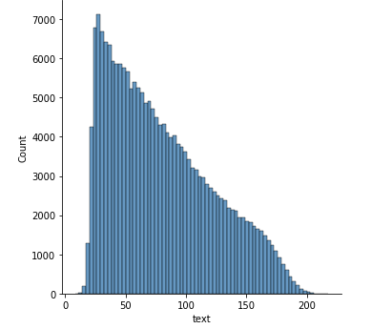
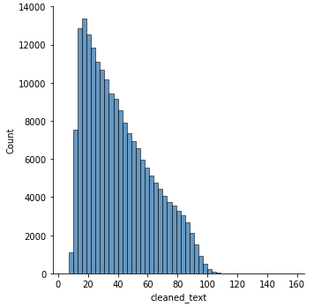

Slide 9

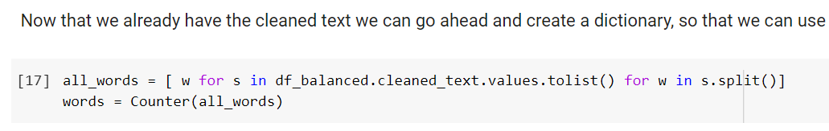
Creating vocab and splitting
With „from collections import Counter”
Vocab is sorted based on the most common words
Added '_PAD', '_UNK’ tokens to the vocab
Splitting: X_train,y_train, X_test, y_test

Slide 10
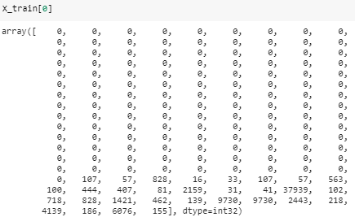

Padding
Firstly with custom post padding but caused some problems
Pre padding with „from keras.preprocessing.sequence import pad_sequences”
MAX length >> 157 (longest seq in train)
TensorDataset creating

Slide 11
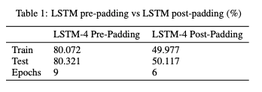
Why is pre-padding better for us?
In RNN's and our LSTM model, we take the final output or hidden state and use this to make the sentiment prediction.
If we send many 0's to the RNN before taking the final output (i.e. 'post' padding),
Then the hidden state of the network at the final word in the sentence would likely get 'flushed out' to some extent by all the zero inputs that come after this word.
That’s why pre-padding is more effective and has impact on performance of the model.

Slide 12
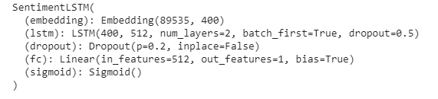

The model
LSTM
2 Layers
Embedding dim = 400
Features in hidden state = 512
Dropout layer 20%
Sigmoid activation
Saving the model

Slide 13
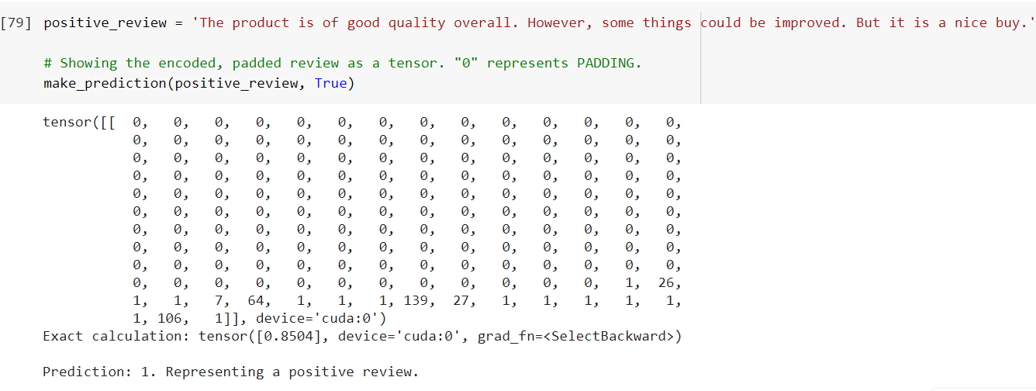
Testing multiple reviews

Slide 14
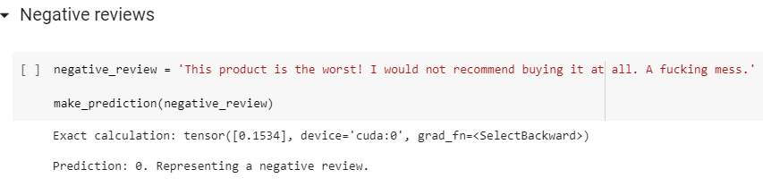
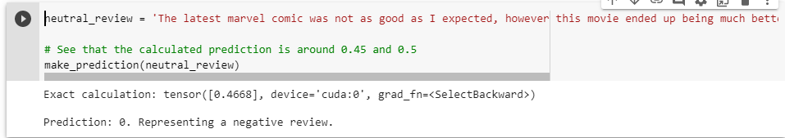

Slide 15
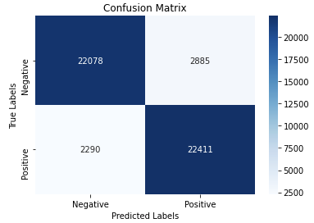
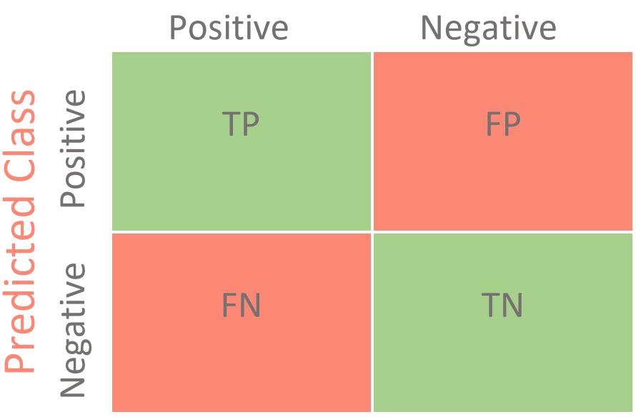
Confusion matrix
Lot of TP
Lot of TN
Small FN ,FP
Confusion Matrix

Slide 16
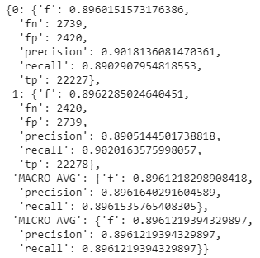
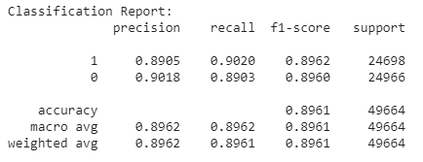
Classification report
Also used a custom function from our lab 10
Scikit-learn

Slide 17
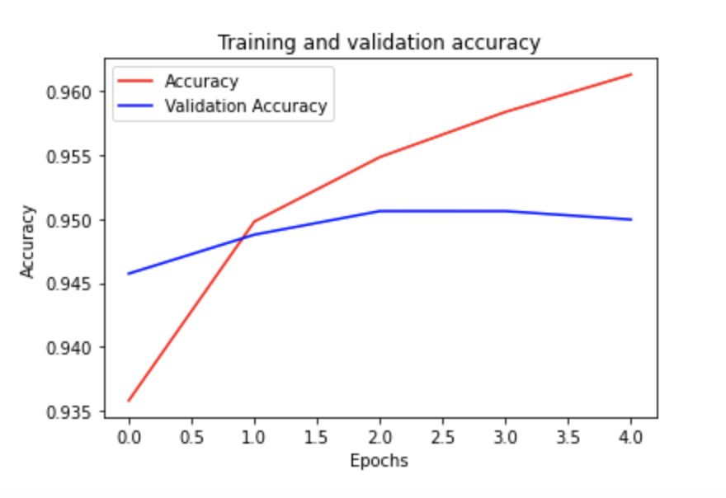
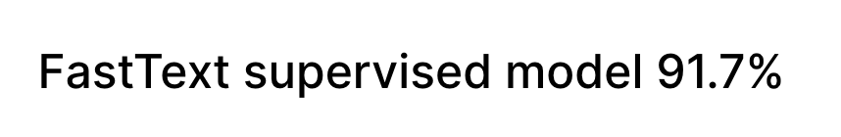
Comparison
Test loss: 0.159
Test accuracy: 93.900%
LSTM /GRU
Accuracy: 0.90292
F1_Score: 0.90328
Confusion Matrix:
[[32371 3629]
[ 3361 32639]]
DistilBert
fully-connected-and-bidirectional-LSTM

Slide 18
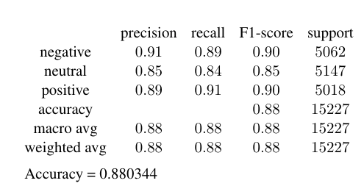
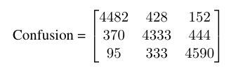
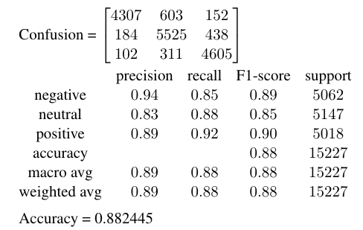
Extra: trying a Machine Learning model
Our first tries,unfortunately they weren’t in Pytorch or deep model,but we kept them as an extra.
1. Random Forest Classifier
2. Naive Bayes
(3. LSTM TensorFlow model - deleted ☹ )

Slide 19
Thank you for your attention! -Dynamic Tigers-
Gonzalez Guerra Rebeca Sarai
Kooshkjalali Navid
Bodonyi Dániel

