Slide 1
Time | Day 1 | Day 2 | Day 3
9:00 - 10:00 | Virtual arrivals / Coffee | The pavlovia environment and gitlab | Coding an experiment from scratch (what’s “under the hood” or PsychoPy)
10:00 - 11:00 | Introductions Builder refresher | Launching your study online
11:00 - 12:00 | Counterbalancing |  | Parallel Session intro
12:00 – 13:00 | LUNCH | LUNCH | LUNCH
13:00 – 14:00 | Extending builder with code | Counterbalancing online | Advanced Builder concepts | Pure Python From strings to classes
14:00 – 15:00 | Clocks and Trial counters | Debugging online: common errors and how to fix them |  | General purpose programming
15:00 – 16:00 | Adding feedback | Advanced Online
16:00 – 17:00 | Making the most of mouse inputs |  | Goodbyes

Slide 2
Hour 1 | Hour 2 | Hour 3
Building an experiment in PsychoPy | Launching your study online Counterbalancing | Making things dynamic

Slide 3
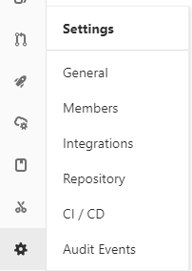

Slide 4
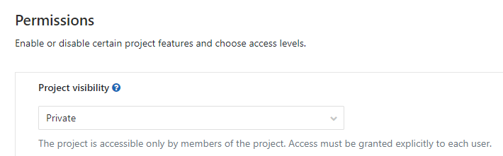

Slide 5
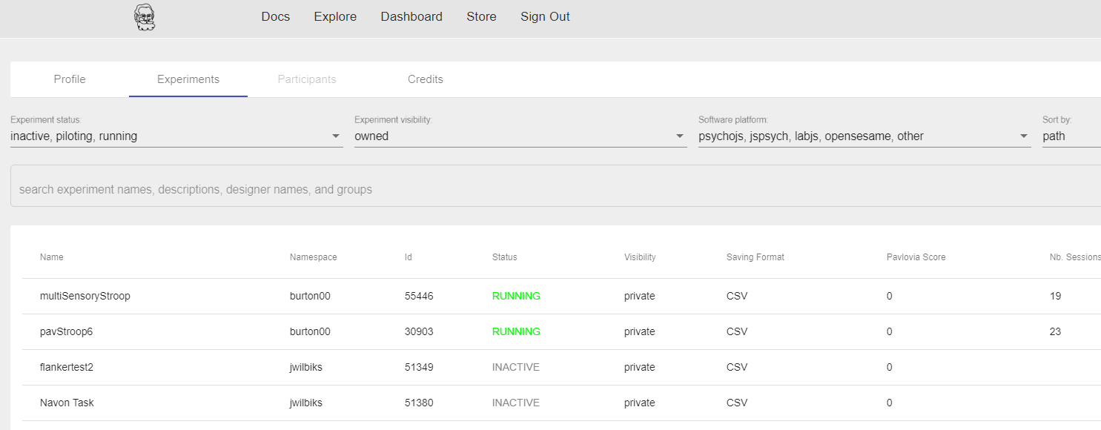

Slide 6
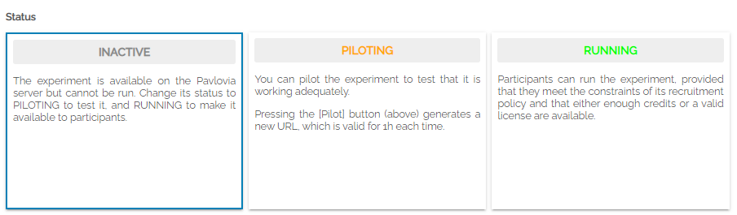
Useful for sharing your task (if public) whilst not allowing users to add data to your own repository.
Generates a pilot token
Lasts 1 hour
No credits used
No data saved to repository
Local data file downloaded
Generates sharable URL
Credit/license needed
Data saved to repository

Slide 7
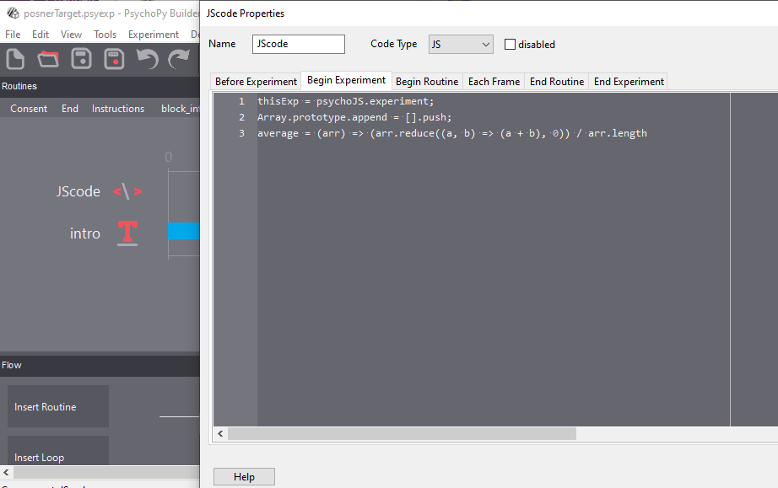

Slide 8
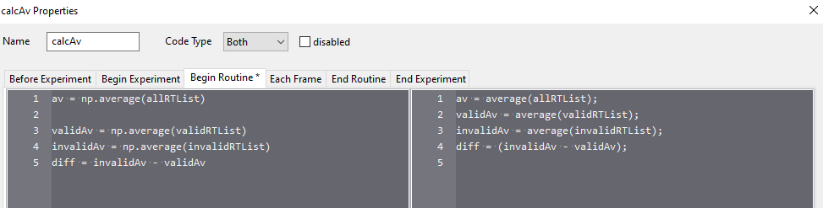

Slide 9



PsychoPy
Local set up
Experiment creation
PsychoJS
PsychoPy
Writes us a JavaScript version
(we can write from pure JS if you want)

Slide 10
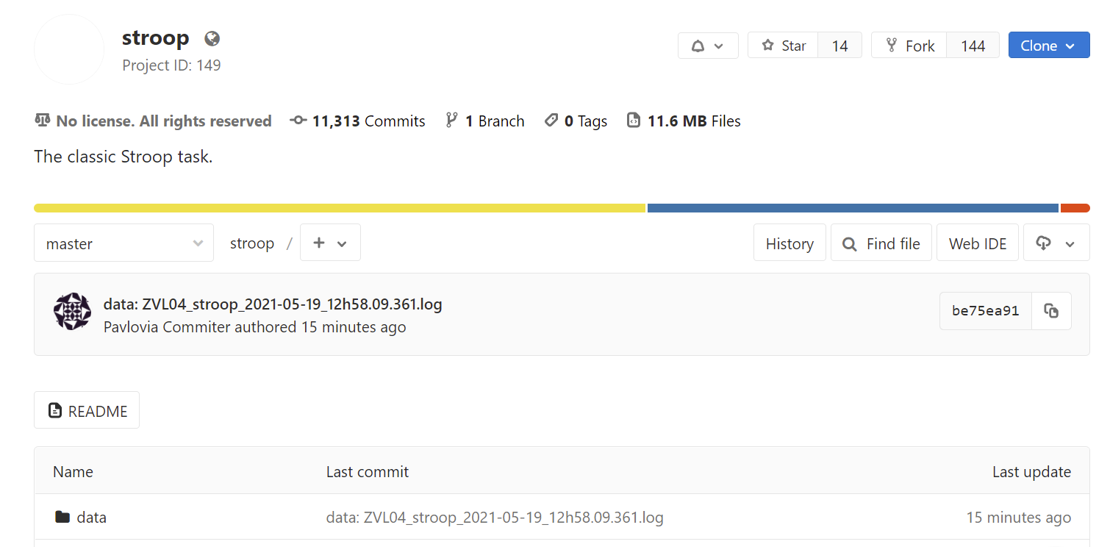

Slide 11
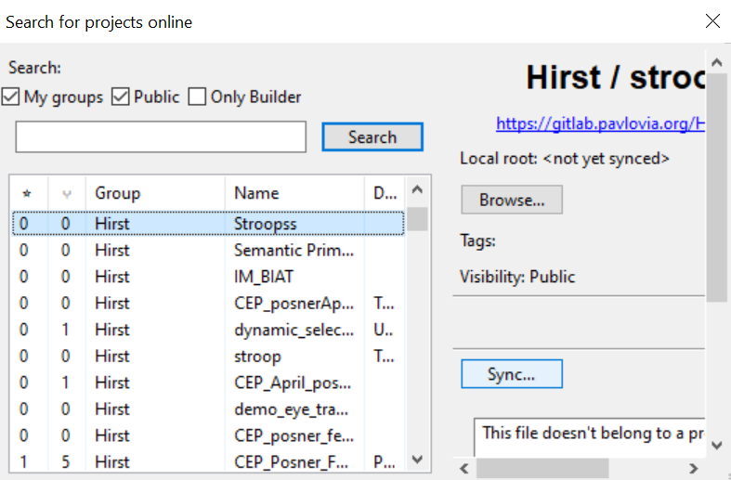

Slide 12
