Slide 1



PsychoPy
Local set up
Experiment creation
PsychoJS

Slide 2
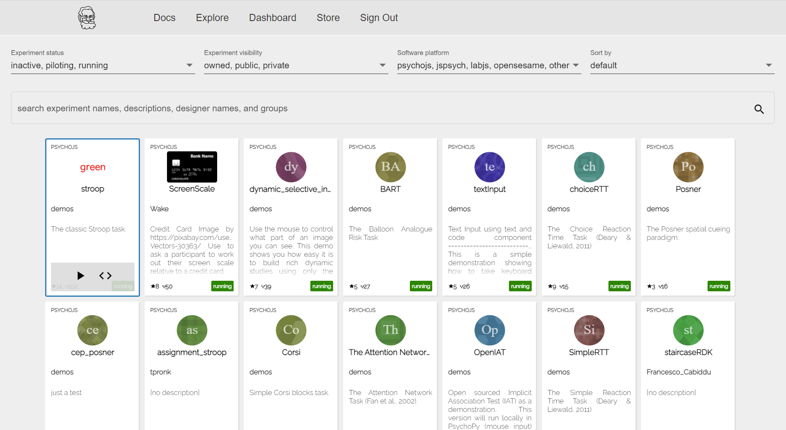
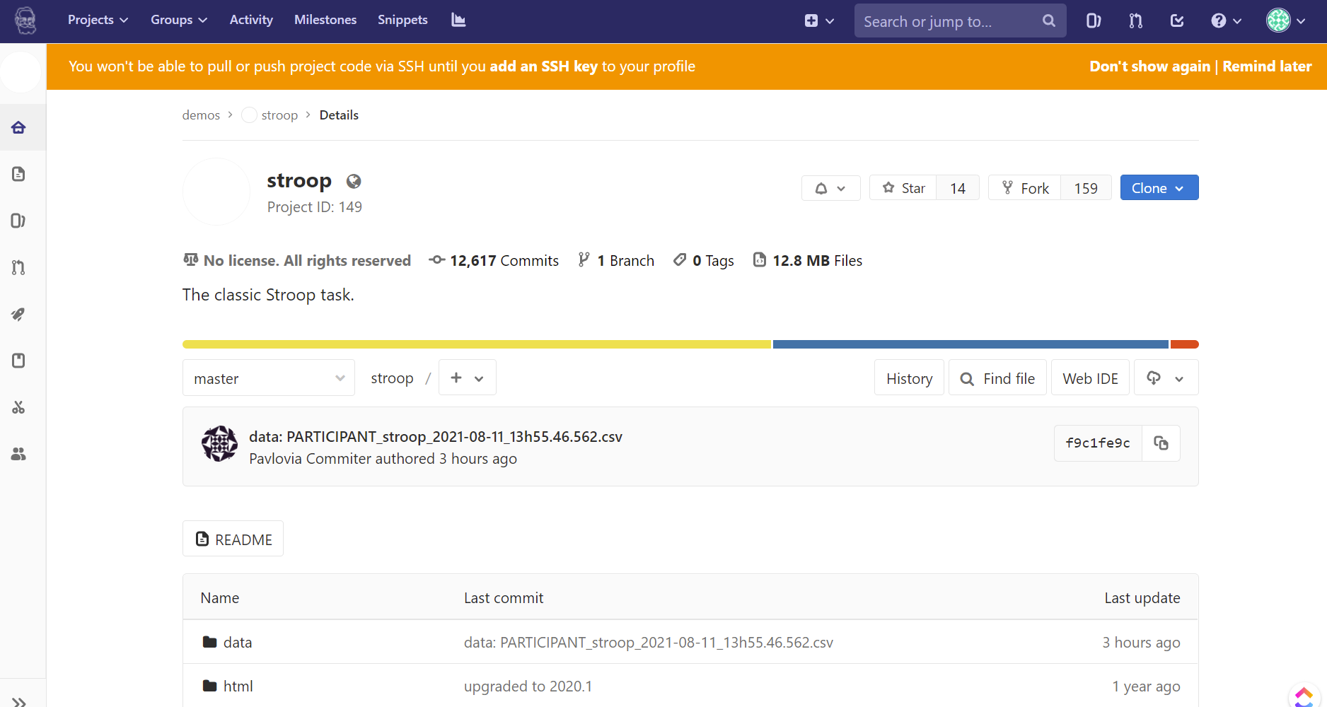
1
2

Slide 3
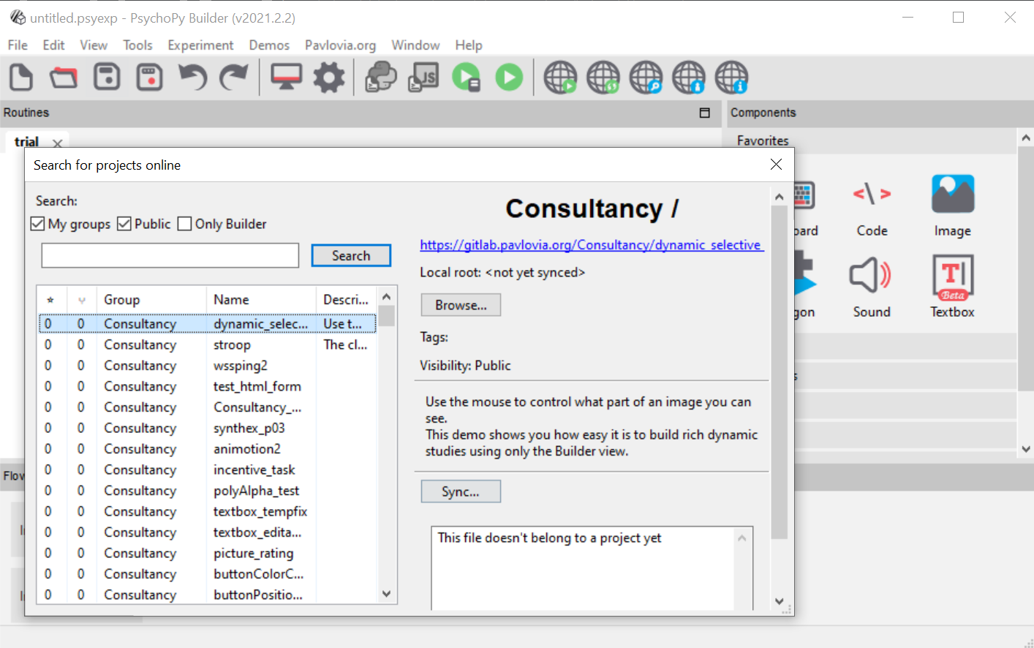
1
2
3

Slide 5
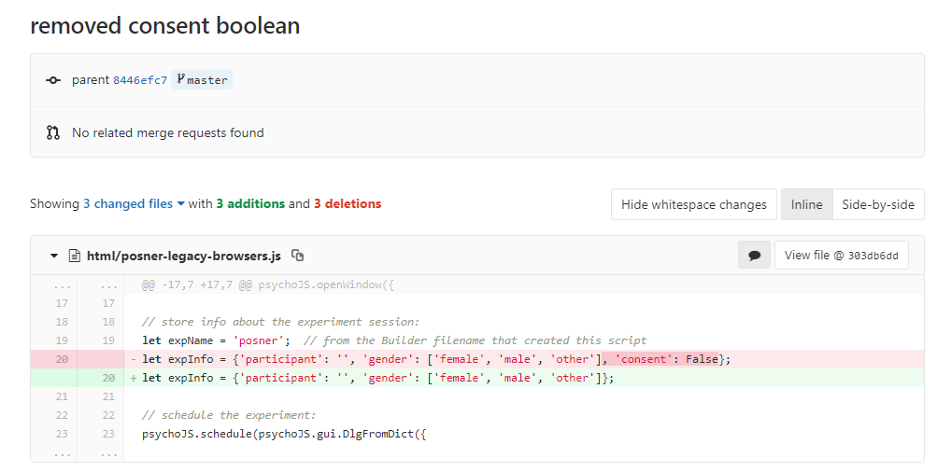


Slide 6
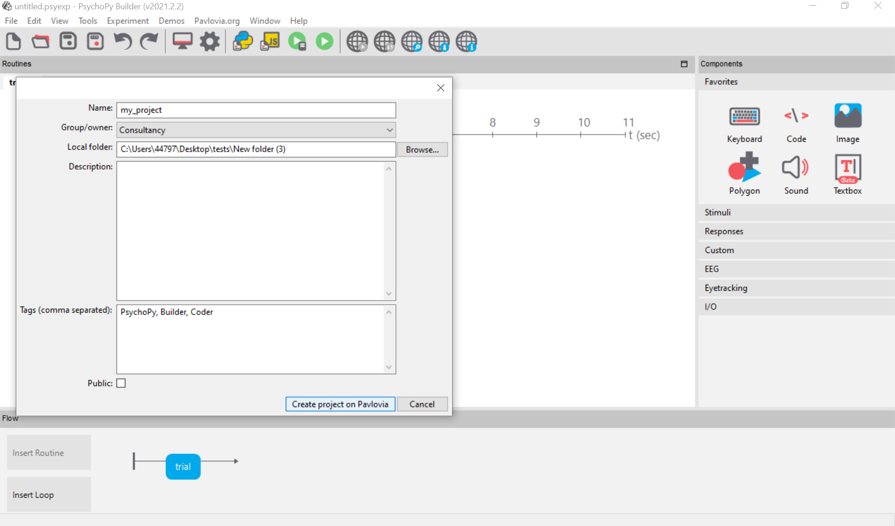
1
2
3

Slide 7
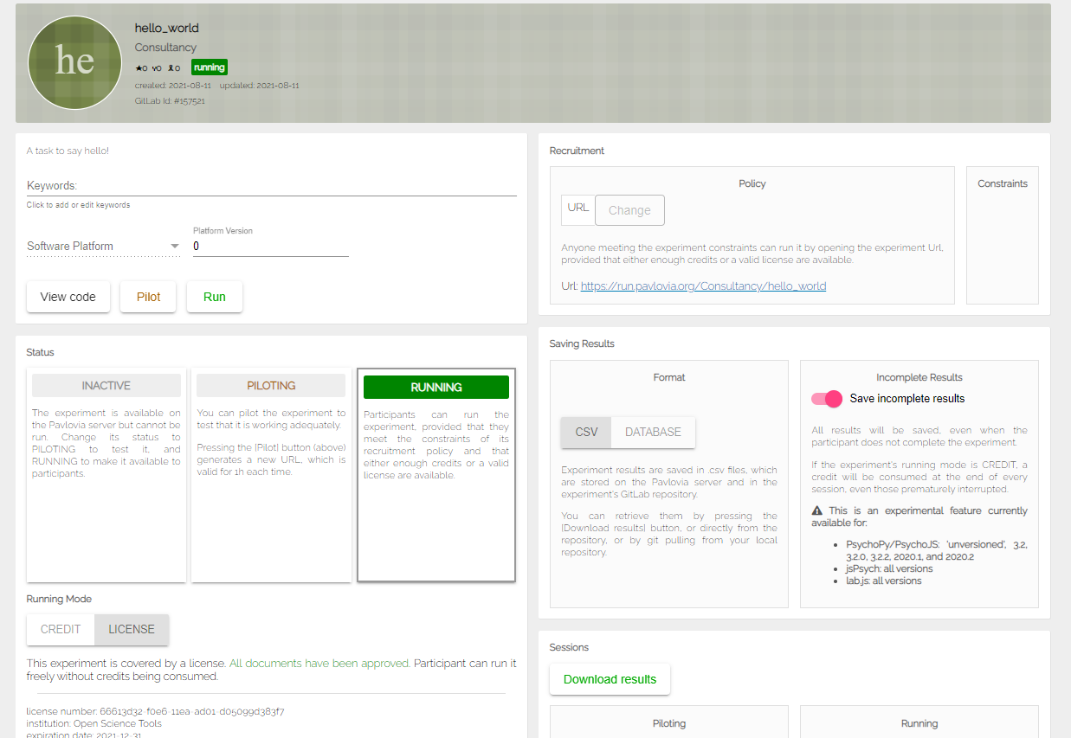
4
2
Pilot and run your study
Share your URL with participants
3
Set your data to save how you need
1
Change the status of your experiment
5
Download your data!

Slide 8
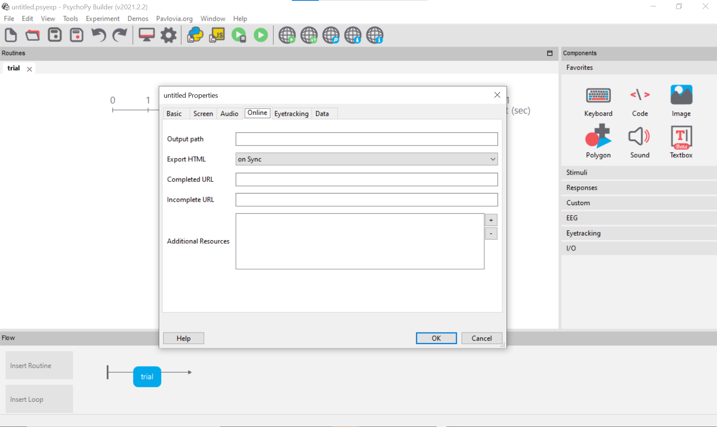
1
2
Do you want your compiled javascript to be send to a different folder? [recommend leaving blank]
3
When do you want the javascript file to be written? (and re-written)
4
Where to send the participant after the study. (e.g. daisychain with Qualtrics)
5
Resources needed by the experiment (e.g. image files, csv files).

