Slide 1





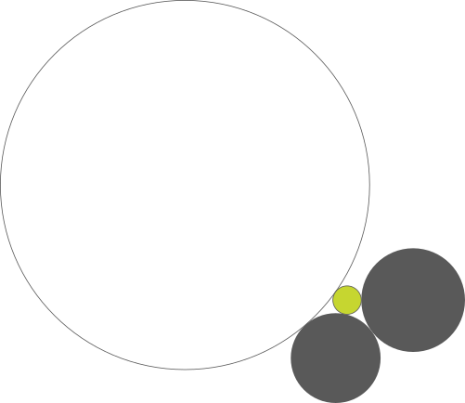




Slide 2
Not a No-Kill, but
No-Kill Minimum
Better
90%
According to community standards, no-kill shelters save 90% of animals though their programs and services.[1]
Working towards a Goal to ZERO homeless animals
12%
84%
Of animals were placed through adoption, transport or return to owner in 2019
Euthanized in 2019
44%
Onsite Adoptions
87%
15%
Return to Owner
13%
Transport Program
12%
Offsite Adoptions
Unhealthy / Untreatable
5%
Fast Track Foster Program
A diverse group of live release programs place animals with owners by encouraging traffic into the shelter, getting animals into the community, and investing in transport.
Most animals euthanized in 2019 had severe medical conditions or irreparable behavior issues
Since 2015
The number of animals saved for every animal euthanized increased 160% since 2015
6.7 to 1
Animals saved for every 1 euthanized.
18%
The Future
34%
Forecasted to go beyond 90% of animals saved in Quarter 2 of 2021
Since 2015, the rate of animals saved increased while the euthanasia rate decreased.
Less Intakes
2021
54%
2015
2019
[1] What does no-kill mean? (n.d.). Best Friends Animal Society. Retrieved October 24, 2020, from https://bestfriends.org/no-kill-2025/what-does-no-kill-mean
Louisiana SPCA

