Slide 1

Data security & Digital Signiture
Rebecca Liu 17238744
Zoe Wang

Slide 2

Background
Challenge: Vulnerability of data security and data privacy over cloud.
Solution: Cryptography— encrypt message with strongly secure key can be a solution.

Slide 3
Content
Cryptography
Implementation
Secret key (or symmetric) cryptography
Public-key (or asymmetric) cryptography ( RSA& DDS)
Hash functions
Application
SSL Certificate
Blockchain

Slide 4
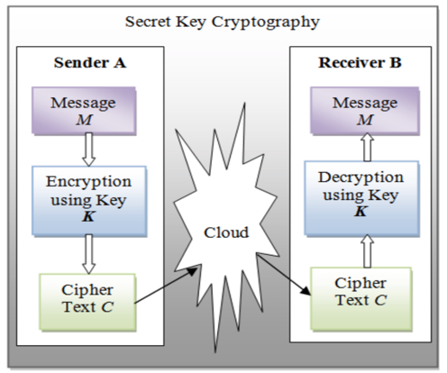
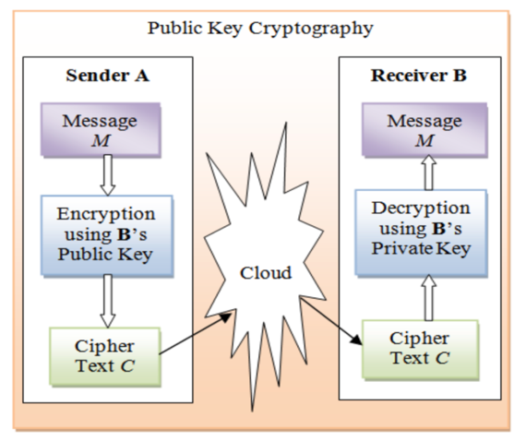
Cryptography
Secret key (or symmetric) cryptography
The Transmition of the key is risky.
Public-key (or asymmetric) cryptography
A pair of keys
Public-key cryptography algorithms that are in use today for key exchange or digital signatures.
Hash functions

Slide 5
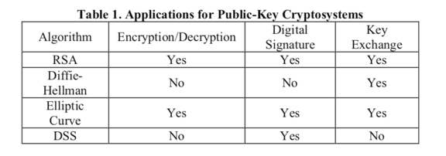
Implementation
Asymmetric encryption can be used for confidentiality, authentication, or both. Applications for Public-Key Cryptosystems are given in Table 1

Slide 6
RSA
The first, and still most common, public key cryptography implementation.
RSA has three phases:
Key Generation
Encryption
Decryption

Slide 7
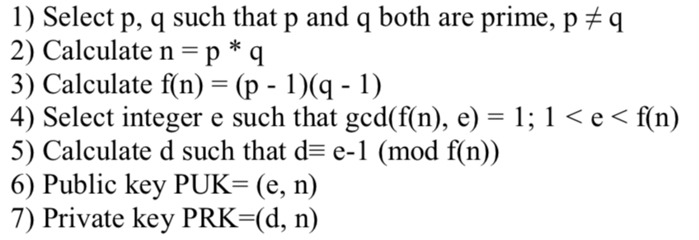
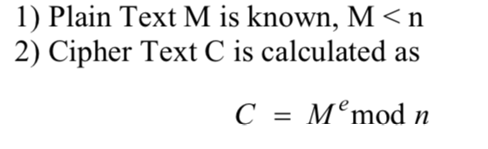
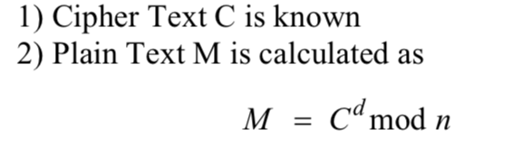
Algorithms
Key Generation:
Encryption:
Encryption:

Slide 8
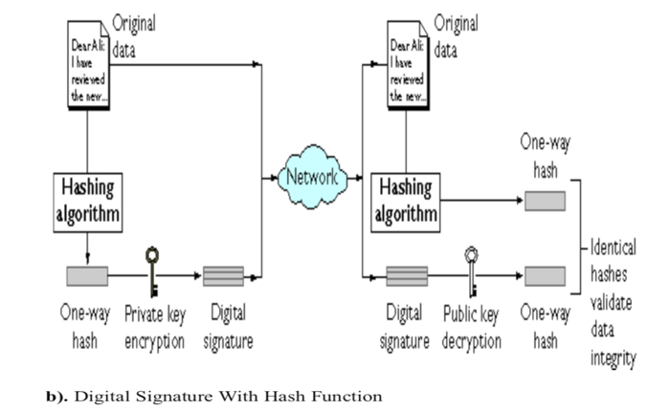
DDS
Digital Signature Standard

Slide 9
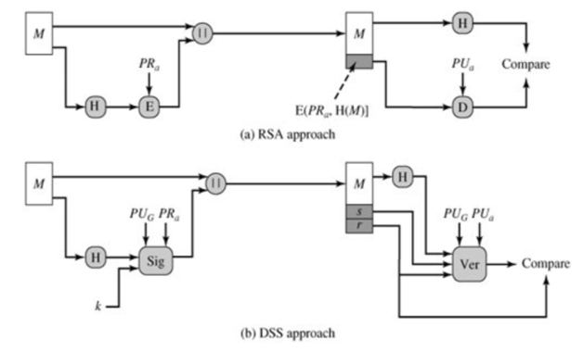
Compare RSA and DSS

Slide 10
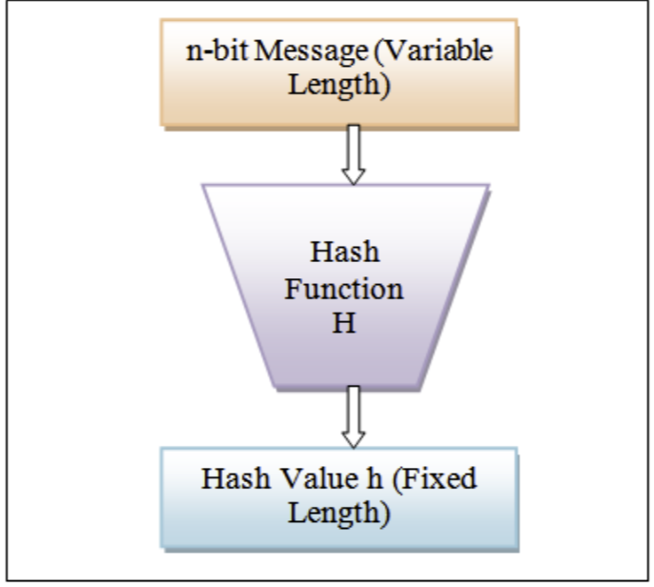
Hash Functions
A hash function H accepts a variable-length block of data M as input and produces a fixed-size hash value h = H(M)

Slide 11
SSL Certificate
Asymmetric encryption
Digital certificates exploit scheme on Scales
Prevent “man-in-the-middle' attacks

Slide 12
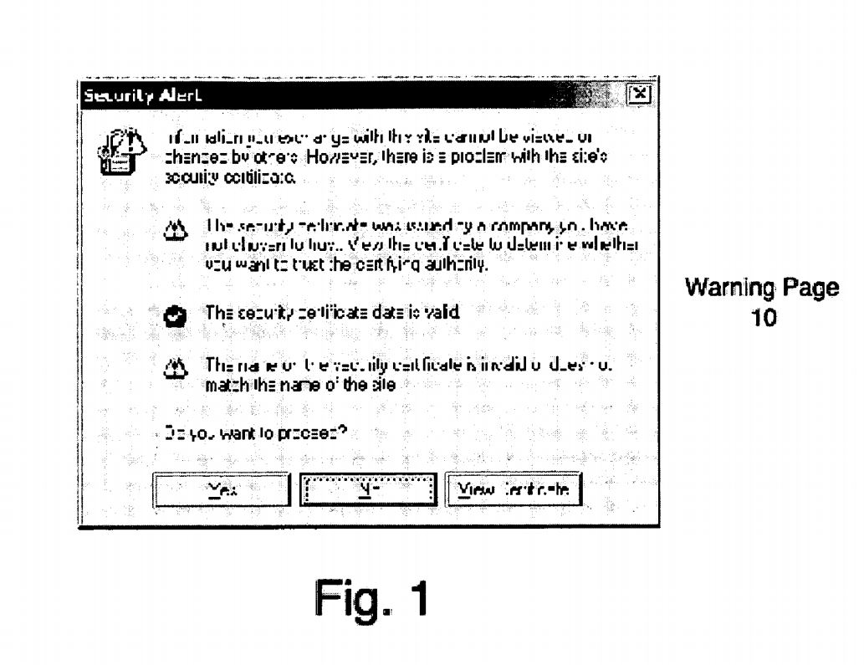
SSL Warning
Illustrates an example of a warning page used in prior Schemes to alert users when unexpected errors are encountered with digital certificates exchanged between computers;

Slide 13
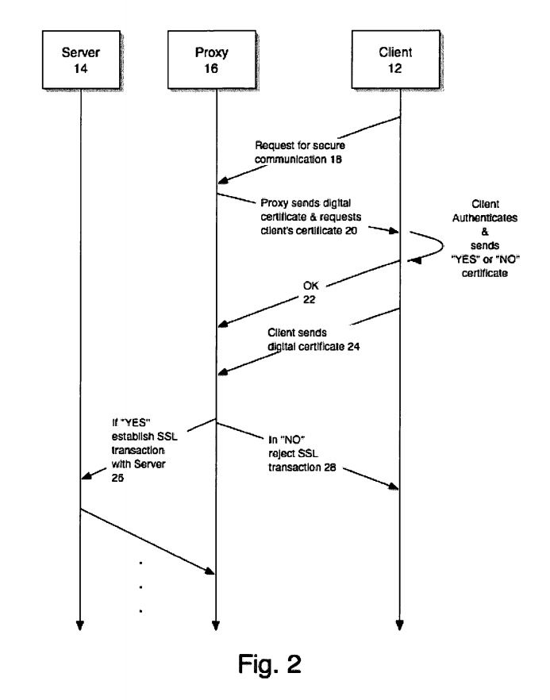
SSL Secure Communication

Slide 14
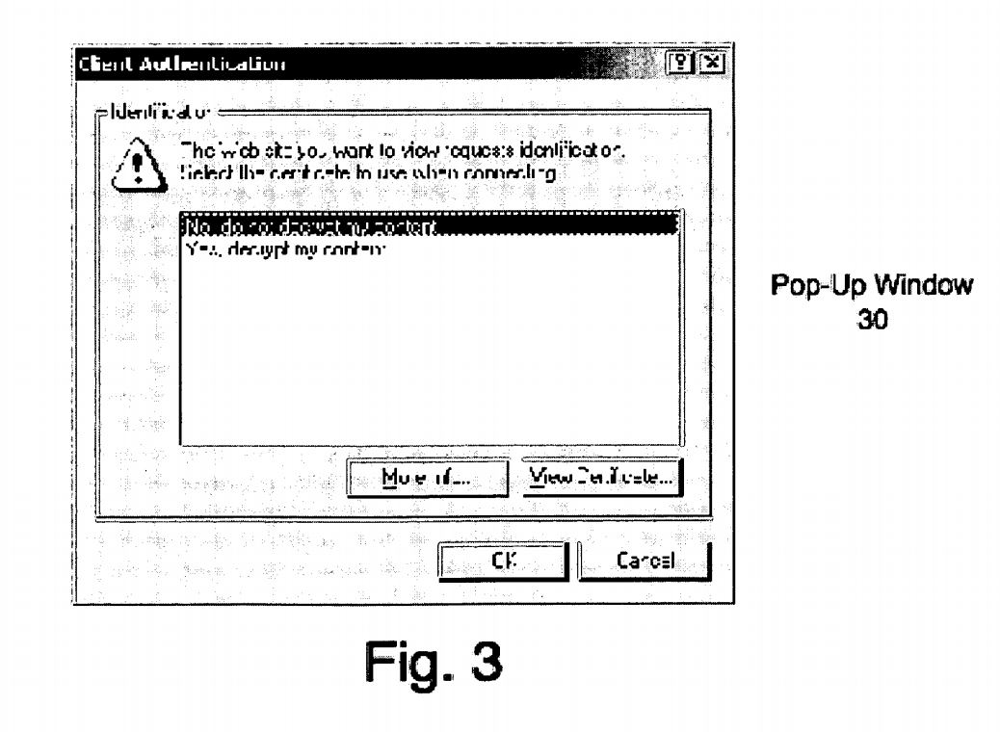
Detailed Textual Description
A pop-up window to be displayed to a user in response to a request by a proxy for authorization to monitor SSL communications in accordance with an embodiment of the present invention.

Slide 15
BlockChain based Anti-Counterfeit Solutions

