Slide 1
It’s LEGALESE to Me
"SECTION 1. SHORT TITLE. This Act may be cited as the ``Neighborhood Infrastructure Improvement and Inner City Job Creation Act''. SEC. 2. ESTABLISHMENT OF GRANT PROGRAM. The Secretary of Labor (in this Act referred to as the ``Secretary'') shall provide grants to eligible administrative entities described in section 3(a) for the purpose of establishing and carrying out programs that provide employment opportunities to unemployed individuals through payments for labor and related costs associated with the repair and renovation of essential community facilities. SEC. 3. ELIGIBLE ADMINISTRATIVE ENTITIES. (a) In General.--An administrative entity shall be eligible to receive a grant under section 2 if the entity is-- (1) a private industry council (described under section 102 of the Job Training Partnership Act (29 U.S.C. 1512)), (2) a unit of general local government, (3) a nonprofit private organization, or (4) in the case of a grant involving a Native American Indian tribe or Alaska Native Village, a grantee designated under subsection (c) or (d) of section 401 of the Job Training Partnership Act, or a consortium of such grantees and the State, that serves 1 or more eligible jurisdictions described under subsection (b). (b) Eligible Jurisdiction.--An eligible jurisdiction described under this subsection is an area which has a poverty rate in excess of 30 percent and which is-- (1) a unit of general local government which has a population of 50,000 or more individuals; or (2) a Native American Indian tribe, band, or group located on a Federal or State reservation, the Oklahoma Indians, and any Alaska Native village or group as defined in the Alaska Native Claims Settlement Act, having a governing body. (c) Priority.--In selecting administrative entities described in subsection (a) to receive a grant under section 2, priority shall be given to administrative entities that give assurances to the Secretary in the application submitted under section 4 that such entities will give priority to individuals who are low-skilled workers in selecting individuals to participate in programs established and carried out by such entities under section 5(a). SEC. 4. APPLICATION. The Secretary may not make a grant under section 2 to an eligible administrative entity unless the entity submits to the Secretary an application in such form and containing such information as the Secretary may require. SEC. 5. USE OF AMOUNTS. (a) In General.--Except as provided in subsection (b), the Secretary may not make a grant under section 2 to an eligible administrative entity unless the entity agrees that it will use all amounts received from such grant to establish and carry out a program to provide wages and related employment benefits to eligible individuals described in subsections (a) and (b) of section 6 for the purpose of employing such individuals to repair and renovate essential community facilities that are located within the eligible jurisdiction that the entity serves, including-- (1) painting bridges; (2) repairing and renovating public buildings and other community facilities, including public libraries; (3) repairing and renovating public housing units; (4) repairing water systems and water development projects; (5) erecting or replacing traffic control signs and removing road sign obstructions; (6) replacing school crossing, intersection, and other road surface markings; (7) repairing roads and streets; (8) repairing and renovating parks and playgrounds; (9) installing and repairing drainage pipes and catch basins in areas subject to flooding; (10) installing graded ramps for individuals with disabilities; and (11) weatherizing community facilities and carrying out other energy conservation activities. (b) Administrative Costs.--Not more than 25 percent of amounts received from a grant under section 2 for any fiscal year may be used for the cost of administration and the acquisition of supplies, tools, and other equipment. SEC. 6. ELIGIBLE INDIVIDUALS. (a) In General.--An individual shall be eligible to participate in a program described in section 5(a) only if the individual-- (1) is an unemployed individual at the time of enrollment in such program; (2) has been unemployed, at a minimum, for the duration of the 15-week period immediately preceding the date of such enrollment; and (3) has made a good-faith attempt to obtain employment during such 15-week period. (b) Additional Requirement for Secondary School-Age Individuals.-- (1) In general.--In addition to meeting the requirements described in subsection (a), a secondary school-age individual shall be eligible to participate in a program described in section 5(a) only if the individual has not attended a secondary school for any part of the 6-month period immediately preceding the date of enrollment in such program. (2) Secondary school-age individual defined.--For purposes of paragraph (1), the term ``secondary school-age individual'' means an individual who has attained the age of 16 but has not attained the age of 20. (c) Priority.--In selecting individuals described in subsections (a) and (b) to participate in a program described in section 5(a), priority shall be given to the individuals who, at the time of selection to the program, have exhausted or are otherwise not eligible for unemployment insurance benefits, particularly those individuals who have been unemployed for the longest periods of time preceding the date of their selection to the program. SEC. 7. NONDISCRIMINATION. No individual shall be excluded from participation in, denied the benefits of, subjected to discrimination under, or denied employment in the administration of or in connection with any program described in section 5(a) because of race, color, religion, sex, national origin, age, disability, or political affiliation or belief. SEC. 8. LABOR STANDARDS. The labor standards described under section 143 of the Job Training Partnership Act (29 U.S.C. 1553) shall apply for purposes of a program established under section 5(a). SEC. 9. MAINTENANCE OF EXPENDITURES. The Secretary may not make a grant under section 2 to an eligible administrative entity unless the entity agrees that it will maintain its aggregate expenditures from all other sources for employing individuals to repair and renovate essential community facilities at or above the average level of such expenditures in the 2 fiscal years preceding the date on which the entity submits an application under section 4 to the Secretary. SEC. 10. REPORT. The Secretary may not make a grant under section 2 to an eligible administrative entity unless the entity agrees that it will submit, for any fiscal year in which the entity receives a grant under such section, a report to the Secretary describing the use of such grant and any other information the Secretary determines to be appropriate. SEC. 11. AUTHORIZATION OF APPROPRIATIONS. (a) In General.--There is authorized to be appropriated to carry out section 2 $5,000,000,000 for fiscal year 1994 and such sums as may be necessary for each succeeding fiscal year. (b) Availability.--Funds authorized to be appropriated under subsection (a) shall remain available until expended."
"SECTION 1. SHORT TITLE. This Act may be cited as the ``Child Safety Lock Act of 1999''. SEC. 2. CHILD SAFETY LOCKS. (a) Definitions.--Section 921(a) of title 18, United States Code, is amended by adding at the end the following: ``(35) The term `locking device' means a device or locking mechanism-- ``(A) that-- ``(i) if installed on a firearm and secured by means of a key or a mechanically, electronically, or electromechanically operated combination lock, is designed to prevent the firearm from being discharged without first deactivating or removing the device by means of a key or mechanically, electronically, or electromechanically operated combination lock; ``(ii) if incorporated into the design of a firearm, is designed to prevent discharge of the firearm by any person who does not have access to the key or other device designed to unlock the mechanism and thereby allow discharge of the firearm; or ``(iii) is a safe, gun safe, gun case, lock box, or other device that is designed to store a firearm and that is designed to be unlocked only by means of a key, a combination, or other similar means; and ``(B) that is approved by a licensed firearms manufacturer for use on the handgun with which the device or locking mechanism is sold, delivered, or transferred.''. (b) Unlawful Acts.-- (1) In general.--Section 922 of title 18, United States Code, is amended by inserting after subsection (y) the following: ``(z) Locking Devices.-- ``(1) In general.--Except as provided in paragraph (2), it shall be unlawful for any licensed manufacturer, licensed importer, or licensed dealer to sell, deliver, or transfer any handgun to any person other than a licensed manufacturer, licensed importer, or licensed dealer, unless the transferee is provided with a locking device for that handgun. ``(2) Exceptions.--Paragraph (1) does not apply to-- ``(A) the-- ``(i) manufacture for, transfer to, or possession by, the United States or a State or a department or agency of the United States, or a State or a department, agency, or political subdivision of a State, of a firearm; or ``(ii) transfer to, or possession by, a law enforcement officer employed by an entity referred to in clause (i) of a firearm for law enforcement purposes (whether on or off duty); or ``(B) the transfer to, or possession by, a rail police officer employed by a rail carrier and certified or commissioned as a police officer under the laws of a State of a firearm for purposes of law enforcement (whether on or off duty).''. (2) Effective date.--Section 922(y) of title 18, United States Code, as added by this subsection, shall take effect 180 days after the date of enactment of this Act. (c) Liability; Evidence.-- (1) Liability.--Nothing in this section shall be construed to-- (A) create a cause of action against any firearms dealer or any other person for any civil liability; or (B) establish any standard of care. (2) Evidence.--Notwithstanding any other provision of law, evidence regarding compliance or noncompliance with the amendments made by this section shall not be admissible as evidence in any proceeding of any court, agency, board, or other entity, except with respect to an action to enforce this section. (3) Rule of construction.--Nothing in this subsection shall be construed to bar a governmental action to impose a penalty under section 924(p) of title 18, United States Code, for a failure to comply with section 922(y) of that title. (d) Civil Penalties.--Section 924 of title 18, United States Code, is amended-- (1) in subsection (a)(1), by striking ``or (f)'' and inserting ``(f), or (p)''; and (2) by adding at the end the following: ``(p) Penalties Relating to Locking Devices.-- ``(1) In general.-- ``(A) Suspension or revocation of license; civil penalties.--With respect to each violation of section 922(y)(1) by a licensee, the Secretary may, after notice and opportunity for hearing-- ``(i) suspend or revoke any license issued to the licensee under this chapter; or ``(ii) subject the licensee to a civil penalty in an amount equal to not more than $10,000. ``(B) Review.--An action of the Secretary under this paragraph may be reviewed only as provided in section 923(f). ``(2) Administrative remedies.--The suspension or revocation of a license or the imposition of a civil penalty under paragraph (1) does not preclude any administrative remedy that is otherwise available to the Secretary.''."
Abstractive Summarization for Legislative Documents

Slide 2
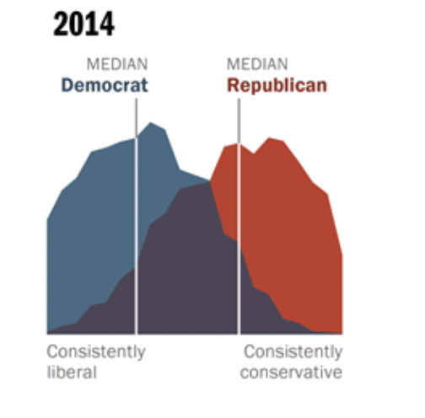

Why summarize legislation?
“HUH?”
"SECTION 1. SHORT TITLE. This Act may be cited as the ``Child Safety Lock Act of 1999''. SEC. 2. CHILD SAFETY LOCKS. (a) Definitions.--Section 921(a) of title 18, United States Code, is amended by adding at the end the following: ``(35) The term `locking device' means a device or locking mechanism-- ``(A) that-- ``(i) if installed on a firearm and secured by means of a key or a mechanically, electronically, or electromechanically operated combination lock, is designed to prevent the firearm from being discharged without first deactivating or removing the device by means of a key or mechanically, electronically, or electromechanically operated combination lock; ``(ii) if incorporated into the design of a firearm, is designed to prevent discharge of the firearm by any person who does not have access to the key or other device designed to unlock the mechanism and thereby allow discharge of the firearm; or ``(iii) is a safe, gun safe, gun case, lock box, or other device that is designed to store a firearm and that is designed to be unlocked only by means of a key, a combination, or other similar means; and ``(B) that is approved by a licensed firearms manufacturer for use on the handgun with which the device or locking mechanism is sold, delivered, or transferred.''. (b) Unlawful Acts.-- (1) In general.--Section 922 of title 18, United States Code, is amended by inserting after subsection (y) the following: ``(z) Locking Devices.-- ``(1) In general.--Except as provided in paragraph (2), it shall be unlawful for any licensed manufacturer, licensed importer, or licensed dealer to sell, deliver, or transfer any handgun to any person other than a licensed manufacturer, licensed importer, or licensed dealer, unless the transferee is provided with a locking device for that handgun. ``(2) Exceptions.--Paragraph (1) does not apply to-- ``(A) the-- ``(i) manufacture for, transfer to, or possession by, the United States or a State or a department or agency of the United States, or a State or a department, agency, or political subdivision of a State, of a firearm; or ``(ii) transfer to, or possession by, a law enforcement officer employed by an entity referred to in clause (i) of a firearm for law enforcement purposes (whether on or off duty); or ``(B) the transfer to, or possession by, a rail police officer employed by a rail carrier and certified or commissioned as a police officer under the laws of a State of a firearm for purposes of law enforcement (whether on or off duty).''. (2) Effective date.--Section 922(y) of title 18, United States Code, as added by this subsection, shall take effect 180 days after the date of enactment of this Act. (c) Liability; Evidence.-- (1) Liability.--Nothing in this section shall be construed to-- (A) create a cause of action against any firearms dealer or any other person for any civil liability; or (B) establish any standard of care. (2) Evidence.--Notwithstanding any other provision of law, evidence regarding compliance or noncompliance with the amendments made by this section shall not be admissible as evidence in any proceeding of any court, agency, board, or other entity, except with respect to an action to enforce this section. (3) Rule of construction.--Nothing in this subsection shall be construed to bar a governmental action to impose a penalty under section 924(p) of title 18, United States Code, for a failure to comply with section 922(y) of that title. (d) Civil Penalties.--Section 924 of title 18, United States Code, is amended-- (1) in subsection (a)(1), by striking ``or (f)'' and inserting ``(f), or (p)''; and (2) by adding at the end the following: ``(p) Penalties Relating to Locking Devices.-- ``(1) In general.-- ``(A) Suspension or revocation of license; civil penalties.--With respect to each violation of section 922(y)(1) by a licensee, the Secretary may, after notice and opportunity for hearing-- ``(i) suspend or revoke any license issued to the licensee under this chapter; or ``(ii) subject the licensee to a civil penalty in an amount equal to not more than $10,000. ``(B) Review.--An action of the Secretary under this paragraph may be reviewed only as provided in section 923(f). ``(2) Administrative remedies.--The suspension or revocation of a license or the imposition of a civil penalty under paragraph (1) does not preclude any administrative remedy that is otherwise available to the Secretary.''."
“OOF”
Something about guns??
Heard about it on the news
Pew research center
Notes:
Child Safety Lock Act of 1999
Amends the Brady Handgun Violence Prevention Act to define (firearm) "locking device."
Makes it unlawful for a licensed manufacturer, importer, or dealer to sell, deliver, or transfer a handgun without a locking device to any person other than a licensed manufacturer, importer, or dealer, with exceptions for law enforcement and governmental entities.
Specifies that nothing in this Act shall be construed to create a cause of action against any firearms dealer or any other person for civil liability, or establish any standard of care.
Makes evidence regarding compliance or noncompliance with this Act inadmissible in a proceeding of any court, agency, board, or other entity, except with respect to an action to enforce this Act.
Sets forth civil penalties (in addition to any administrative penalties) for related violations, including suspension or loss of license.

Slide 3
Experiments
Fine-tune a generic transformer model (T5) for legal domain-specific summarization and compare to unsupervised baseline & out-of-the-box T5
Explore the impact of pre-processing legislative documents prior to generating summaries (taking n tokens after section headers and concatenating)

Slide 4
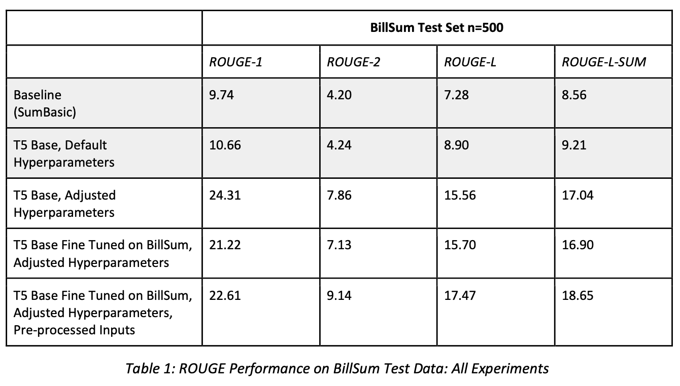
Results

Slide 5
Example
SumBasic: 2) Acres of forested land treated for reduction of \n mortality risk from insect and disease infestation.
*Original = 800 words
*Target = 80 words
T5 OOTB, Default HP: a report to congress identified the Forest Service as at 'high risk' of waste,
Target:
Forest Service Financial Accountability Restoration Act of 1999 – Places specified limits on Forest Service appropriations until the earlier of the following: (1) the Service is no longer an agency at high risk of waste, fraud, and mismanagement due to accounting and financial reporting weaknesses; or (2) the end of the fifth fiscal year subject to such limitations. \nEnumerates the criteria under which the Comptroller General shall certify to Congress that the Service is no longer at high risk \nSets forth Service backlog reduction requirements.
T5 OOTB, Adjusted HP: a report to congress identified the Forest Service as at 'high risk' of waste, fraud, abuse. the Comptroller general has stated that the agency will maintain its high risk status if it corrects deficiencies - despite initial efforts... obama has not acted on this issue he says ; sen. john mccain says the act is ok unless it is repealed, but not before january 1, 1999 eve dre
T5 Finetuned: Amends the Forest Service Organic Act to prohibit the Secretary of Agriculture from acquiring, supplying, or delivering for use in any Forest service program rere a forest service that has incurred the cost of establishing or maintaining
T5 Finetuned w. pre-processing: Requires the Secretary of Agriculture to establish a Forest Service financial assistance program to provide financial support to forest service organizations and other eligible entities that serve rere s appropriations. Authorizes an apportion to

Slide 6
Analysis
Length is a challenge.
Summaries stop abruptly or devolve into nonsense
HPs for generation (min/max length) are important – 6+ point improvement in ROUGE-L. Could further adjust.
Missing info from end of target – truncation is an issue (168 in our case due to compute)
2. Pre-processing was likely too simplistic
Lack of coherence in the inputs
Simplification or extractive summarization pre-processing approaches should continue to be explored where truncation is an issue
3. T5 is likely too generic for this task – better algos exist

Slide 7


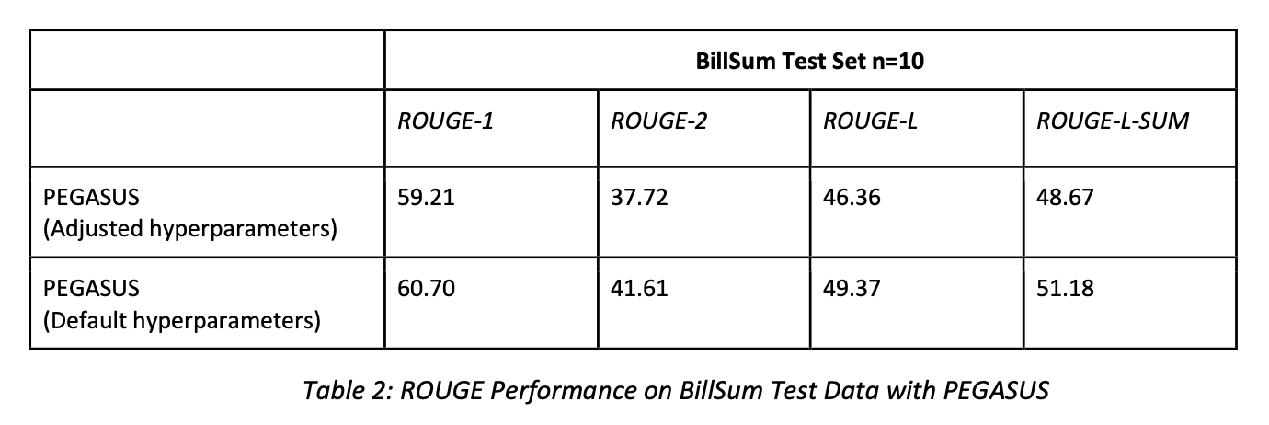

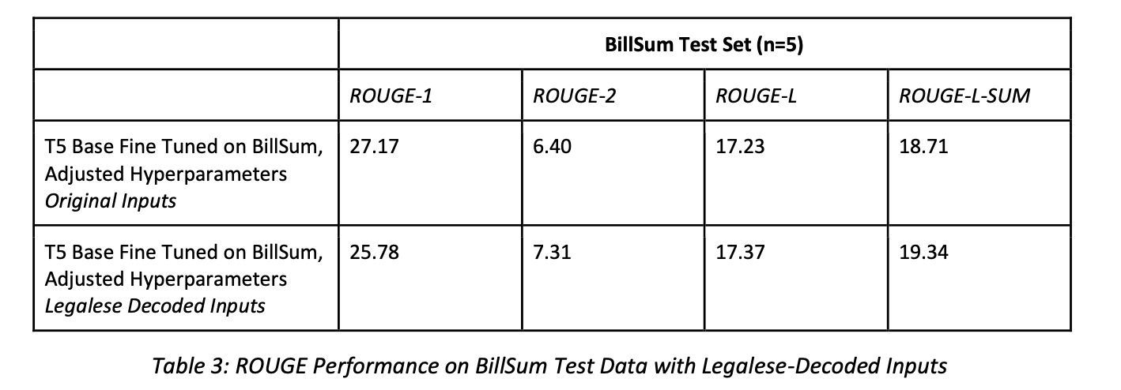
Follow-Up Experiments
*Also did a tiny experiment comparing cosine sim (SBERT) and ROUGE to human rankings

Slide 8
Example
PEGASUS - Adjusted HPs: Forest Service Financial Accountability Restoration Act of 1999 - States that specified limitations on Forest service appropriations or obligations shall terminate on the earlier of: (1) the date on which the Forest Services is no longer an agency at high risk of waste, fraud, abuse, and mismanagement due to weaknesses in its accounting and financial reporting systems; and (2) the end of the fifth fiscal year subject to such limitations. <n>Declares that the FOREST Service shall no more be an entity athigh risk if the Comptroller General certifies in writing to the Congress that Forest SERVICE financial management is No longer at such high Risk. Sets forth conditions under which The Comptroller general may certify such a removal. (Sec. 3) Requires the forest service to maintain or increase outputs, relative to those achieved during
*Original = 800 words
*Target = 80 words
Target:
Forest Service Financial Accountability Restoration Act of 1999 – Places specified limits on Forest Service appropriations until the earlier of the following: (1) the Service is no longer an agency at high risk of waste, fraud, and mismanagement due to accounting and financial reporting weaknesses; or (2) the end of the fifth fiscal year subject to such limitations. \nEnumerates the criteria under which the Comptroller General shall certify to Congress that the Service is no longer at high risk \nSets forth Service backlog reduction requirements.
PEGASUS – Default HPs: Forest Service Financial Accountability Restoration Act of 1999 - States that specified limitations on Forest Service appropriations or obligations shall terminate on the earlier of: (1) the date on which the Forest Service is no longer an agency at high risk of waste, fraud, abuse, and mismanagement due to weaknesses in its accounting and financial reporting systems; and (2) the end of the fifth fiscal year subject to such limitations. <n>Declares that the Forest Service shall no longer be at high risk if the Comptroller General certifies in writing to the Congress that Forest Service financial management is no longer at high risk. Authorizes the Comptroller General to make such certification only if: (1) the Forest Service receives two consecutive unqualified audit opinions from the Inspector General of the Department of Agriculture; and (2) the Forest Service corrects the material weaknesses identified in the audit reports of the Inspector General regarding the Forest Service's FY 1995 financial statements and all subsequent audit reports of the Inspector General regarding such statements published before the date of the enactment of this Act. <n>Requires the Forest Service, during each fiscal year, to maintain or increase output, relative to the levels achieved during FY 1999, from programs that directly reduce the natural resources restoration and maintenance backlog within the National Forest System, including: (1) acres of forested land treated for reduction of wildfire risk

Slide 9
Conclusions
Context-specificity and document length remain significant challenges for summarizing legislation.
PEGASUS > T5 for this task
Pre-processing needs more research
Explore at scale with sophisticated methods e.g. very strong extractive summary as input
Create open-source labeled dataset for simplification of legislative text
Suggest follow-up research comparing different possible metrics with human evaluations and determining which metrics (or combination of metrics) best capture summary quality.

