Slide 1
AutoDraw
A google‘s AI experiment
Notes:
Project of Google‘s AI experiments

Slide 2
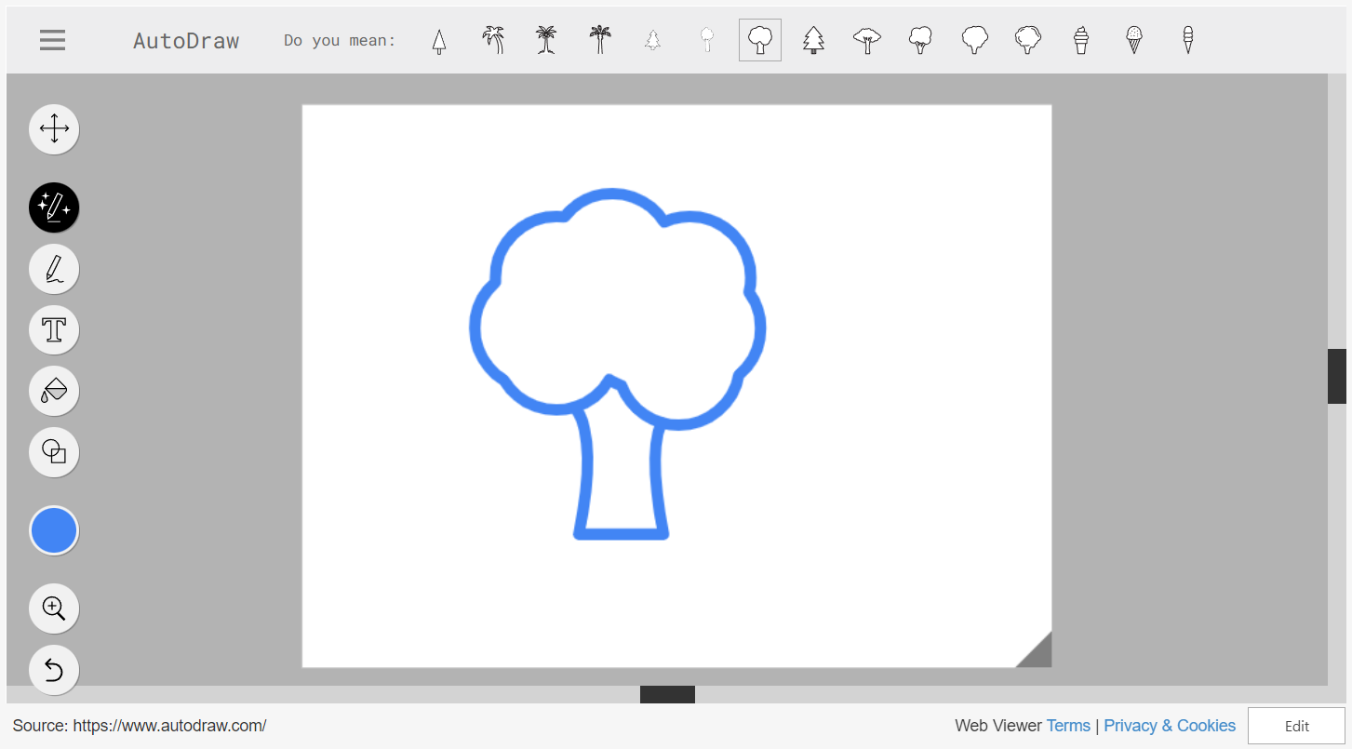
Notes:
It reads your ugly doodles and suggests nice clipArts
It is a neural network identifying objects while you draw them
If you pick one of the suggestions you give the AI positiv feedback; so it is more likely that it will make the same suggestion next time
Uses data collected with Quick, Draw!

Slide 3
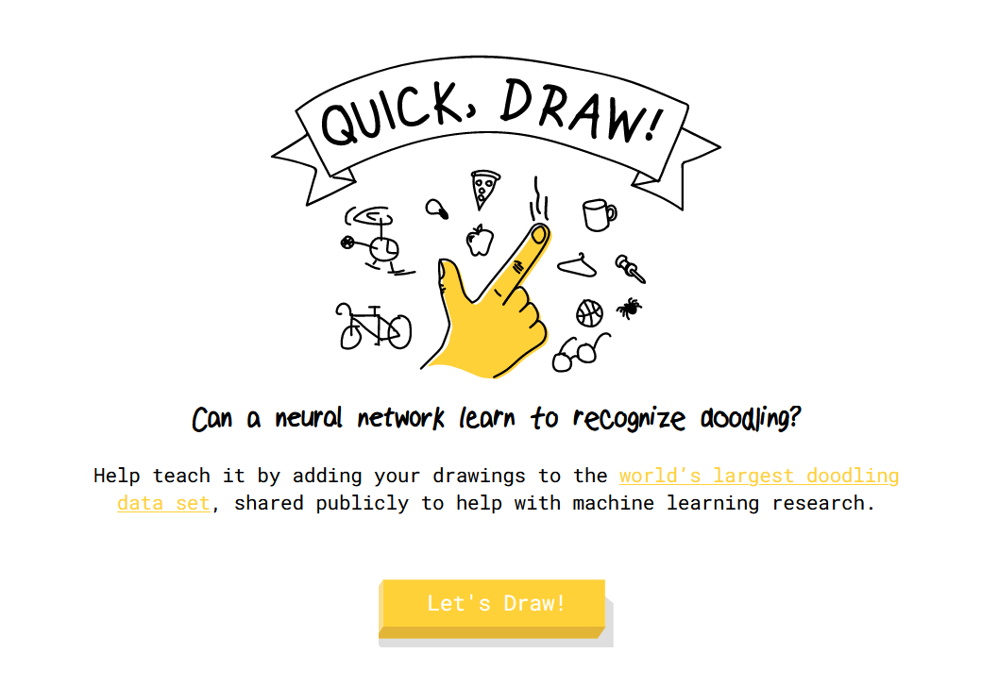
Notes:
Is another Google‘s AI experiment.
It is a game: 20 sec to draw a given word; the AI is guessing; and learning (You are training it)

Slide 4
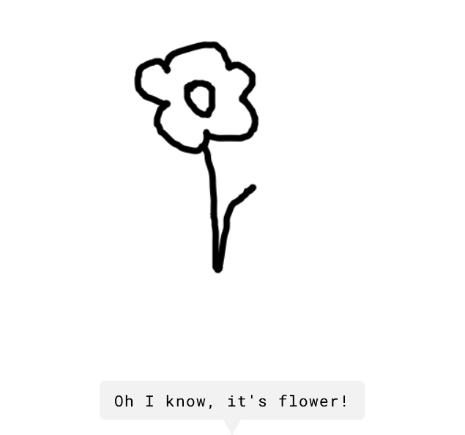
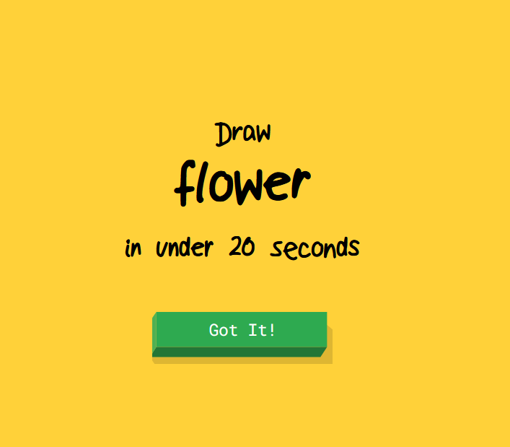

Slide 5
same technology as handwriting recognition in Gboard
AI don‘t only look at the outcome but at the process
Notes:
Both of these AI use ….

Slide 6
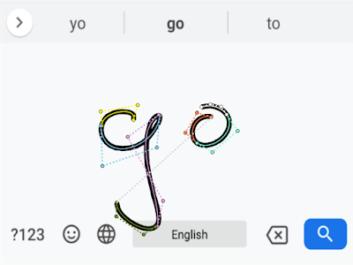
How does it work?
Notes:
I will explain how the handwriting recognition works:
Handwriting is a sequence of points with a timestamp
Seq of points are converted into Bezier curves; represented by polynomials (start & end-point & 2 additional control points)

Slide 7
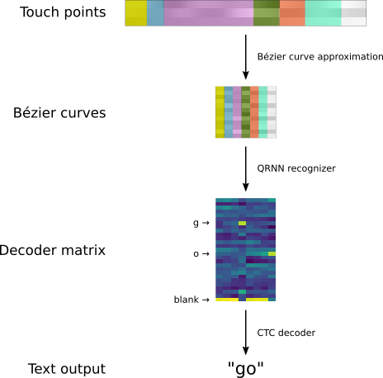
Notes:
The Bezier curves are the input to a recurrent neural network (RNN)
RNN: neurons can have connections to the same level or one level above
RNN produces a decoder matrix with probability dist. For all letters, where the columns are the input curves and the rows are all letters
+ a blank, because we have a mismatch between input curves and output letter
Algorithm decodes it into the actual letters

Slide 8
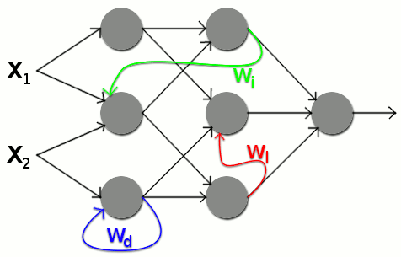
Notes:
The Bezier curves are the input to a recurrent neural network (RNN)
RNN: neurons

Slide 9
Sources:
https://www.theverge.com/2016/11/15/13641876/google-ai-experiments-quick-draw-image-recognition-game
https://ai.googleblog.com/2019/03/rnn-based-handwriting-recognition-in.html
https://quickdraw.withgoogle.com/?locale=en_US
https://www.autodraw.com/
https://developers.google.com/ml-kit/vision/digital-ink-recognition

