Slide 1

Poet Bot
An A.I. writing poems
build and presented by Rebecca Saalfeld
Notes:
Hello and welcome to my final project presentation. I created an A.I that is able to write poems.
And before we dive into my approach on this task, i would like to show you two poems

Slide 2
I.
you never know
the body of night opens like a river
it drifts upward like white smoke
II.
sweetest one of those magical places
wing like the dreams of your body waking
the bird was saying anything i can‘t remember
Notes:
One of it is an output I got from the AI and the other one is part of a real poem.
I will read them to you and I would like you to guess which one is which.
Now let me show you the AI in action…

Slide 3
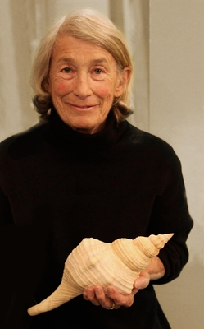
Approach
Predicts next word
Based on a bidirectional LSTM-model
Data: 100 poems from Mary Oliver
https://en.wikipedia.org/wiki/Mary_Oliver
Notes:
The AI looks at preceding words and predicts the next most likely word
It is based on a bidirectional LSTM-model. I will not go into the details of LSTM-models, only that it can retain information while learning. So if it takes the beginning of a sentence into account while computing the word in the end of it.
I fed this ML-model with about 100 poems from Mary Oliver. An american poet, who was writing mainly about nature-

Slide 4
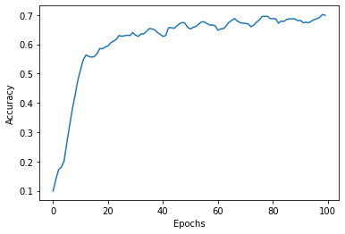
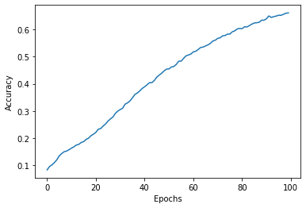
Model 1
Model 2
1 LSTM layer
2 LSTM layer + dropout layer

Slide 5
Problems - Improvements
Same sequence over and over again:
‚break wherever it was‘
Interprets ‚s‘ or ‚t‘ as a word
Doesn‘t know sentences
Notes:
The AI has some problems.
For example it spits out the same sequence of words over and over again, whenever I saw break, the following words where wherever it was.
This might be fixed with more data, so the AI learns that these words don‘t have to appear together.
I also sometimes get an s or a t in the middle of the sentence. This is due to my data cleaning. I removed the apostrophe. Should go back to the cleaning and fix this
A systematic error is, that the AI doesn‘t know sentences, so sometimes it breaks off in the middle of a sentence

Slide 6
I.
impossible but display outside merely grinning world
humans diseased momentary plot
jays leans mane halls sunflowers sands
II.
seems one life task
fire is a thumb and
the world hold me
curtains us going on one hoof over the fire
Notes:
So although my AI has some issues, it is doing a great job!
Here I put a ‚poem‘, where I created a random output from the same vocabulary as the AI used and in comparison another output from my AI, that I liked.
I will read them…

Slide 7
Any
Questions
?
Notes:
This brings me to the end of my presentation. Are there any questions? Or comments?

