Slide 1
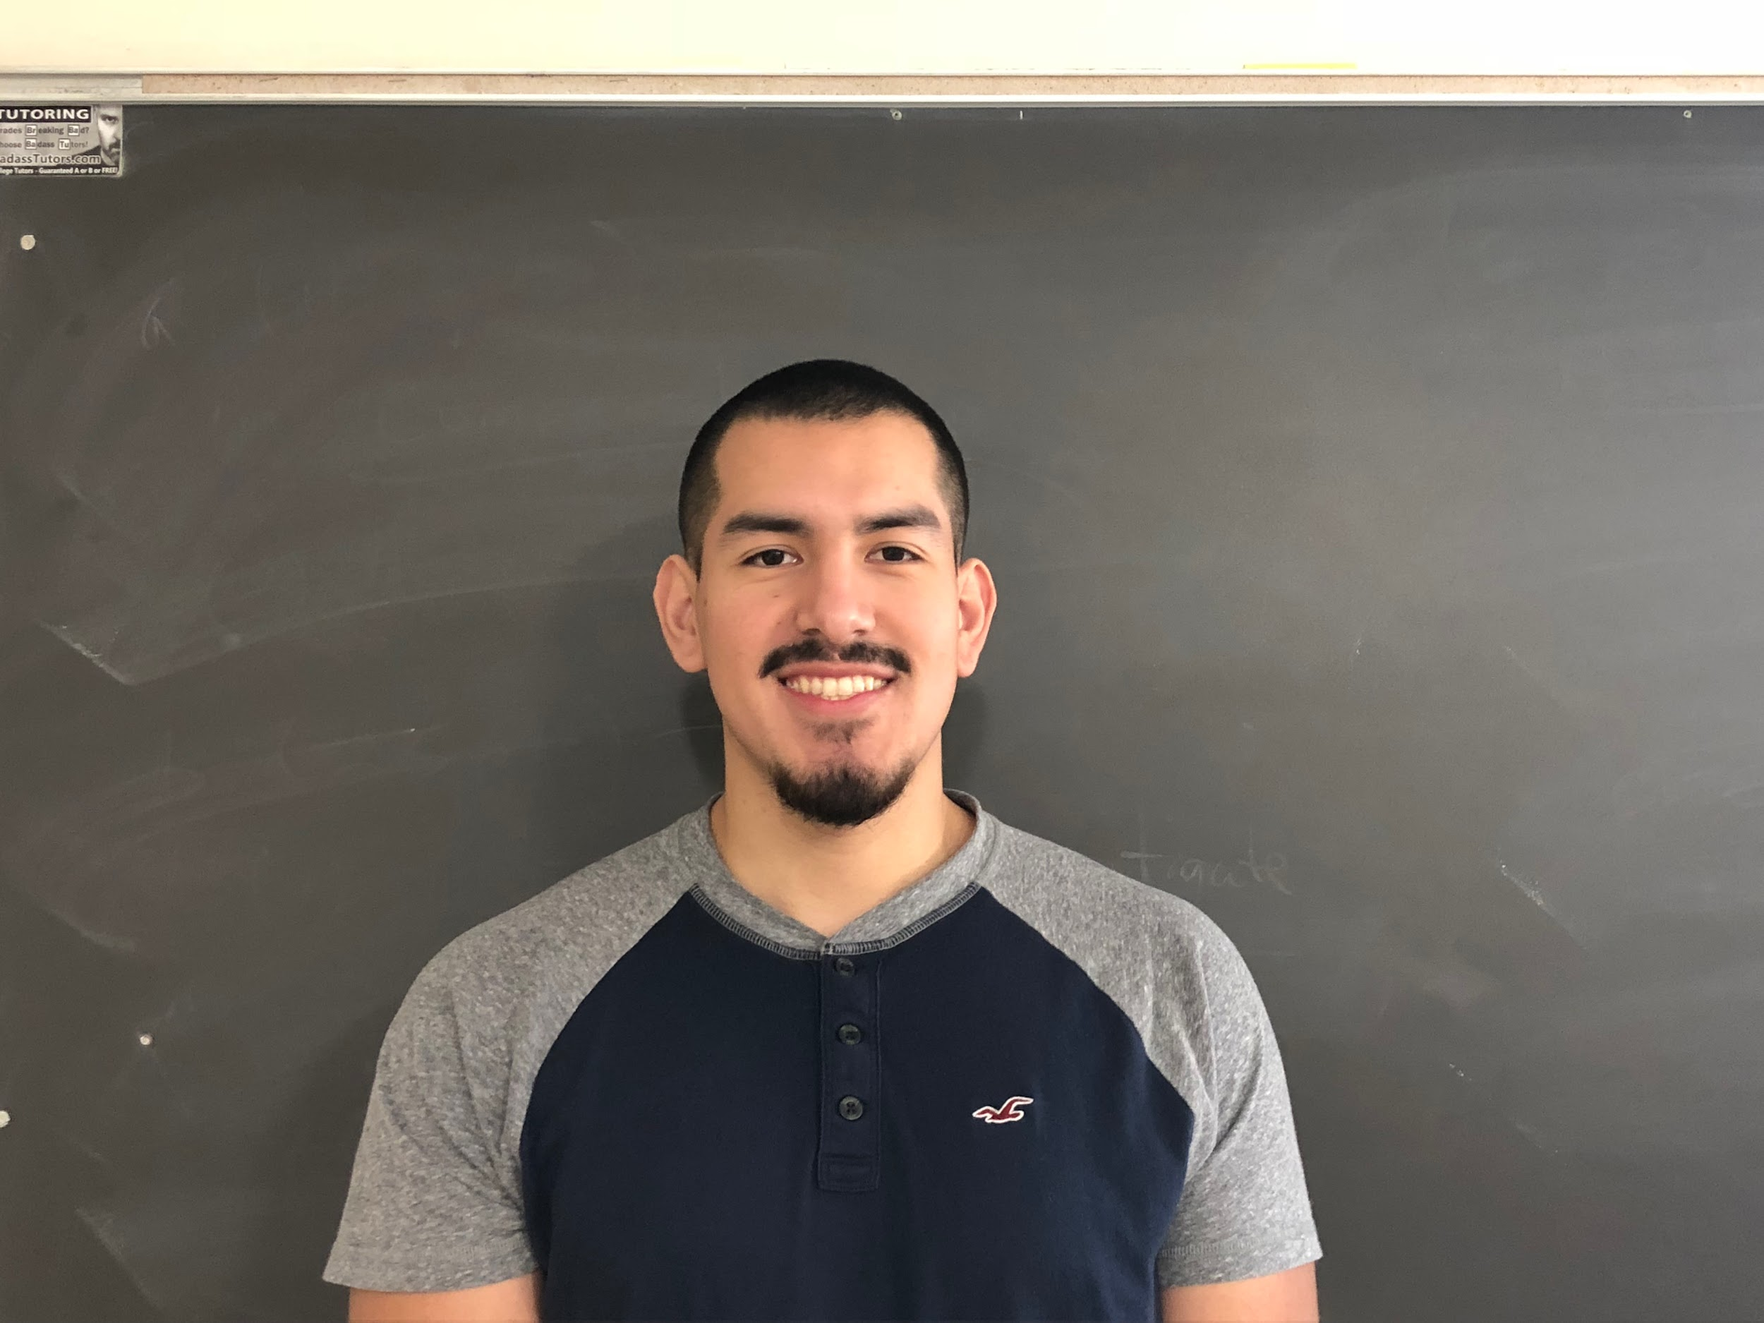
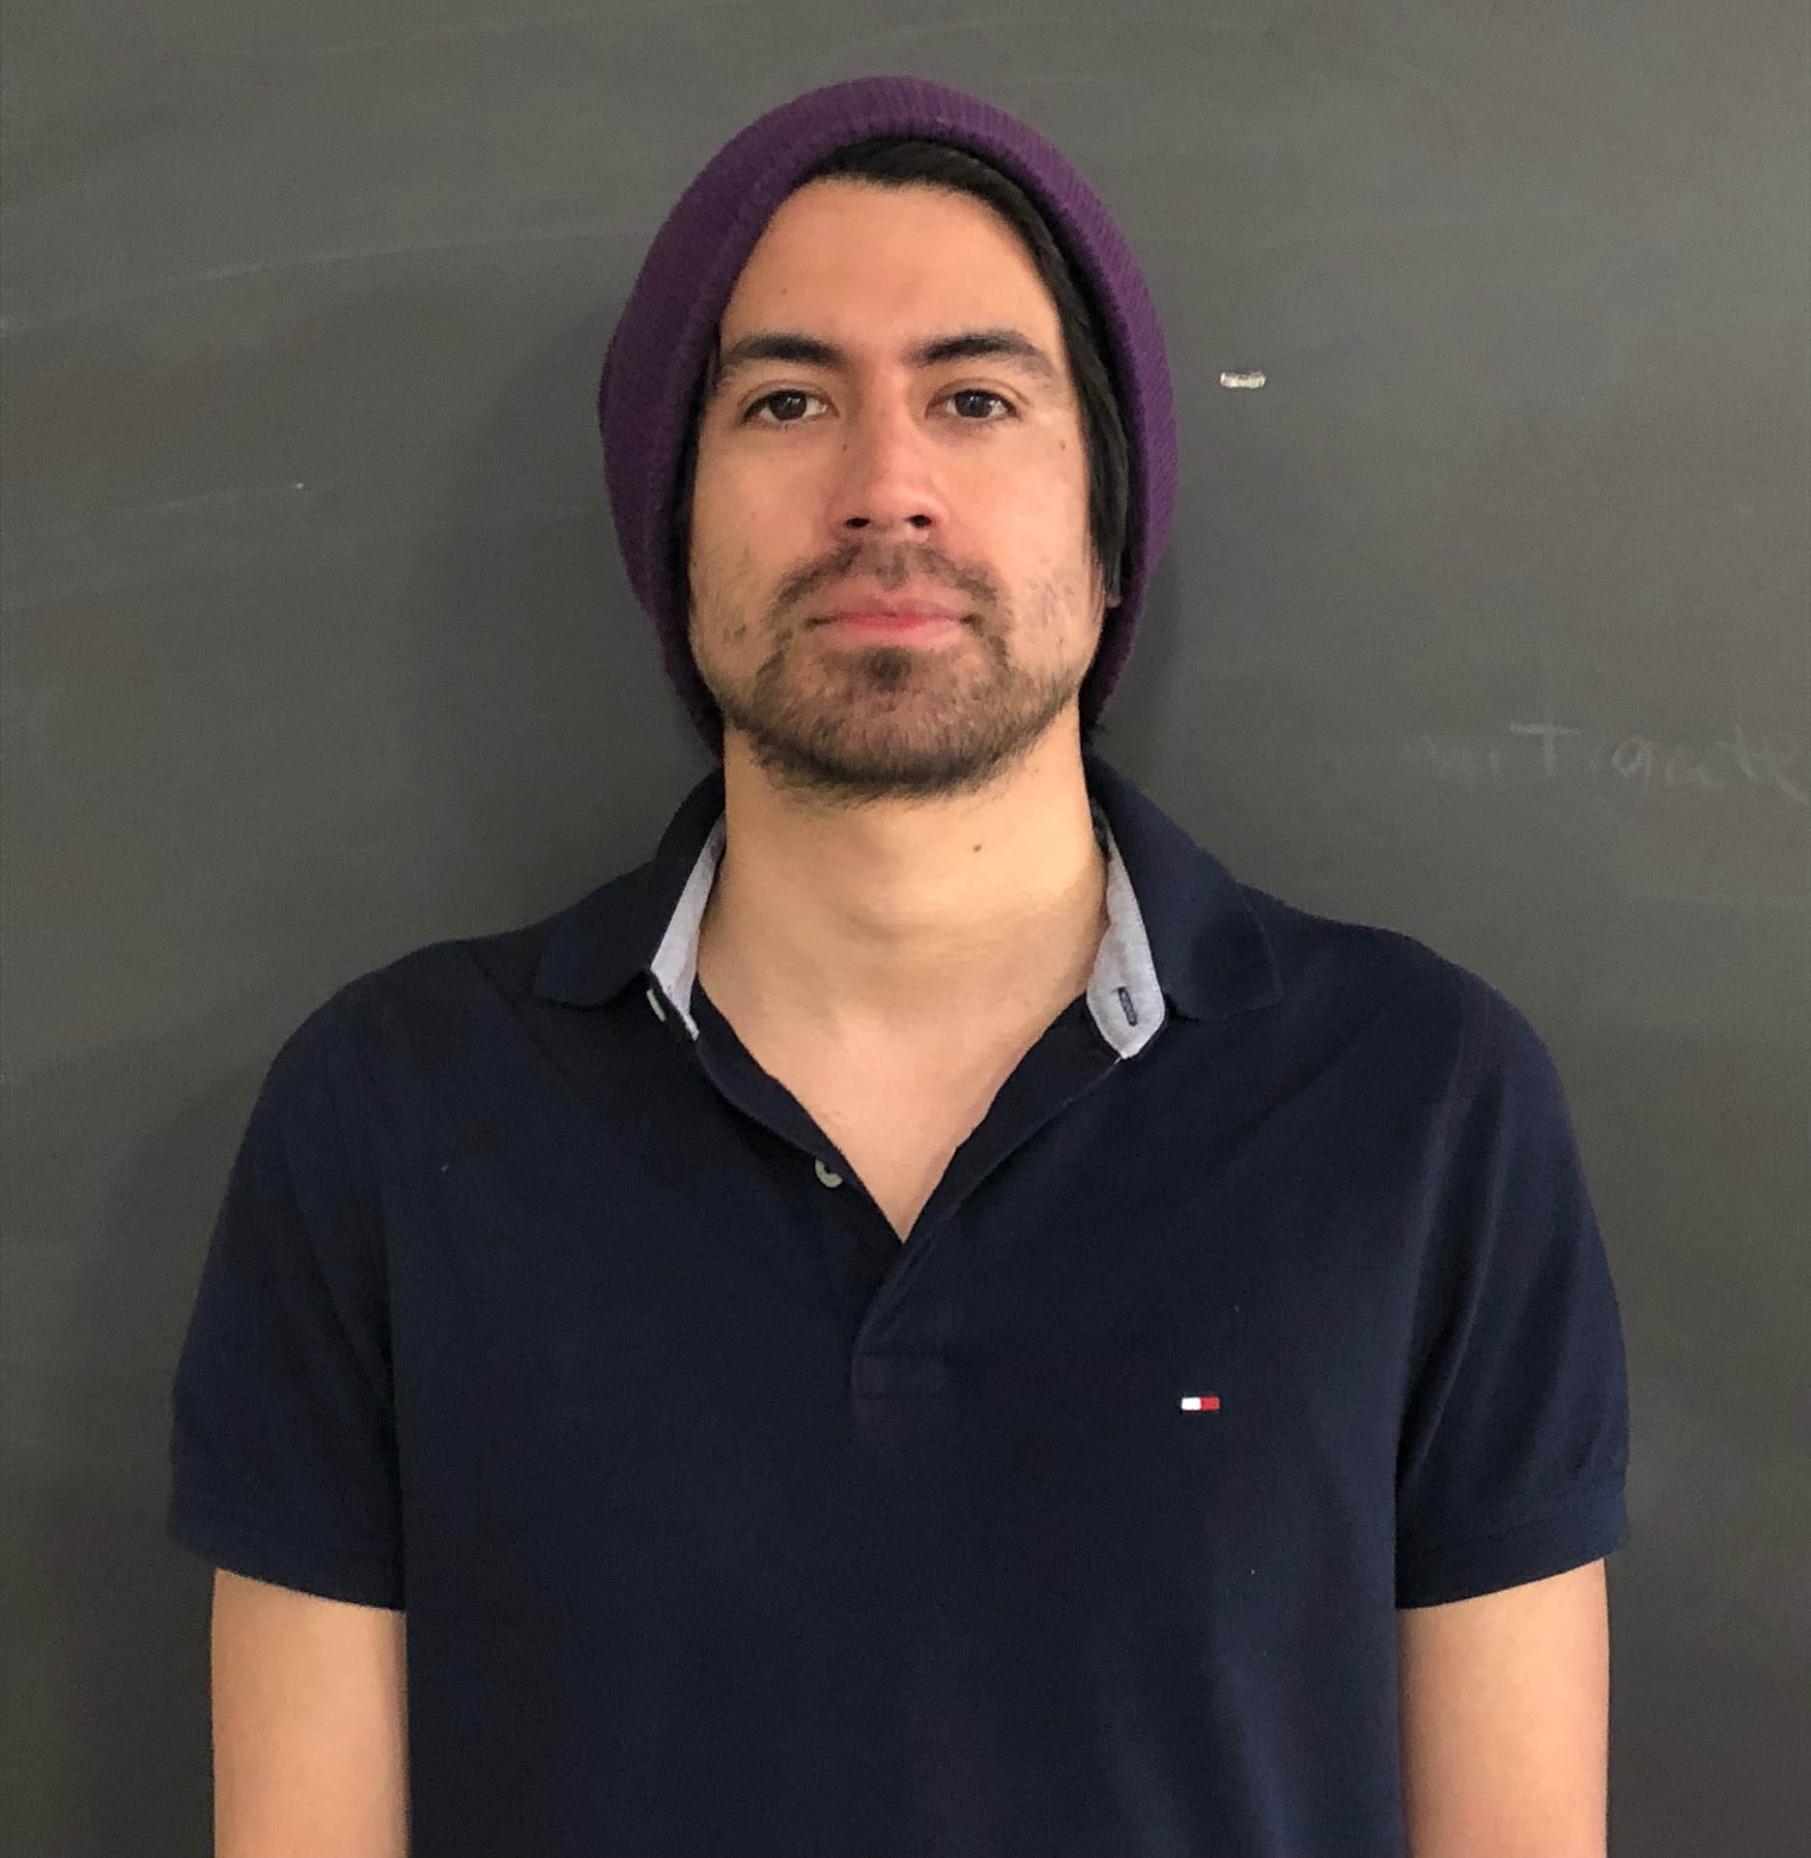
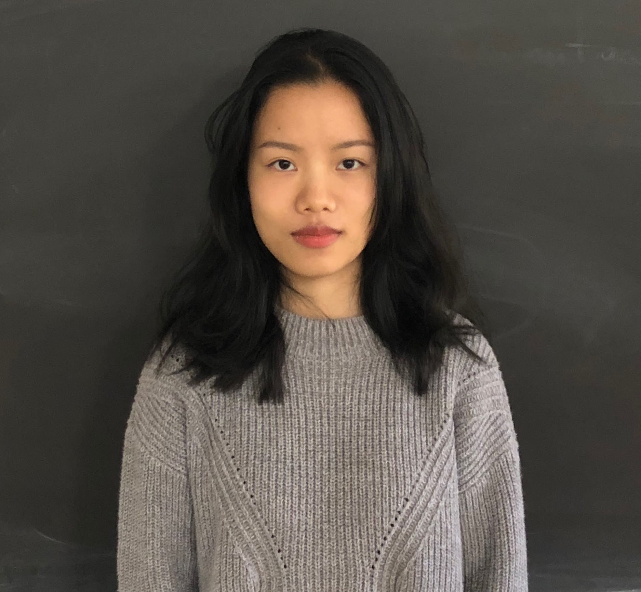
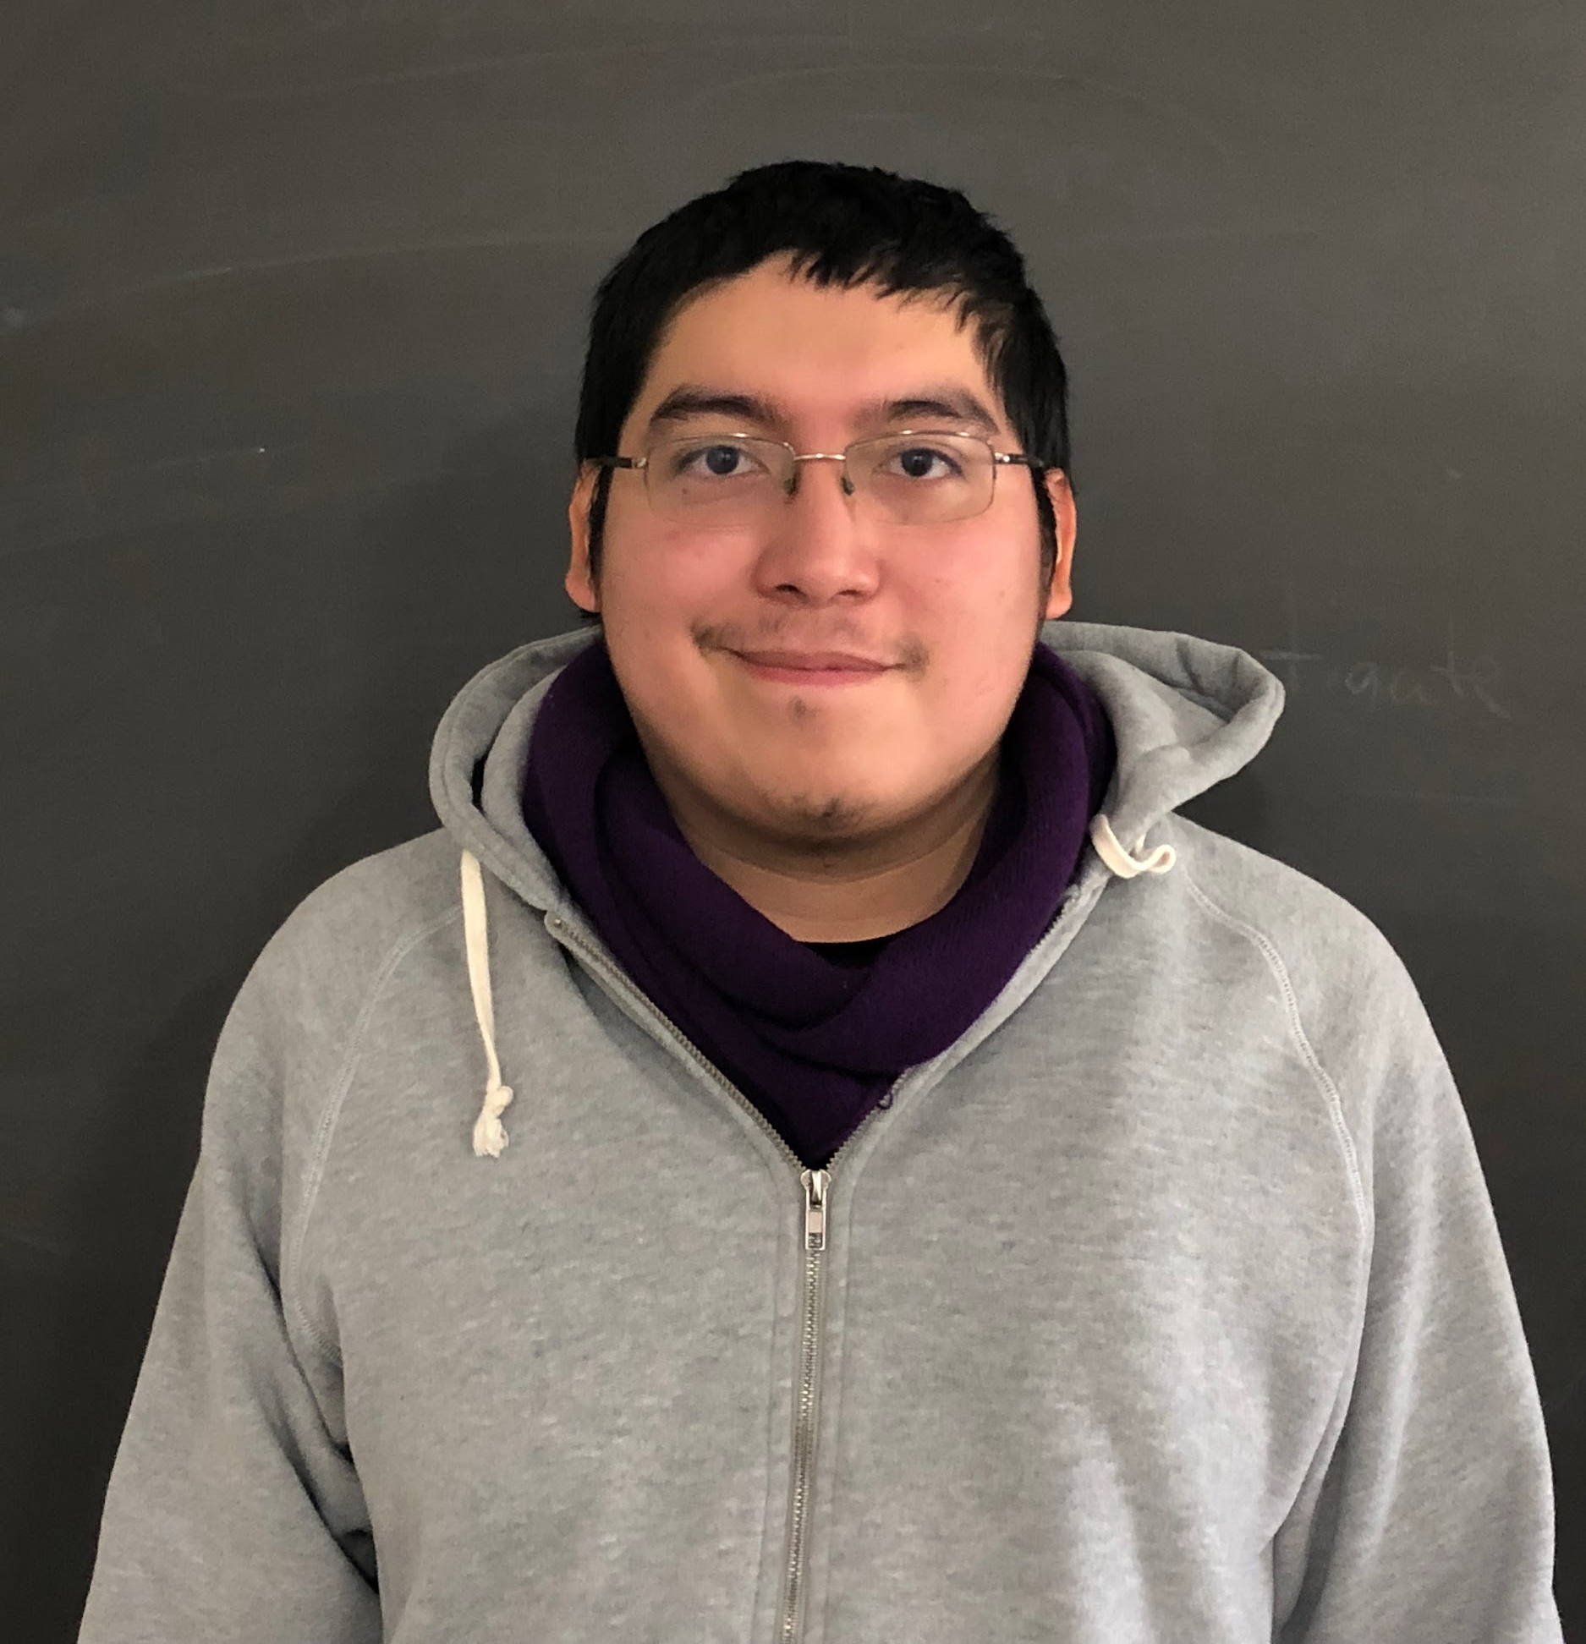
Golden Eagle Sustenance (GES)
CS3337, Software Engineering, Fall 2018
Days Worked LOC Written LOC/day
Freddy Gutierrez
Julio Aguilar
Ruolan Shen
Alexander Lopez
8.3 1157 140
6.0 311 52
6.3 305 50
5.5 190 35
Team Productivity = 69 LOC/day
Notes:
In class: 32 hrs
Skype: 2 hrs
Meeting: 8-10 hrs? total= 42 hrs = 5.4 days + individual days (8 hrs per hr)
LOC: 417+ 65 + 76 + 84+287+97 + 86+ 71+ 235+ 81+105+ 236+193+91+28+ 10+20+20+30+ 10+ 15+ 5+5+5 +5 +10 + 20 -378 = 1970 LOC TOTAL IN PROJECT

Slide 2
Member Contributions
Freddy Gutierrez: Assisted in coding evey modules . Assisted editing SRS. Provided materials for DFDs. Attended 100% of meeting.
Julio Aguilar: Assisted in coding modules 2, 3, and 4. Assisted editing SRS. Created powerpoint. Attended 100% of meetings.
Ruolan Shen: Assisted in coding modules 3,4, and 5. Provided materials for DFDs and powerpoint. Assisted editing SRS. Attended 100% of meeting.
Alexander Lopez: Assisted in coding module 2 and 6. Uploaded and edited SRS. Attended 100% of meetings.

Slide 3
What is GES (Golden Eagle Sustenance)
Food order application for students and employees

Slide 4
GES DFD Level 0
Restaurant Selection
Menu
Item Details
Checkout
Payment
Notify Restaurant
User input
User
Restaurant
System output

Slide 5
GES DFD Level 1
User views menu from selected restaurant
Price
Calories
Golden Eagle Sustenance Application (GES)
Prompt user to select a restaurant from list
Restaurant Selection
Menu
User views item details
Item Details
User
Prompt user to select a restaurant from list
User views menu from selected restaurant
User views menu from selected restaurant
Selected Items
My Cart
Restaurant
View
Selected Items
Review order
Add items
Total price
Order name
Pick up time
Total price and calories
Order Confirmation
Attempt payment method
Verify Payment
Checkout
Notify restaurant
Restaurant
Returns if payment fails

Slide 6
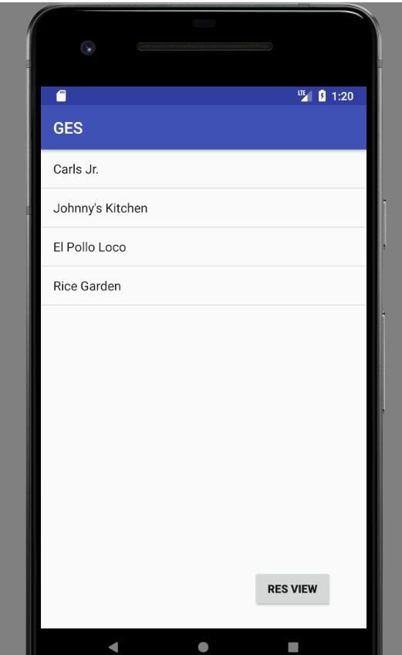
Module 1 : Restaurant Select Module
Restaurant Selection
Menu
Restaurant
View

Slide 7
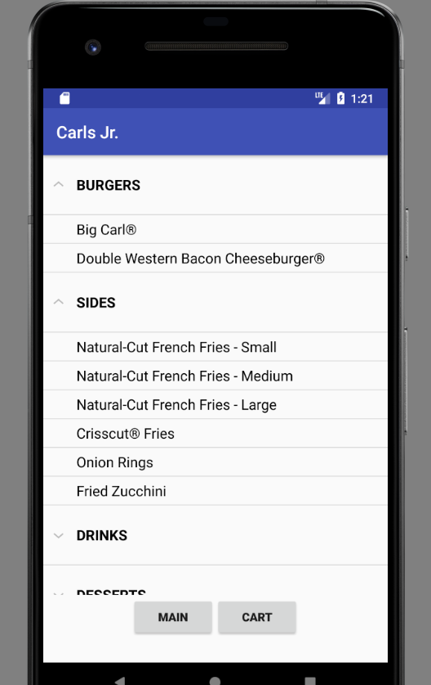
Module 2: Menu Module
Restaurant Selection
Menu
Item Details
My Cart
Notes:
alex

Slide 8
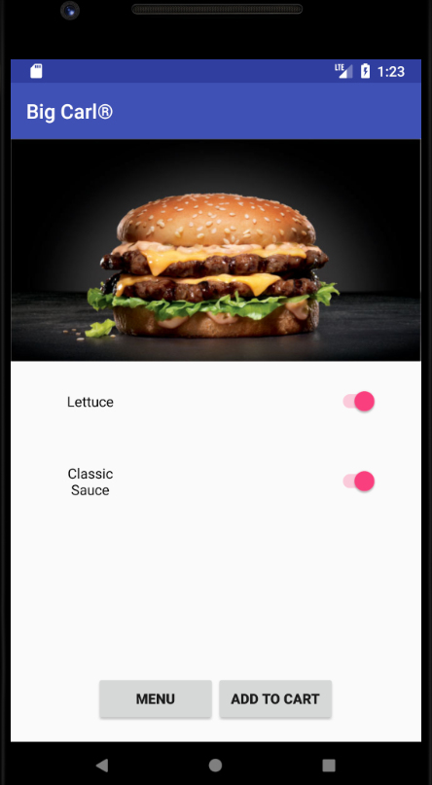
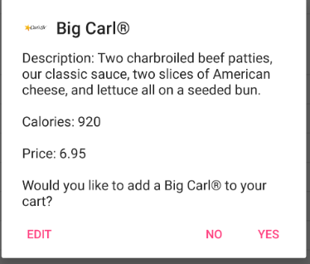
Module 3: Item Details Module
Menu
Item Details
My Cart
Notes:
reb

Slide 9
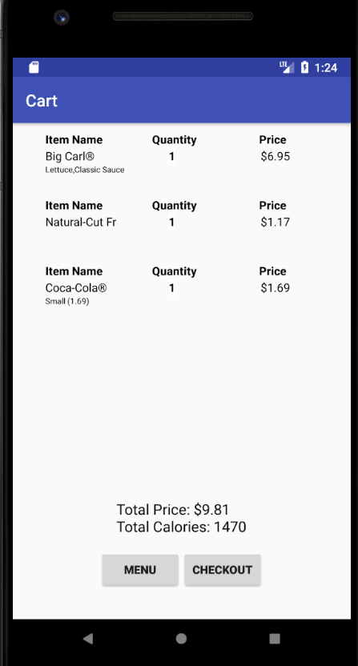
Module 4: My Cart Module
Menu
Item Details
My Cart
Notes:
Rebecca
Freddy/Rebecca
Freddy-explain layout (RecyclerView)
Rebecca-explain cart logic

Slide 10
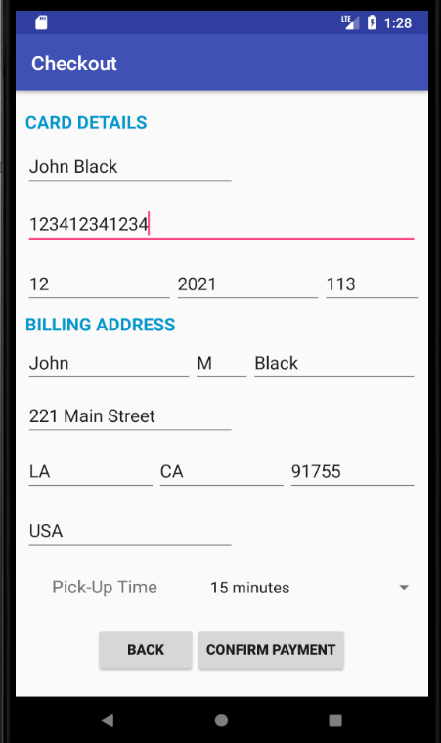
Module 5: Checkout Module
My Cart
Payment
Verification
Checkout
Notes:
rebecca
Ensure valid card number
Valid year + month
Valid CVV
State/Province
Postal
Logic for pickup time

Slide 11
Module 6: Verify Payment Module
Verify Payment
Restaurant
checkout
Notes:
alex

Slide 12
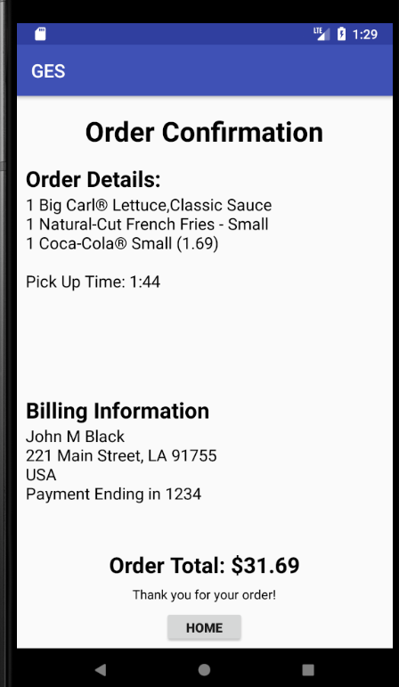
Module 7: Order Confirmation Module
Restaurant Selection
User
Order Confirmation

