Slide 1
Eagle Image Classification
For Hawk Watch International (HWI)

Slide 2
HWI Problem Statement
HWI is measuring eagle behavior while the eagles feed on carcasses near roads
Motion triggered game cameras record eagle behavior for later analysis
HWI has a backlog of about 1 million images needing to be analyzed
Low signal to noise ratio
5% eagles (50,000 eagles in 1,000,000 images)

Slide 3
Specification for Eagle Image Classifier
Automate finding the eagles in the 1 million image backlog
Provide low false negative rate to ensure no eagle data is lost
Tune in favor of allowing false positives
Produce a list of image ranges containing eagles for each image set

Slide 4
Constraint
The solution must run on a laptop. More powerful computing resources are not available to HWI at this time.

Slide 5
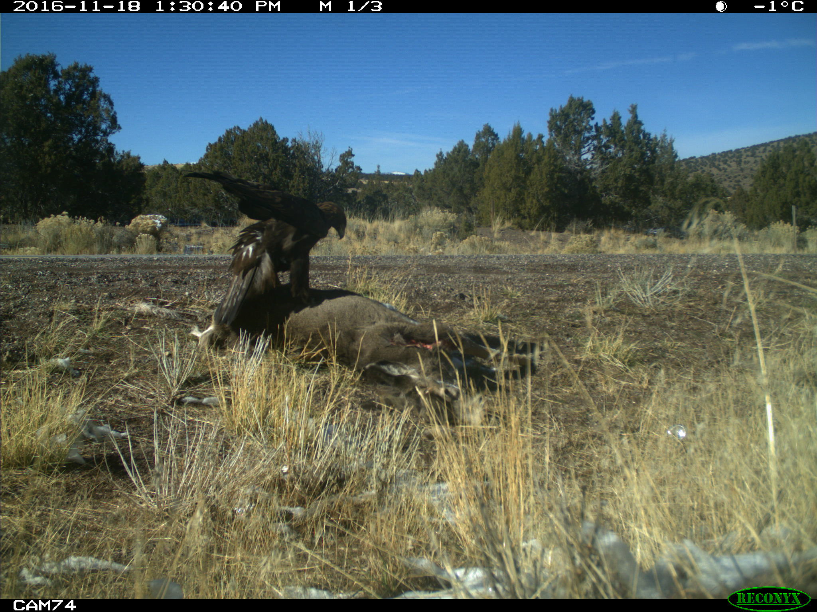
Example Image
Metadata
Datetime stamp
Sequence number /Sequence length
Camera number

Slide 6
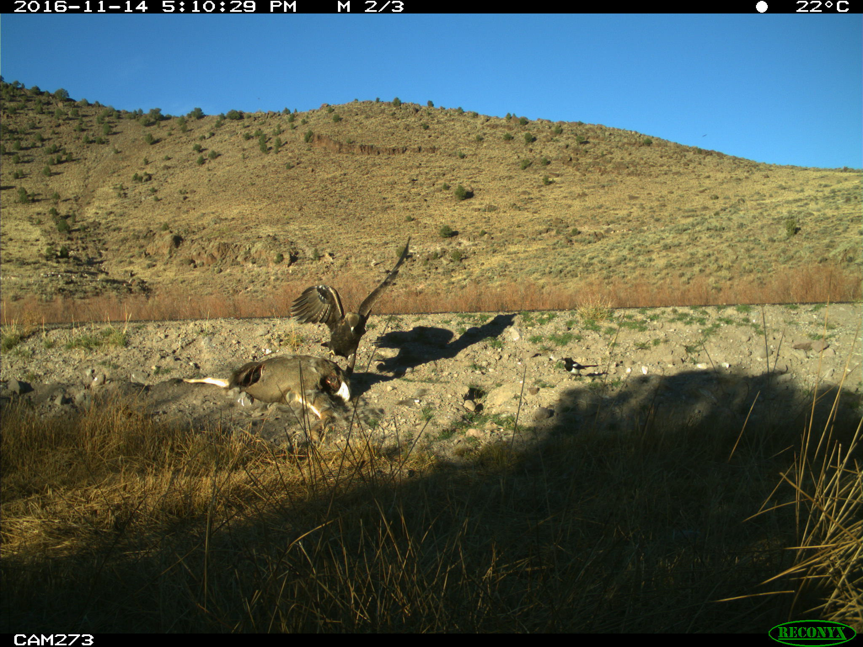
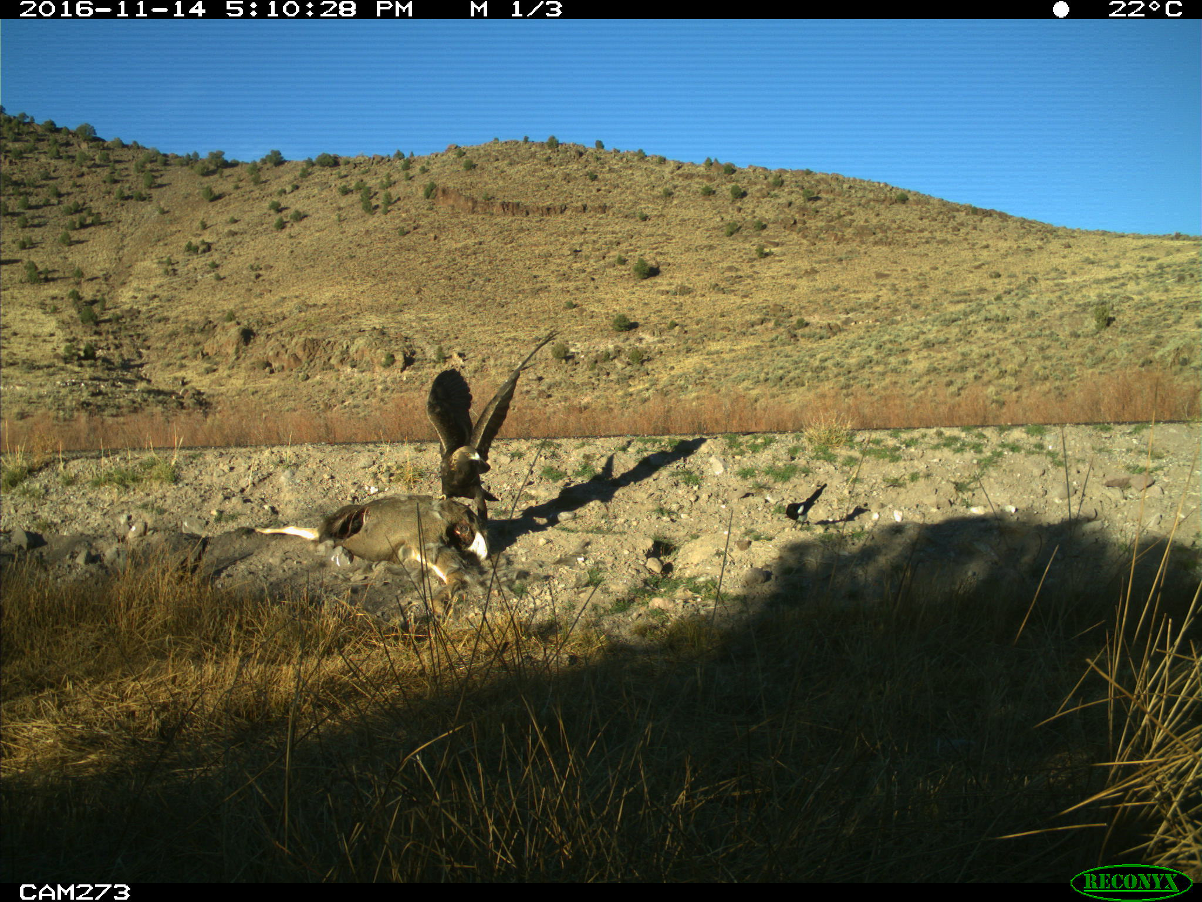
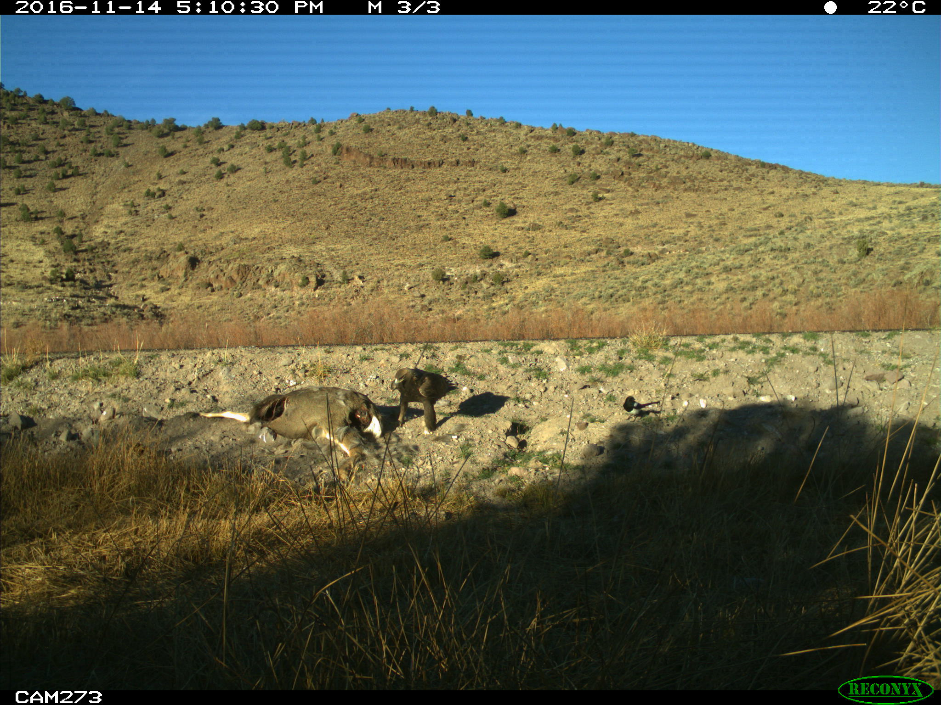
Image Variation
Distance from camera to carcass
Shadows
Clouds
Lighting varies with position of sun
Plants such as grass and sagebrush
Scavengers such as magpies, ravens, dogs, etc.
Cars and trucks
Carcass size (elk, cow, deer, jackrabbit, racoon, skunk)

Slide 7
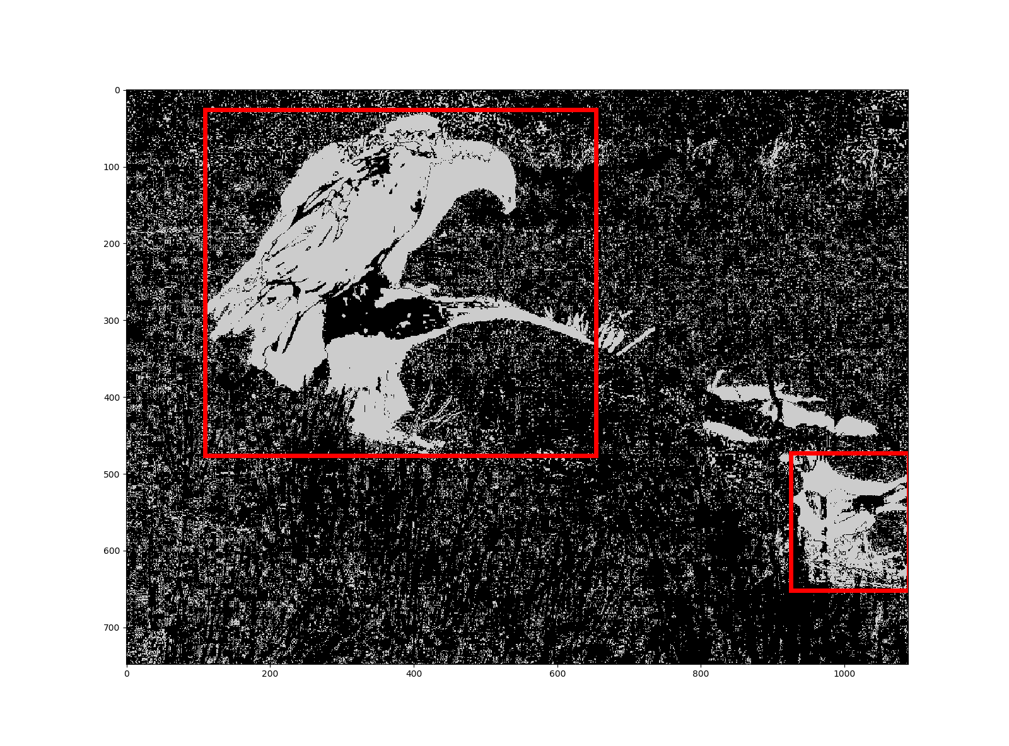
Approach
User selects ROI
Subtract images in a sequence to capture moving objects
Use morphology to calculate bounded boxes (bboxes) around moving objects
Filter to keep large moving objects

Slide 8
Process
User selects ROI
Use difference images in sequence to find moving objects
Use morphology to get bounded boxes (bbox) around moving objects
Calculate aggregate statistics and moments for each bbox
Manually classify bboxes as ‘Eagle’ or ‘No Eagle’ for training dataset
Train a machine learning (ML) classifier model to find the eagles
Predict Eagle/No Eagle for image sets
Evaluate the accuracy of the ML classifier
Look at per/image predictions as a time series to determine time periods when eagles were present

Slide 9
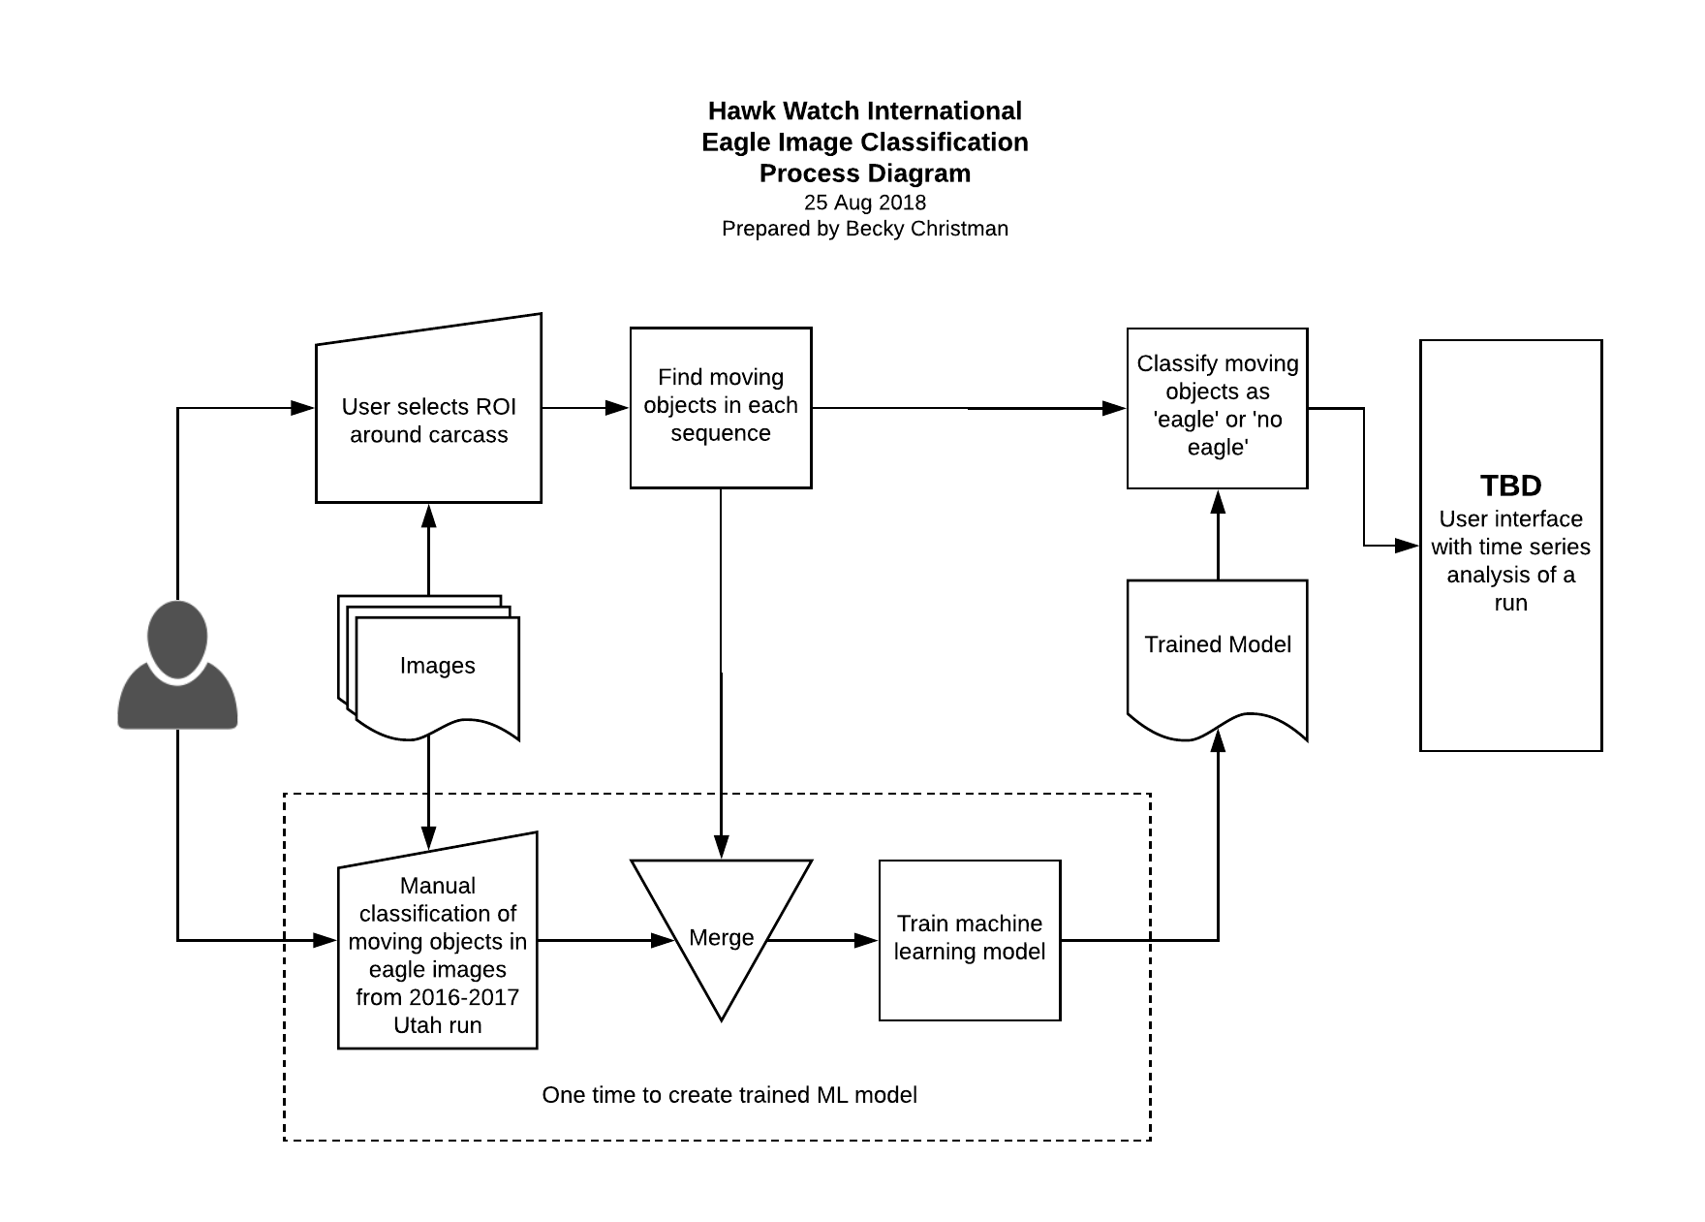
Classification Process Diagram

Slide 10
Feature Set
Area: filled area in bbox normalized to median filled area for the run
Aggregate statistics: mean, standard deviation, skewness of original image intensity in bbox
Hu invariant moments for original image intensity in bbox

Slide 11
Best Results So Far
65% recall: 65% of the images with eagles predicted correctly
THIS IS NOT GOOD ENOUGH. Eagle data would be lost.

Slide 12
Next Steps
Improve the training set
Visualize the data once again to look for correlations that may have been missed
Explore additional feature engineering
Recommend HWI obtain supercomputer resources in order to use neural network machine learning algorithms

Slide 13
Data Visualizations

Slide 14
Results

Slide 15
Conclusion

