Slide 1



Utah Homeless Veterans 2017
View in Power BI
Last data refresh:
3/26/2018 8:30:42 AM Mountain Standard Time
Downloaded at:
3/26/2018 8:32:43 AM Mountain Standard Time
Notes:
Road Home, Switch Point, The Lantern House, and others

Slide 2
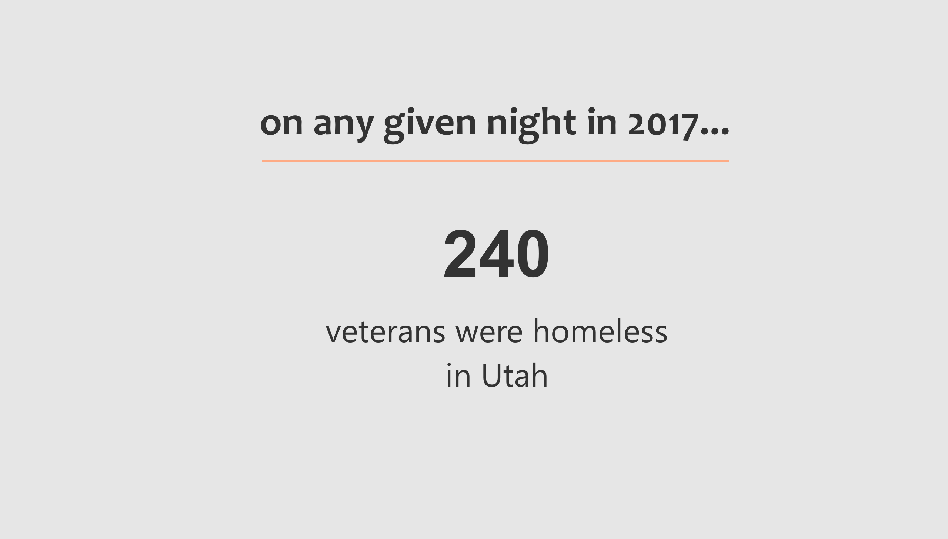
Notes:
Comprehensive Report on Homelessness: State of Utah 2017, Workforce Services, Housing & Community Development

Slide 3
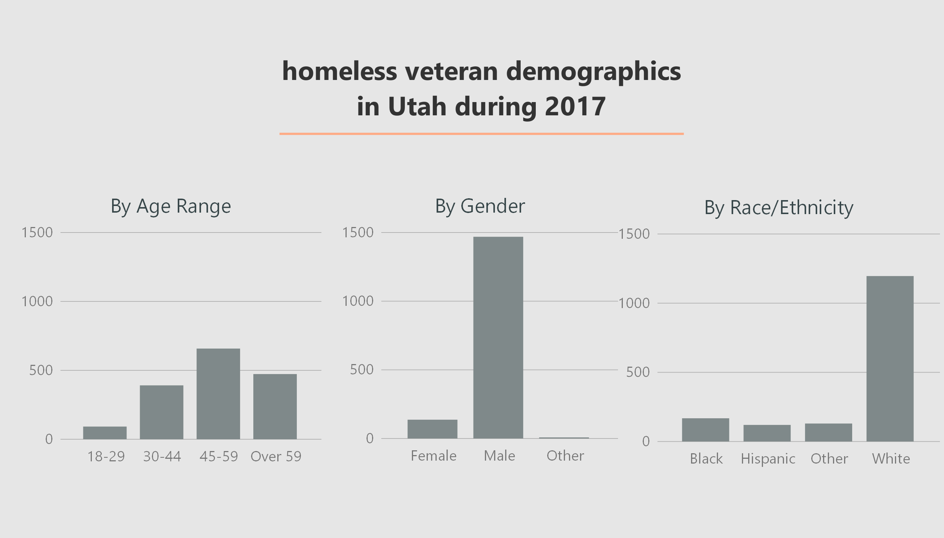
Notes:
Skewed toward Vietnam vets.
More men than women.
Predominantly white. Nation-wide 45% African American.
UDRC provided homeless case management dataset

Slide 4
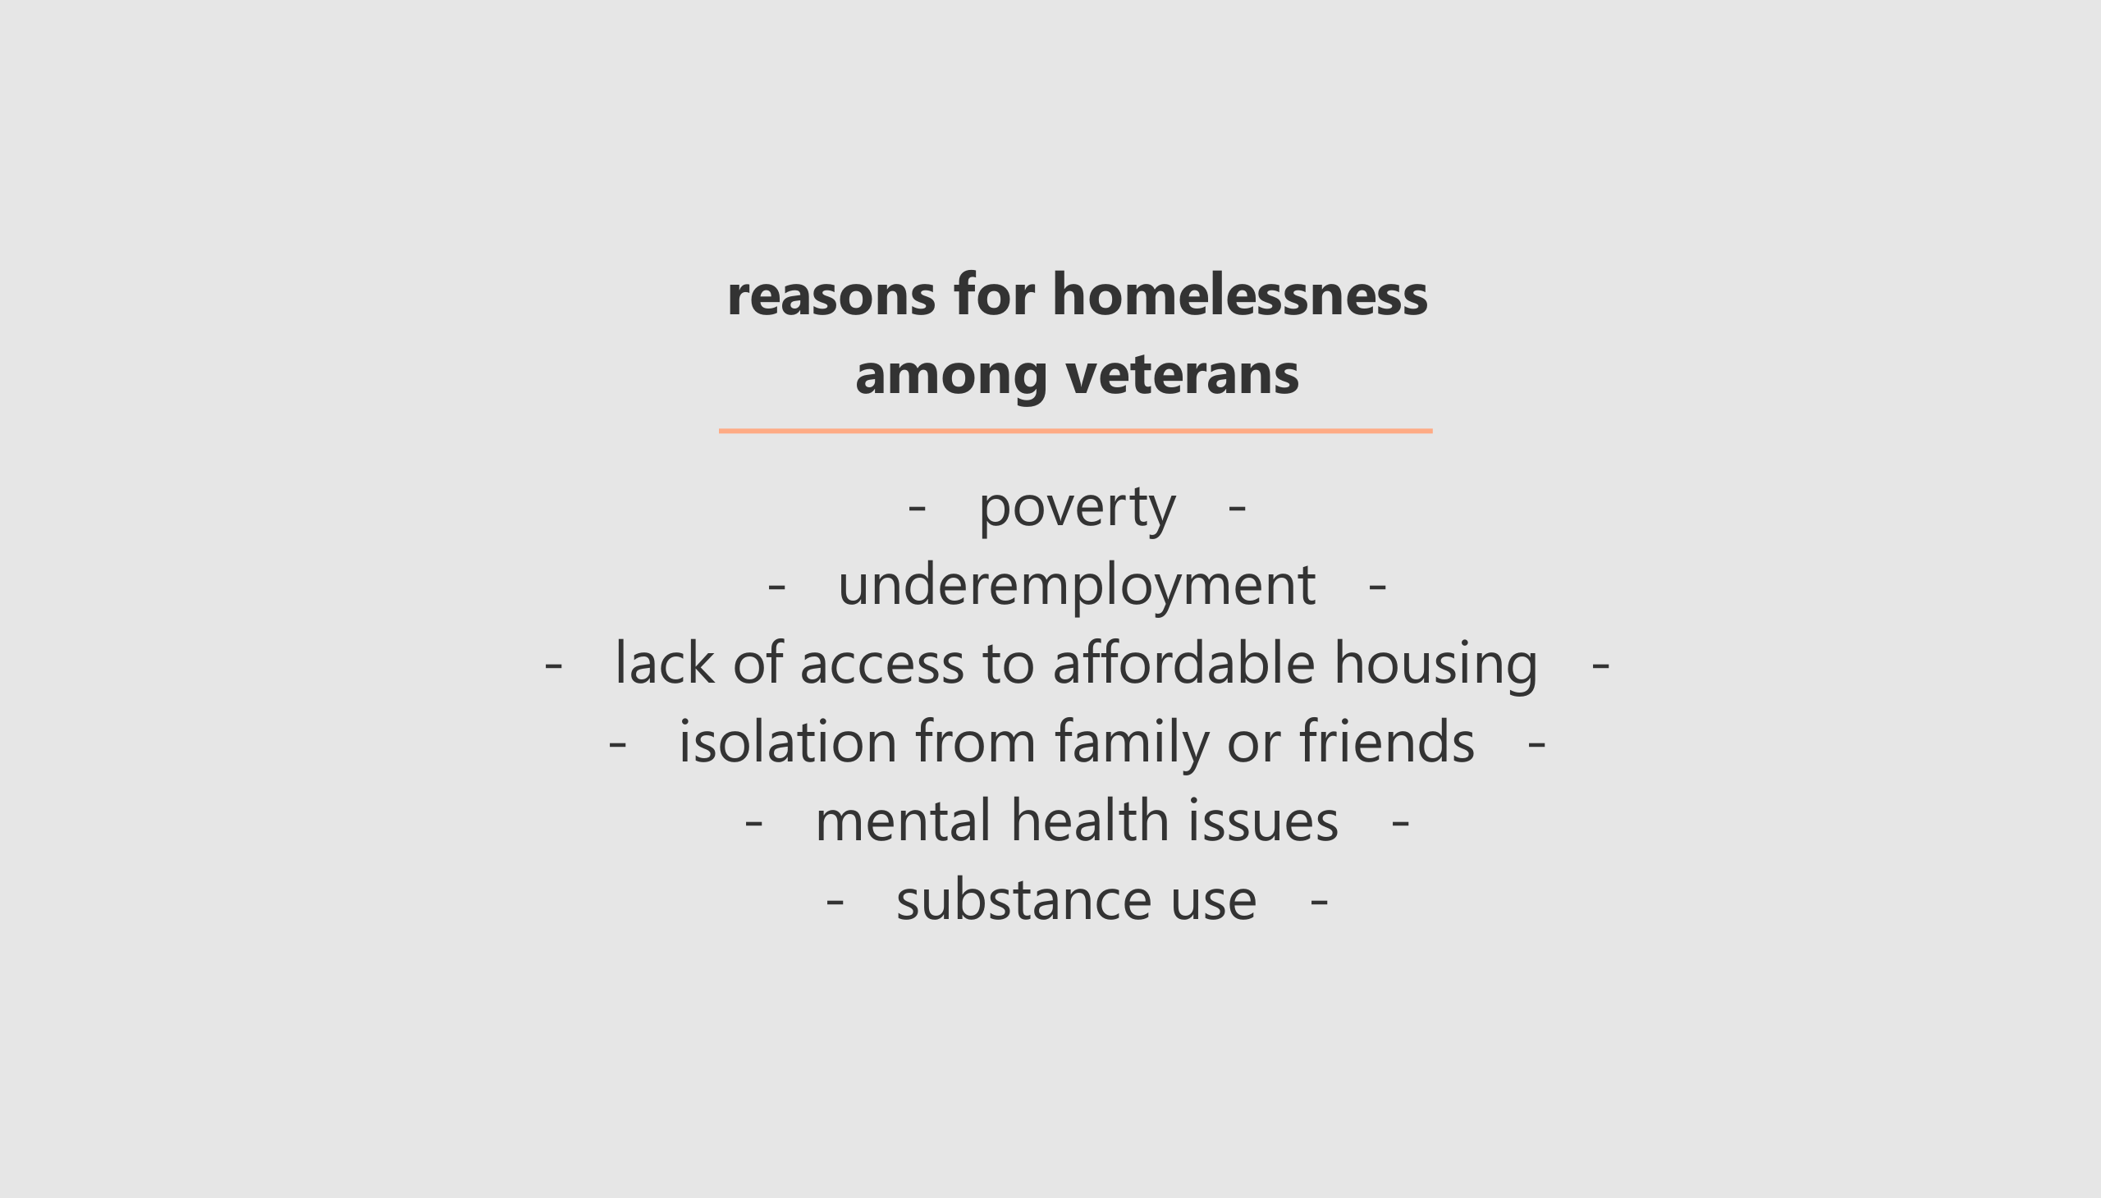
Notes:
Comprehensive Report on Homelessness

Slide 5
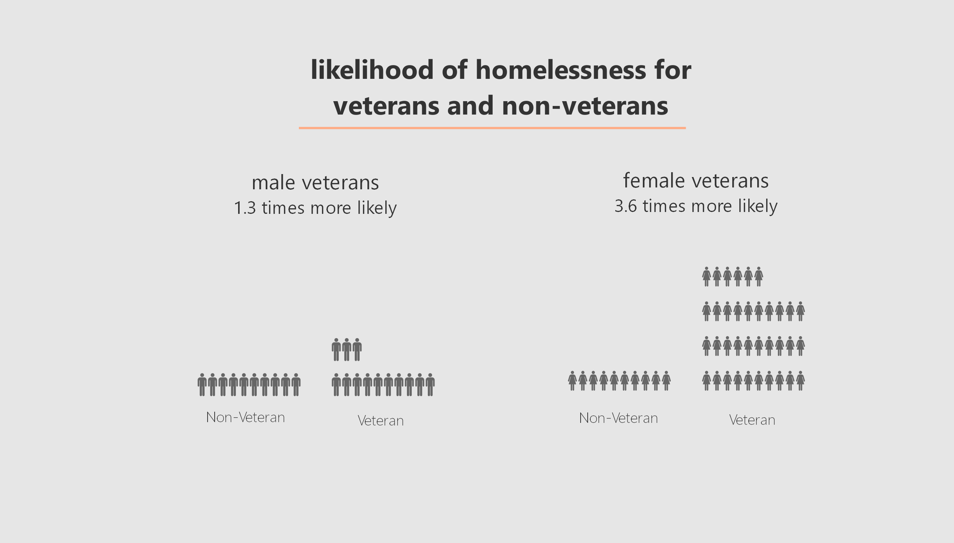
Notes:
Likelihood is determined by statistical inference—predictive analysis
APA - American Psychological Association

Slide 6
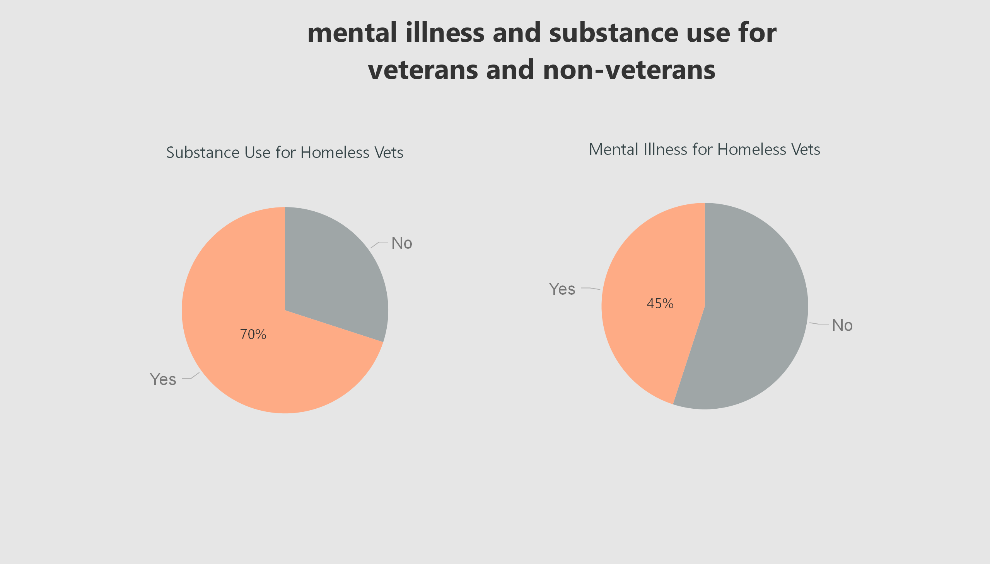
Notes:
APA - American Psychological Association

Slide 7
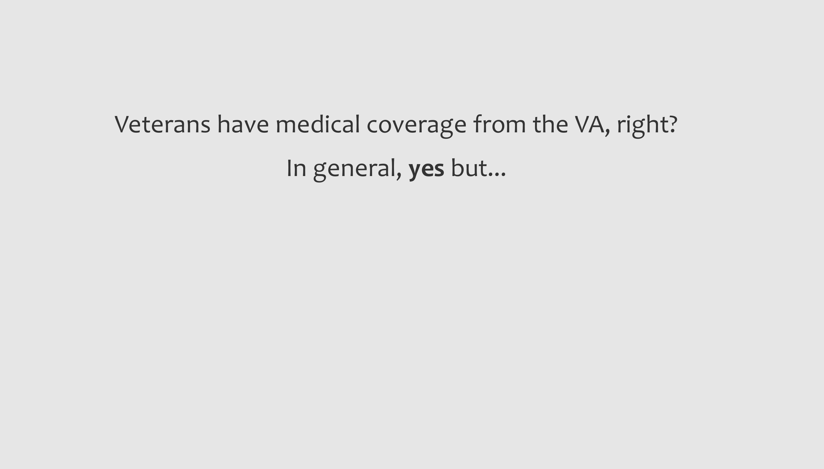

Slide 8
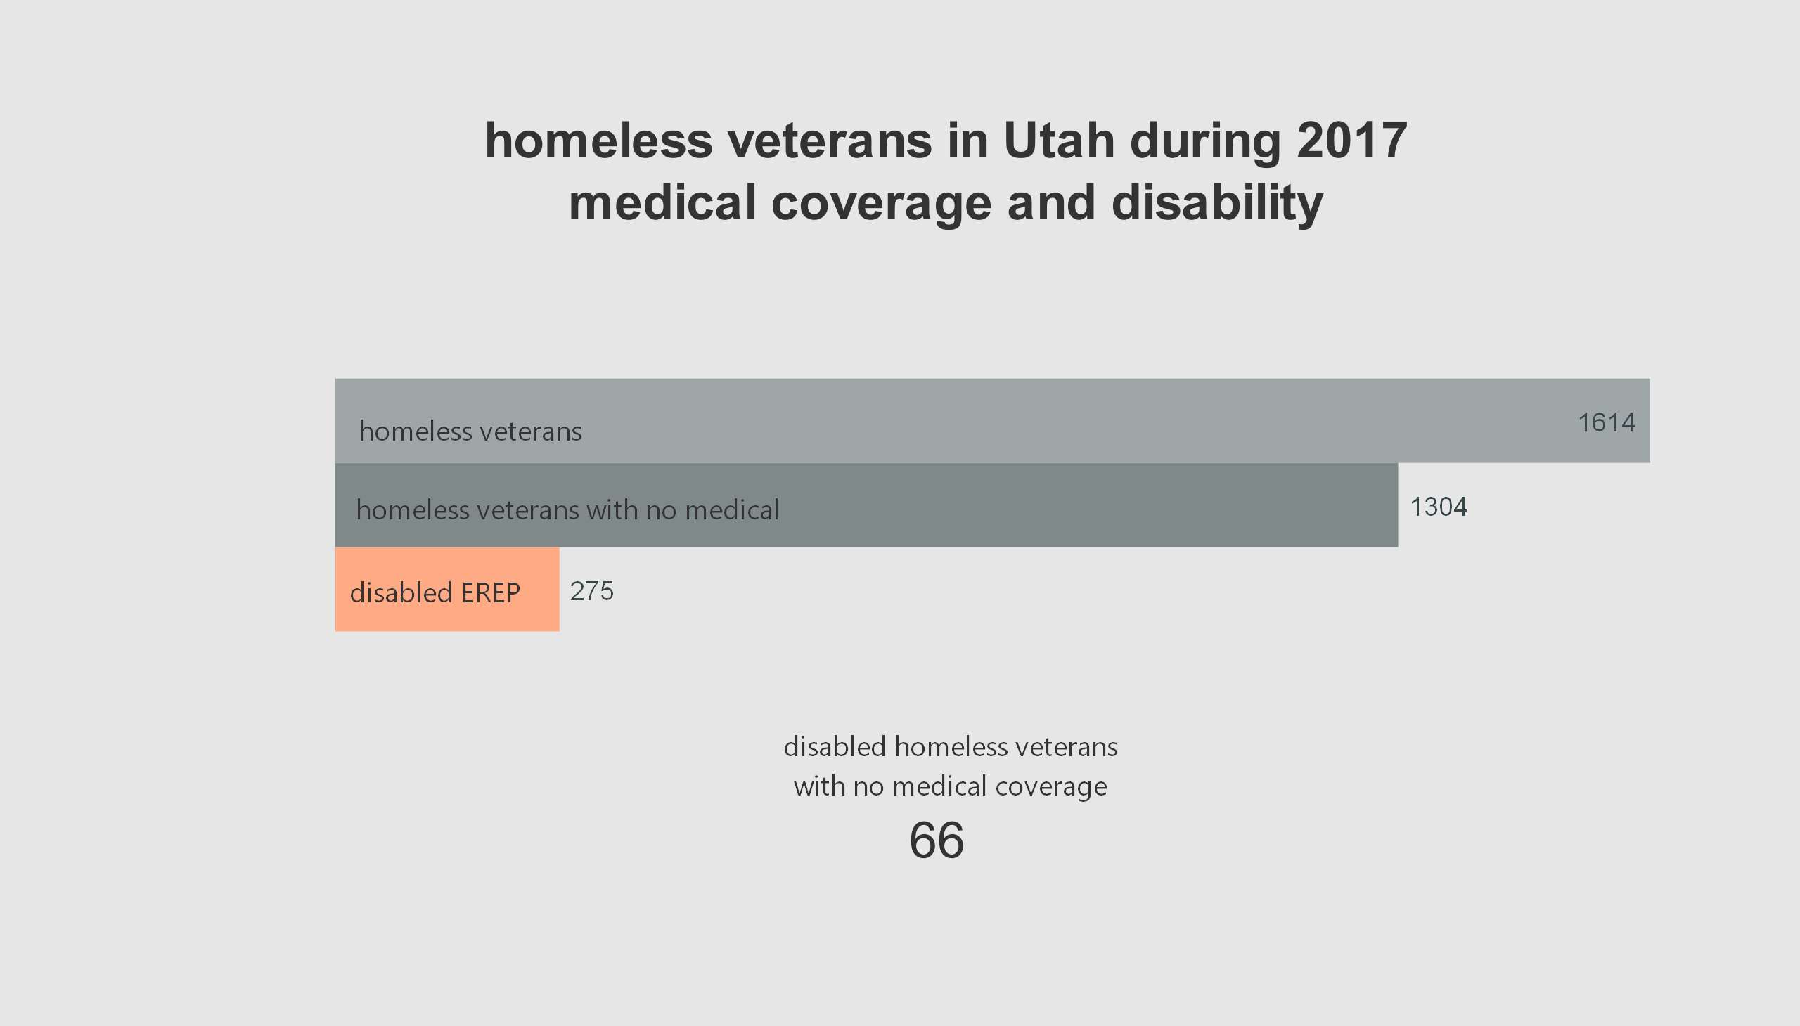
Notes:
UDRC provided homeless case management dataset

Slide 9
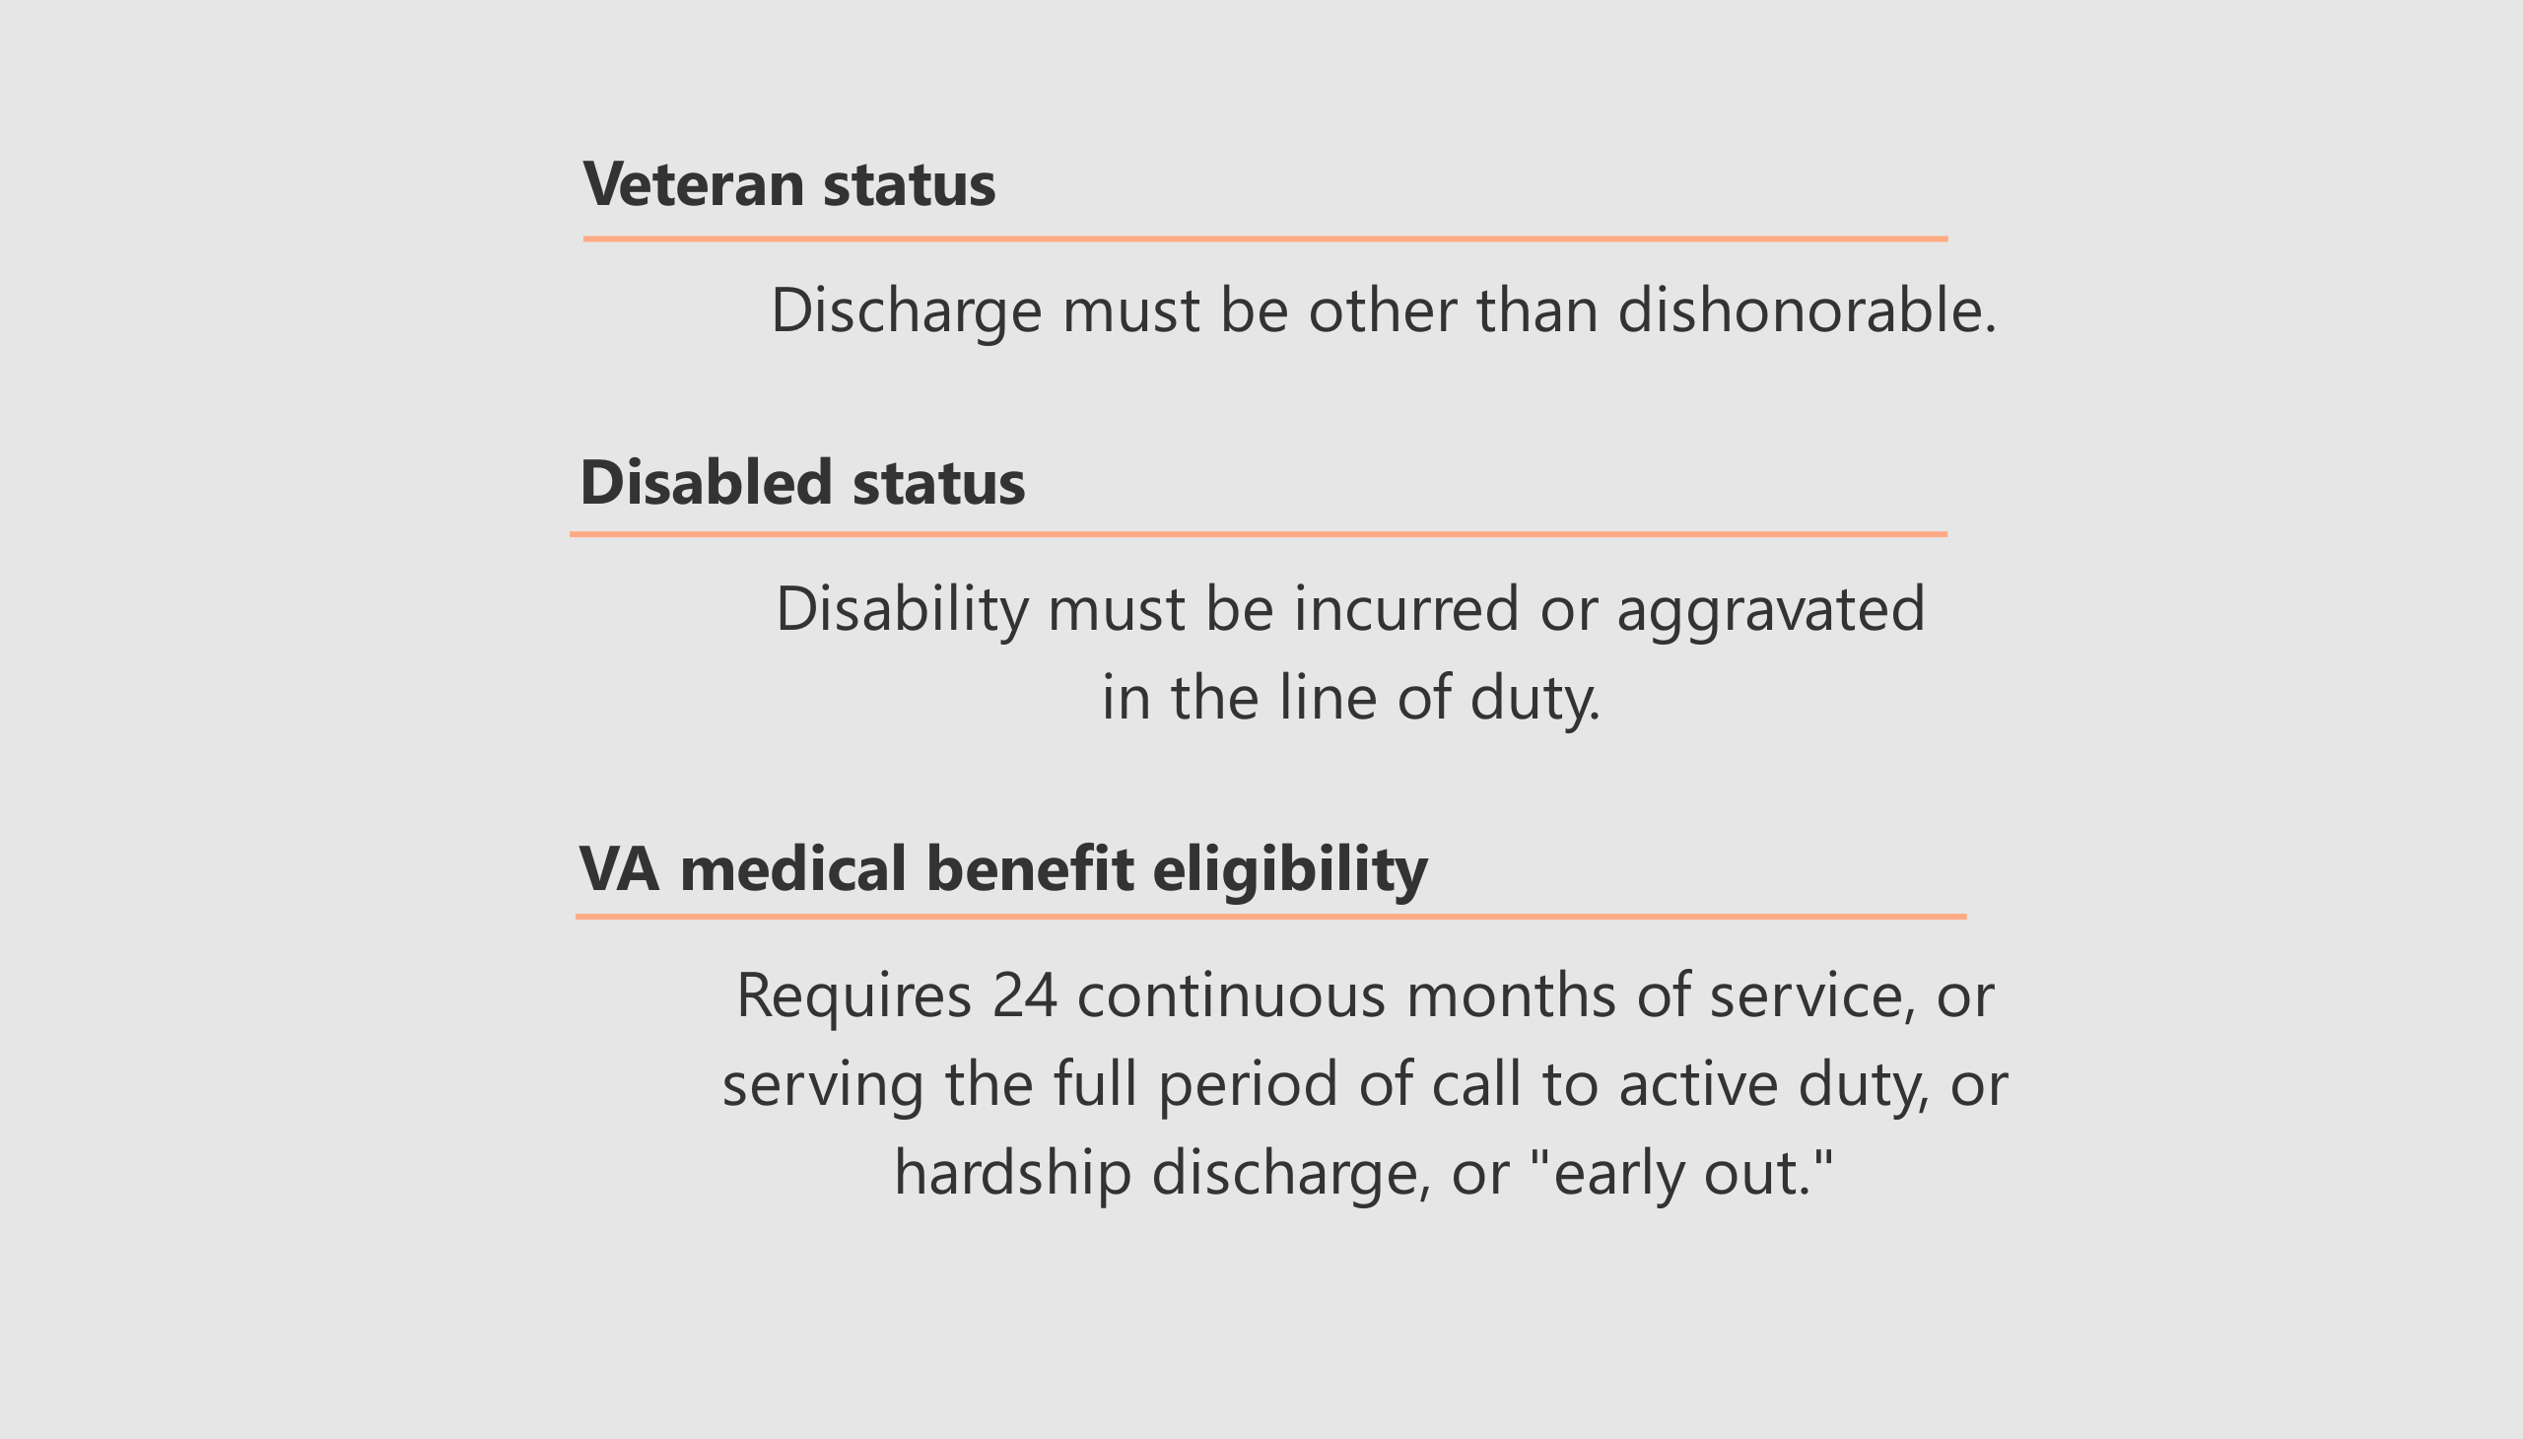
Notes:
Dishonorable discharge is equivalent of a federal felony. Reasons are AWOL, sedition, sexual assault, manslaughter & murder.
Other discharge statuses are general, less-than-honorable and honorable
U.S. Department of Veteran Affairs website

Slide 10
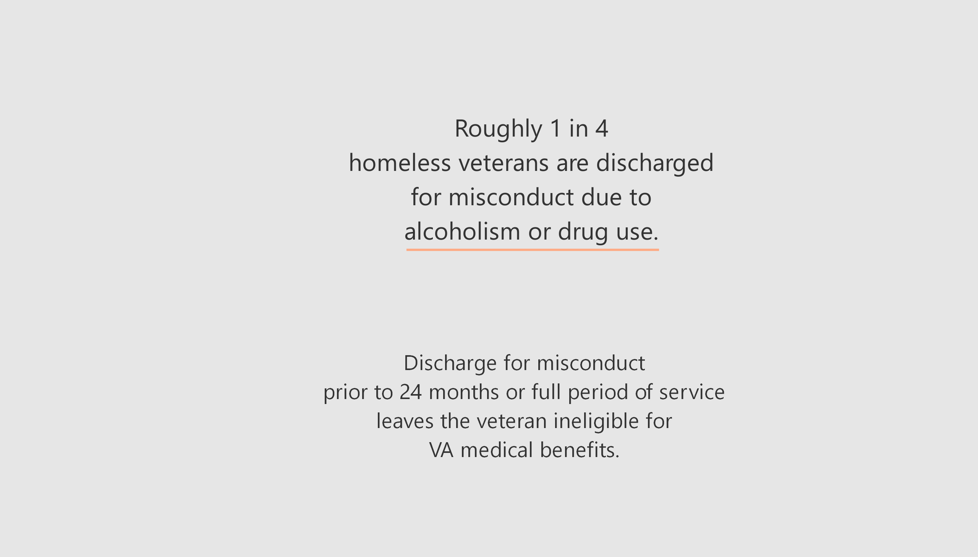
Notes:
0.25 * 1600 = 400
JAMA – Journal of the American Medical Association
5.6% of active-duty discharged for misconduct.
This group is 25% of veterans who are homeless at the first VA encounter
28% at the one-year mark, and
20% five years out.
U.S. Department of Veteran Affairs, Office of Research and Development
JAMA – Journal of the American Medical Association

Slide 11
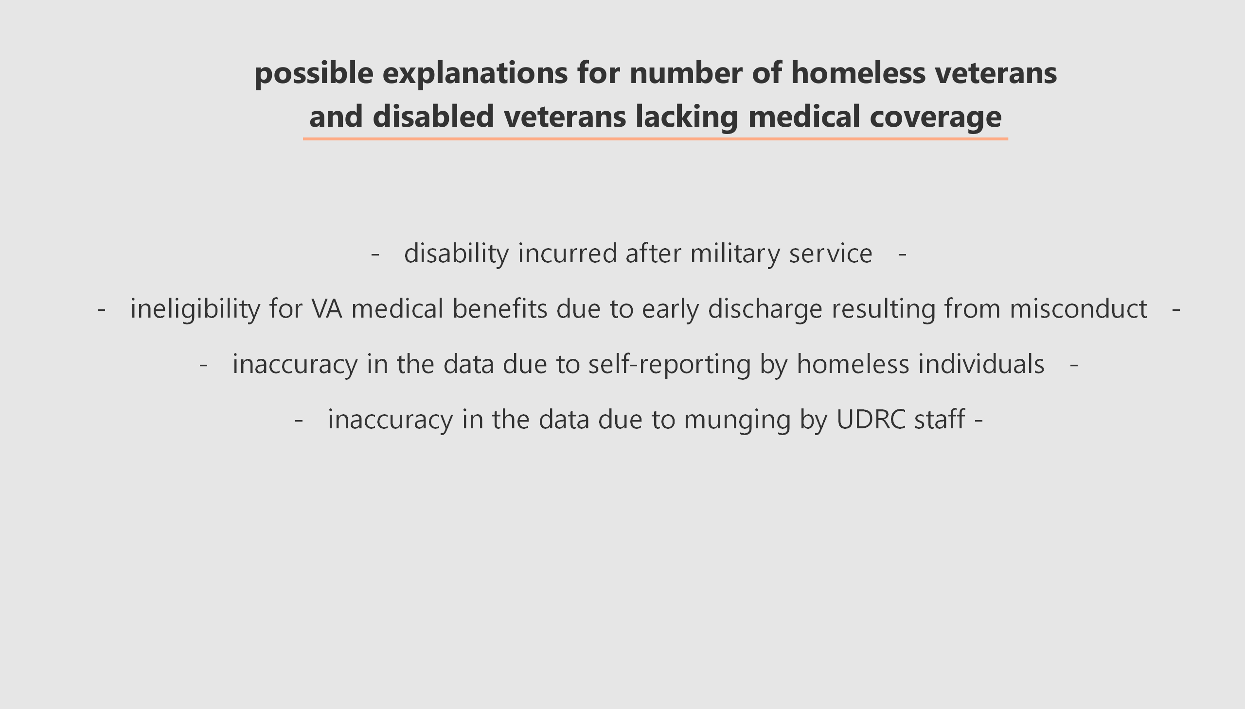

Slide 12
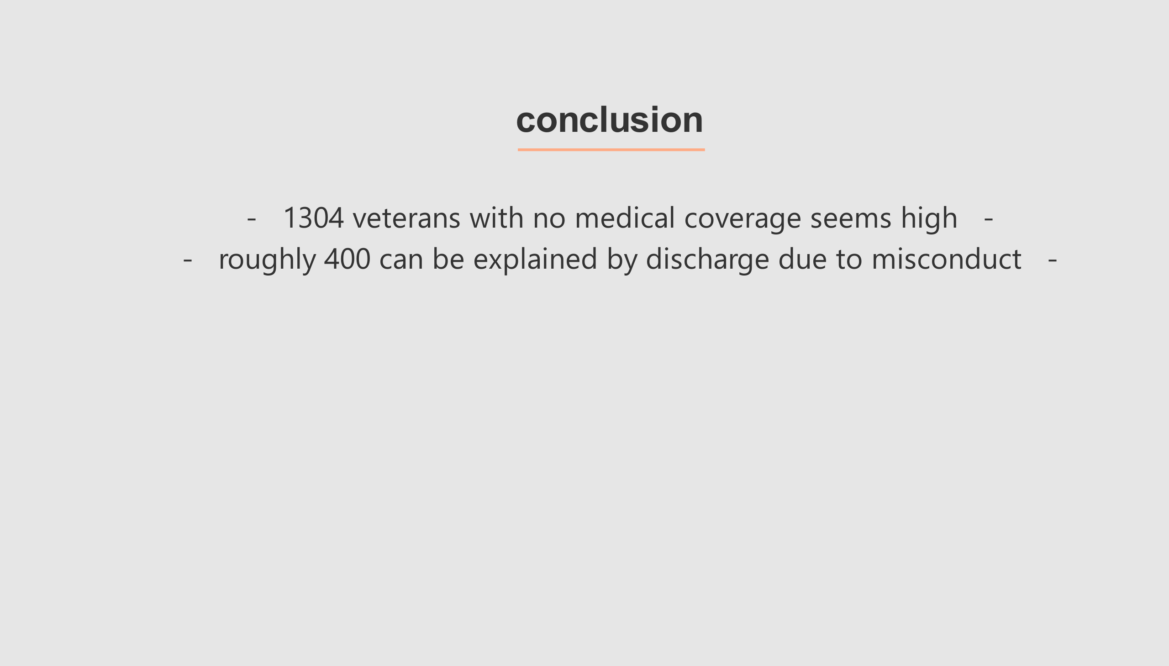
Notes:
Out of the 1614 homeless veterans

Slide 13
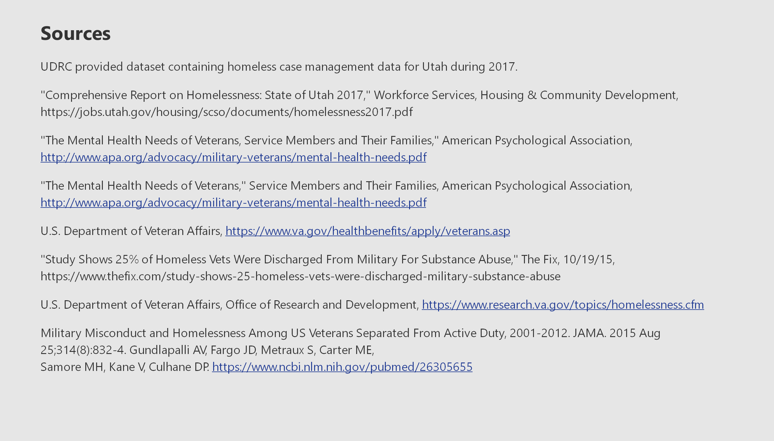

Slide 14
