Slide 1

Data Analysis-Cyclistic Case Study
By Rebecka Mangrah
2023

Slide 2
To design new marketing strategies
to convert casual riders into annual members
WHY THIS PROJECT?

Slide 3
Main question:
How do annual and casual riders use Cyclistic bikes differently?

Slide 4
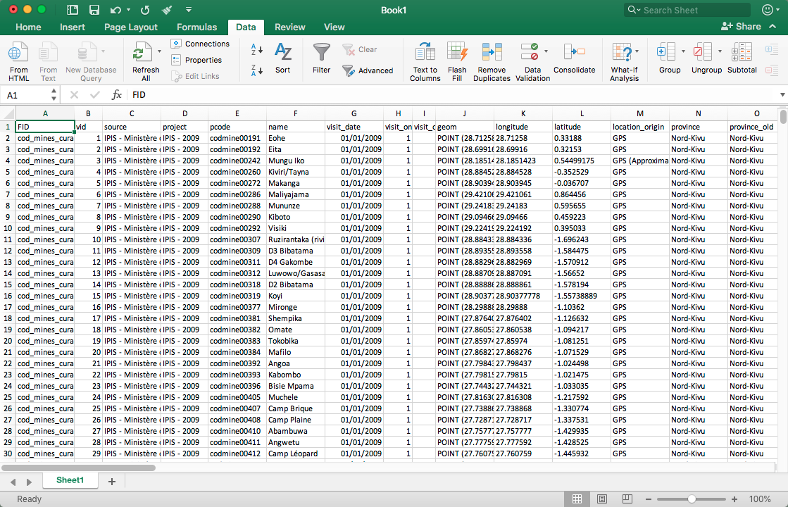
What have been analysed?
January to July 2023 Cyclistic dataset

Slide 5





Mean and maximum ride length
Most recurring day
Average ride length per day
Average ride length between casual and annual riders
Total amount of rides per day

Slide 6
Observations?

Slide 7


Average ride time
January
July

Slide 8
Peak Season:
May to July

Slide 9



Months | Most recurring day
January | 3
February | 3
March | 4
April | 7
May | 3
June | 6
July | 7
Most recurring day:
Tuesday
1 = Sunday 7 = Saturday

Slide 10
Most recurring day differs among casual and annual riders

Slide 11









Casual:
Saturday and Sunday
Annual:
Tuesday
Months | Casual recurring day
January | 1
February | 1
March | 4
April | 7
May | 1
June | 7
July | 7
Months | Annual recurring day
January | 3
February | 3
March | 4
April | 5
May | 3
June | 6
July | 2

Slide 12


Average casual ride time > average annual ride

Slide 13
However

Slide 14
Total casual riders < total annual members

Slide 15
What to be concluded?

Slide 16


Peak Season:
Spring-Summer

Slide 17
Casual members
- less frequently
- longer trips
- prefer weekends
Annual members
- more frequently
- shorter trips
- prefer weekdays

Slide 18
Recommendations

Slide 19
- single ride pass available for only 20 mins
- increase of full day pass
- introduction of weekends membership and instalments
First
recommendation

Slide 20
Second
recommendation
- increase of membership services

Slide 21
Weekends membership
Annual membership
- Bikes reservation up to two people
- Second priority access during peak times
- Available every week: Friday to Sunday
- have to renew every week
- Bikes reservation up to four people
- First priority access during peak times
- Available for whole year
- if refer our program to a new member, the client will get a 20% discount for the next year

Slide 22
- implement marketing advertisements during Spring-Summer
Third
recommendation

Slide 23
Thank you for your partecipation

