Slide 1
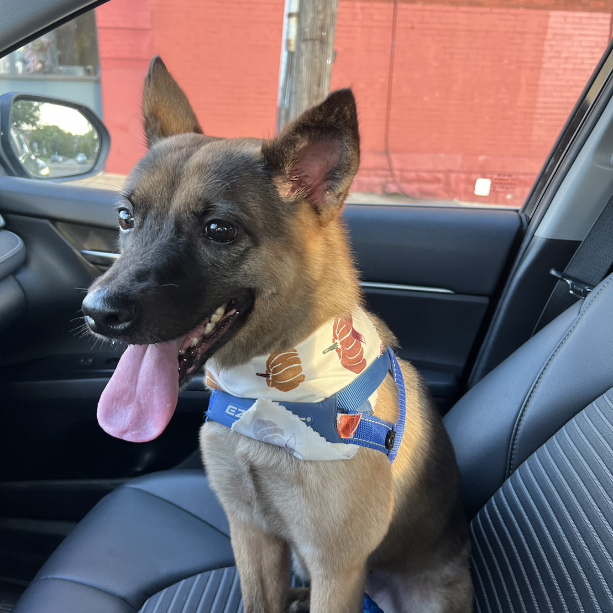
Animal Adoption Trends and Analysis in Austin, TX
Presenter: Rebekah Chuang
Notes:
Today the topic I’m going to present is the animal adoption trends and analysis in Austin Texas.
League of legends

Slide 2
Outline
Introduction
Exploratory Data Analysis
Hypothesis
Research Question
Conclusions & Improvement

Slide 3
Introduction
Sources: City of Austin Animal Center
Datasets: Animal Intake Data, Animal Outcome Data
Notes:
There are two datasets: animal intake data and outcome data. They have been provided by the City of Austin, collecting data from October 1st, 2013, to the present day (and they are updated daily). These datasets track the journey of animals from the moment of intake to their eventual adoption or transfer, including those still awaiting.

Slide 4
Introduction
Neutering/spaying pets is mandatory in Taiwan($1500 to $8000 fines)
Black, large, old, or mixed-breed dogs face lower adoption rates
Ownership of Pit Bulls is prohibited in Taiwan($1500 to $8000 fines)
Notes:
The reason why I would like to do research on this topic is that I want to know what’s the difference between Taiwan and America, before starting this presentation I would like to talk a little bit about what’s the policy or situation in Taiwan
Neutered/Spayed for your pet is mandatory in Taiwan($1500-$8000 fine)
Black/Large/Old/Mixed Dogs have less probability of being adopted
People perceive black dogs as less cute than others, and given Taiwan's small size and high population density, most people live in apartments. This makes it challenging to provide enough space for larger dogs to expend their energy.
Having a Pit Bull is illegal in Taiwan(The reason is that there have been too many cases of Pit Bulls hurting or even accidentally killing people. If you already owned a Pit Bull before March 2022, you are required to report it. However, there is no way to adopt or buy one legally, and owning one afterward could result in fines ranging from $1500 to $8000.)

Slide 5
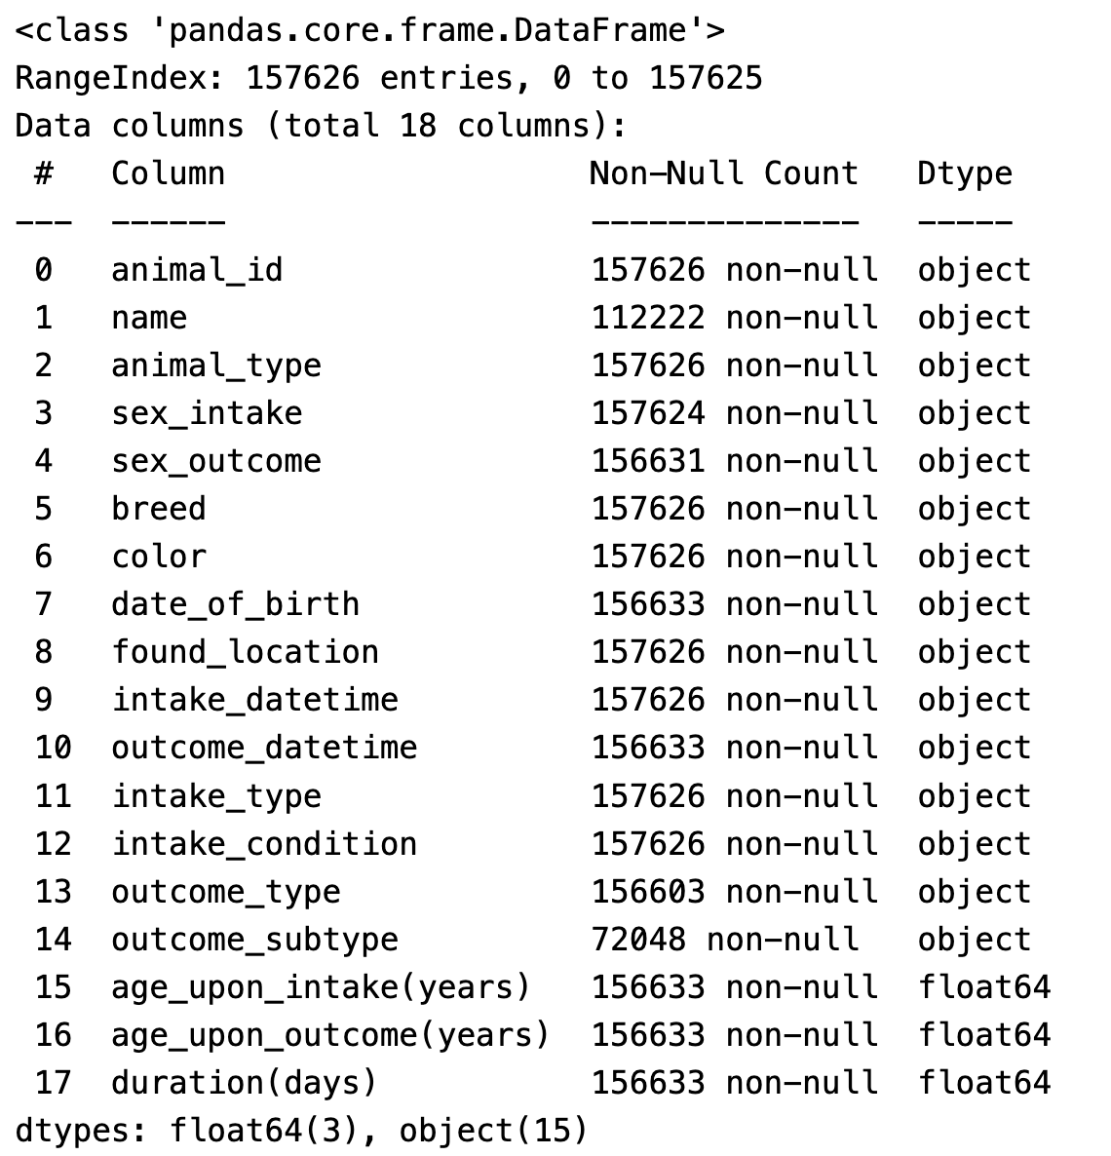
Exploratory Data Analysis
Notes:
This dataset represents the merged information from both intake and outcome datasets. Each row contains an animal's intake and outcome information. If the animal is still in the animal center, their outcome information would be represented as a NaN value. Now, I’m going to show some simple visualizations of EDA.

Slide 6
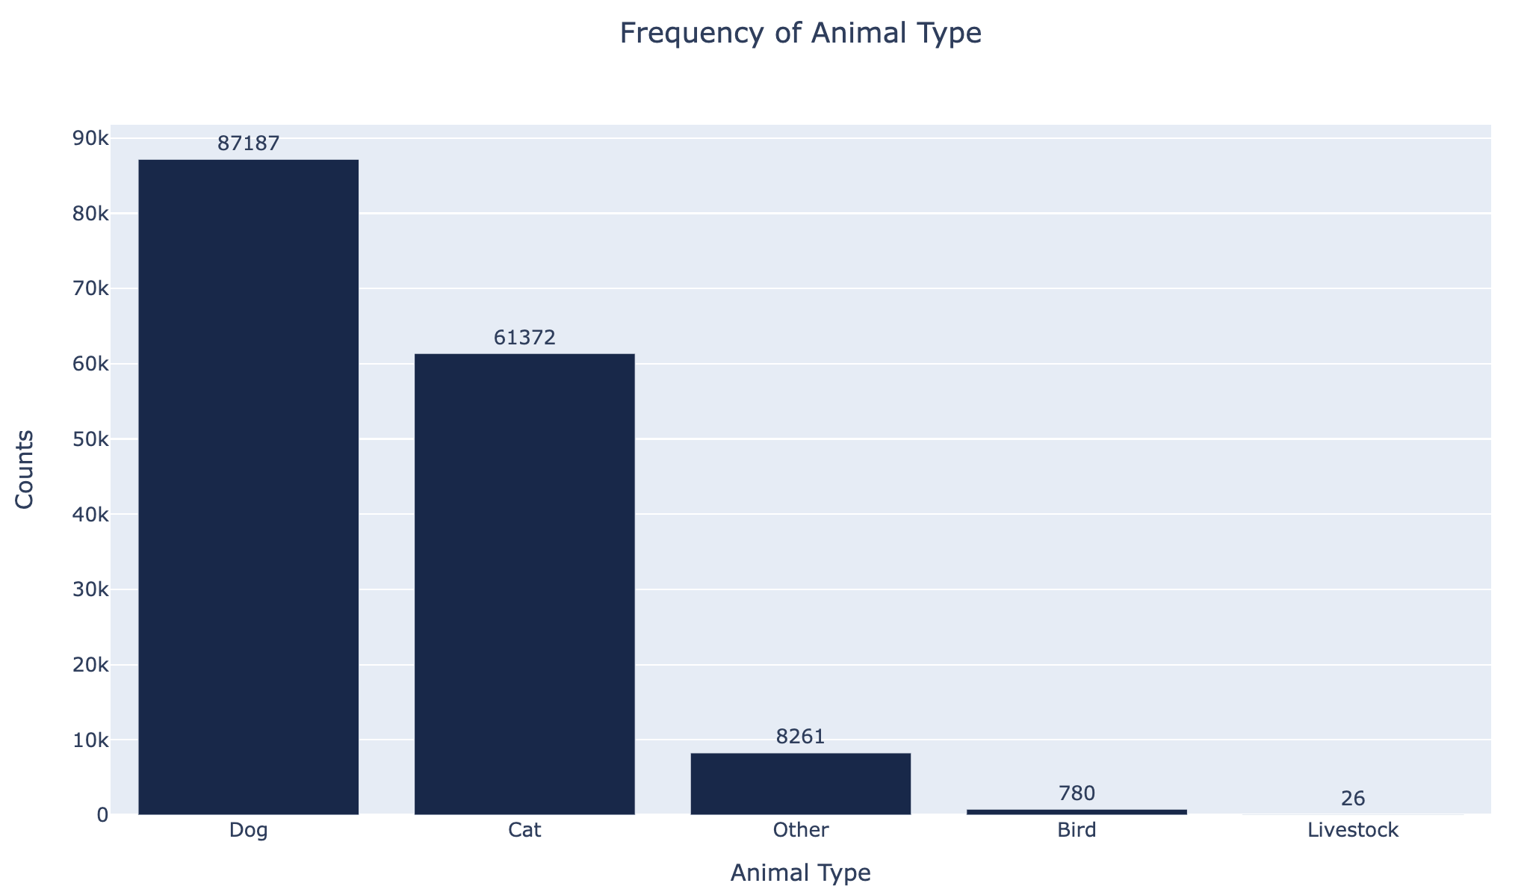
Notes:
The first chart shows the frequency of animal types among these five categories. Dogs and cats are the most common ones.

Slide 7
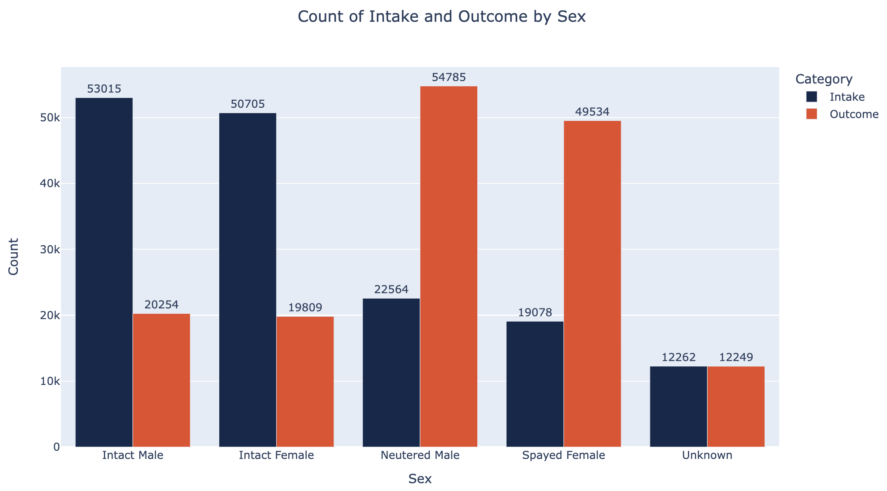
Notes:
This chart displays the sex by intake and outcome. The reason for having two columns to represent sex is that some animals undergo neutering or spaying during their stay at the center. Upon reviewing the plot, it’s evident that the number of neutered or spayed animals is significantly higher than those that remain intact.

Slide 8
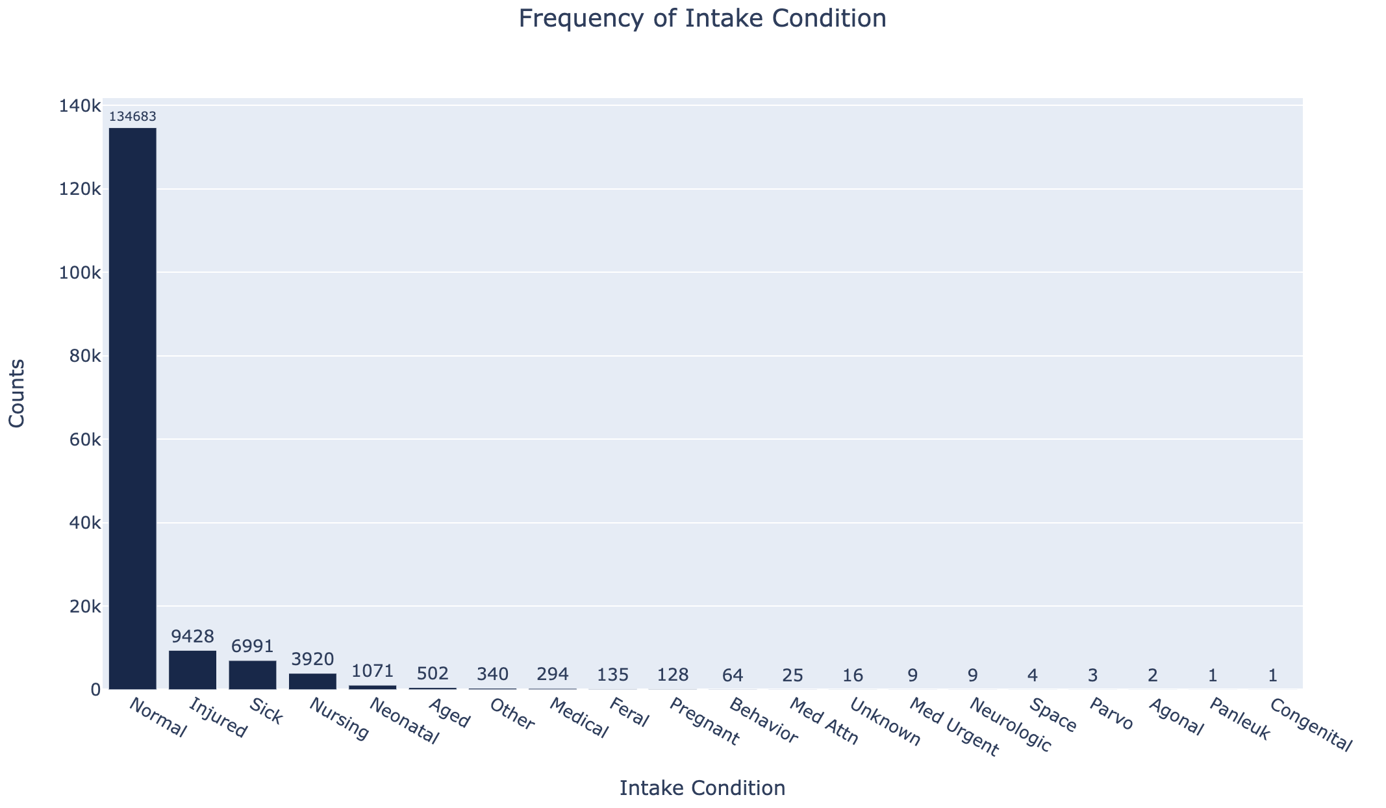
Notes:
For intake condition, the majority of the animals are in normal condition, however, there are several animals that are injured, sick, or have special diseases.

Slide 9
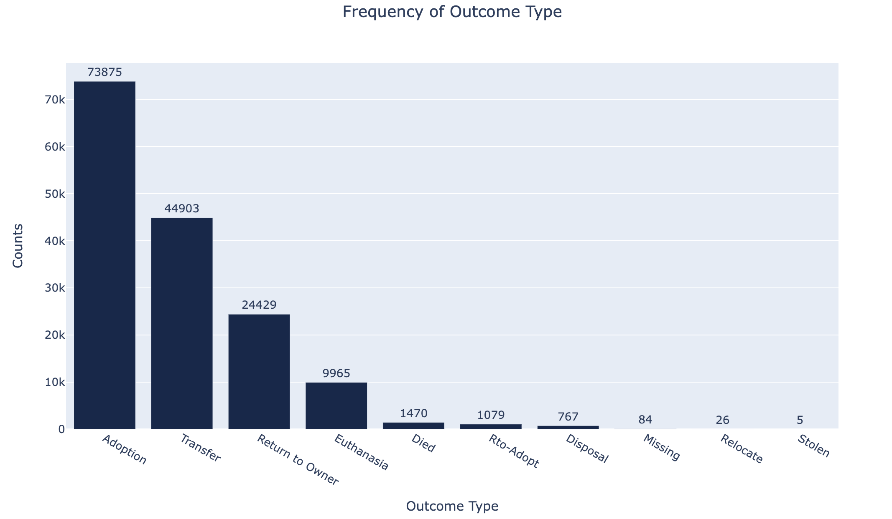
Notes:
This chart represents the frequency of outcome types, including adoption, transfer, return to owner, and others.

Slide 10
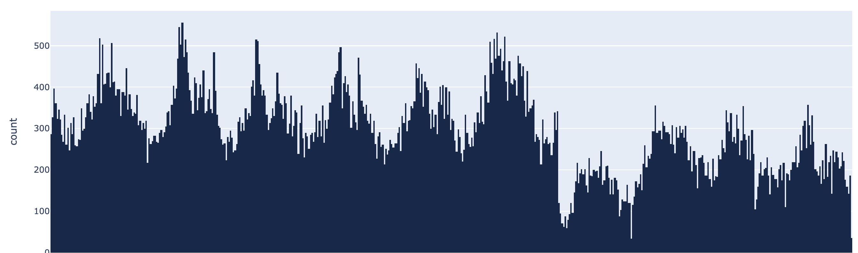
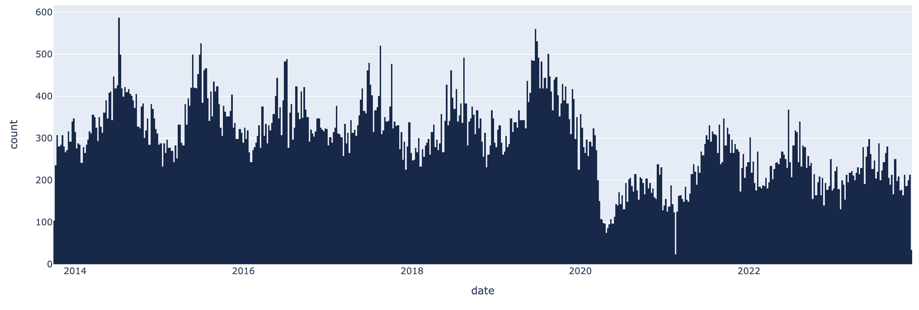
Notes:
This graph shows how intake and outcome numbers have changed over time. If you take a look at the distribution, you can see that there’s a significant drop in both intake and outcome
If we zoom in on the plot, we can see that this drop occurred specifically around April and May 2020.

Slide 11
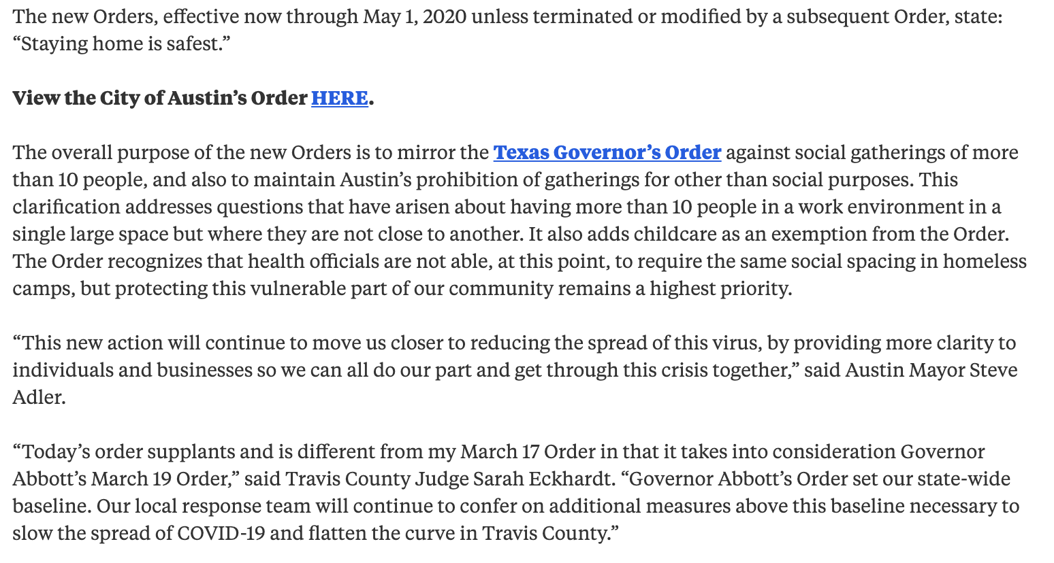
Source: City of Austin
Notes:
One possible explanation could be the city of Austin's decision to extend the stay-at-home policy starting from the end of March.

Slide 12
Hypothesis 1
Is there a correlation between the neuter/spay status of animals and their age?
H0: There is no significant relationship between neuter/spay status and age in animals.
H1: There is a significant relationship between neuter/spay status and age in animals.
Notes:
In the next part, I’m going to talk about the 4 hypothesis in this project. The first hypothesis is ……
Although there is no specific age limit for undergoing the procedure, the recommended time to spay or neuter a dog or cat is typically between six to nine months. Sometimes, people may have concerns about the risks associated with surgery in older animals. Moreover, if their animal hasn't displayed behavioral issues related to mating behaviors or health problems related to remaining intact, some owners might feel less urgency to proceed with the surgery.

Slide 13
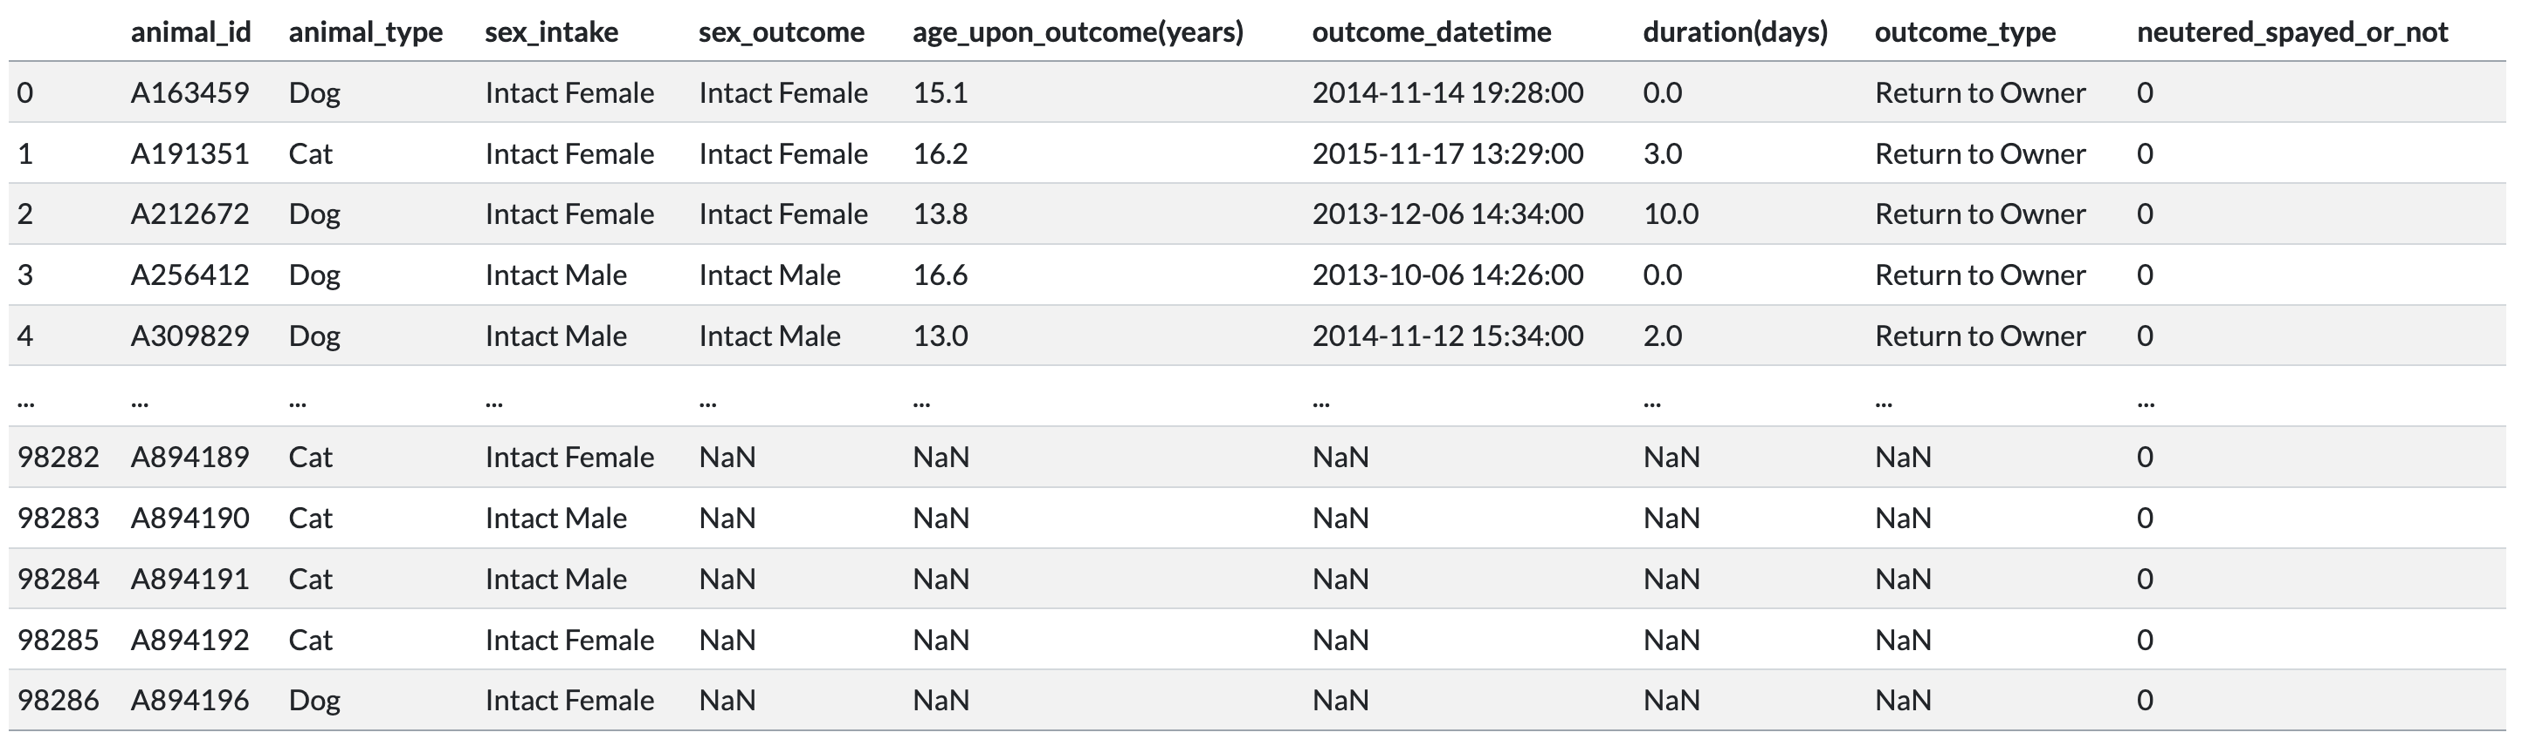
Keep only animals that
were intact upon intake
Create a new column indicating
the neutered or spayed status of the animal
Keep only dogs and cats
Notes:
This is how I test my hypothesis: Firstly, I only retain data related to dogs and cats as they are the more commonly neutered or spayed animals. Secondly, I only include data where the animals were intact upon intake.

Slide 14
63.5% of the animals that were intact before have been neutered/spayed upon outcome
Notes:
Looking at the overall data, 63.5% of the animals that were intact before have been neutered or spayed upon outcome.

Slide 15
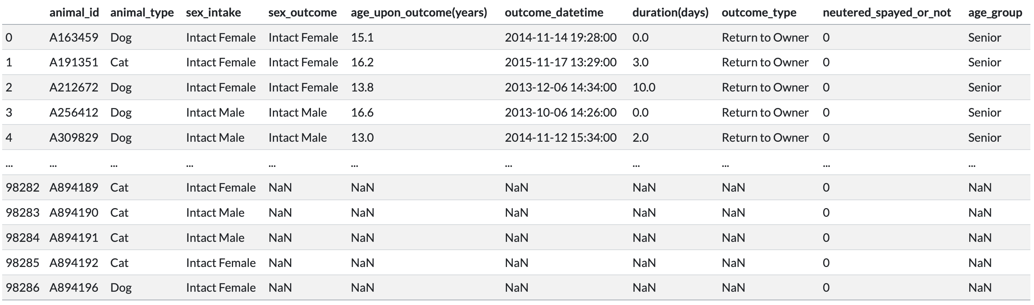
Classify ages into three groups:
- Young (0-2 years)
- Adult (2-7 years)
- Senior (7 years and older)
Notes:
Next, we'll determine whether an animal's age affects their neuter/spay status or not.
I've categorized ages into three groups: animals between 0-2 years old are considered young, those between 2-7 years old are labeled as adults, and those older than 7 years old are classified as seniors.

Slide 16
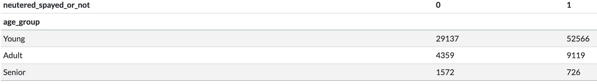
Contingency Table(Age VS. Neutered/Spayed Status)
The neuter/spay rate for young dogs/cats is 64.34%
The neuter/spay rate for adult dogs/cats is 67.66%
The neuter/spay rate for senior dogs/cats is 31.59%
Notes:
We can get the neuter/spay rate for each group from the contingency table…
Although we already get the percentage, we still need to use scientific method to confirm our hypothesis.

Slide 17
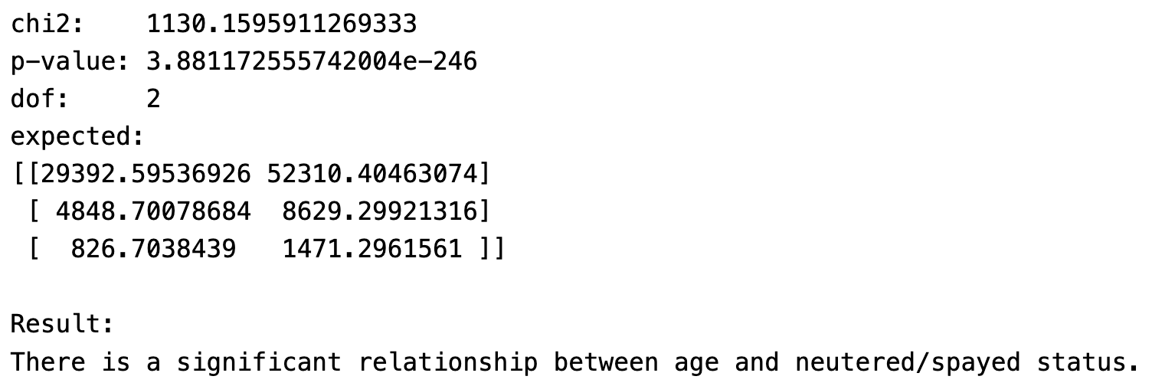
Chi-Squared Test
Notes:
I used a chi-squared test to examine my hypothesis, and the results indicate that the alternative hypothesis is accepted, and there is a relationship between age and neuter/spay status.

Slide 18
Hypothesis 2
Has there been a significant change in the adoption rate of animals before and after the onset of COVID-19?
H0: There is no significant difference in the adoption rate of animals before and after the onset of COVID.
H1: There is a significant increase in the adoption rate of animals after the onset of COVID compared to before.
Notes:
My second hypothesis proposes a meaningful surge in animal adoption rates after the onset of COVID-19.
With more people spending time at home due to lockdowns and remote work situations, there was an increased desire for companionship, leading to a higher demand for pets.

Slide 19
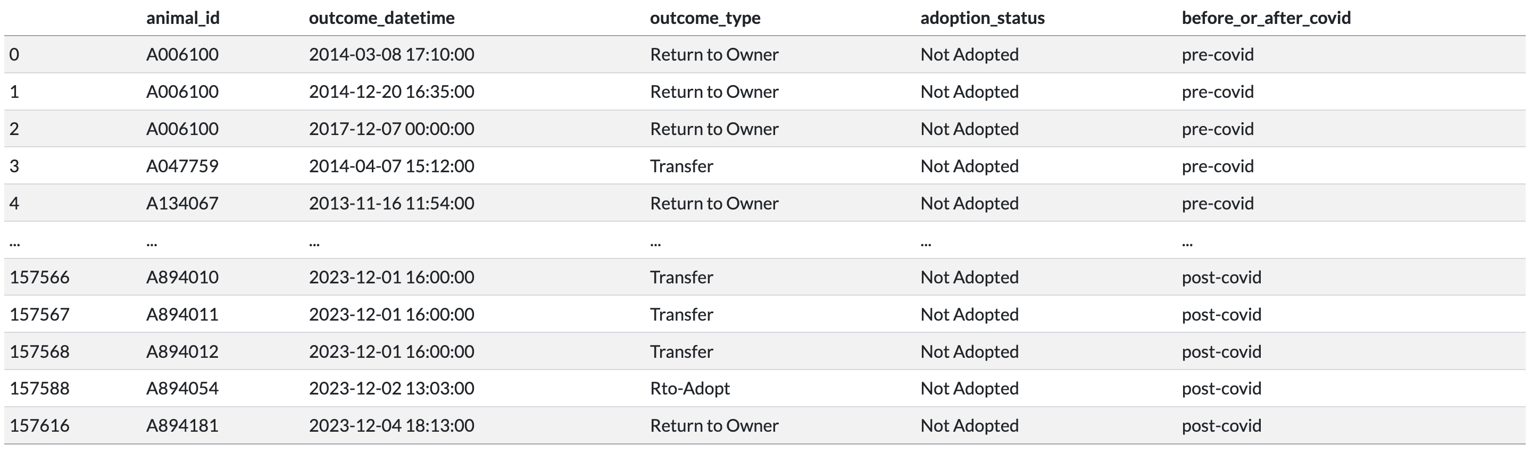
Set January 1, 2020, as the threshold
for before and after COVID
Check the adoption status of the animal
Notes:
I use January 1, 2020, as the dividing point between the periods before and after the onset of COVID-19.

Slide 20
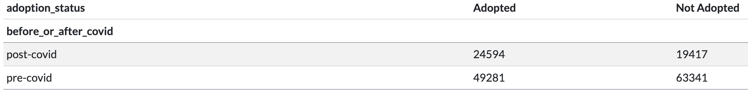
Contingency Table(Before of After Covid vs Adoption Status)
The adoption rate after-covid is 55.9%
The adoption rate before-covid is 43.8%

Slide 21
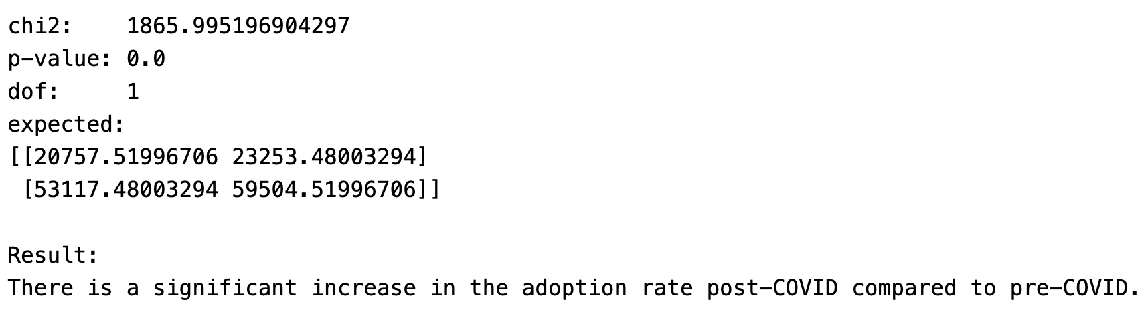
Chi-Squared Test
Notes:
The results indicate that the alternative hypothesis is accepted, and there is a significant increase in the adoption rate after COVID.

Slide 22
Hypothesis 3
Does intake condition influence the probability of adoption for animals?
H0: There is no significant relationship between the intake condition of animals at the shelter and their likelihood of adoption.
H1: There is a significant relationship between the intake condition of animals at the shelter and their likelihood of adoption.
Notes:
My third hypothesis suggests that an animal's intake condition significantly influences its likelihood of adoption. In general, healthy animals tend to have a higher chance of being quickly adopted, while those who need extensive medical care, having chronic health issues, or displaying challenging behaviors might take longer to find homes.

Slide 23
Non-Normal
Notes:
As we’ve observed in the bar chart, there are numerous types of conditions listed. Therefore, any condition that is not labeled as 'normal' would be considered as 'non-normal'.

Slide 24
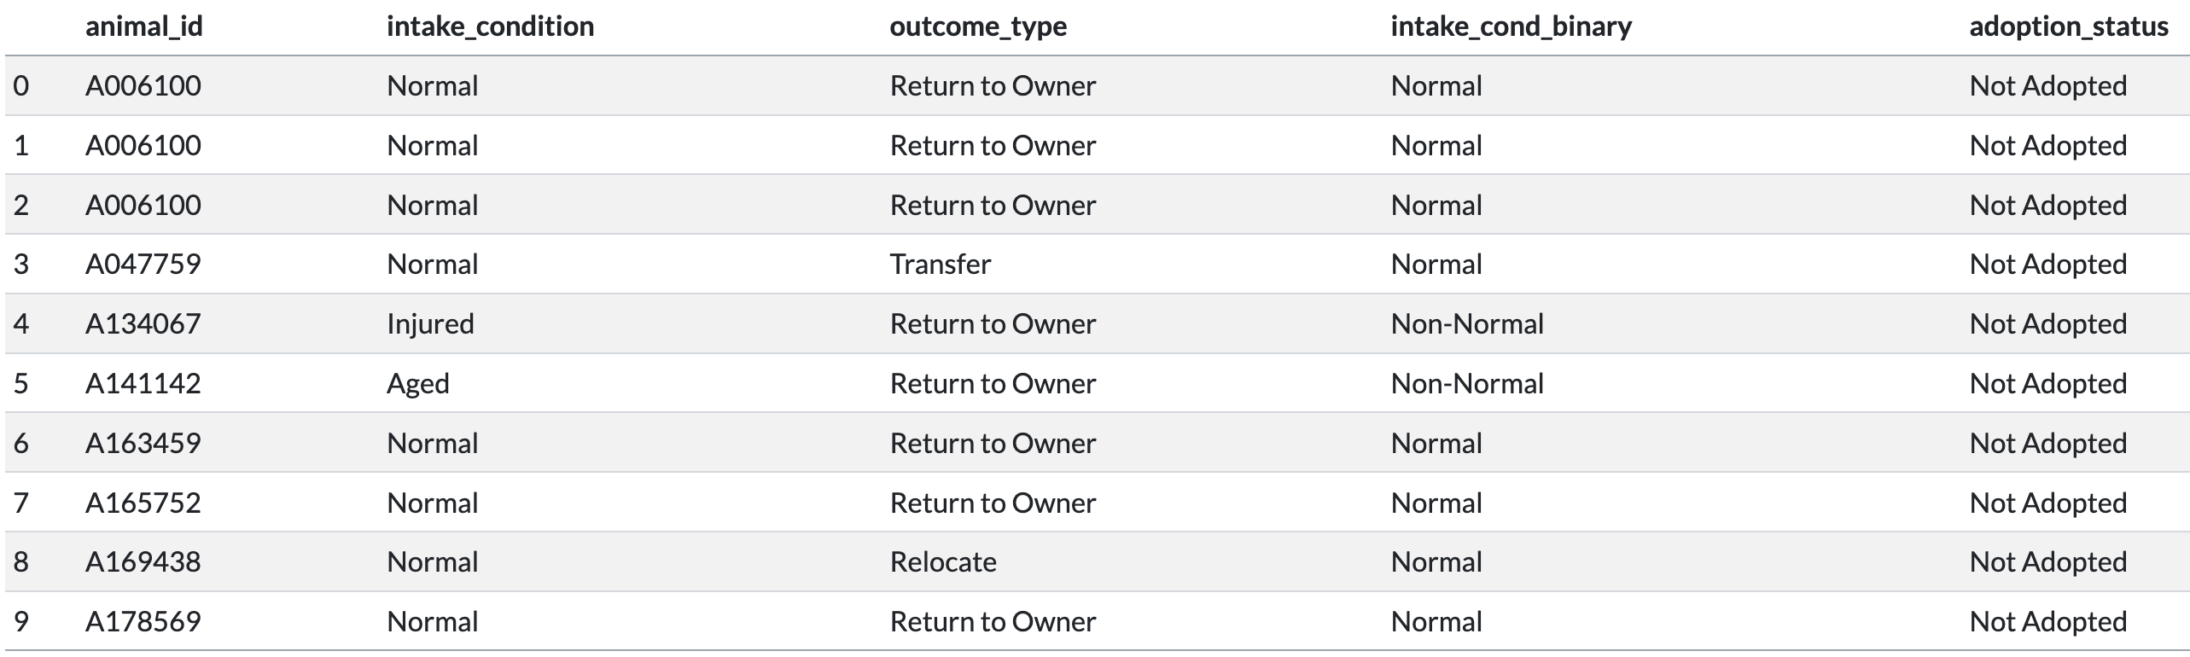
Check the condition upon intake
of the animal
Check the adoption status
of the animal

Slide 25
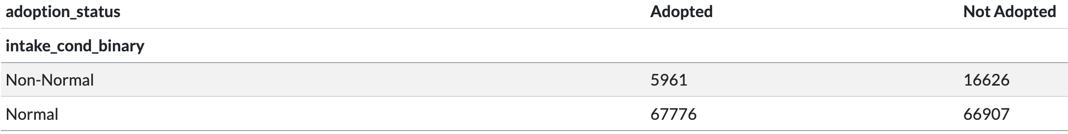
Contingency Table(Intake Condition vs. Adoption Status)
26.39% of animal whose condition is non-normal have been adopted.
50.32% of animal whose condition is normal have been adopted.

Slide 26
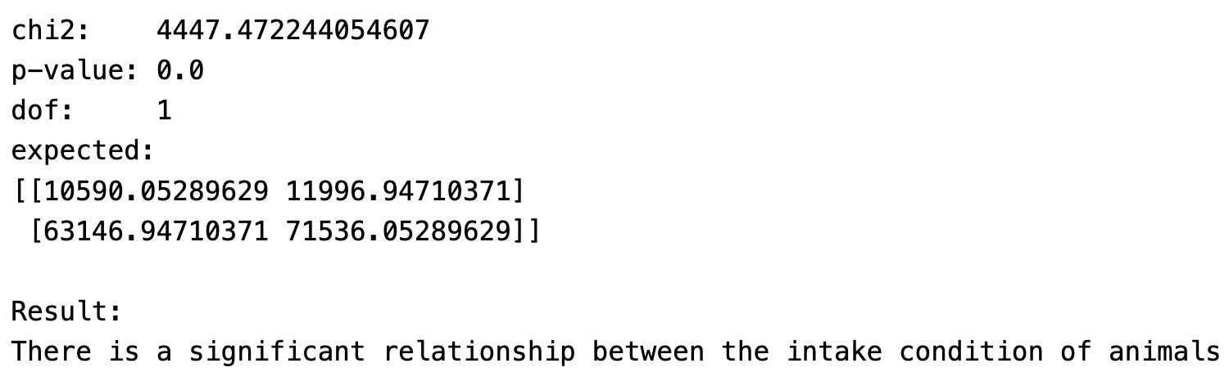
Chi-Squared Test
Notes:
The results also indicate the acceptance of the alternative hypothesis, demonstrating a significant relationship between the intake condition of animals and their likelihood of being adopted.

Slide 27
Hypothesis 4
Does age influence the probability of adoption for animals?
H0: There is no significant relationship between animals’ age and their likelihood of adoption.
H1: There is a significant relationship between animals’ age and their likelihood of adoption.
Notes:
The final hypothesis actually shares a similar concept with the third hypothesis. I believe that an animal's age could impact their likelihood of being adopted. Generally, most people prefer younger animals as they are often seen as more trainable. Younger animals haven't developed habits, making them easier to train. They also offer longer companionship and have more energy.

Slide 28
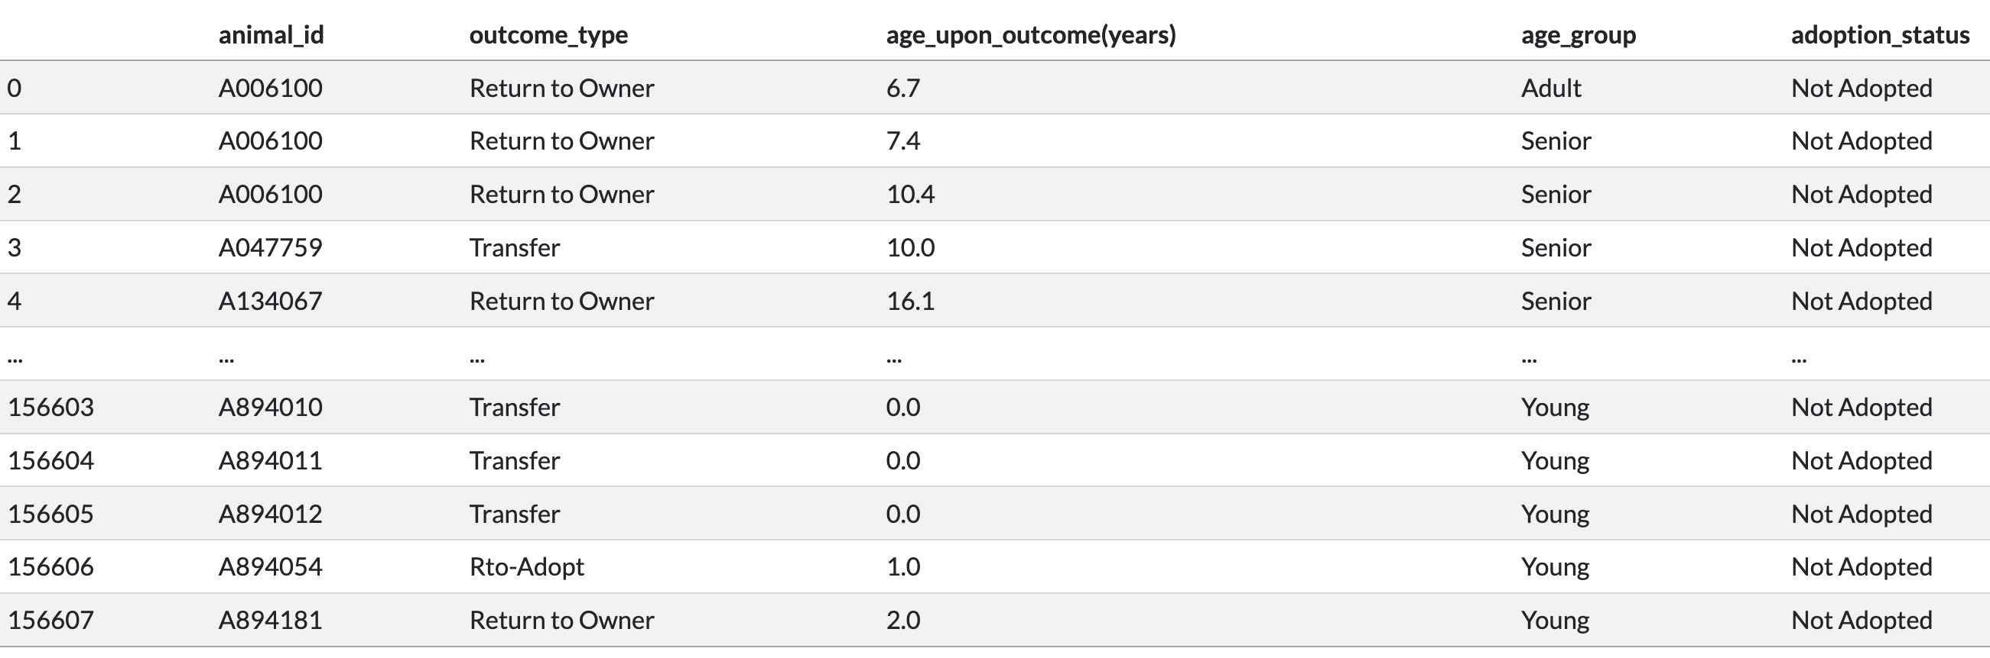
Classify ages into three groups:
- Young (0-2 years)
- Adult (2-7 years)
- Senior (7 years and older)
Check the adoption status
of the animal

Slide 29
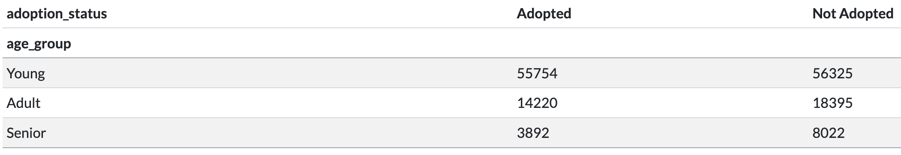
Contingency Table(Age vs. Adoption Status)
The adoption rate for young dogs/cats is 49.75%
The adoption rate for adult dogs/cats is 43.6%
The adoption rate for senior dogs/cats is 32.67%

Slide 30
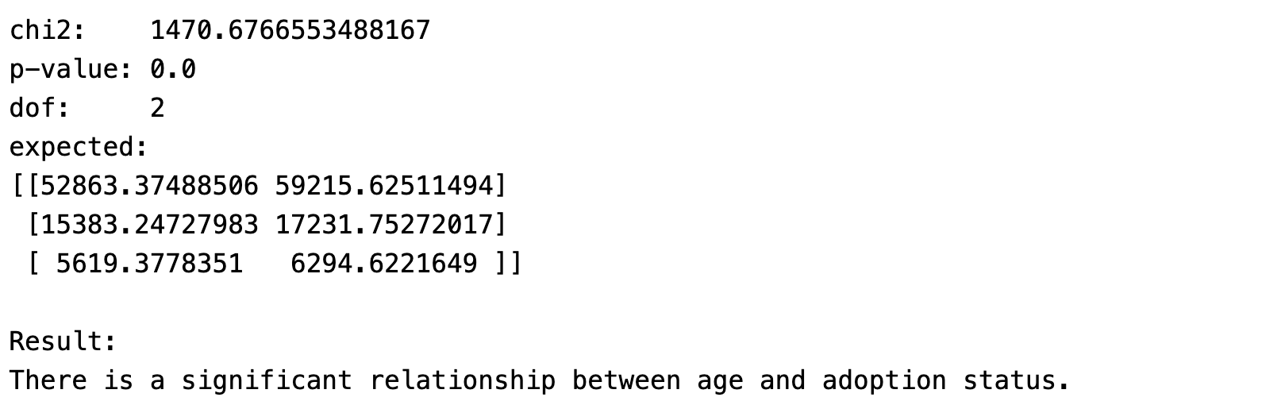
Chi-Squared Test
Notes:
The results also indicate the acceptance of the alternative hypothesis, demonstrating a significant relationship between animal’s age and their likelihood of being adopted.

Slide 31
Research Questions

Slide 32
Research Question 1
Does the city of Austin maintain a save rate of 90% or higher for animals, thereby meeting the criteria to be classified as a no-kill city?
Notes:
The reason why I aim to research this question is that Austin is one of the largest no-kill cities in America. According to the city of Austin, annually, over 90% of animals entering the center are adopted, transferred to rescue, or returned to their owners.

Slide 33
What is No-Kill?
To be considered no-kill, a shelter/rescue/city has to reach a save rate of 90% or higher. [bestfriends.org]
Some organization define no-kill as having a 90% placement rate for the animals in their care [animalhumansociety.org]
Notes:
First, we need to know what is no-kill…
But for this project, I will use the first definition.

Slide 34
What is No-Kill?
Save Rate =
[(Live Intakes) - (Lost in Care) - (Shelter Deaths*)]/(Live Intakes)
* Shelter Deaths = animals euthanized, killed, or died in care
Notes:
Save rate is calculated as [(Live Intakes) - (Lost in Care) - (Shelter Deaths*)]/(Live Intakes)

Slide 35
Notes:
I've created three visualizations to determine if the save rate is above 90% or not. The first one shows the save rate over time, the second one shows the save rate by year. The third visualization displays the save rate by month.
In the plots, there are two lines because I've used two methods to calculate the save rate. The first method involves calculating the save rate solely based on euthanasia cases, while the second method considers the total death cases.
From the visualizations, it's evident that not all months reach the 90% benchmark. However, when we examine the save rate by year, starting from 2015, the save rate has never fallen below 90%.
However, there's a surprising observation that the lowest save rate usually appears in March of almost every year, but I haven't found an answer to explain this situation so far. Even if we group the data by month and take a look at the total intake cases, it didn’t have a super surprising number, instead, the total intake cases is just as normal or even lower than every other month. However, the euthanasia cases and total death cases is pretty much the highest among the whole year. I can’t find explanation so far, but I believe it is somewhat related to the policy of the animal center itself.

Slide 36
Conclusions
Older animals are less likely to be neutered/spayed during their stay at the center.
The adoption rate significantly increased after the onset of COVID-19.
Animals with a normal intake condition are more likely to be adopted.
Younger animals are more likely to be adopted compared to older animals.
Austin has consistently maintained a save rate above 90% annually since 2015, although it didn't meet the benchmark every month.

Slide 37
Improvement
Relationship between an animal's breed or color and its likelihood of being adopted?
Animal’s characteristics VS. duration(days)
Notes:
One of my hypotheses was to determine the correlation between an animal's breed/color and their likelihood of being adopted. However, after examining the data, I discovered there are hundreds of thousands of types in terms of breed and color, making the analysis challenging. I'm now considering ways to simplify or narrow down the groups for easier analysis.
Another analysis could be the relationship between animal’s characteristics and how many days have they spent in the center.

Slide 38
Thank You!

