Slide 1
Lecture 12
Faults
&
Earthquake cycle

Slide 2
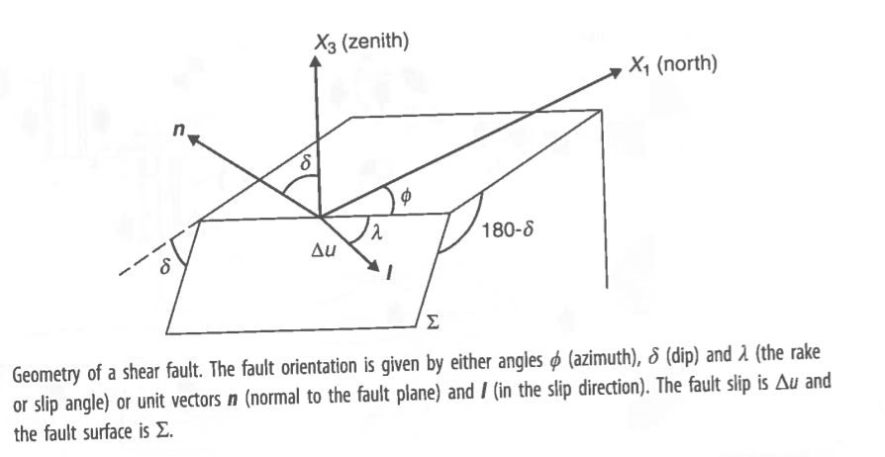

Slide 3
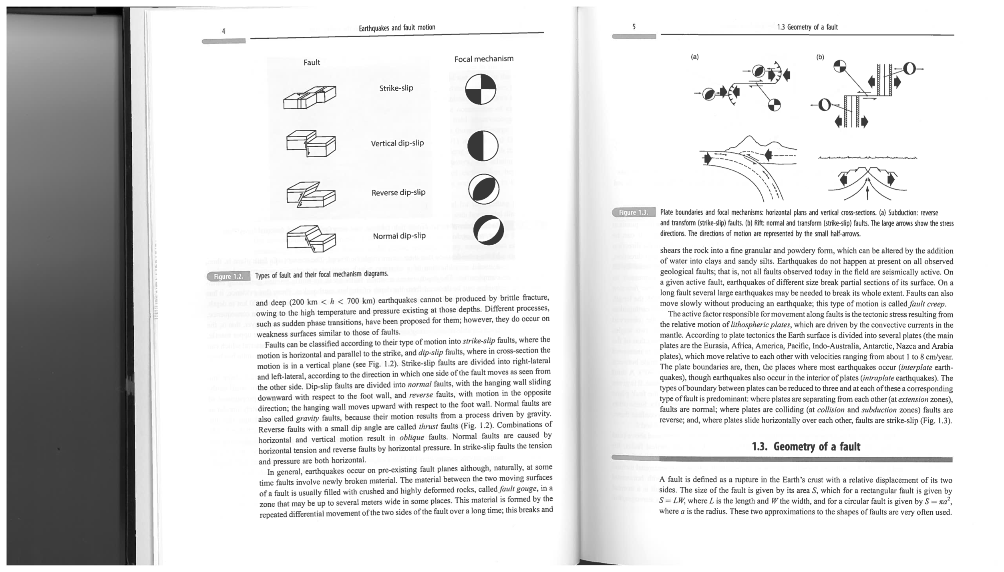

Slide 5
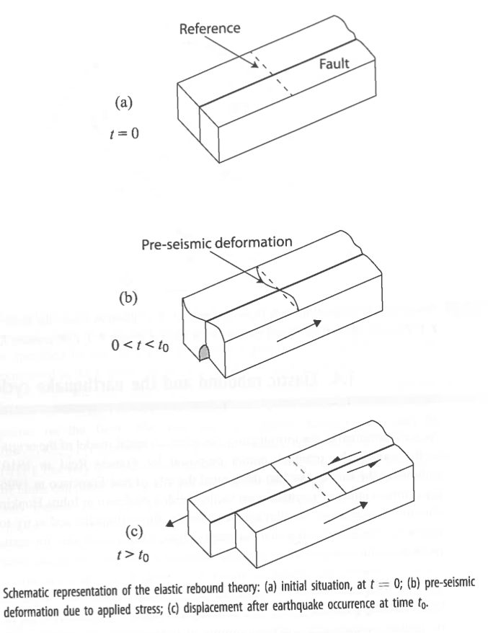
All figures in Lecture 12 come from
Source mechanism of Earthquakes:
theory and practice
By Udias, Madriaga and Buforn

