Slide 1
Lecture 19
Moment Tensors and Radiation Patterns

Slide 2
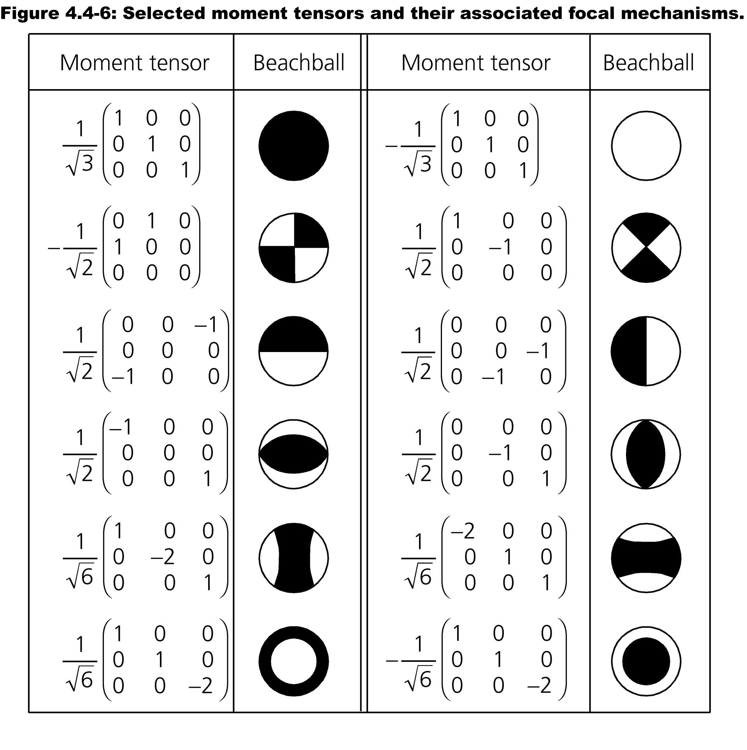

Slide 6
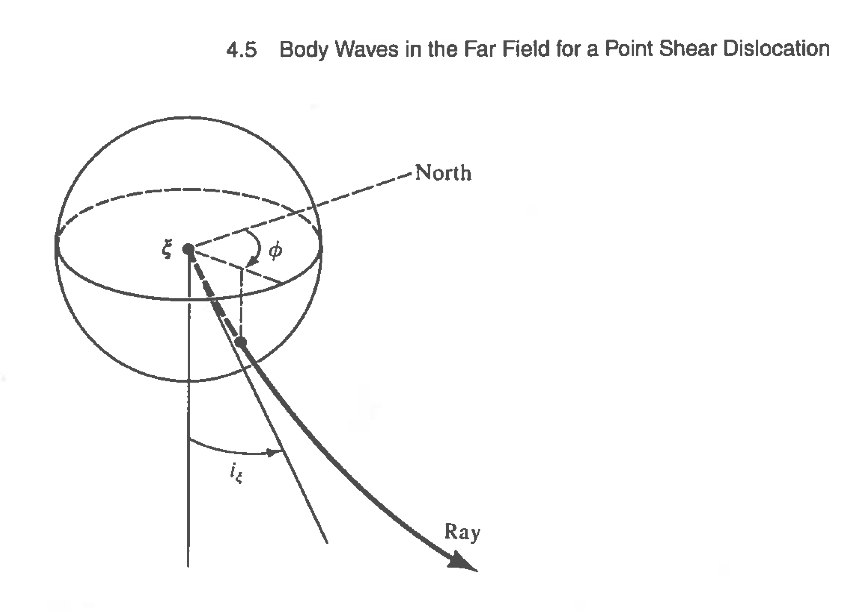

Slide 7
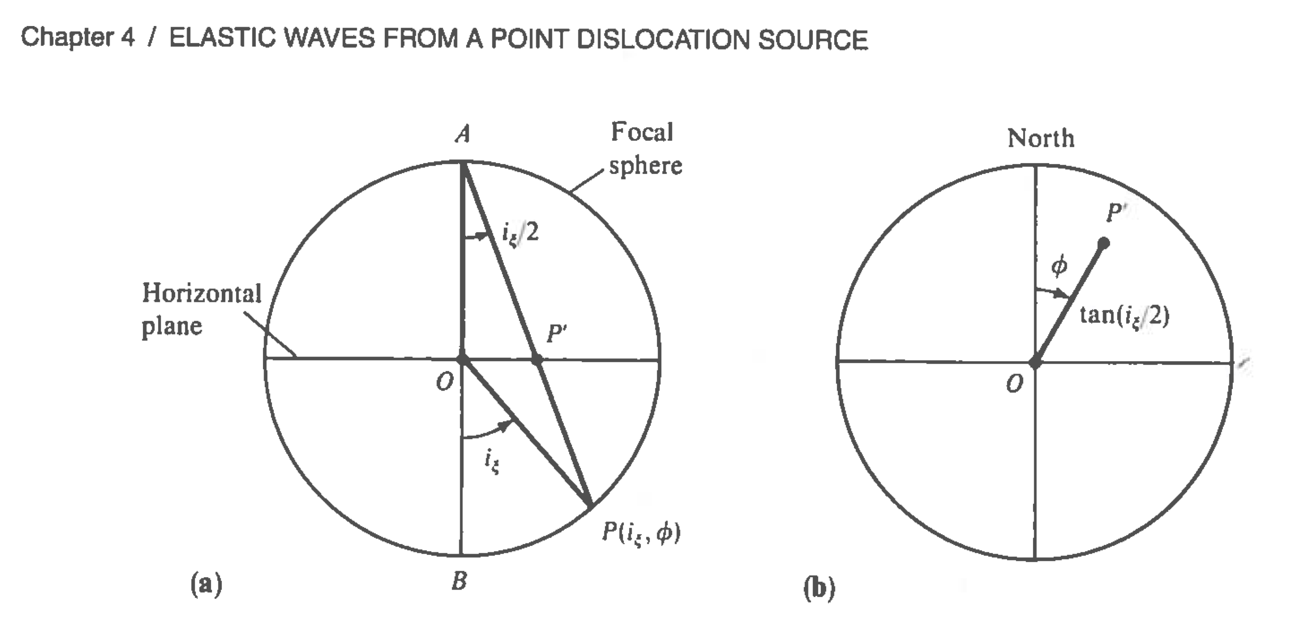

Slide 8
