Slide 1
World Happiness Project 2 team: Ivan Choi, Meng-Yin Lee, Paul Smith

Slide 2
Topic
Happiness Around the World
Amid pandemic, Peace, Safety and Happiness seem even more precious than ever.
Our group would like to explore and create visualizations by using the world happiness data to tell the story on what in people’s lives influences ones’ happiness and put the happiest counties on the world map.

Slide 3
Data Srouces and Reference
Kaggle: https://www.kaggle.com/unsdsn/world-happiness
Transparency International: https://www.transparency.org/en/cpi/2019/results/table
Forbes: Ranked: The 20 Happiest Countries In The World
https://www.trackinghappiness.com/happiness-index-2018/#The_happiest_countries_based_on_the_Happiness_Index
World Happiness Report: https://worldhappiness.report/ed/2020/#read

Slide 4

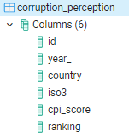
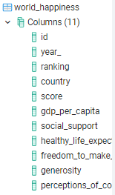
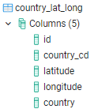
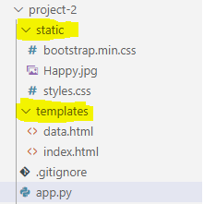
Our process
First
Second
last
Download and Import dataset into PostgreSQL
Program design
index.html/css
App.py
Logic.js
Create Visualization
1. Web Landing Page
2. Nav Links – Search, Map, Data

Slide 5
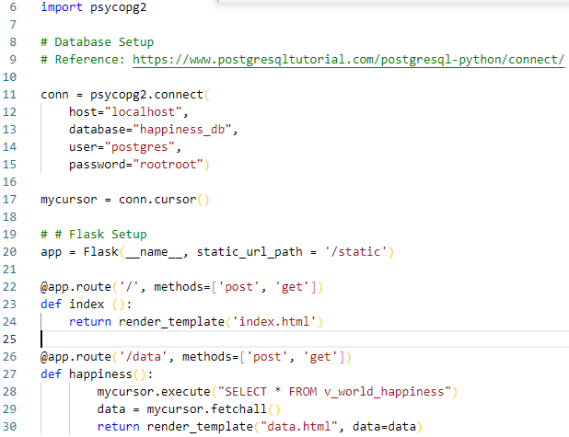
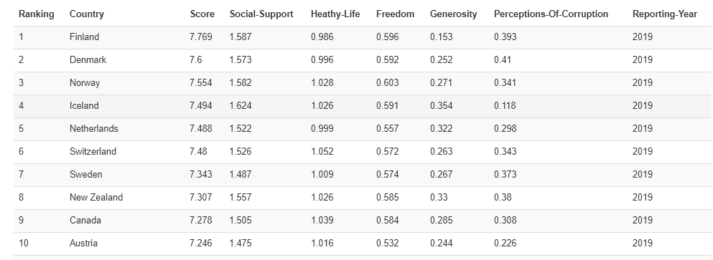
Data
App.py
Set up Flask, Database connection
Render index.html and data.html on route selected
The following table describes the
World Happiness dataset used for this project

Slide 6
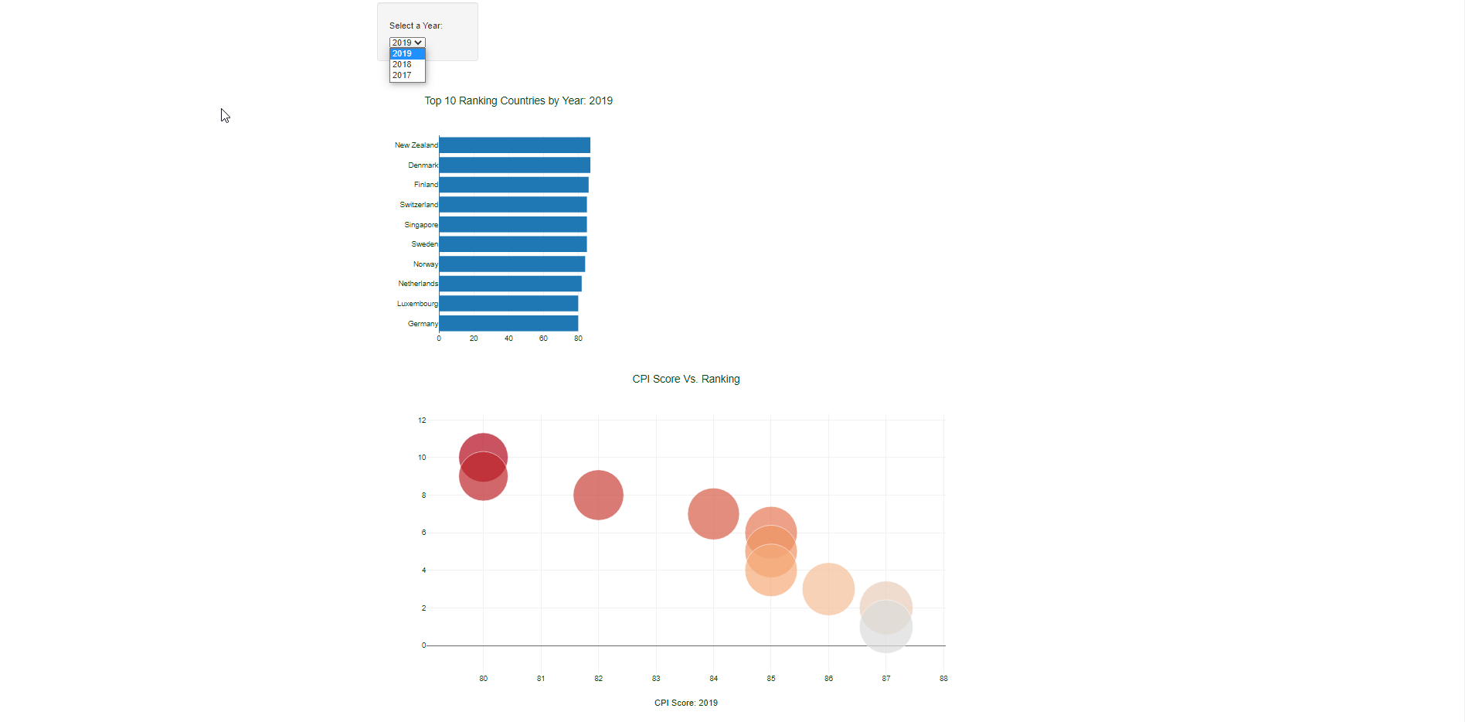
Ranking
Dropdown menu to select different years.
Changes in years led to changes in CPI_Score
Trends between CPI_Score and Ranking

Slide 7
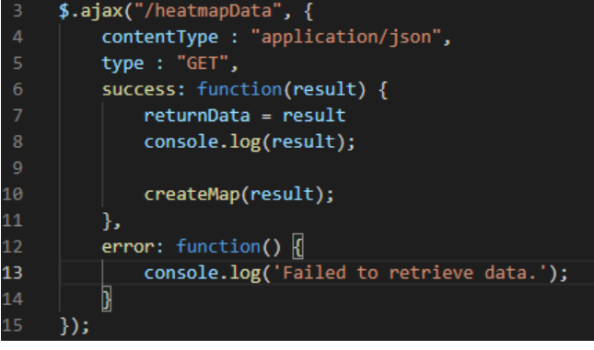
Additional Function AJAX Using Ajax to retrieve data from our Flask application.

Slide 8
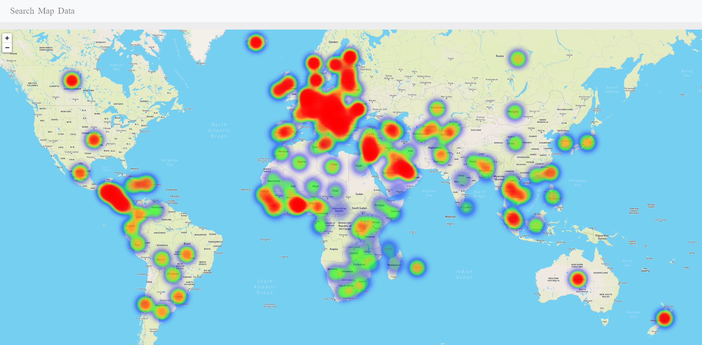
Maps
Leaflet Heat Map: The distribution of world happiness
our office

Slide 9


DEMO
Place your screenshot here

Slide 10

Thanks!
any
questions
?

Slide 11

Credits
Special thanks to all the people who made and released these awesome resources for free:
https://www.kaggle.com
https://www.transparency.org/en/cpi/2019/results/table
Forbes: Ranked: The 20 Happiest Countries In The World
World Happiness Report: https://worldhappiness.report/ed/2020/#read
Presentation template by SlidesCarnival

