Slide 1
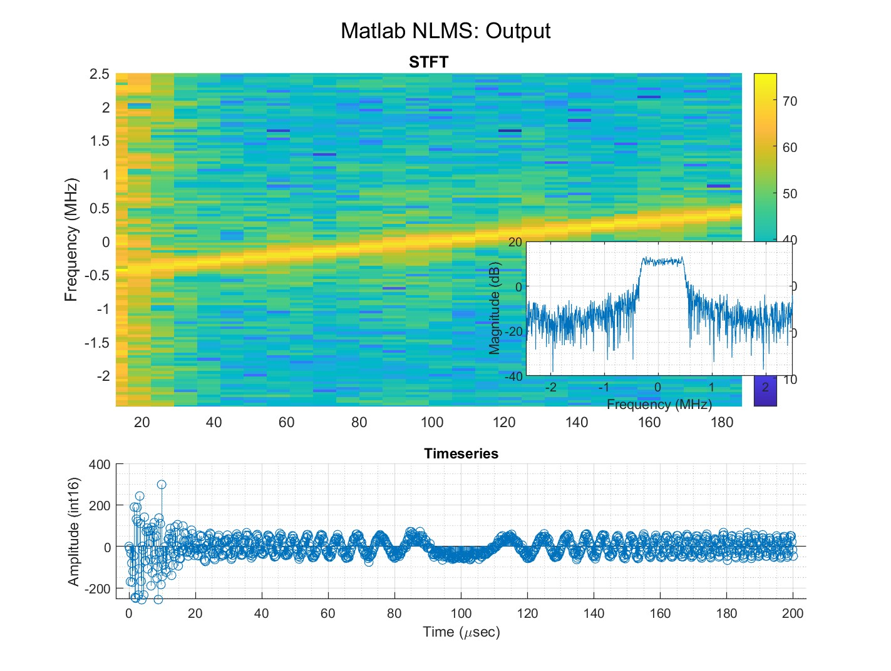

Slide 2
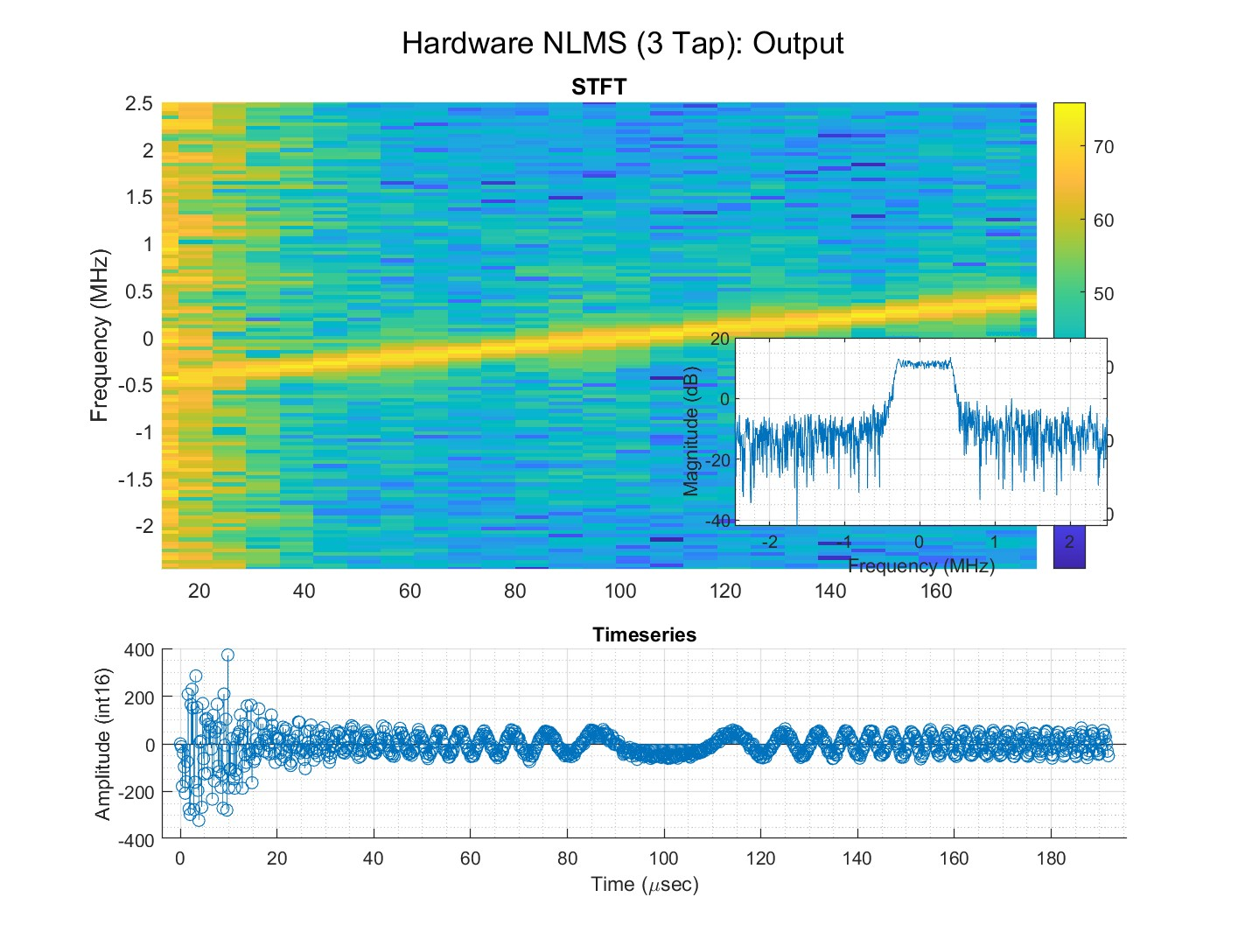

Slide 4
Input to Ouput Delay
II
Utilization

