Slide 1
Ghost Policy Tracer: A GenAI Assistant for Recovering Unclaimed Insurance
Hackathon: DSW
Date: 28 June 2025

Slide 2
Introduction
Ghost Policy Tracer is an AI assistant that helps families find lost or unclaimed life insurance policies of loved ones who have passed away. Even if documents or policy numbers are missing, the system helps users move forward.
It works by understanding the case, asking one smart question, guessing the type of policy, and writing a formal email to the insurance company. This makes a confusing process simple and helps families take action quickly.

Slide 3
Problem Statement
Challenge: Many families struggle with recovering lost or unclaimed life insurance policies due to:
Missing documents or policy numbers
Lack of awareness about existing policies
Uncertainty about where to start or whom to contact
Fear of legal or procedural complications
Goal: Design a GenAI-powered assistant that helps families trace lost insurance policies, recover unclaimed claims, and communicate effectively with insurers even when documentation is missing

Slide 4
Objectives
Develop a GenAI assistant to trace lost or unclaimed life insurance policies.
Accept natural language case input from users with minimal details.
Ask a key clarifying question to extract missing information.
Infer possible insurance policy types and suggest recovery steps.
Generate formal email drafts to help users contact insurers easily.

Slide 5
Features
Smart Clarifying Question: The system asks one AI-generated question to fill in missing or unclear information.
Policy Type Inference: Uses AI to suggest the most likely LIC or life insurance policy based on the user's input.
Personalized Guidance: Provides next steps and recommendations to help users start the claim recovery process.
Email Draft Generator: Automatically creates a formal email that users can send to insurers like LIC for policy verification.

Slide 6
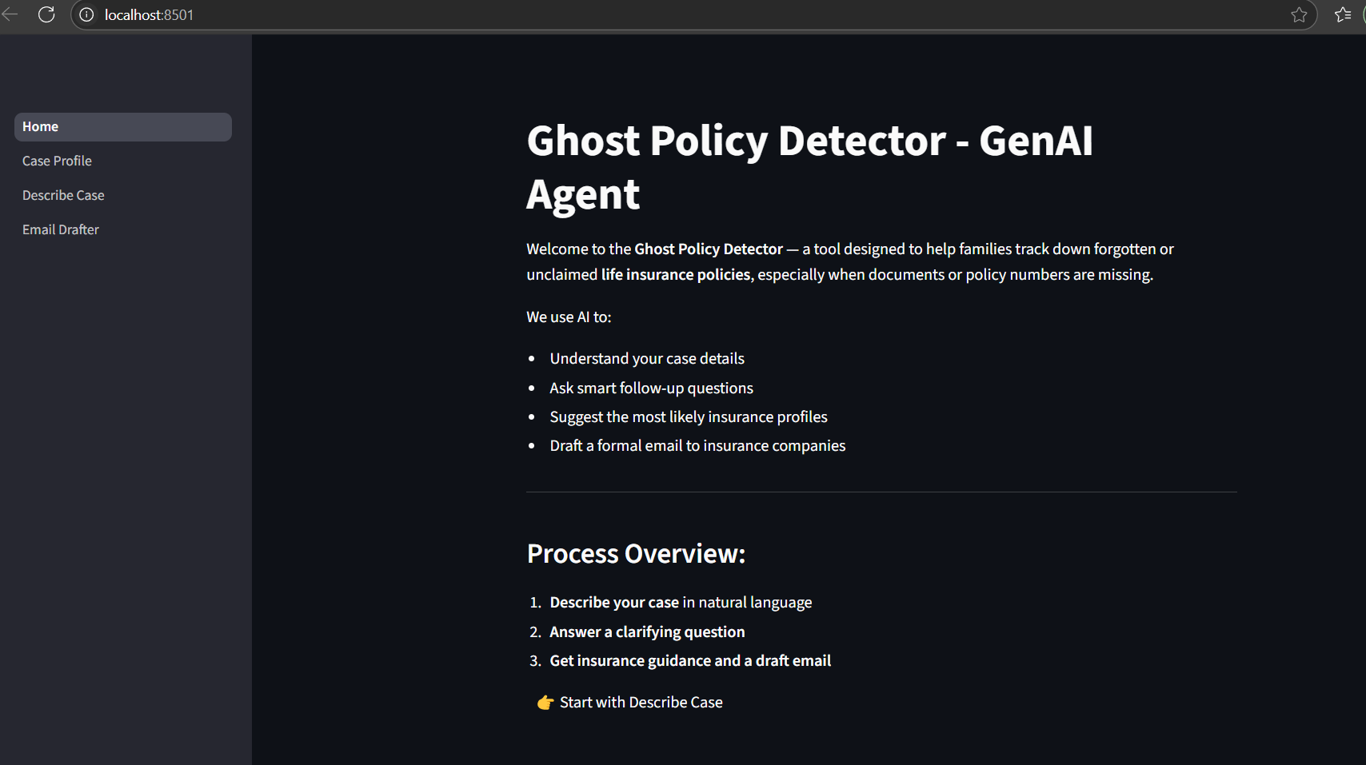
Implementation

Slide 7
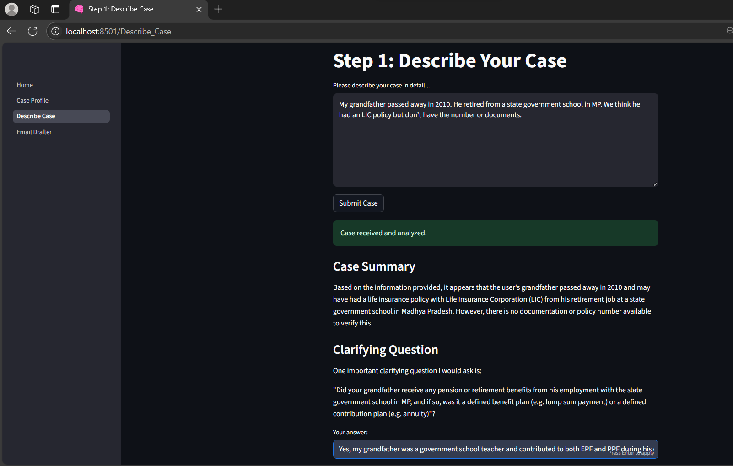
Implementation

Slide 8
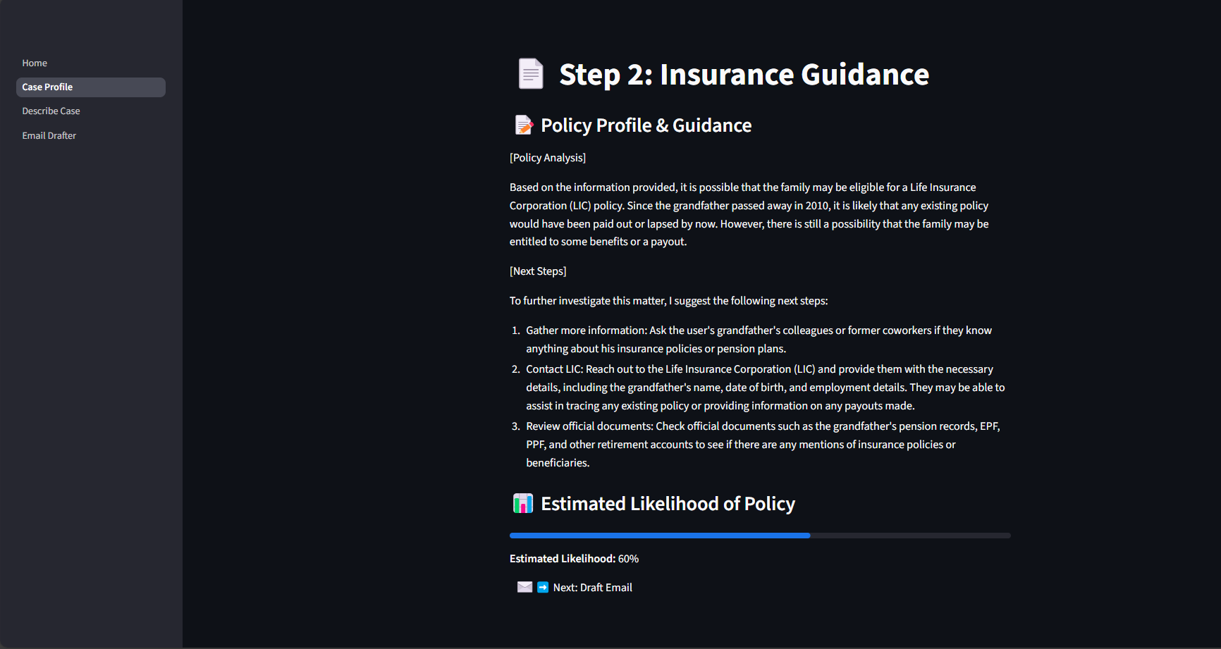
Implementation

Slide 9
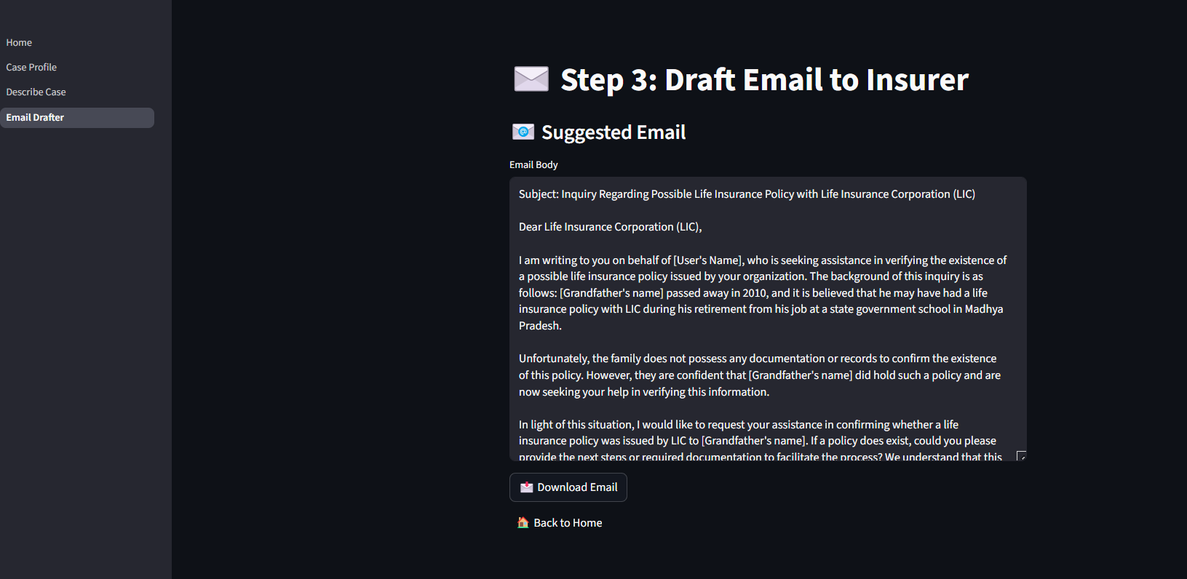
Implementation

Slide 10
Tech Stack
Frontend: Streamlit (interactive, multi-step user interface)
Backend: Python (logic, state handling, data flow)
AI Engine: LLaMA 3 (via Ollama for local GenAI processing)
Model Integration: Custom prompt handling for case analysis, Q&A, and response generation

Slide 11
Conclusion
Ghost Policy Tracer brings the power of Generative AI into the hands of everyday users helping families uncover life insurance policies that might otherwise be forgotten.
Through an intuitive, step-by-step experience, it listens to the user's story, asks just the right question, and provides clear, personalized guidance. With built-in email drafting and smart policy profiling, the system turns confusion into confidence and lost hope into real action.

