Slide 1

Semantics and Sentiment Analysis

Slide 2
Natural Language Processing Bootcamp
Section Goals
Understand Semantic Word Vectors
Understand Sentiment Analysis
Leverage Sentiment Analysis for Text Classification

Slide 3
Semantics and
Word Vectors

Slide 4
Natural Language Processing Bootcamp
In order to use Spacy’s embedded word vectors, we must download the larger spacy english models.
Full details can be found at:
https://spacy.io/usage/models

Slide 5
Natural Language Processing Bootcamp
At the command line download the medium or large spacy english models:
python -m spacy download en_core_web_md
python -m spacy download en_core_web_lg

Slide 6
Natural Language Processing Bootcamp
Now that you have the larger models that contain the word vectors, let’s discuss how word vectors are created.

Slide 7
Natural Language Processing Bootcamp
Word2vec is a two-layer neural net that processes text.
Its input is a text corpus and its output is a set of vectors: feature vectors for words in that corpus.

Slide 8
Natural Language Processing Bootcamp
The purpose and usefulness of Word2vec is to group the vectors of similar words together in vectorspace.
That is, it detects similarities mathematically.

Slide 9
Natural Language Processing Bootcamp
Word2vec creates vectors that are distributed numerical representations of word features, features such as the context of individual words.
It does so without human intervention.

Slide 10
Natural Language Processing Bootcamp
Given enough data, usage and contexts, Word2vec can make highly accurate guesses about a word’s meaning based on past appearances.
Those guesses can be used to establish a word’s association with other words (e.g. “man” is to “boy” what “woman” is to “girl”)

Slide 11
Natural Language Processing Bootcamp
Word2vec trains words against other words that neighbor them in the input corpus.
It does so in one of two ways, either using context to predict a target word (a method known as continuous bag of words, or CBOW), or using a word to predict a target context, which is called skip-gram.

Slide 12
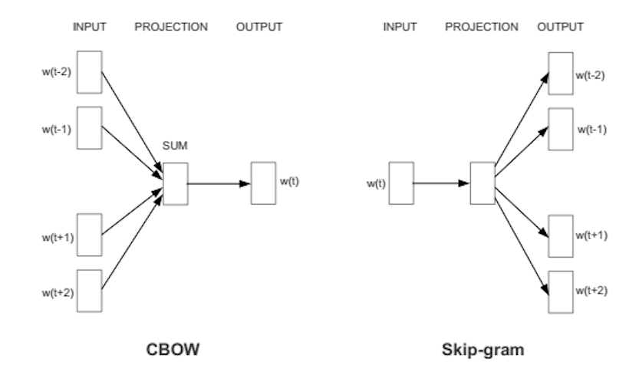
Natural Language Processing Bootcamp
Two Possible Approaches

Slide 13
Natural Language Processing Bootcamp
Recall that each word is now represented by a vector.
In spacy each of these vectors has 300 dimensions.

Slide 14
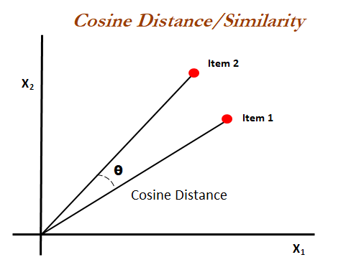
Natural Language Processing Bootcamp
This means we can use Cosine Similarity to measure how similar word vectors are to each other.

Slide 15
Natural Language Processing Bootcamp
This means we can also perform vector arithmetic with the word vectors.
new_vector = king - man + woman
This creates new vectors (not directly associated with a word) that we can then attempt to find most similar vectors to.
new_vector closest to vector for queen

Slide 16
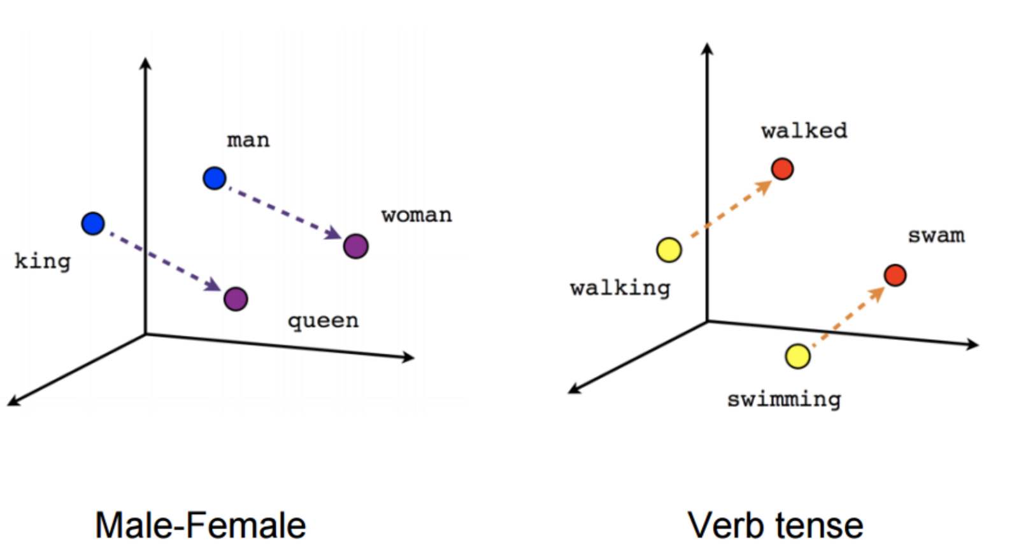
Natural Language Processing Bootcamp
Interesting relationships can also be established between the word vectors

Slide 17
Natural Language Processing Bootcamp
Let’s begin to explore Spacy Word Vectors with Python!

Slide 18
VADER Sentiment
with Python and NLTK

Slide 19
Natural Language Processing Bootcamp
We’ve already explored text classification and using it to predict sentiment labels on pre-labeled movie reviews.
But what if we don’t already have those labels?
Are there methods of attempting to discern sentiment on raw unlabeled text?

Slide 20
Natural Language Processing Bootcamp
VADER (Valence Aware Dictionary for sEntiment Reasoning) is a model used for text sentiment analysis that is sensitive to both polarity (positive/negative) and intensity (strength) of emotion.
It is available in the NLTK package and can be applied directly to unlabeled text data.

Slide 21
Natural Language Processing Bootcamp
Primarily, VADER sentiment analysis relies on a dictionary which maps lexical features to emotion intensities called sentiment scores.
The sentiment score of a text can be obtained by summing up the intensity of each word in the text.

Slide 22
Natural Language Processing Bootcamp
For example, words like “love”, “like”, “enjoy”, “happy” all convey a positive sentiment.
VADER is intelligent enough to understand basic context of these words, such as “did not love” as a negative sentiment.
It also understands capitalization and punctuation, such as “LOVE!!!!”

Slide 23
Natural Language Processing Bootcamp
Sentiment Analysis on raw text is always challenging however, due to a variety of possible factors:
Positive and Negative sentiment in the same text data.
Sarcasm using positive words in a negative way.

Slide 24
Natural Language Processing Bootcamp
Let’s explore using VADER sentiment analysis with NLTK and Python!

Slide 25
Sentiment Analysis
Project

Slide 26
Sentiment Analysis
Assessment Solutions

