Slide 1

SESAME
CONNECTING PEOPLE
TO SERVICES THEY NEED

Slide 2
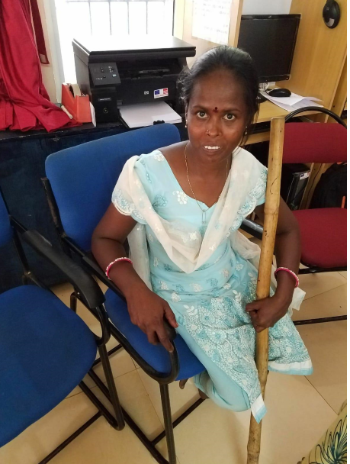
There are over 1 Billion people with disabilities in the world.
Over 80% of which live in developing countries.

Slide 3
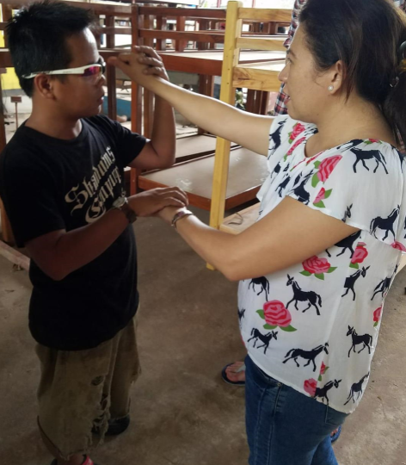
People with disabilities have a diverse set of needs.
From the most basic level of communication and navigating the world…

Slide 4
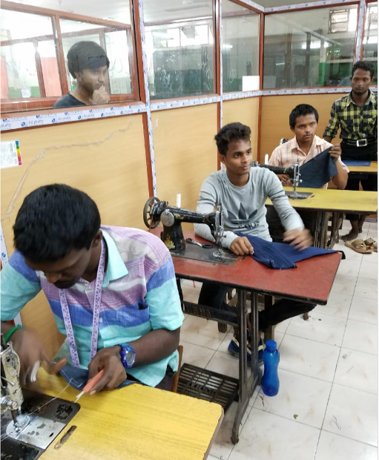
…to employment, sense of belonging to a community, healthcare and various other things.

Slide 5
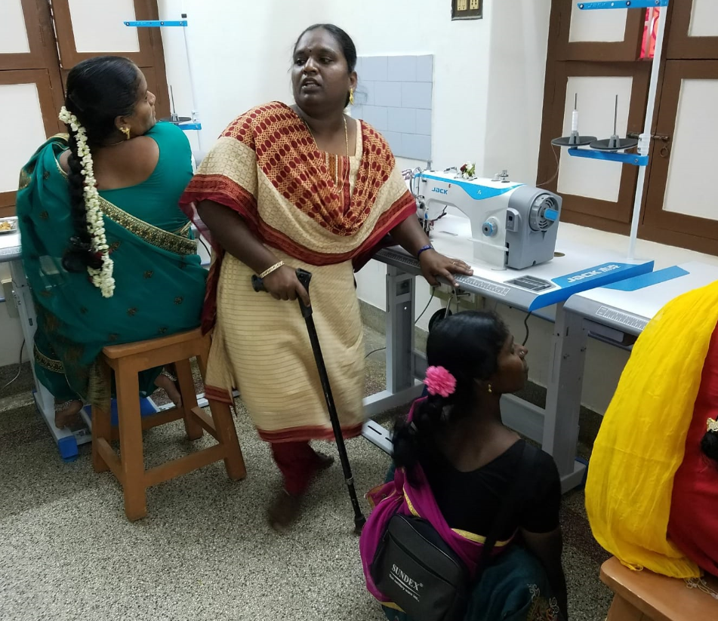
…It is often difficult for people with disabilities to access the information and services they need to thrive economically, socially and participate fully in society.

Slide 6
…SESAME connects people with disabilities to a diverse range of services personalized to their needs

Slide 7
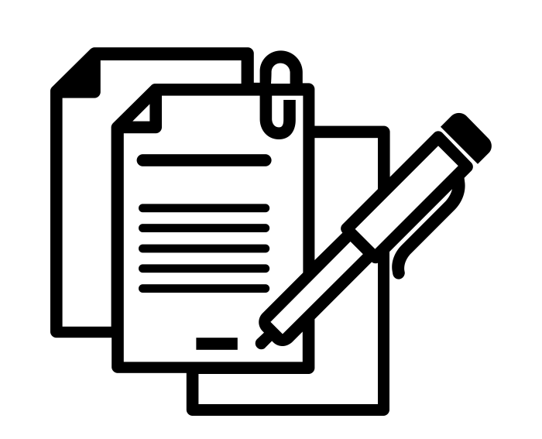
Document Analysis
Health Insurance and Work Contracts are long and complicated
How best to summarise their contents relevant to disabilities?
How does the document compare to other policies?
How to present this information in a clear and concise way?

Slide 8
