Slide 1

Digital Diary & Sentiment Analysis

Slide 2
TEAM 1
Ujjwal Dwivedi
Team Leader
Rayhans Madhup
Programmer
Prince Kumar
Data Analyst
Meem Ibna Ashraf
Literature Reviewer
Dr. Ajay Shriram Kushwaha
Professor(SSET)
Project Mentor

Slide 3
Introduction
Welcome the audience
Provide a brief overview of the app's purpose
Mention the importance of tracking and managing emotions for mental well-being

Slide 4
Mood Minder is a user-friendly digital diary app designed to empower individuals to take control of their emotional well-being. It provides a platform for users to record their daily experiences, thoughts, and feelings, allowing them to gain insights into their emotional patterns, track their mood changes, and make informed decisions to enhance their quality of life.
Mood Minder - A Digital Diary App"
Recording Emotions and Promoting Well-being"
Digital Diary and sentiment analysis

Slide 5
Average Mood and Quality of Life Statistics
Title: "Average Mood and Quality of Life Data"
Content
Display statistics on average mood scores for users over time
Show quality of life data, including user satisfaction ratings
Include a graph illustrating trends in mood and quality of life

Slide 6
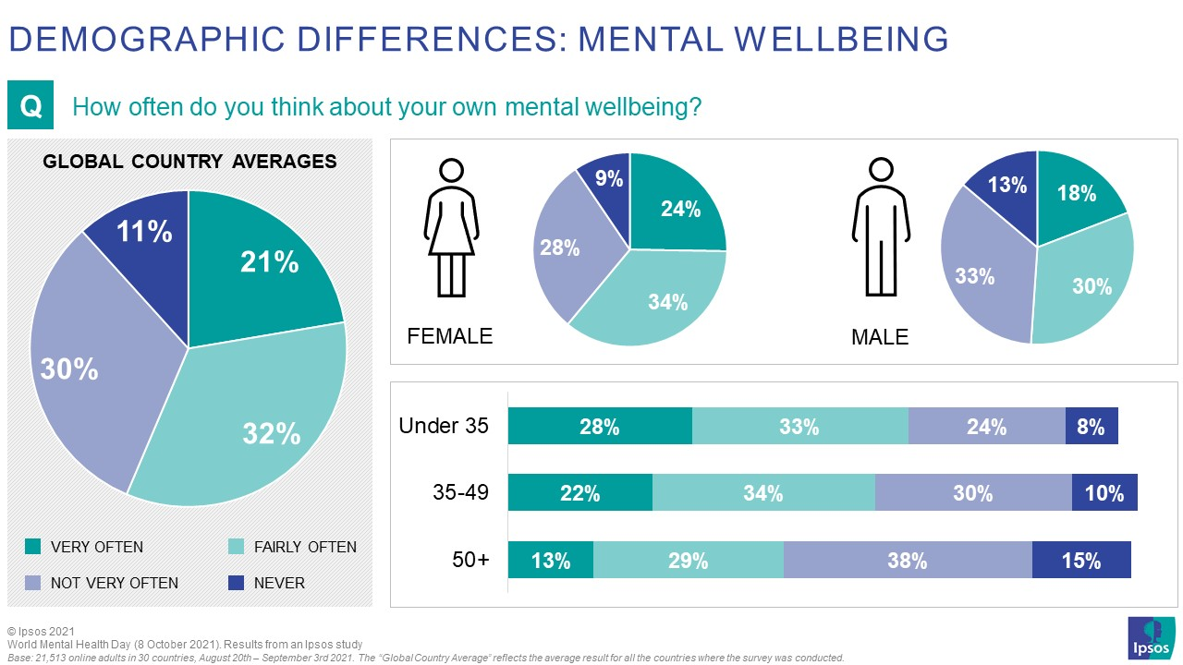




Slide 7
Key Features
Highlight the key features of the Mood Minder app
Diary Entry: Write daily diary entries
Sentiment Analysis: Analyze and classify emotions
Mood Classification: Categorize emotions as happy, sad, or neutral
Activity Suggestions: Receive personalized activity recommendations
Use visuals and icons to make this slide engaging

Slide 8
Diary Entry
the core component of the app, providing users with a digital space to document their thoughts, feelings, and daily experiences.
user-friendly and convenient platform for individuals to maintain a diary in a digital format, allowing for easy and organized self-expression.
Documenting daily experiences helps users track their emotional patterns over time. They can identify triggers for mood changes and learn how to manage their emotions more effectively.
Text analysis for sentiment scoring interprets the emotional tone in text, quantifying positivity, negativity, or neutrality for insights.

Slide 9
Slide 6: Sentiment Analysis
Describe the sentiment analysis process
How the app uses text analysis to determine sentiment
Mention the 'vaderSentiment' library for sentiment analysis

Slide 10

The Sentiment Analysis Process

Slide 11
Text Preprocessing: The process begins with text preprocessing. This involves tasks like removing special characters, punctuation, and formatting to prepare the text for analysis.
Tokenization: The text is then broken down into individual words or tokens. This allows the analysis to focus on the sentiment of each word.
Lexicon and Data Training: Sentiment analysis relies on a lexicon, which is a database of words or phrases associated with sentiment scores. Some words have predefined sentiment values,
Scoring Words: Each word in the text is assigned a sentiment score based on the lexicon or machine learning model
Sentence and Document Analysis: The sentiment of the entire sentence or document is calculated by aggregating the sentiment scores of individual words.
Sentiment Classification: After aggregating the scores, the sentiment is classified into categories such as positive, negative, or neutral
Emotion Classification: In more advanced analyses, the sentiment can be further classified into specific emotions like joy, anger, sadness, etc
Context Analysis: Contextual factors, such as negations ("not happy") and word order, are considered to enhance the accuracy of sentiment analysis.
Results Presentation: The final sentiment analysis results are presented as a sentiment score or category

Slide 12

How the app uses text analysis to determine sentiment

Slide 13
Diary Entry Collection: Users input their daily experiences and emotions through diary entries within the app.
Text Analysis: MoodTracker extracts the text content of these diary entries.
VaderSentiment Integration: The app uses the 'vaderSentiment' library, a powerful tool for sentiment analysis. 'VaderSentiment' is integrated into MoodTracker's text analysis pipeline.
Sentiment Scoring: Each word in the diary entry is scored for sentiment using the 'vaderSentiment' library, which assigns positive, negative, or neutral scores to words.
Aggregated Sentiment: The sentiment scores of individual words are aggregated to determine the overall sentiment of the diary entry.
Mood Classification: The aggregated sentiment is then classified into mood categories, such as "Happy," "Sad," or "Neutral."

Slide 14

The ‘Vader Sentiment' library for sentiment analysis

Slide 15
Mood Minder utilizes the 'vader Sentiment' library for its sentiment analysis needs. 'Vader Sentiment' is an essential component of the app's text analysis pipeline, aiding in the determination of sentiment scores and the subsequent mood classification. This library enhances Mood Minder's ability to accurately assess the emotional tone of user diary entries, offering valuable insights into users' well-being and emotional patterns.

Slide 16
Mood Classification
Explain how the app classifies moods
Sentiment analysis: the app assesses the emotional tone of diary entries.
Sentiment Scoring: Each word gets a sentiment score, positive or negative.
Aggregation: Scores are combined to create an overall entry sentiment score.
Mood Classification: The entry is categorized as "Happy," "Sad," or "Neutral" based on sentiment scores..
Show how sentiment scores are categorized as happy, sad, or neutral
self-reflection: encourages users to reflect on their emotional states and experiences.
Trend Analysis: Helps users track and visualize emotional trends over time.
Emotional Management: Aids in emotional self-management and well-being.
Personal Growth: Acts as a record of personal development and self-improvement.
Decision-Making: Informs users' daily decisions and choice of coping strategies.
Highlight the relevance of mood classification for self-awareness
facilitates self-reflection on emotional states and experiences.
Enables tracking and visualization of emotional trends over time.
Supports emotional self-management and overall well-being.
Serves as a record of personal development and self-improvement.
Informs daily decisions and choice of coping strategies.

Slide 17
Activity Suggestions
Introduce activity suggestions
How the app recommends activities based on the user's mood
Examples of activities for each mood category

Slide 18
How the App Suggests Activities:
Mood Mapping: The app maps the user's mood to one of three primary categories: "Happy," "Sad," or "Neutral" based on sentiment analysis.
Activity Database: Mood Minder has an extensive database of activities linked to mood categories.
Personalization: The app selects activities that correspond to the user's current mood category.
Recommendations: Users receive a list of suggested activities tailored to their emotional state.
Examples of Activity Suggestions:
Happy Mood:
Suggest outdoor activities: Go for a nature walk or picnic.
Encourage social interactions: Call a friend or host a small gathering.
Propose creative outlets: Engage in art, music, or cooking.
Sad Mood:
Recommend relaxation techniques: Try meditation or deep breathing exercises.
Suggest comforting activities: Watch a favorite movie or read a good book.
Encourage self-care: Take a warm bath or engage in journaling.
Neutral Mood:
Propose exploratory activities: Visit a museum or try a new hobby.
Encourage exercise: Go for a workout or practice yoga for a mood boost.
Suggest simple self-improvement tasks: Set a small achievable goal for the day.

Slide 19
Relevance of Activity Suggestions:
Mood-Enhancing: Activities are chosen to boost the user's mood and well-being.
Personalized: Tailored to the user's current emotional state.
Encourages Proactive Self-Care: Promotes self-awareness and proactive emotional management.
Variety: Offers a diverse range of options to accommodate individual preferences and interests.
Promotes Healthy Habits: Encourages users to engage in positive and healthy activities to stabilize their mood.

Slide 20

Slide 9: User Testimonials
"Mood Minder is a fantastic tool for managing my emotional health. The personalized activity suggestions have turned my sad days around. I've discovered new hobbies and ways to keep myself in a happier state of mind. It's truly a mood-lifting app!"
User Testimonial 1:
"Mood Minder has been a game-changer for me. It's like having a trusted friend who listens to my thoughts and feelings. The activity suggestions based on my mood have been incredibly helpful. I've noticed a significant improvement in my overall well-being since I started using this app."

Slide 21

Slide 10: Conclusion and Call to Action
Call to Action:
We invite you to experience MoodTracker for yourself.
Download the app from your preferred app store and embark on a journey towards a more balanced and emotionally fulfilling life.
Start tracking your emotions, benefiting from sentiment analysis, mood classification, and personalized activity suggestions.

