Slide 1


Maintenance Procedure

Slide 2
Table of contents
Introduction
Maintenance
Management
Content
Archive
Epilogue
Question round

Slide 3
1.
Introduction
Let’s with introducing ourselves

Slide 4
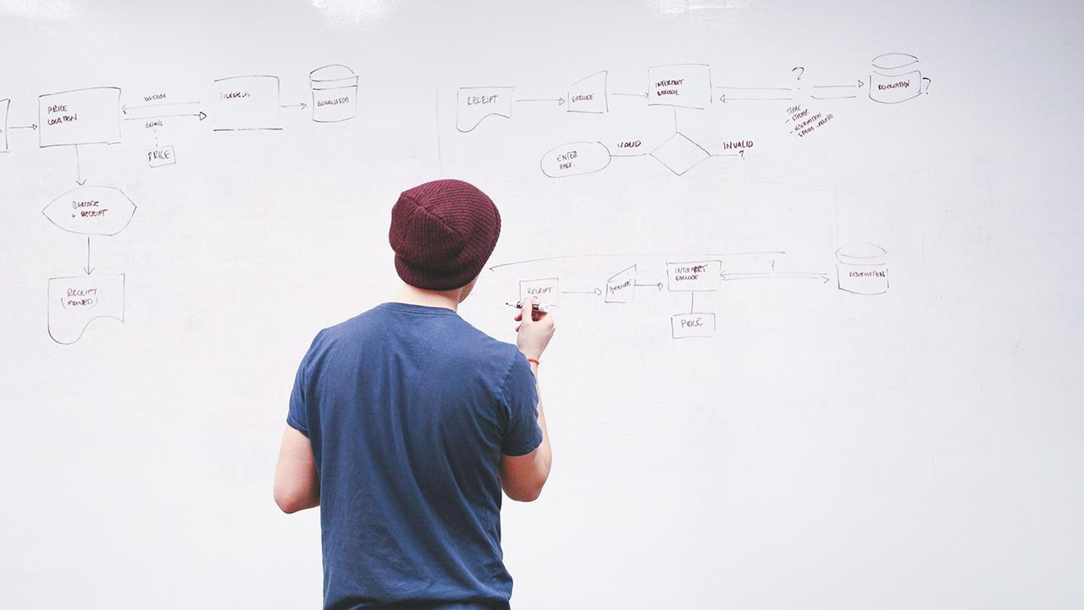
INTRODUCTION
We are Comp-U-Service and we’d like to talk to you about the maintenance procedures today.

Slide 5
2.
Maintenance
……

Slide 6
Maintenance
Here you have a list of items
And some text
But remember not to overload your slides with content

Slide 7
3.
Management
……

Slide 8
4.
Content
……

Slide 9
Content
Here you have a list of items
And some text
But remember not to overload your slides with content

Slide 10
5.
Archive
……

Slide 11
6.
Epilogue
……

Slide 12
7.
Question round

Slide 13

Question round
THANKS!
Any questions?

Slide 14
Quotations are commonly printed as a means of inspiration and to invoke philosophical thoughts from the reader.

Slide 15
BIG CONCEPT
Bring the attention of your audience over a key concept using icons or illustrations

Slide 16
You can also split your content
White
Is the color of milk and fresh snow, the color produced by the combination of all the colors of the visible spectrum.
Black
Is the color of coal, ebony, and of outer space. It is the darkest color, the result of the absence of or complete absorption of light.

Slide 17
In two or three columns
Yellow
Is the color of gold, butter and ripe lemons. In the spectrum of visible light, yellow is found between green and orange.
Blue
Is the colour of the clear sky and the deep sea. It is located between violet and green on the optical spectrum.
Red
Is the color of blood, and because of this it has historically been associated with sacrifice, danger and courage.

Slide 18
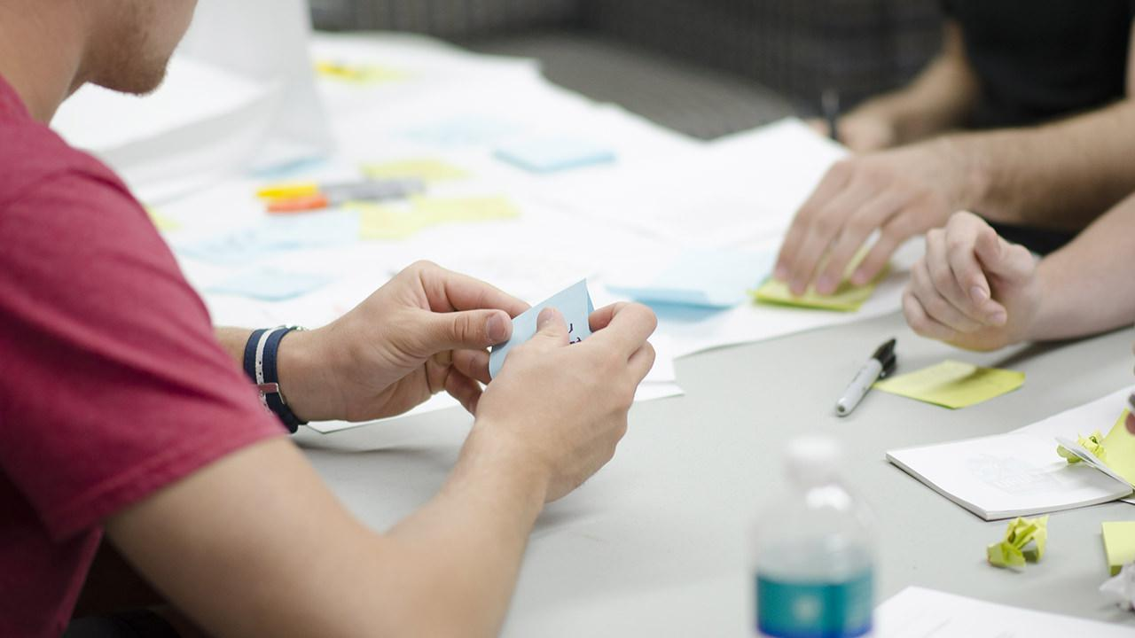
A picture is worth a thousand words
A complex idea can be conveyed with just a single still image, namely making it possible to absorb large amounts of data quickly.

Slide 19
Use charts to explain your ideas
White
Gray
Black

Slide 20
And tables to compare data
 | A | B | C
Yellow | 10 | 20 | 7
Blue | 30 | 15 | 10
Orange | 5 | 24 | 16

Slide 21
Maps
our office

Slide 22
89,526,124
Whoa! That’s a big number, aren’t you proud?

Slide 23
89,526,124$
185,244 users
100%
That’s a lot of money
And a lot of users
Total success!

Slide 24
Our process is easy
first
second
last

Slide 25
Let’s review some concepts
Yellow
Is the color of gold, butter and ripe lemons. In the spectrum of visible light, yellow is found between green and orange.
Blue
Is the colour of the clear sky and the deep sea. It is located between violet and green on the optical spectrum.
Red
Is the color of blood, and because of this it has historically been associated with sacrifice, danger and courage.
Yellow
Is the color of gold, butter and ripe lemons. In the spectrum of visible light, yellow is found between green and orange.
Blue
Is the colour of the clear sky and the deep sea. It is located between violet and green on the optical spectrum.
Red
Is the color of blood, and because of this it has historically been associated with sacrifice, danger and courage.

Slide 26
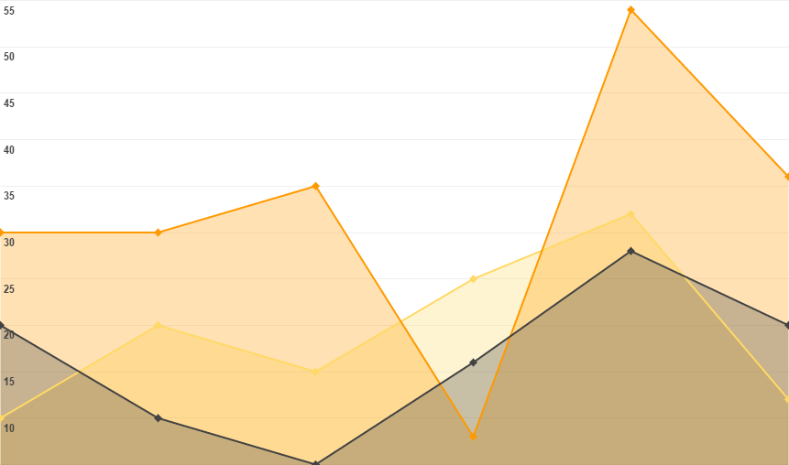
You can insert graphs from Google Sheets

Slide 27
ANDROID PROJECT
Show and explain your web, app or software projects using these gadget templates.
Place your screenshot here

Slide 28
iPHONE
PROJECT
Show and explain your web, app or software projects using these gadget templates.
Place your screenshot here

Slide 29
TABLET
PROJECT
Show and explain your web, app or software projects using these gadget templates.
Place your screenshot here

Slide 30
DESKTOP PROJECT
Show and explain your web, app or software projects using these gadget templates.
Place your screenshot here

Slide 31
THANKS!
Any questions?
You can find me at @username & user@mail.me

Slide 32
Credits
Special thanks to all the people who made and released these awesome resources for free:
Presentation template by SlidesCarnival
Photographs by Startupstockphotos

Slide 33
Presentation design
This presentation uses the following typographies and colors:
Titles: Dosis
Body copy: Roboto
You can download the fonts on these pages:
https://www.fontsquirrel.com/fonts/dosis
https://material.google.com/resources/roboto-noto-fonts.html
Orange #ff8700
You don’t need to keep this slide in your presentation. It’s only here to serve you as a design guide if you need to create new slides or download the fonts to edit the presentation in PowerPoint®

Slide 34
SlidesCarnival icons are editable shapes.
This means that you can:
Resize them without losing quality.
Change line color, width and style.
Isn’t that nice? :)
Examples:

Slide 35
😉
Now you can use any emoji as an icon!
And of course it resizes without losing quality and you can change the color.
How? Follow Google instructions https://twitter.com/googledocs/status/730087240156643328
✋👆👉👍👤👦👧👨👩👪💃🏃💑❤😂😉😋😒😭👶😸🐟🍒🍔💣📌📖🔨🎃🎈🎨🏈🏰🌏🔌🔑 and many more...

