Slide 1


Maintenance Procedure

Slide 2
Table of contents
Introduction
Maintenance
Management
Content
Archive
Question round

Slide 3
1.
Introduction
Let’s start with introducing ourselves

Slide 4
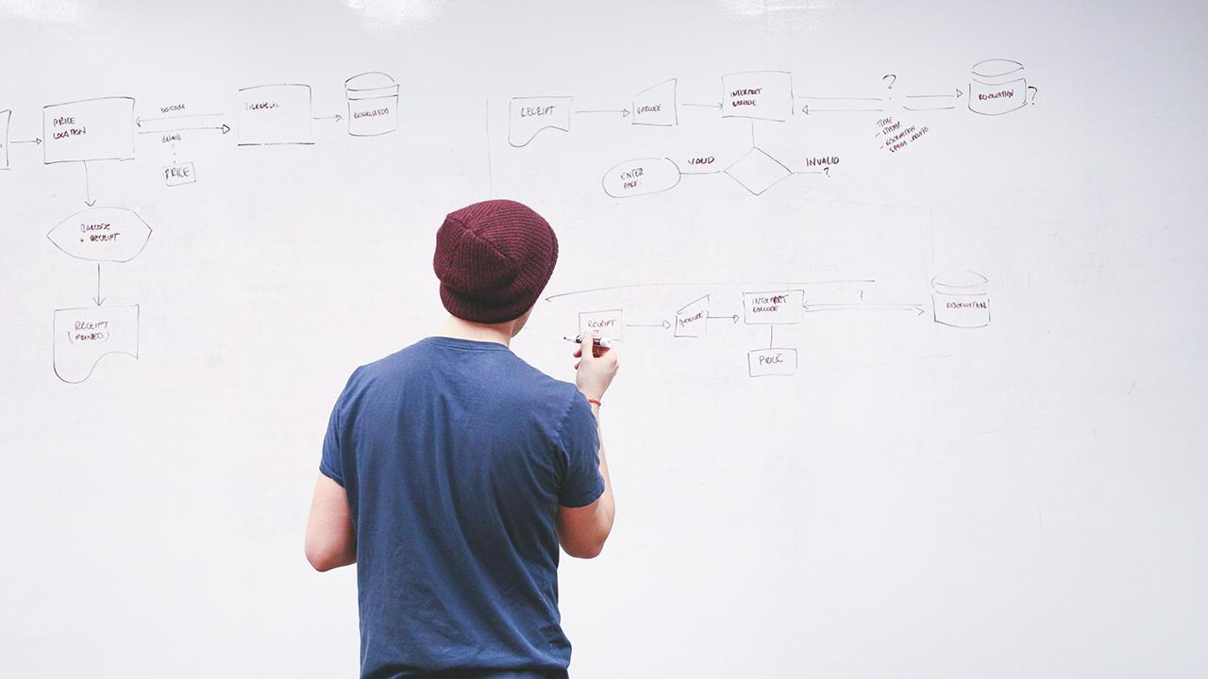
INTRODUCTION
We are Comp-U-Service and we’d like to talk to you about the maintenance procedures today.

Slide 5
2.
Maintenance

Slide 6
Maintenance
Installationprocedures
Incident handeling
Register
External helpdesk
Amendment procedure
Form

Slide 7
3.
Management

Slide 8
Management

Slide 9
4.
Content

Slide 10
Content
When is something content?
Barcodes
Stored medicine
Issue of drugs
How will we treat the content?
Database
Up to date
Protected
Changes will be documented
Who will manage the content?
Logistician
Wim Schreurs

Slide 11
5.
Archiving

Slide 12
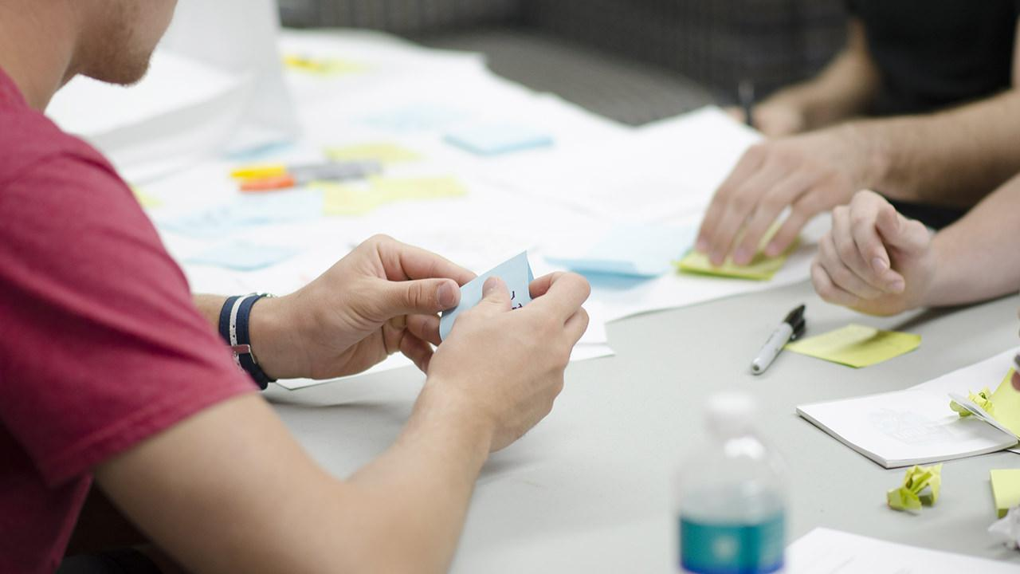
Archiving
GE MOET HIER TEXT DOUWE KUT

Slide 13

6. Question round
THANKS!
Any questions?

