Slide 1
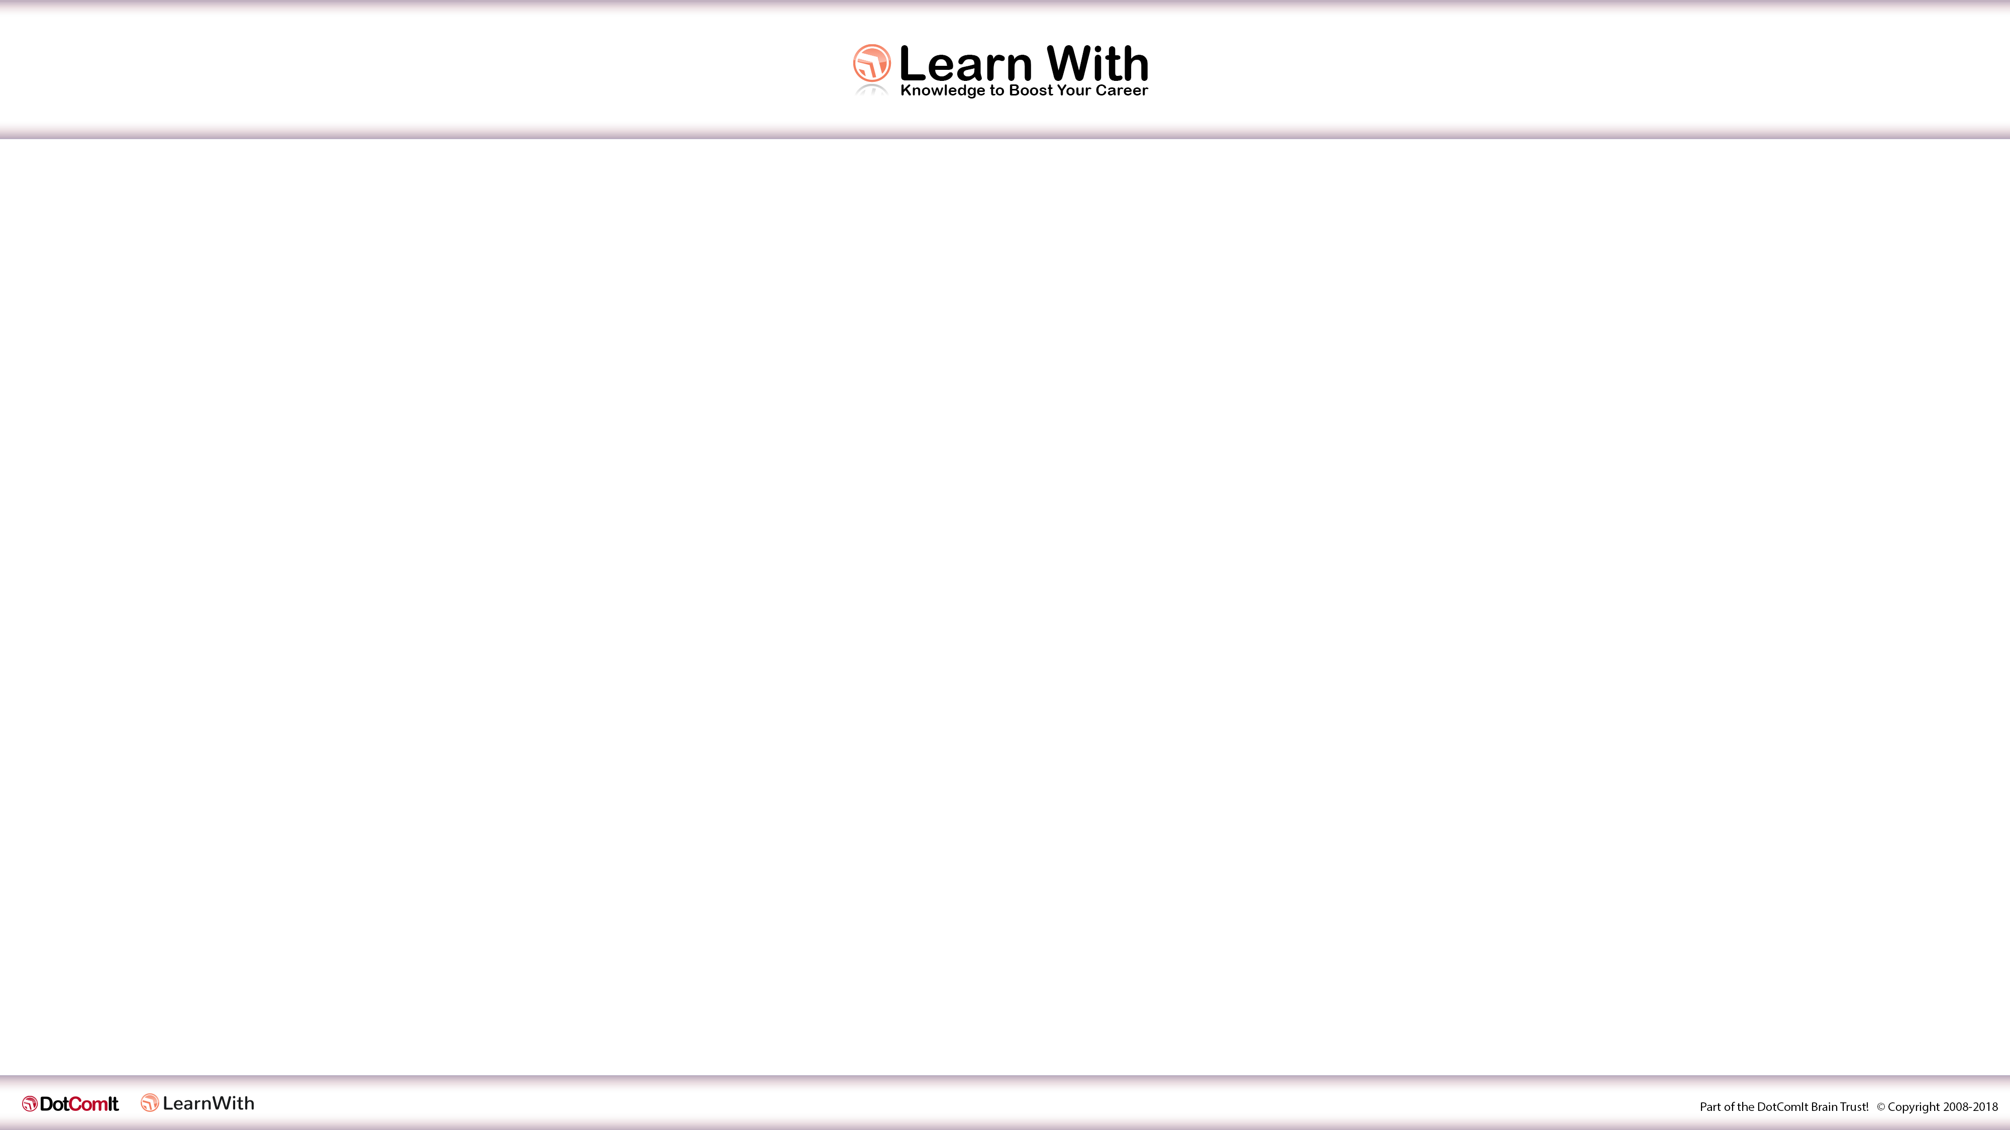
Optimizing Angular Components for Reuse
By Jeffry Houser
www.jeffryhouser.com
www.dot-com-it.com
www.learn-with.com
Twitter: Reboog711
www.youtube.com/dotcomit

Slide 2

Who is Jeffry?
Past:
  Small Business Owner who did custom software development
    Flextras – UI Components for Flex Developers
Present:
  I write a book series on Angular at www.learn-with.com
  Blog weekly at www.jeffryhouser.com
  Engineering Manager at Disney Streaming

Slide 3
What we’ll cover
Simple Component
  Display an array of objects
labelField Input
labelFunction Input and itemToDisplayLabel()
Examples:
  Array of Strings
  Array of Arrays

Slide 4
Details –Sample
Inputs:
  dataProvider: Array of Somethings
Functionality
  Display Items in array

Slide 5
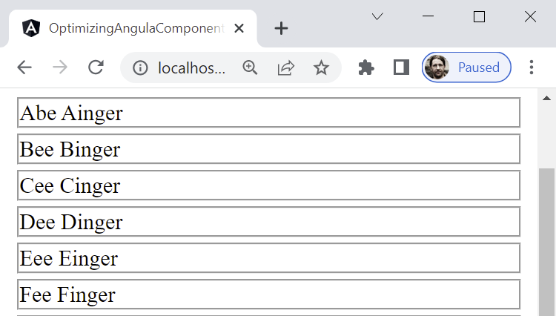
Screenshot - Sample
Inputs:
  dataProvider: Array of Somethings
Functionality
  Display Items in array

Slide 6
Data Source - Sample
objectDataProvider: any[] = [
{name: 'Abe Ainger' },
{name: 'Bee Binger'},
{name: 'Cee Cinger’},
]

Slide 7
Component Class - Sample
import { Component, OnInit, Input } from '@angular/core';
@Component({
selector: 'app-sample1',
templateUrl: './sample1.component.html',
styleUrls: ['./sample1.component.css']
})
export class Sample1Component {
@Input()
dataProvider: any[] = [];
}

Slide 8
HTML Template - Sample
<div *ngFor="let data of dataProvider" class="item">
{{data.name}}
</div>

Slide 9
Use – Sample
<app-sample1 [dataProvider]="objectDataProvider">
</app-sample1>

Slide 10
The Good – Sample
Encapsulated Display Logic

Slide 11
The Questionable – Sample
dataProvider uses generic type
dataProvider must be an array of objects
dataProvider objects must contain a name field

Slide 12
labelField
Introduce labelField Input
Allows component to dynamically introspect the objects in the dataProvider

Slide 13
Component Class – labelField
import {Component, Input, OnInit} from '@angular/core';
@Component({
selector: 'app-sample2',
templateUrl: './sample2.component.html',
styleUrls: ['./sample2.component.css']
})
export class Sample2Component {
@Input() dataProvider: any[] = [];
@Input() labelField = 'label';
}

Slide 14
HTML Template - labelField
<div *ngFor="let data of dataProvider" class="item">
{{data[labelField]}}
</div>

Slide 15
Use – labelField
<app-sample2
[dataProvider]="objectDataProvider"
[labelField]="'name’”>
</app-sample2>

Slide 16
The Good – labelField
Encapsulated Display Logic
Component can use any element on the dataProvider’s objects to create the display

Slide 17
The Questionable – labelField
dataProvider uses generic type
dataProvider must be an array of objects
dataProvider objects must contain a name field
Display String must be represented by a single property in array

Slide 18
labelFunction
Introduce labelFunction Input
Add itemToDisplayLabel() function
Allows component to dynamically introspect the dataProvider to determine how to process each item.

Slide 19
Component Class – labelFunction
export class Sample3Component {
@Input() dataProvider: any[] = [];
@Input() labelField = 'label’;
@Input() labelFunction!: (item: any) => string;
itemToDisplayLabel(item: any): string {
// next slide
}
}

Slide 20
Component Class P2 – labelFunction
itemToDisplayLabel(item: any): string {
if (typeof item === 'object') {
if (this.labelFunction) {
return this.labelFunction(item);
} else if (this.labelField) {
return item[this.labelField];
}
}
return item;
}

Slide 21
HTML Template - labelFunction
<div *ngFor="let data of dataProvider" class="item">
{{itemToDisplayLabel(data)}}
</div>

Slide 22
Use2 – labelFunction
labelFunction = (item: any) => {
return item.name;
}

Slide 23
Use – labelFunction
<app-sample3
[dataProvider]="objectDataProvider"
[labelFunction]=“labelFunction”>
</app-sample3>

Slide 24
The Good – labelFunction
Encapsulated Display Logic
Component can adapt to unknown dataproviders, including objects strings, or even arrays

Slide 25
Questionable – labelFunction
dataProvider uses generic type
dataProvider must be an array of objects
dataProvider objects must contain a name field
Display String must be represented by a single property in array

Slide 26
DataProvider - String Sample
simpleDataProvider: any[] = [
'Abe Ainger',
'Bee Binger',
'Cee Cinger',
]

Slide 27
HTML - String Sample
<app-sample3
[dataProvider]="simpleDataProvider">
</app-sample3>

Slide 28
Why does this work?
itemToDisplayLabel(item: any): string {
if (typeof item === 'object') {
if (this.labelFunction) {
return this.labelFunction(item);
} else if (this.labelField) {
return item[this.labelField];
}
}
return item;
}

Slide 29
DataProvider - Complex Sample
arrayOfArraysDataProvider: any[] = [
[
{name: 'Abe Ainger', purpose: 'primary'},
{name: 'Abe', purpose: 'nickName'},
],
[
{name: 'Bee Binger', purpose: 'primary'},
{name: 'BB', purpose: 'nickName'},
{name: 'Bee Rang', purpose: 'maiden'},
],
]

Slide 30
labelFunction - Complex Sample
arrayOfArraysLabelFunction = (item: any): string => {
let foundName = item.find((name: any) => name.purpose === 'primary')?.name;
if (!foundName) {
foundName = item.find((name: any) => name.purpose === 'nickName')?.name;
}
if (!foundName) {
foundName = item.find((name: any) => name.purpose === 'maiden')?.name;
}
if (!foundName) {foundName = 'No Name Found’; }
return foundName;
}

Slide 31
HTML - String Sample
<app-sample3
[dataProvider]="arrayOfArraysDataProvider"
[labelFunction]="arrayOfArraysLabelFunction">
</app-sample3>

Slide 32
Review
Simple Component
  Display an array of objects
labelField Input
labelFunction Input and itemToDisplayLabel()
Examples:
  Array of Strings
  Array of Arrays

Slide 33
Get the Books or Screencasts
http://www.learn-with.com

Slide 34
Slides
http://github.com/Reboog711/presentations

Slide 35
Optimizing Angular Components for Reuse
Thank You!
By Jeffry Houser
www.jeffryhouser.com
www.dot-com-it.com
www.learn-with.com
Twitter: Reboog711
www.youtube.com/dotcomit

