Slide 1
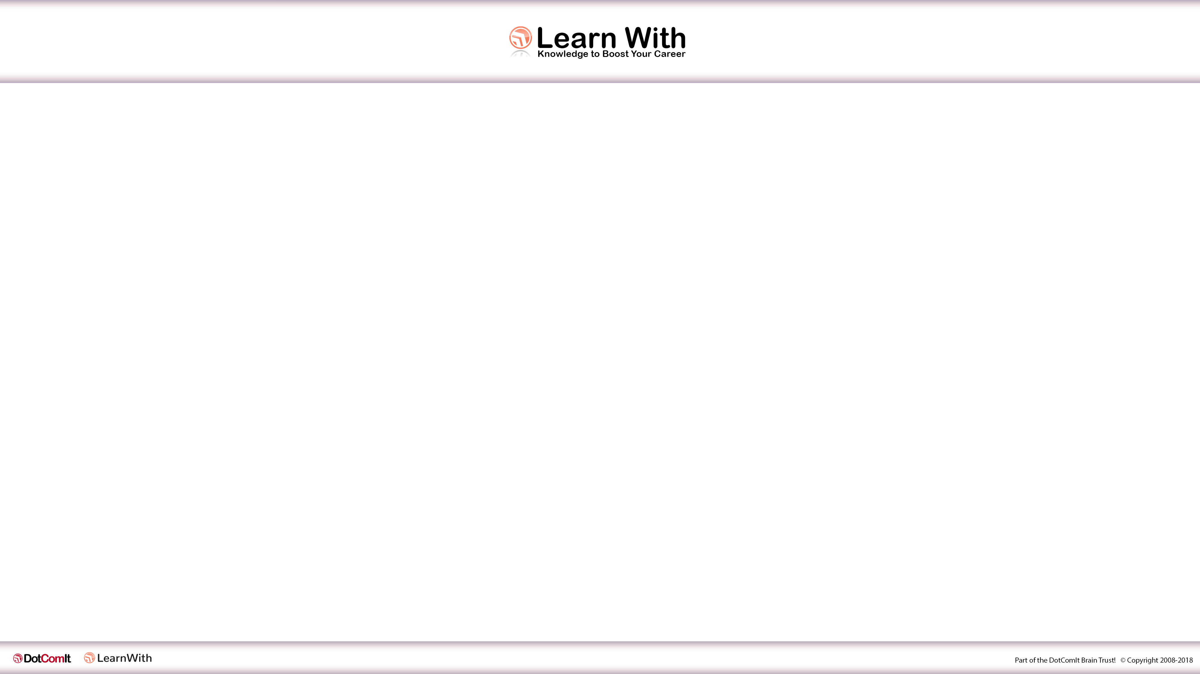
Introduction to Angular
By Jeffry Houser www.jeffryhouser.com www.dot-com-it.com www.learn-with.com
jeffry@dot-com-it.com

Slide 2

Who is Jeffry?
I write a book series on Angular at www.learn-with.com
Small Business Owner who did custom software development
Senior Developer at Disney Streaming Services

Slide 3
Who Are You?

Slide 4
What we’ll cover
What is Angular and why we use it?
Creating Angular Components
Using Angular Services to share Data between Angular Components

Slide 5
Part 1: What is Angular?
What is Angular
History of Angular
Why We Use It
Creating and Running Angular Application

Slide 6
What is Angular?
A Web Application Framework from Google
Decouples DOM Manipulation from Application Logic
Decouples client application from server application
Used for Building Single Page Applications

Slide 7
Angular History
2009: AngularJS Beta Released - a JavaScript MVC framework
2012: AngularJS 1.0.0 release
2016: AngularJS 1.6.0 release – added Component based architecture
2016: Angular released – Brand new TypeScript framework
2017: Angular CLI 1.0.0 released
2018: Angular and Angular CLI version / releases start to sync
2019: Angular 8 released

Slide 8
Angular Ecosystem
Angular Framework
TypeScript Framework
Dependency Injection
Angular CLI
Build Scripts (Webpack)
Scaffolding (Code Generation)
Angular Material
UI Library

Slide 9
Why would anyone use Angular?
Opinionated structure, which helps teams build consistent code
Custom Components have a clearly defined API
HTML Binding, with clear separation of display code and business logic.
Dependency Injection
Built to be testable, which helps make better code

Slide 10
Install Prerequisites
NodeJS and npm
Download from nodejs.org
Angular CLI
npm install -g @angular/cli

Slide 11
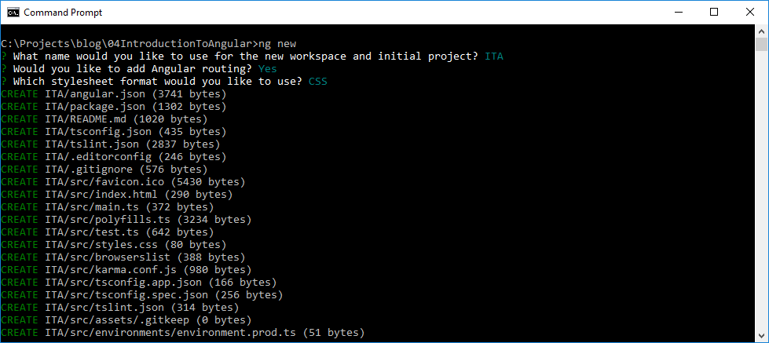
Create an Angular App
ng new

Slide 12
Create an Angular App – Code Review
e2e: For End to End Tests
node_modules: All the packages that had to be installed for the application to run.
src: The main application’s source
src/app: The main application code.
src/assets: The assets folder for the main application
src/environments: The environment configurations

Slide 13
AppComponent Files – Code Review
app.component.css: CSS
app.component.html: HTML Template
app.component.spec.ts: Tests for this component
app.component.ts: TypeScript code

Slide 14
AppComponent Files – Code Review
app.component.ts
import { Component } from '@angular/core'; @Component({ selector: 'app-root', templateUrl: './app.component.html', styleUrls: ['./app.component.css'] }) export class AppComponent { title = 'ITA'; }

Slide 15
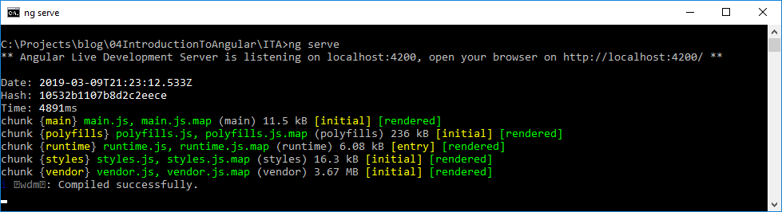
Create an Angular App – Run
ng serve

Slide 16
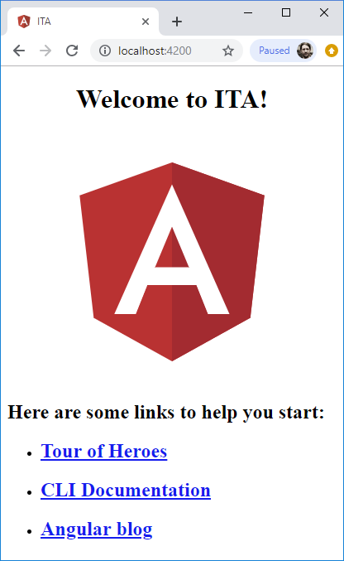
Create an Angular App – Browser

Slide 17
Part 1: What is Angular? - Review
What is Angular
History of Angular
Why We Use It
Creating and running Angular Application

Slide 18
Question Break

Slide 19
Part 2: Angular Components
What is a component?
How to Create Angular Components
Share data between view and class
Respond to view interactions inside class
Define Formal Inputs and Outputs

Slide 20
What is an Angular Component?
Encapsulate code, HTML, and CSS into one unit
Clear separation of HTML, CSS, and TypeScript.
Create your own HTML tag, with defined inputs and events.

Slide 21
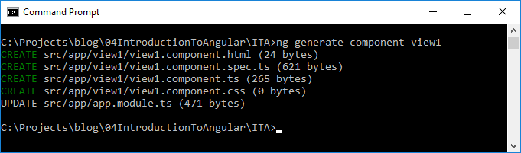
Create a Component (Sample 2)
ng generate component view1

Slide 22

Create a Component
ng generate component view2

Slide 23
Create a Component – Module Changes
Import:
Declaration
import { View1Component } from './view1/view1.component'; import { View2Component } from './view2/view2.component';
declarations: [ AppComponent, View1Component, View2Component ],

Slide 24
Create a Component – Component Code
view1.component.ts:
View1.component.html:
import {Component, OnInit} from '@angular/core'; @Component({ selector: 'app-view1', templateUrl: './view1.component.html', styleUrls: ['./view1.component.css'] }) export class View1Component implements OnInit { constructor() {} ngOnInit() {} }
<p> view 1 works </p>

Slide 25
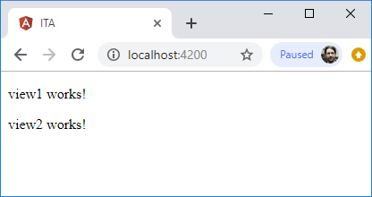
Add Components to Main View
app.component.html
Reload App
<app-view1></app-view1> <app-view2></app-view2>

Slide 26
Components – Sample 3
Share between View and Class

Slide 27
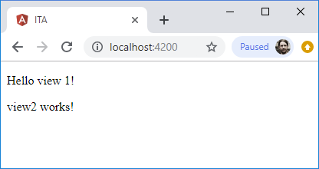
Components – Share between View and Class
view1.component.ts
View1.component.html
Reload App
myValue = 'Hello';
<p> {{myValue}} view 1! </p>

Slide 28
Components – Sample 4
Respond to User Interaction

Slide 29
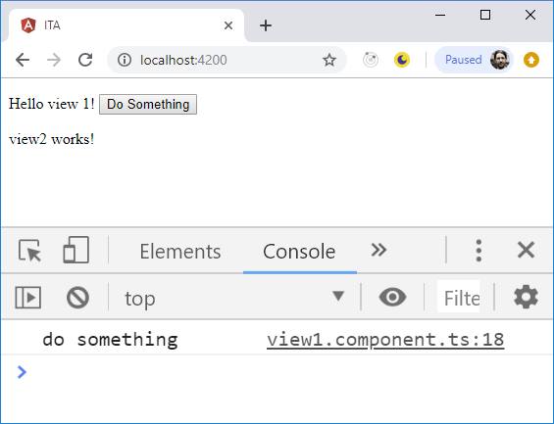
Components –View Actions
View1.component.html
view1.component.ts
Reload App
<button (click)="doSomething()">Do Something</button>
doSomething() { console.log('do something'); }

Slide 30
Components – Sample 5
Create a Formalized Input
Create a Formalized Output

Slide 31
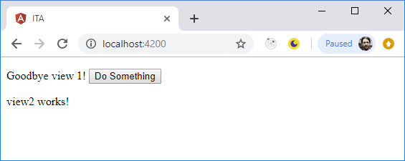
Components - Inputs
view1.component.ts
app.component.html
Reload App
import {Component, Input, OnInit} from '@angular/core';
@Input() myValue = 'Hello';
<app-view1 [myValue]=“’Goodbye’"></app-view1>

Slide 32
Components - Outputs
view1.component.ts
app.component.html
app.component.ts
import {Component, EventEmitter, Input, OnInit, Output} from '@angular/core';
@Output() doSomethingRequest: EventEmitter<any> = new EventEmitter();
doSomething() { this.doSomethingRequest.emit('do something'); }
<app-view1 [myValue]="'Goodbye’” (doSomethingRequest)="onDoSomething($event)"> </app-view1>
onDoSomething(event) { console.log(event); }

Slide 33
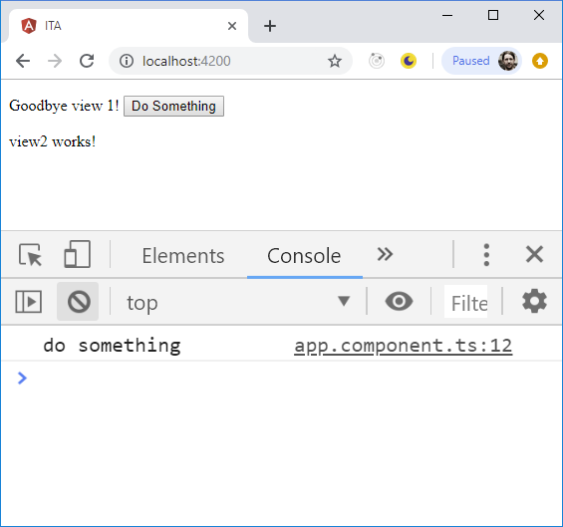
Components – Outputs Part 2
Reload App

Slide 34
Part 2: Angular Components - Review
What is a Component
How to Create Angular Components
Share data between view and class
Respond to view interactions inside class
Define Formal Inputs and Outputs

Slide 35
Question Break

Slide 36
Part 3: Services
What is an Angular service?
How to Create
How to Use

Slide 37
Services – What they are
A class used to share data or functionality among multiple components
A Singleton
Uses Dependency Injection

Slide 38
Services – What they are Not
Not a construct for integrating with REST services or other external systems.

Slide 39
Components – Sample 6
Use a Service to share data between components

Slide 40
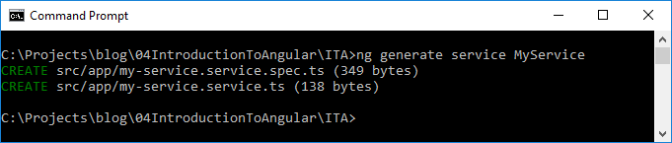
Services - Create
ng generate service MyService

Slide 41
Services – Files
my-service.service.spec.ts: Tests
my-service.service.ts: The Service Class

Slide 42
Services – Code Review
my-service.service.spec.ts: Tests
my-service.service.ts: The Service Class
import { Injectable } from '@angular/core'; @Injectable({ providedIn: 'root' }) export class MyServiceService { constructor() { } }

Slide 43
Services – Alternate Setup
my-service.service.ts
app.module.ts:
import { Injectable } from '@angular/core'; @Injectable() export class MyServiceService { constructor() { } }
import {MyServiceService} from './my-service.service';
providers: [ MyServiceService ],

Slide 44
Service – Use it – Load Forms Module
app.module.ts
import {FormsModule} from '@angular/forms';
imports: [ BrowserModule, AppRoutingModule, FormsModule ],

Slide 45
Service – Use it in view1
my-service.service.ts
view1.component.ts
view1.component.html
myValue = 'default';
import {MyServiceService} from '../my-service.service';
constructor(public service: MyServiceService) { }
<input [(ngModel)]="service.myValue">

Slide 46
Service – Use it in view2
view2.component.ts
view2.component.html
import {MyServiceService} from '../my-service.service';
constructor(public service: MyServiceService) { }
<p> Value: {{service.myValue}} </p>

Slide 47
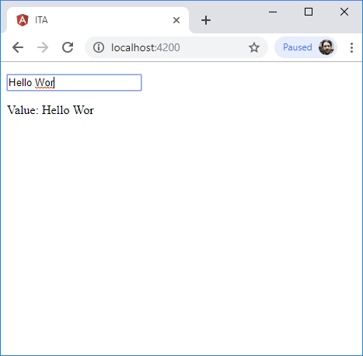
Service – Use it in view2
Reload the app

Slide 48
Part 3: Services - Review
What is an Angular service?
How to Create
How to Use

Slide 49
Question Break

Slide 50
Final Review
What is Angular and why we use it?
Creating Angular Components
Using Angular Services to share Data between Angular Components

Slide 51
Introduction to Angular Thank You
By Jeffry Houser www.jeffryhouser.com www.dot-com-it.com www.learn-with.com
jeffry@dot-com-it.com

