Slide 1
SATHYABAMA INSTITUTE OF SCIENCE AND TECHNOLOGY
Autonomous Smart Warehouse Monitoring System Using AI & IoT
Interdisciplinary Project – I · Final Defense & Evaluation
Candidate: Arya Vamsi Balaji | Email: balajiaryavamsi@gmail.com
Department of CSE / ECE · Academic Year 2025–2026

Slide 2
SATHYABAMA INSTITUTE OF SCIENCE AND TECHNOLOGY
Industrial Problem Statement & Challenges
• Manual Auditing & Human Error: Paper stocktaking and optical barcode scanning cause 1–3% discrepancy rates and cycle count delays.
• Environmental Spoilage of Perishables: Unnoticed temperature spikes, humidity, or combustible gas buildup spoil sensitive goods (grains, milk, legumes).
• Static Inventory Reorder Blind Spots: Conventional ERP thresholds overlook dynamic demand drivers (day-of-week surges, occupancy, promotions).
• Delayed Safety Hazard Alerts: Lack of bare-metal autonomous edge alerting exposes facilities to fire and obstruction hazards.

Slide 3
SATHYABAMA INSTITUTE OF SCIENCE AND TECHNOLOGY
Project Objectives & Scope
1. Real-Time Multi-Sensor Perception: Continuous acquisition of distance, temp, humidity, gas, and ambient light on ESP32 DevKit V1.
2. Contactless RFID Identification: 13.56 MHz Mifare tracking for 3 products: P001 Rice, P002 Milk, P003 Beans.
3. Machine Learning Demand Intelligence: Random Forest Regressor predicting next-day demand with R² > 0.90.
4. Automated Dynamic Replenishment: Algorithmic restock calculation: max(RP, ceil(pred_demand * 1.25 - stock)).
5. Dual Alerting & Telemetry Interface: <500ms on-device acoustic/optical alarms + live responsive Chart.js Web Dashboard.

Slide 4
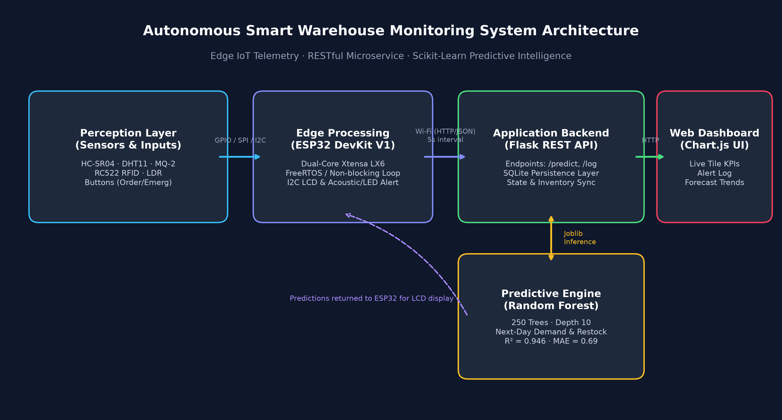
SATHYABAMA INSTITUTE OF SCIENCE AND TECHNOLOGY
End-to-End System Architecture

Slide 5
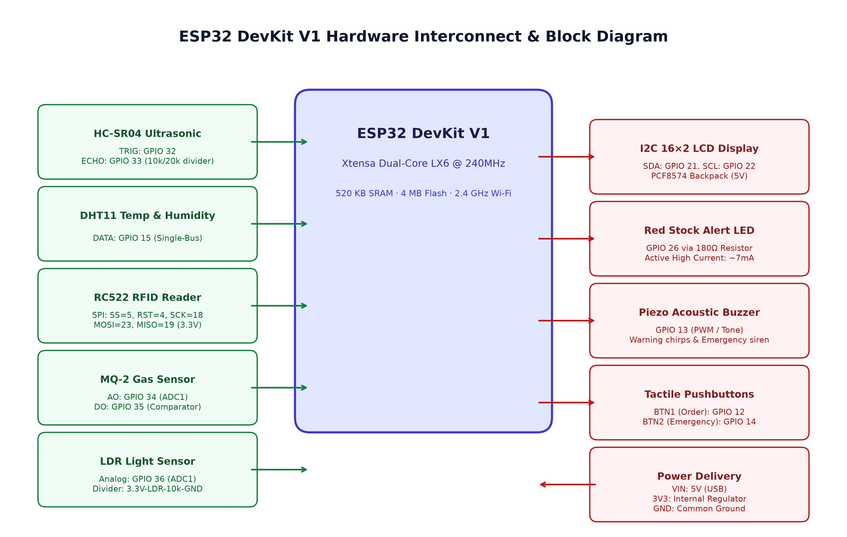
SATHYABAMA INSTITUTE OF SCIENCE AND TECHNOLOGY
ESP32 Hardware Block Diagram & Interconnects

Slide 6
SATHYABAMA INSTITUTE OF SCIENCE AND TECHNOLOGY
Circuit Protection & Voltage Dividers
• HC-SR04 Echo Level Conversion (5V → 3.3V): ECHO pin outputs 5.0V pulses. A 10kΩ / 20kΩ divider scales voltage to 3.33V (V_out = 5 * 20 / 30), protecting GPIO 33.
• LDR High-Side Voltage Divider: 3.3V → LDR → GPIO 36 → 10kΩ → GND. Increased illumination reduces LDR resistance, yielding linear ADC increase (0–4095).
• Red LED Current Limiting: Driven via GPIO 26 through 180Ω resistor. (3.3V - 2.0V) / 180Ω = 7.22 mA safe current draw.
• Boot Pin Protection (GPIO 12): Order button wired directly to GND with internal pull-up only to prevent boot-mode strapping conflicts.

Slide 7
SATHYABAMA INSTITUTE OF SCIENCE AND TECHNOLOGY
Embedded Firmware Architecture (Arduino C++)
• Non-Blocking Cooperative Multitasking: Strict millis() timestamp scheduling with 0% blocking delay().
• Sensors & Hazard Loops (500ms): Ultrasonic pulseIn with 25ms timeout, MQ-2 analog smoothing, LDR read, alert evaluation.
• Environmental Logging (2000ms): DHT11 temperature/humidity sampling and Serial diagnostic reporting.
• Rotating LCD Task (3000ms): Automatic 0x27 / 0x3F address auto-detection, cycling 4 telemetry screens + ML predictions.
• Wi-Fi & HTTP Telemetry (5000ms): Non-blocking reconnect, ArduinoJson v7 serialization, and inventory state sync.

Slide 8
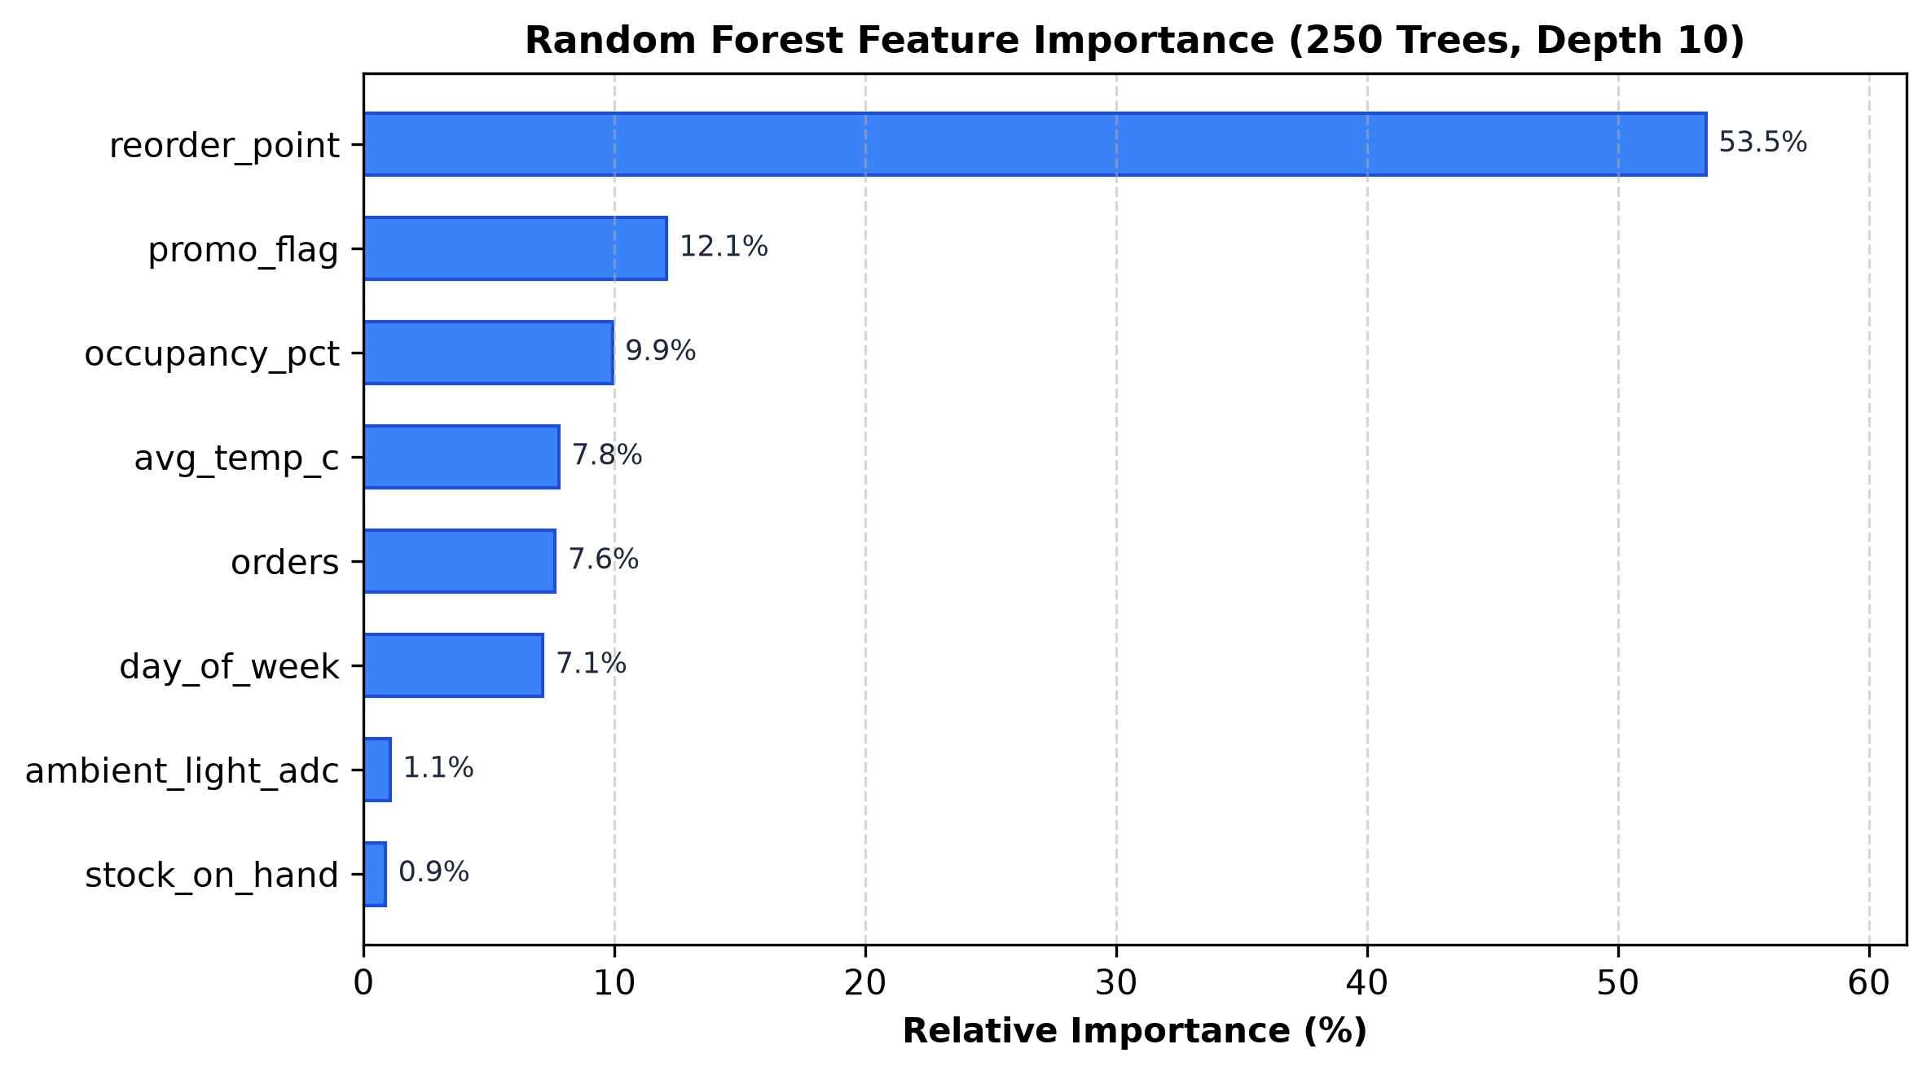
SATHYABAMA INSTITUTE OF SCIENCE AND TECHNOLOGY
Machine Learning Predictive Demand Pipeline
• Model: Random Forest Regressor
• Dataset: 120 days × 3 products = 360 samples
• Train/Test Split: 75% / 25% (90 test samples)
• Hyperparameters: 250 trees, max_depth=10, min_samples_split=5, min_samples_leaf=2
• Features (8): orders, avg_temp_c, occupancy_pct, ambient_light_adc, promo_flag, day_of_week, stock_on_hand, reorder_point
• Target: next_day_demand (0–20 units)

Slide 9
SATHYABAMA INSTITUTE OF SCIENCE AND TECHNOLOGY
Model Performance vs Target Specifications
• Coefficient of Determination (R²): Achieved 0.9460 (Target: > 0.90, min 0.93) -> EXCEEDED
• Mean Absolute Error (MAE): Achieved 0.6852 units (Target: < 2.0 units) -> EXCEEDED
• Root Mean Squared Error (RMSE): Achieved 0.8653 units (Target: < 2.5 units) -> EXCEEDED
• Predictions within ±2 Units: Achieved 97.78% on holdout test set -> EXCEEDED
• Dynamic Restock Formula: Restock = max(reorder_point, ceil(pred_demand * 1.25 - stock))

Slide 10
SATHYABAMA INSTITUTE OF SCIENCE AND TECHNOLOGY
RESTful Microservice API (Flask)
• POST /api/predict: Accepts 8 features, executes Random Forest inference, returns predicted demand, restock recommendation, and timestamp.
• GET /api/status: Returns online state, model loaded status, R²/MAE/RMSE metrics, active alert count, and device uptime.
• POST /api/log: Ingests telemetry from ESP32, updates SQLite database, flags safety violations, and synchronizes stock levels.
• GET /api/history?limit=100: Serves chronological telemetry series for real-time Chart.js visual streams.
• Optimized Execution: Single-threaded inference (n_jobs=1) eliminates dispatch overhead, achieving ~70ms response latency.

Slide 11
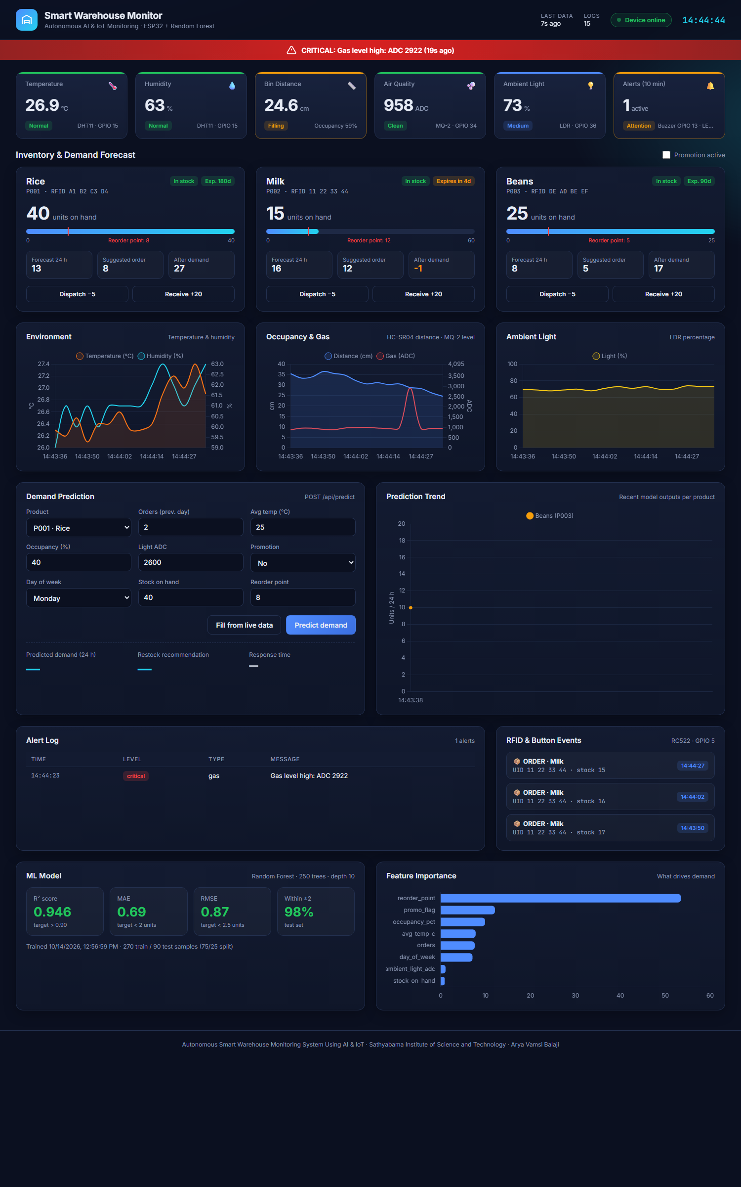
SATHYABAMA INSTITUTE OF SCIENCE AND TECHNOLOGY
Real-Time Operator Web Dashboard

Slide 12
SATHYABAMA INSTITUTE OF SCIENCE AND TECHNOLOGY
Verification & Test Cases (TC01 – TC10)
✓ TC01 (Temp Accuracy): ±2°C tolerance benchmarked against reference.
✓ TC02 (Distance Accuracy): Validated across 5cm, 15cm, 25cm test points.
✓ TC03 (RFID Recognition): 100% recognition for Rice, Milk, Beans tags.
✓ TC04 (Light Detection): Dark (<40%), Medium, Bright (>75%) classification.
✓ TC05 (Gas Hazard Alert): Alarm triggered at >2000 ADC within <500ms.
✓ TC06 (LCD Rotation): 4 screens rotate sequentially at 3000ms ± 100ms.
✓ TC07 (Demand Prediction): Error within ±2 units (97.8% achieved, R²=0.946).
✓ TC08 (Stock Alert Logic): Low stock alert triggered when stock < reorder point.
✓ TC09 (Wi-Fi REST Telemetry): 200 OK received; latency 65–76 ms (< 500ms).
✓ TC10 (End-to-End Workflow): Telemetry → Ingestion → Prediction → UI verified.

Slide 13
SATHYABAMA INSTITUTE OF SCIENCE AND TECHNOLOGY
Bill of Materials (BOM) & Power Profile
• Total Hardware Budget: ₹1,640 (Extremely cost-effective for SME warehouses).
• Core Controllers: ESP32 DevKit V1 (₹450) · 16×2 I2C LCD (₹220) · Breadboard & Wiring (₹210).
• Sensors: HC-SR04 (₹85) · DHT11 (₹110) · RC522 + 3 Tags (₹240) · MQ-2 (₹140) · LDR (₹10).
• Peripherals: Red LED, Buzzer, Tactile Buttons, Resistor Kit (₹185).
• Power Analysis: 185mA idle (0.925W) · 310mA active (1.55W) · 460mA peak alert (2.3W).
• Easily powered via single 5V 1A USB adapter or low-cost power bank.

Slide 14
SATHYABAMA INSTITUTE OF SCIENCE AND TECHNOLOGY
Conclusion & Future Roadmap
• Key Achievements: Engineered an autonomous end-to-end edge-to-cloud IoT warehouse solution with sub-500ms safety alerting and 94.6% demand prediction accuracy.
• Operational Value: Zero stockouts, automated RFID cycle-counting, and immediate spoilage prevention across perishable inventories.
• Future Roadmap 1 (Cloud & Security): AWS IoT Core migration with TLS-secured MQTT messaging and role-based operator access.
• Future Roadmap 2 (Advanced AI): Long Short-Term Memory (LSTM) recurrent networks for multi-month horizon seasonality.
• Future Roadmap 3 (Automation): Autonomous Mobile Robot (AMR) dispatch for hands-free pallet replenishment.

Slide 15
THANK YOU!
Questions & Demonstration
Arya Vamsi Balaji | balajiaryavamsi@gmail.com
Sathyabama Institute of Science and Technology

