Slide 1
Design Thinking
Quietify : Noice Detecting and Alert System
Batch: E-23
Group Name : MindCraft
Team Members:
1.Varad Patil (202501070193)
2.Kadambari Jawali (202501070186)
3.Parth Nasare (202501070185)
4.Pavani Kulkarni (202501070183)
Guided By:
Mrs. Nitasha Chaudhari

Slide 2
POV Statement:
The Statement:
"A focused college student preparing for exams needs an automated, unbiased, and non-intrusive way to maintain library silence, because intermittent noise disruptions (like whispering) break their concentration flow, and current manual monitoring by librarians is inconsistent and often distracting."

Slide 3
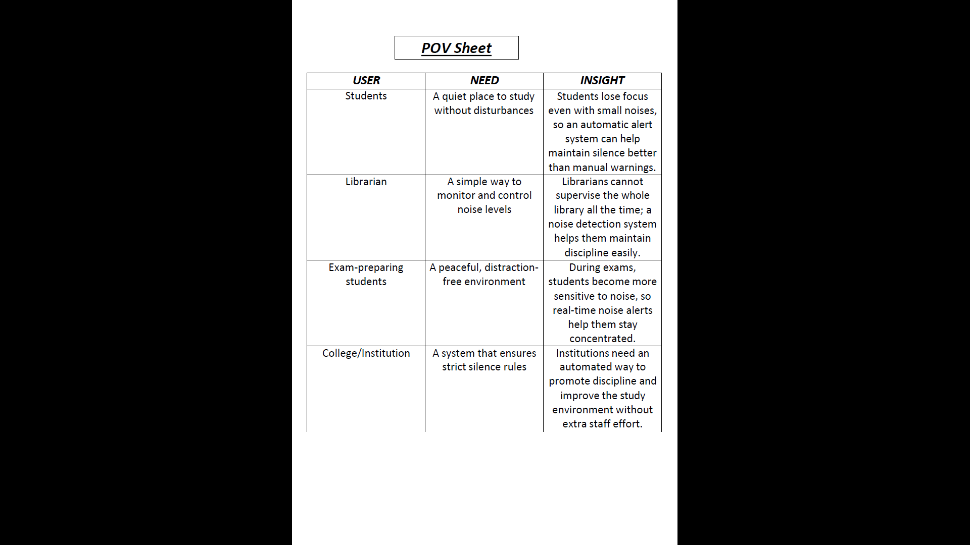

Slide 4
Alternative Solutions Identified:
Solution A:
Manual patrolling by the librarian to quiet students (Ineffective and tiring).
Solution B:
Mobile app where students report noisy peers (Creates conflict between students).
Solution C:
Soundproofing the entire library (Too expensive and impractical).

Slide 5
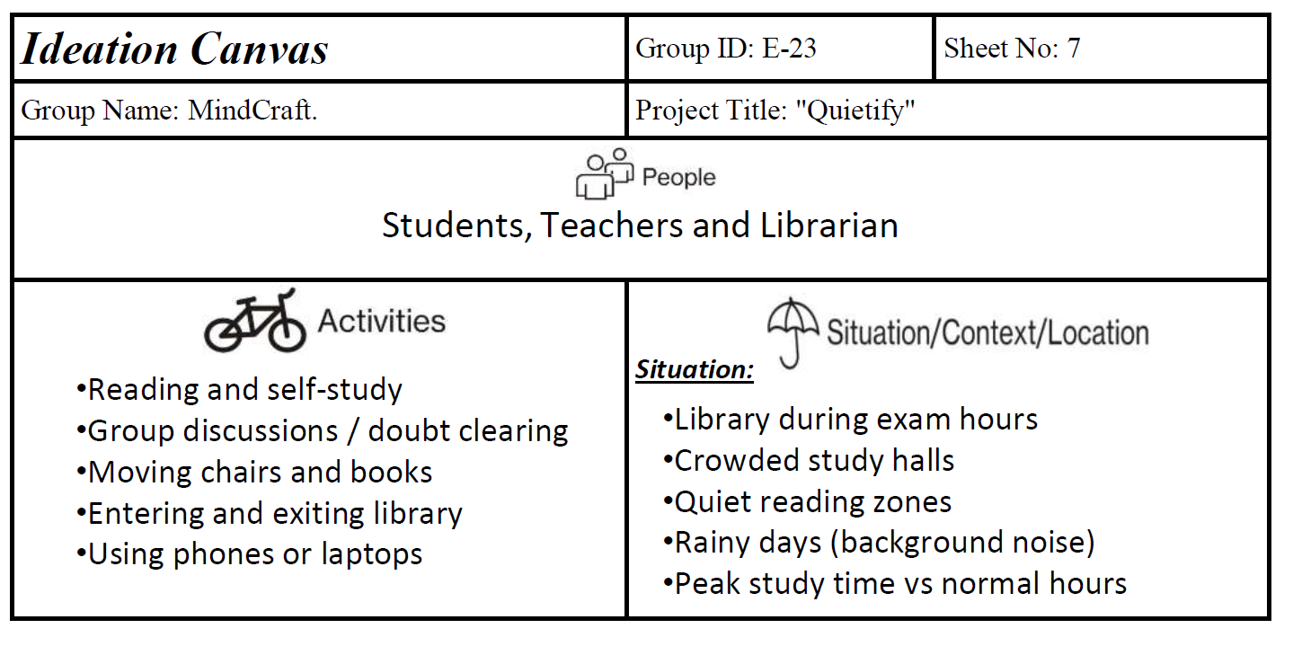

Slide 6
SCAMPER Application:
Substitute: Substitute verbal "Shh" warnings with a Visual Light Alert.
Combine: Combine a Sound Sensor (Microphone) with an LED Display.
Adapt: Adapt traffic light logic (Red = Too Loud, Green = Okay) for study tables
Modify: Modify standard decibel meters to be smaller and cheaper for mass use.
Put to another use: Can be used in Hospitals or Exam Halls later.
Eliminate: Eliminate the need for constant human supervision.
Reverse: Instead of a loud alarm (which adds noise), use a silent visual signal.

Slide 7
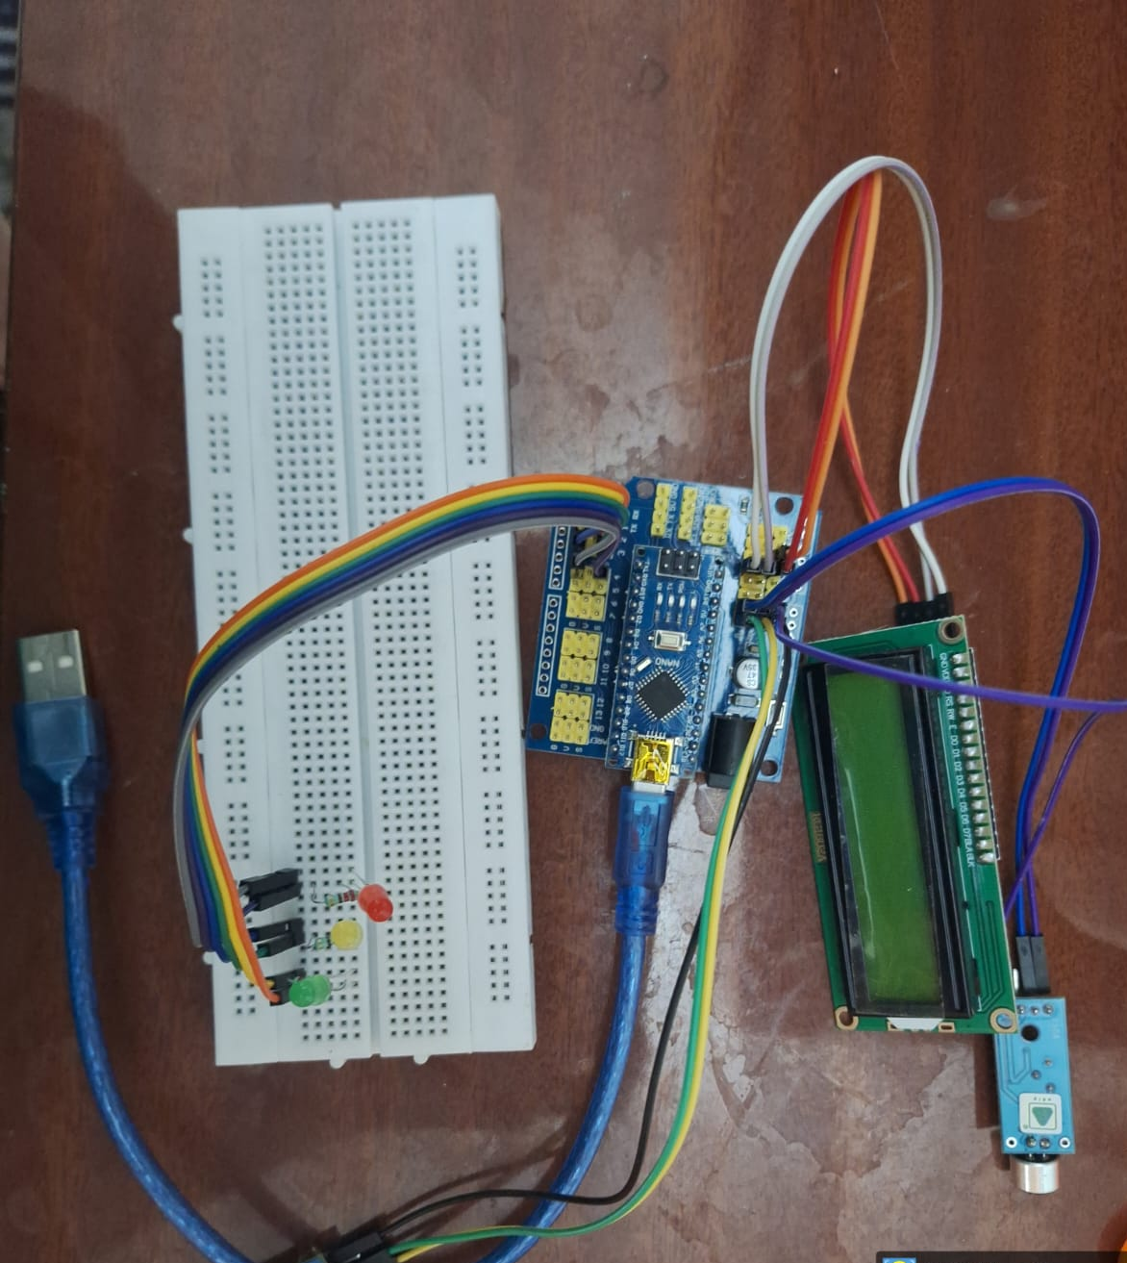
Final Idea Framed (As per User Requirement):
An automated Library Noise Detector that monitors decibel levels in real-time and triggers a visual warning light when noise exceeds the limit. This solves the user's problem of distraction without requiring constant librarian intervention.

