Slide 1


Team
Kirk Volin
Dominick Trusko
Gwen Eging
Arick Nitzsche
Eli Greetis
Enoc Manivasagam
Neglect Reminder
4/28/2026
RAS 555

Slide 2
Background - Hemiparesis
It is a symptom of neurological damage.
Usually caused by stroke or a traumatic brain injury.
One sided weakness, appear as:
Facial drooping
Balance issues
Forgetting one side exists
The first 2-3 weeks after injury are the most important for recovery
Effects Memory, dexterity, & strength.
Head and neck recovery and stability is necessary before treatment can move on to limbs.
Early on rehab is focusing on reconnecting the two sides of the brain.
Notes:
Background → Gwen

Slide 3
Related Work
1.
2.
AR Simulation →
Never commercially released, only a study was done.
Bulky
Formatted to work on the Microsoft HoloLens 2 (~$4,396.73)
Tobii Centered Devices →
Expensive
Provides various options for configuration
Costs span $299 for the gaming solutions to $4,500 for the medical assistive devices.
Notes:
Background/Related Work → Gwen

Slide 4
Neglect Reminder System with Facial Tracking
Timed Audio Alerts
Visual Display
Facial Tracking
Isolated from Internet
Proposed Solution
Allows therapists to schedule routine alerts
Alerts remind the patient to look towards the device
Routine, audible cues keep patients engaged in therapy mostments
The patient is instructed to look at a specific object on the screen
Provides visual feedback and rewards the patient for interacting
The heart of the system
Software processes the image from a webcam to determine where the patient it looking to determine success rate
Logs statistical data for therapists to review
The device is standalone with no internet or bluetooth capabilities
Maintains patient privacy
Does not store image data
Meets HIPAA standards

Slide 5
Computer (01)
Raspberry Pi 5
Hardware Overview
Webcam (02)
Inland C840
Touchscreen (03)
Roadom 10” Touchscreen
Cooling (04)
Noctua NF-A4x10 5V PWM
Case (05)
Modelled in Fusion 360, 3D Printed, VESA compatible
I/O (06)
Case mounted USB-A port

Slide 6
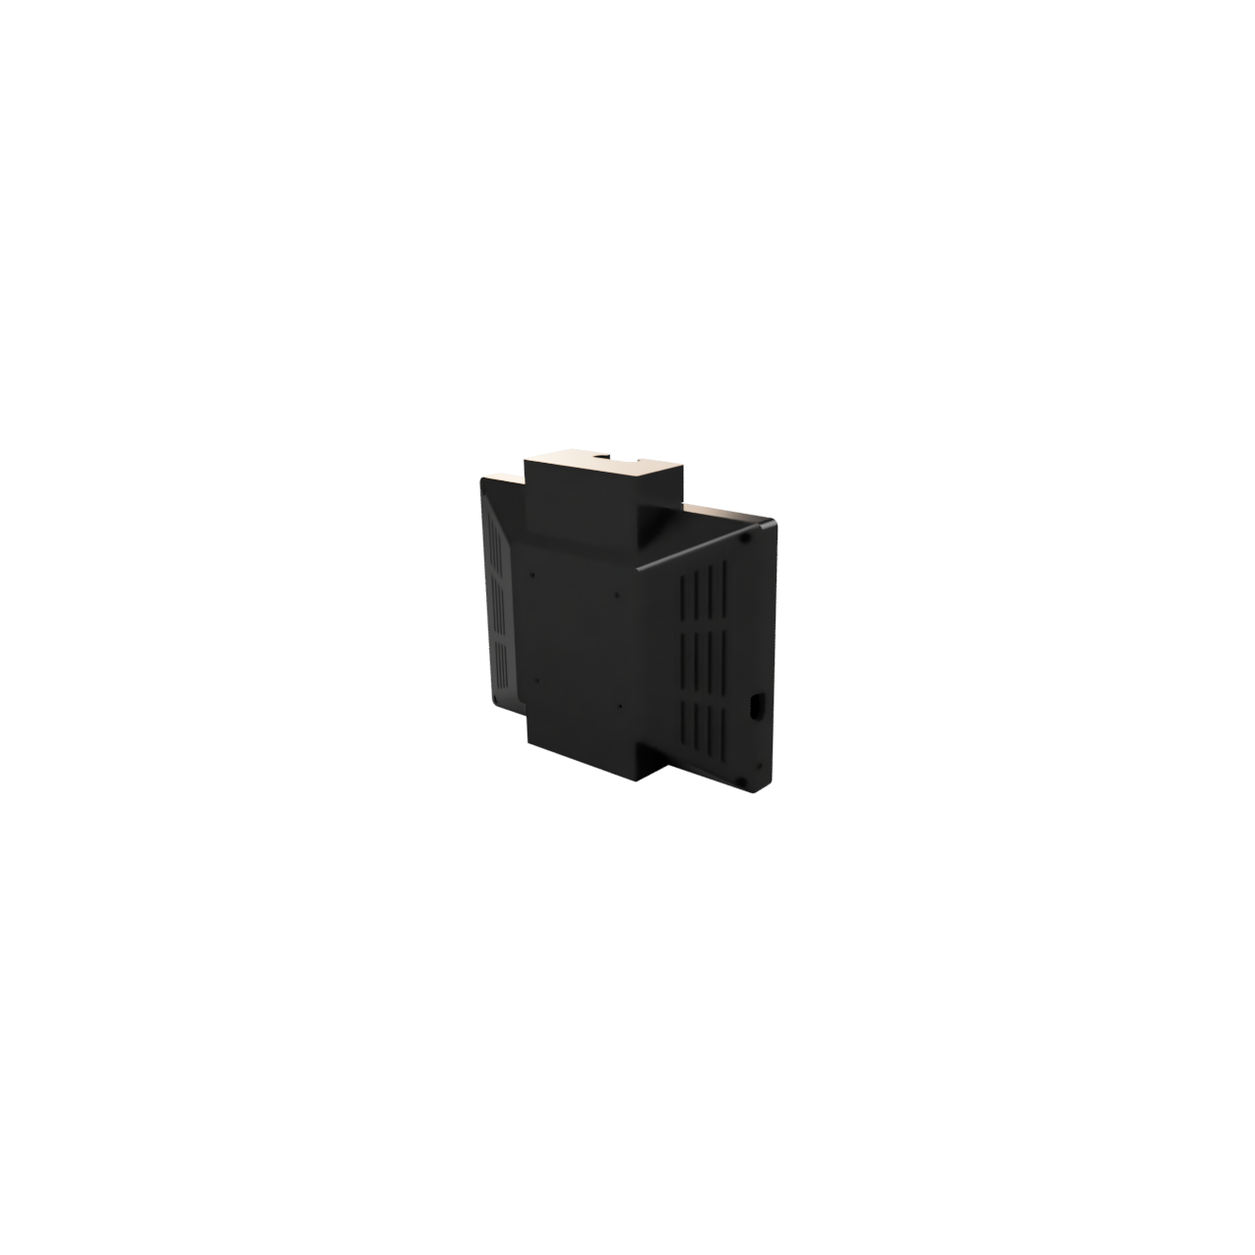

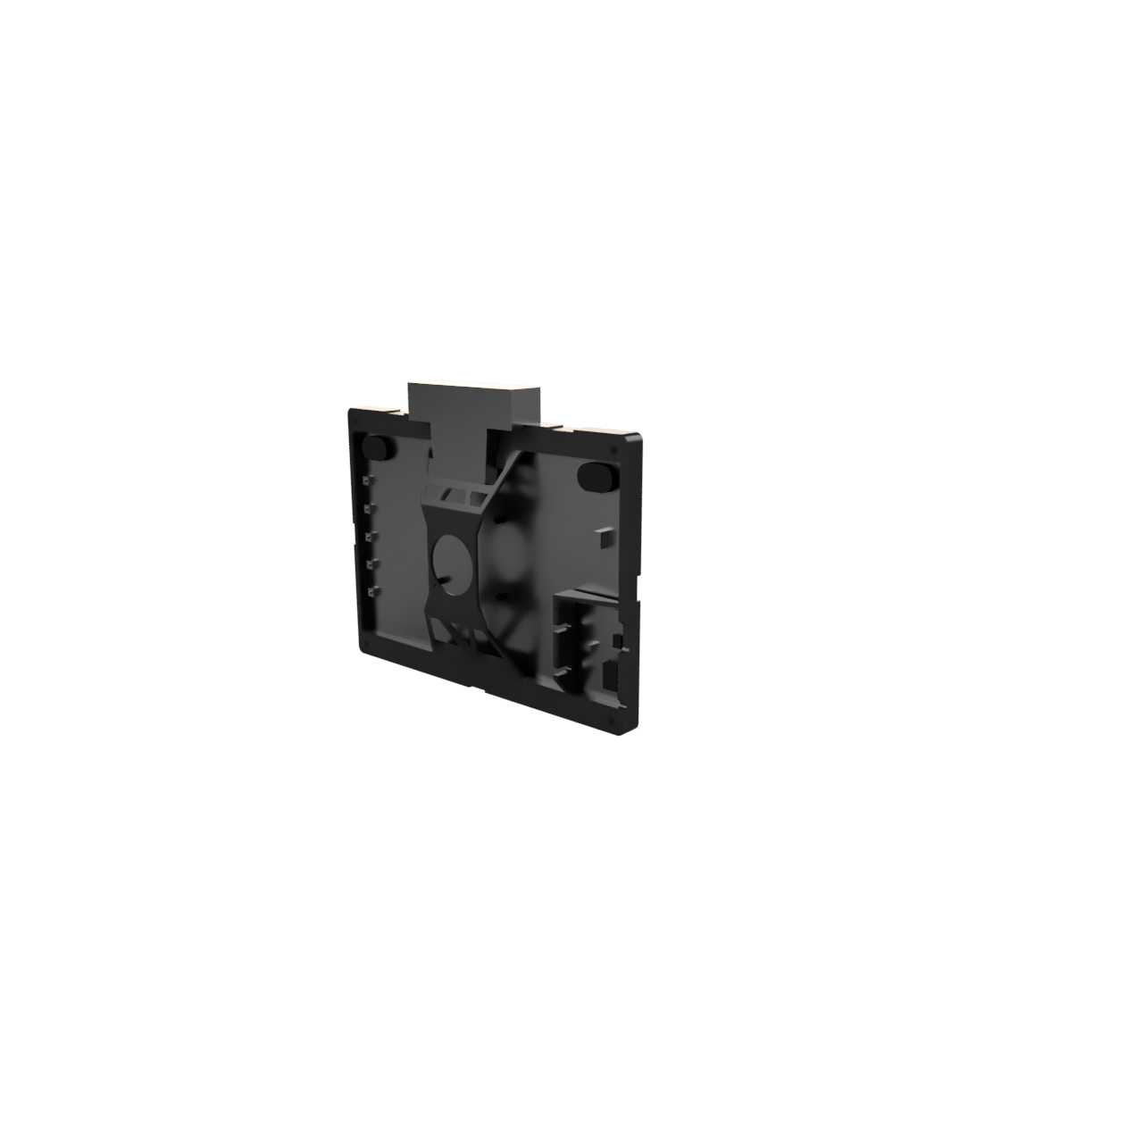
CAD Design
Modelled in Fusion 360

Slide 7
Initialization (01)
Verify presence of required files, cache transform data, test camera + Blaze Face
Software Overview
Load Config (02)
Load patient settings and existing save data from previous session
Setup
Disable Cam (03)
Disable non-critical hardware and sleep until trigger is activated
Trigger Alert (04)
Enable camera and show alert information + play audio cue
Loop
Log Stats (05)
Cache information about time to target, time off target, and session number/time
Export Data (06)
Export cached data to CSV or append existing data log
Export

Slide 8

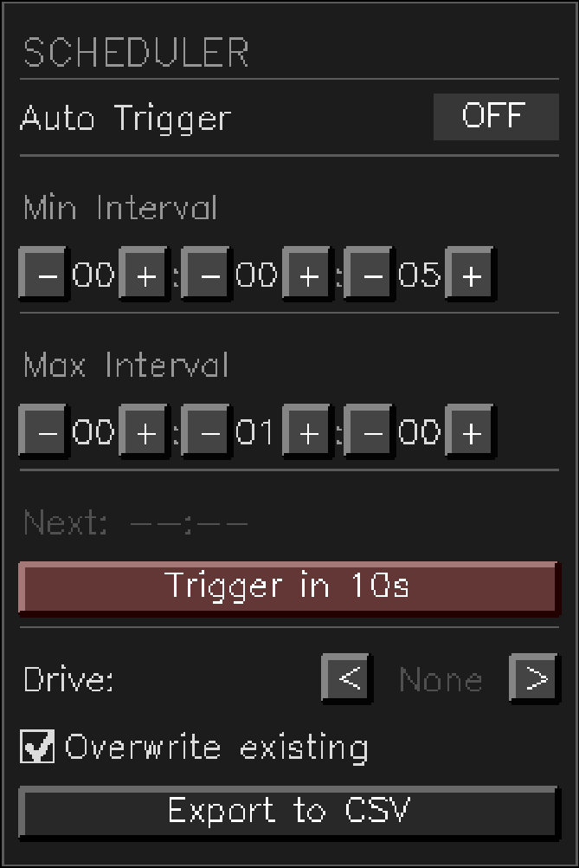


Facial Tracking Implementation
Overview
Head tracking is used as a remote selection method to prevent the user from having to physically interact with the device, while pupil attention is mandated by identification and selection of symbols.
Facial detection is handled offline using Google Mediapipe Blazeface, analyzing 6 tracking points to determine facial orientation
Interaction
Export
Interactions can be scheduled by the physician at determined intervals, as well as exported to the selected medium.
Data is exported as a CSV, either overwriting existing data or appending the list. Drive data is not read, and files can only be added to the drive’s root with the name ReMindLog.csv
Visualization
The interface is drawn using OpenCV with some custom functions to produce bevelled edges
Icons are parsed from a folder called “Images” in the project root. To add new icons you just add the image to that folder and rename it as an identifier, on startup the program will cache any images in that folder.
Icons are from https://game-icons.net/, but supports dynamic content scaling and chroma masking for backgrounds.

Slide 9
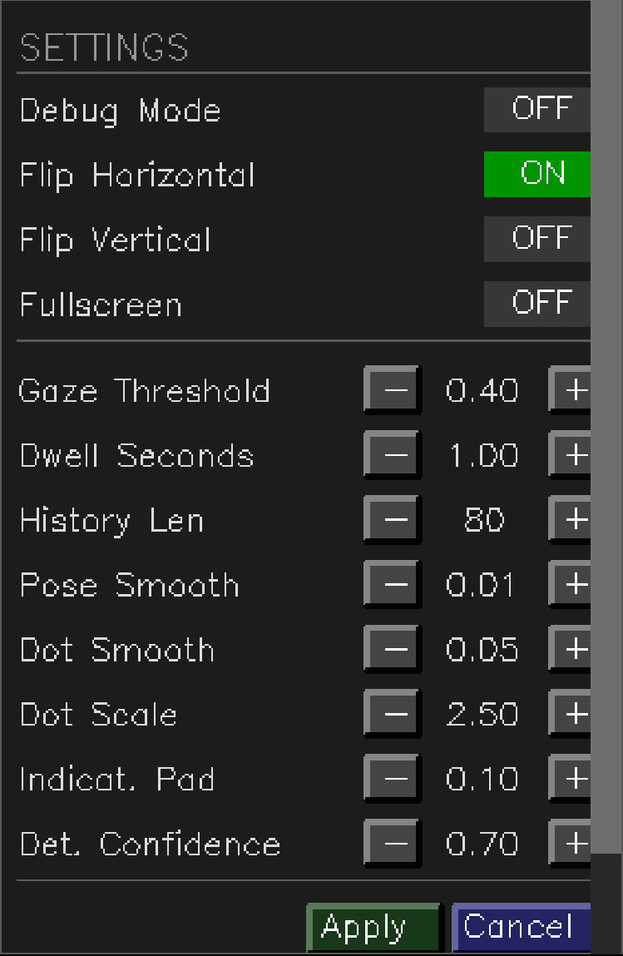
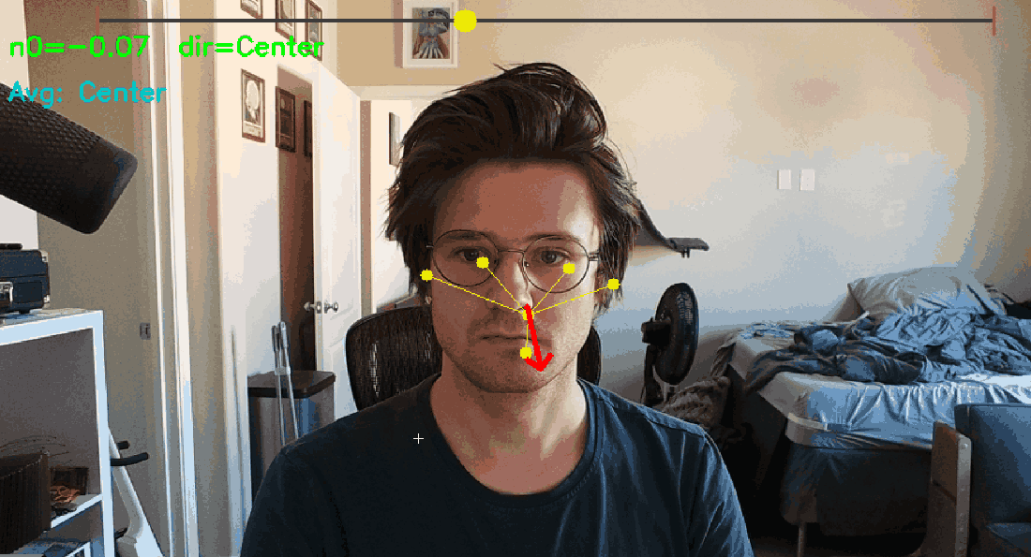
Facial Tracking Specifics
> A “facial plane” is generated using the tracking points and cv2’s solvePnP function (Perspective-n-Point). A Rodrigues Transformation is used to convert it to a 3x3 rotational matrix. This matrix represents the facial forward as a 3d-vector.
> By taking the dot product of this vector with the forward facing vector (0,0,1), you get a value from (-1)-(1). At -1, the user is pointing towards the camera, at 0, they are perpendicular. At -0.3 the side selection is determined.
> All relevant tuning parameters are exposed in the Debug/Settings menu. These settings are saved on “Apply” and loaded during startup.
> Values are interpolated over a set interval to account for tracking jitter which allows the device to operate in extremely poor lighting conditions. Outliers are excluded
cv2.solvePnP
cv2.Rodrigues
—---------------
(0, 0.5, -0.5) = A
A
np.dot(A,B)
—--------------
-0.4
A
B

Slide 10
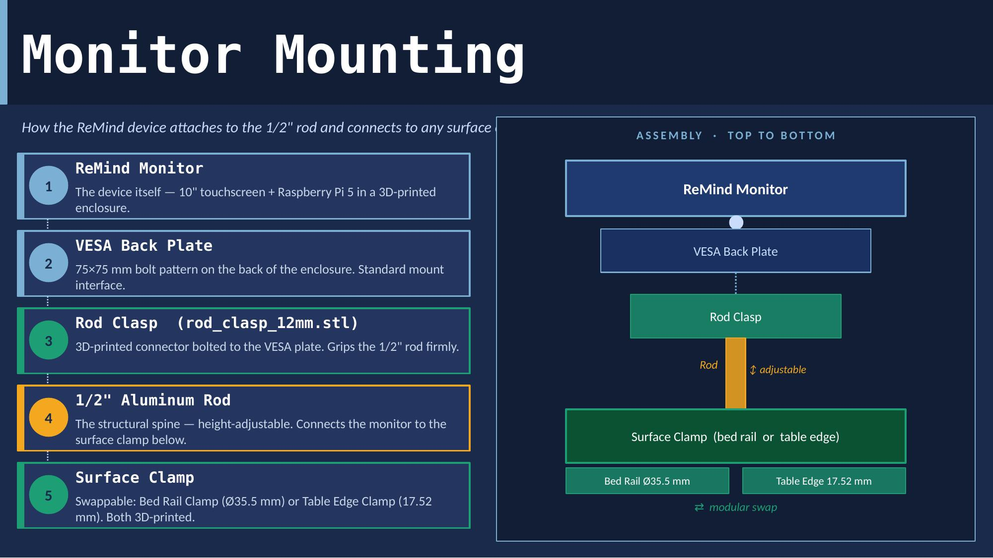
Mounting of the device
Date
Company Name

Slide 11
The device has not undergone formal clinical trials or FDA clearance, so it cannot yet be used as a diagnostic tool.
Facial tracking accuracy degrades if the patient is lying at an extreme angle or has significant facial asymmetry from their condition.
The system requires a power outlet nearby and has no battery backup, limiting placement flexibility in some rooms.
Session data is exported manually via USB with no automatic cloud sync, which adds a step for clinical staff.
Limitations

Slide 12
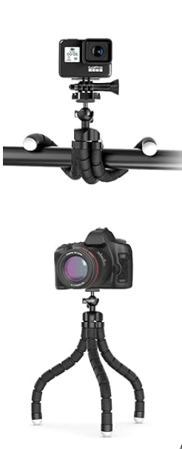
Future Work
Clinical Trials
Battery
Integrating Tech.
Better Mounting
Allowing our industry partner to test the product and give us real use case data.
A battery would allow for more modularity and freedom of movement.
Our industry partner was open to the idea of adding a Tobii eye tracker to improve facial tracking even more.
Exploring other clamping options such as a flexible tripod allowing for a more streamlined mounting process.

Slide 13
Milestones
1.
2.
Take a look back at the company history.
Get investors up to speed on your biggest milestones and achievements.
This is your first milestone. It’s the beginning of your company’s story, such as when it was founded.
Include any important industry awards, prizes, or achievements. Add relevant dates for each.
3.
4.
You can also mention when you reached certain goals or targets, such as the hiring of your 100th employee.
Include as many milestones as you want. You can duplicate this slide if you need more items.

Slide 14
Agenda
Add section title (01)
Add section title (02)
Add section title (03)
Add section title (04)
Add section title (05)
Add section title (06)

Slide 15






Meet the team
Full Name
Title
Full Name
Title
Full Name
Title
Full Name
Title
Full Name
Title
Full Name
Title

Slide 16
Team intro
Full
Name
Bio
They are the [title]
of the [team]
Write a brief bio of the team member. Include their background, expertise, and project responsibilities.
Contact
[email]

Slide 17
Our mission
Write your mission statement.
This is your chance to articulate your vision to potential investors. In a few words, explain what you do, why you do it, and who you do it for.
Date
Company Name

Slide 18
The problem
State the problem. What pain point are you tackling? What gap are you going to fill in your industry?
Lay down the stakes and explain why investors should care.
?
!

Slide 19
Our solution
State your proposition.
Use clear, direct language to describe exactly what you offer and how it’s different or better than what’s already available.

Slide 20

How it works
Product feature
Product feature
Product feature
Briefly describe a product feature and how it benefits the user. Bring it to life with clear, vivid language.
Describe another product feature. Think about how it helps solve the problem you identified earlier.
Add as many features as you need to describe your product. You can duplicate this slide if you need more items.

Slide 21
How it works
Briefly describe a product feature and how it benefits the user. Bring it to life with clear, vivid language.
Describe another product feature. Think about how this feature helps solve the problem you identified earlier.
Add as many features as you need to describe your product. Duplicate this slide if you need more items.
List 2 or more benefits
Benefit 1
Benefit 2
List 2 or more benefits
Benefit 1
Benefit 2
List 2 or more benefits
Benefit 1
Benefit 2

Slide 22

Persona name
Bio
Introduce your persona, who they are and where they come from. Think about a hypothetical user or customer. Although the individual might be fictional, the insights should be derived from your audience research.
ID
“Quote the persona on their needs and wants. This can be a fictional line or an excerpt from a real user interview.”
00 (Age)
Job Title (Occupation)
Single (Status)
College Degree (Education)
Place Name (Location)
Tech Lover (Archetype)
Goals
What does the persona want to achieve?
Motivations
Why do they care about these goals?
Frustrations
What is keeping them from achieving their goals?
Personality/Tech skills
Extrovert
Introvert
Device
00 %
Intuitive
Planner
Device
00 %
Feeling
Thinking
Device
00 %

Slide 23

Briefly describe your user or buyer persona
Needs
Describe what your persona wants to achieve. List their goals and outline their motivations to pursue those goals.
Pain points
Describe an obstacle your persona struggles with.
Think about what interferes with their needs and motivations.
Persona Name
Introduce your audience persona, who they are and where they come from. Mention their age and profession.
How we can help
Describe how your product or service helps your persona to achieve their goals and solve their pain points.

Slide 24
Outline a far-reaching insight about your competitive landscape.
Competitor 1
Competitor 2
Competitor 3
Competitor 4
List 2 or more of this competitor’s features:
Feature 1
Feature 2
List 2 or more of this competitor’s features:
Feature 1
Feature 2
List 2 or more of this competitor’s features:
Feature 1
Feature 2
List 2 or more of this competitor’s features:
Feature 1
Feature 2
Product
features
List 2 or more of this competitor’s features:
Strength 1
Strength 2
List 2 or more of this competitor’s features:
Strength 1
Strength 2
List 2 or more of this competitor’s features:
Strength 1
Strength 2
List 2 or more of this competitor’s features:
Strength 1
Strength 2
Strengths
Weaknesses
List 2 or more of this competitor’s features:
Weakness 1
Weakness 2
List 2 or more of this competitor’s features:
Weakness 1
Weakness 2
List 2 or more of this competitor’s features:
Weakness 1
Weakness 2
List 2 or more of this competitor’s features:
Weakness 1
Weakness 2

Slide 25
Classify your competitors by placing them into different columns based on how successful they are now — and how prepared they are for the future.
Visionaries
Niche Players
Leaders
Challengers
List competitors who have a clear vision of the future, but have yet to fulfill their business potential.
Competitor 1
Competitor 2
List competitors who have a clear vision of the future, but have yet to fulfill their business potential.
Competitor 1
Competitor 2
List competitors who have a clear vision of the future, but have yet to fulfill their business potential.
Competitor 1
Competitor 2
List competitors who have a clear vision of the future, but have yet to fulfill their business potential.
Competitor 1
Competitor 2

Slide 26
Business model
This is how you will create, deliver, and capture value.
Key activities
Cost
structure
Revenue
streams
Value
proposition
What are the core activities your company undertakes to deliver on the value proposition?
What are the major costs of your proposal? Think about salaries, rent, marketing, etc.
Outline how you plan to generate revenue through sales, subscriptions, or other methods.
Give your audience time to breathe. Recap the main points about your product or service.
Key partnerships
Who are your key partners or suppliers? What resources do they provide? And how do they contribute to your business model?
Expense 1
Expense 2
Expense 3
Stream 1
Stream 2
Stream 3
What value are you offering?
What problems does your product or service solve?
Who makes up your audience?

Slide 27
Go-to-market
strategy
Objectives
Markets
Launch
Channels
Post-launch
plan
Establish how you’ll measure success
Define your target audiences
Envision your product launch
Highlight where you’ll reach customers
Prepare for the for the long term
Introduce key performance indicators (KPIs). You might have only one or several.
Refer back to your individual user personas and group them into broader target audiences.
Describe when and where you’ll launch, along with the people, events, or deals involved.
Name the channels, platforms and assets through which you’ll engage customers.
Anticipate what will happen after you launch your product or service.
KPI 1
KPI 2
KPI 3
Audience 1
Audience 2
Audience 3
Time and locations
Deals, discounts
Ambassadors,
spokespeople
Channel, platform, asset
Channel, platform, asset
Evaluations
Retrospectives
Downloadable content, promos

Slide 28

Establish how you’ll measure and track success
Success metric 1
Success metric 2
Success metric 3
Success metric 4
Go-to-market strategy
Introduce your key performance indicators (KPIs). You might have a single KPI or several.
Introduce your key performance indicators (KPIs). You might have a single KPI or several.
Introduce your key performance indicators (KPIs). You might have a single KPI or several.
Introduce your key performance indicators (KPIs). You might have a single KPI or several.
KPI 1
KPI 2
KPI 3
KPI 1
KPI 2
KPI 3
KPI 1
KPI 2
KPI 3
KPI 1
KPI 2
KPI 3

Slide 29
Define your target audiences
and how you’ll speak to them
Segment 01
Segment 02
Segment 03
Segment 04
Segment 05
Go-to-market strategy
Describe a target audience or segment you want to reach. Identify their traits, values, behaviors, or preferences.
While your user personas represented ideal individual customers, target audiences are wider ranges of people who share certain characteristics.
Think about how each target audience or segment relates to your product or service, why they need it and how they’ll use it.
Refer back to your user personas and point out what segments they belong to. This will help your presentation feel more interconnected.
For example, a tech-savvy user persona might fall into a broader Tech Enthusiast or Industry Professional audience segment.

Slide 30
Envision your upcoming product or service launch
How and when will you introduce your newest offering to the world? Give a top-level summary here, then expand below.
Where will you launch your product?
Who will help launch your product?
How will you launch your product?
Channels
Events
Drops
Influencers
Ambassadors
Endorsements
Promotions
Specials
Giveaways
Go-to-market strategy

Slide 31
Highlight the channels where you’ll reach your customers
Channel name
Channel name
Channel name
Channel name
Go-to-market strategy
Describe the channel and its role in your campaign.
Segments: Name the target audiences you’ll reach through this channel.
Actions: List what you’ll produce: videos, viral posts, thought leadership content, etc.
Goal: Share your marketing objectives or calls to action.
Describe the channel and its role in your campaign.
Segments: Name the target audiences you’ll reach through this channel.
Actions: List what you’ll produce: videos, viral posts, thought leadership content, etc.
Goal: Share your marketing objectives or calls to action.
Describe the channel and its role in your campaign.
Segments: Name the target audiences you’ll reach through this channel.
Actions: List what you’ll produce: videos, viral posts, thought leadership content, etc.
Goal: Share your marketing objectives or calls to action.
Describe the channel and its role in your campaign.
Segments: Name the target audiences you’ll reach through this channel.
Actions: List what you’ll produce: videos, viral posts, thought leadership content, etc.
Goal: Share your marketing objectives or calls to action.

Slide 32
Marketing assets
Assets
Size/time
Channels
Description
Go-to-market strategy
Asset type 1
00 / 00s
Channel names
Briefly describe the content of this asset.
Asset type 2
00 / 00s
Channel names
Briefly describe the content of this asset.
Asset type 3
00 / 00s
Channel names
Briefly describe the content of this asset.
Asset type 4
00 / 00s
Channel names
Briefly describe the content of this asset.
Asset type 5
00 / 00s
Channel names
Briefly describe the content of this asset.

Slide 33
Break down your post-launch strategy
1
2
3
Go-to-market strategy
Tell potential investors how you plan to leverage momentum after your launch.
Tell potential investors how you plan to leverage momentum after your launch. For example, you might release product updates or expand to new markets.
Tell potential investors how you plan to leverage momentum after your launch. For example, you might release product updates or expand to new markets.
Tell potential investors how you plan to leverage momentum after your launch.
Tell potential investors how you plan to leverage momentum after your launch. For example, you might release product updates or expand to new markets.
Tell potential investors how you plan to leverage momentum after your launch.
Tell potential investors how you plan to leverage momentum after your launch. For example, you might release product updates or expand to new markets.

Slide 34
Conclusion

Slide 35
Thank you

