Slide 1
tSNE implementation modifications
Team: Linear Men
Team members:
Makhin Artem
Kuznetsov Mikhail
Mumladze Maximelian
Zelentsov Aleksei

Slide 2
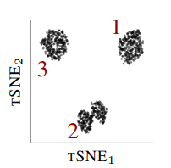
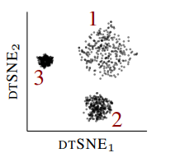
Problem
Traditional low-dimensional embedding techniques do not work well
Cluster sizes and densities in the embedding do not model those of high-dimensional data. This can be solved by dtSNE
If we have prior knowledge, we can exhibit meaningful low-lever structure. This is implemented by JEDI
dtSNE can help distinguish cell types while looking at relative differences in local densities in biological datasets
JEDI is useful both for unstructured and structured data analysis, provided we have prior knowledge
dtSNE Preserving local densities in low-dimensional embeddings

Slide 3

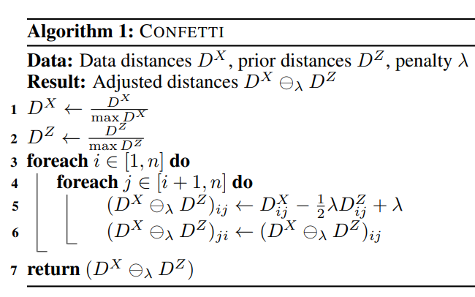

JEDI
To use prior
Define the new operator :
Implementation by Makhin Artem

Slide 4

dtSNE
We want to map the distances of close neighbors of points in differently dense regions in X to regions in Y that show a similar relative difference in scale.
So, a scaling factor is defined:
Implemented by Kuznetsov Mikhail

Slide 5
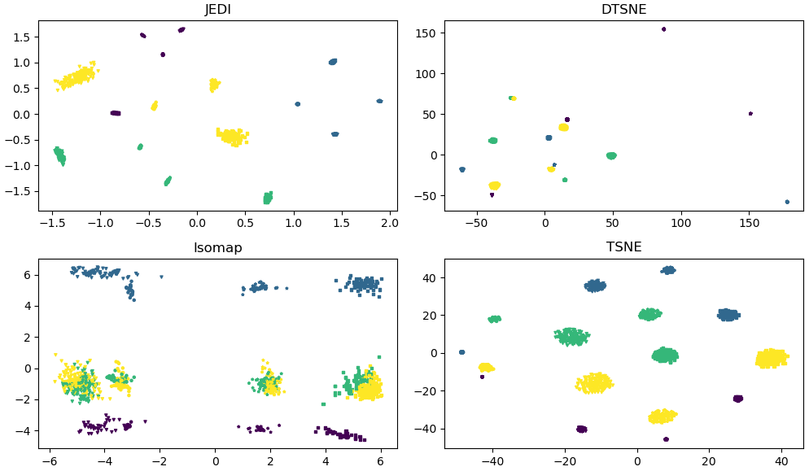
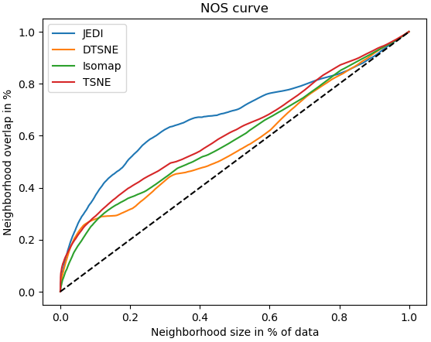
Experiments, JEDI
Done by Zelentsov Aleksei

Slide 6
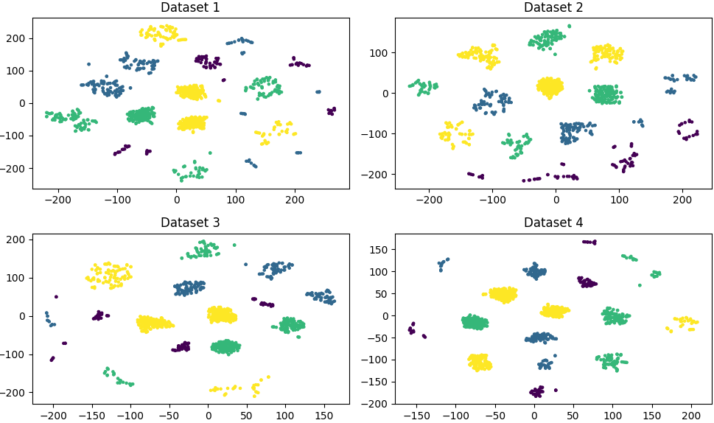
Experiments, dtSNE
Done by Mumladze Maximelian

Slide 7
Conclusion

