Slide 1
Making low-dimensional embeddings more informative
Team: Linear Men
Team members:
Makhin Artem
Kuznetsov Mikhail
Mumladze Maximelian
Zelentsov Aleksei

Slide 2
Motivation
Low-dimensional embeddings can be extremely useful thing
(for example, for analysis)
One of the current state of the art methods (according to [1]) for making low-dimensional embeddings is tSNE.
But tSNE fails to model many of the important properties of the initial dataset, which can be useful for the researcher.
The purpose of our work is to implement and investigate improvement methods, experimental proof of the preservation of some properties of the dataset after low-dimensional transformation
[1] https://arxiv.org/pdf/2103.01828.pdf

Slide 3
Related works
There are some works with modifications of t-SNE method by van der Maaten & Hinton (2008).
Names of this methods:
JEDI and CONFETTI
dtSNE
ctSNE

Slide 4
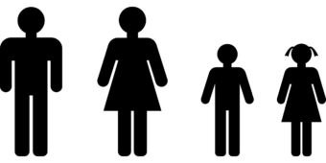
Problem #1
If we have prior knowledge, we can exhibit meaningful low-lever structure.
This is implemented by JEDI
JEDI is useful both for unstructured and structured data analysis, provided we have prior knowledge

Slide 5
Problem #1
If we have prior knowledge, we can exhibit meaningful low-lever structure.
This is implemented by JEDI
JEDI is useful both for unstructured and structured data analysis, provided we have prior knowledge

Slide 6


JEDI
Vanilla t-SNE:
JEDI:
Parameterized Jensen Shannon Divergence:
Implementation by Makhin Artem

Slide 7
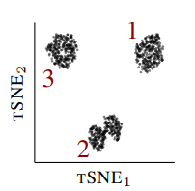
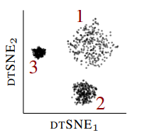
Problem #2
Cluster sizes and densities in the embedding do not model those of high-dimensional data. This can be solved by dtSNE
dtSNE can help distinguish cell types while looking at relative differences in local densities in biological datasets
dtSNE Preserving local densities in low-dimensional embeddings

Slide 8


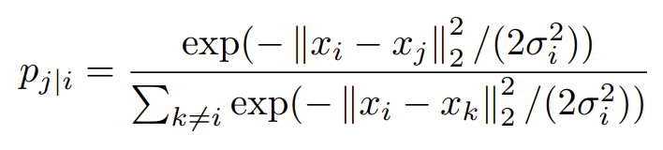
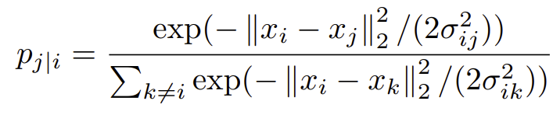
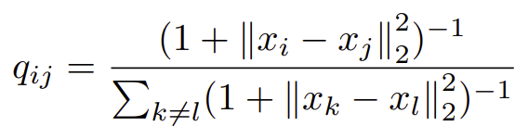
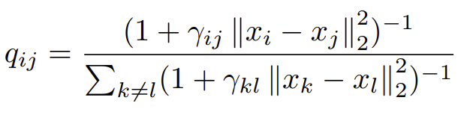
dtSNE
We want to map the distances of close neighbors of points in differently dense regions in X to regions in Y that show a similar relative difference in scale.
So, a scaling factor is defined:
t-SNE
dt-SNE
Implemented by Kuznetsov Mikhail

Slide 9
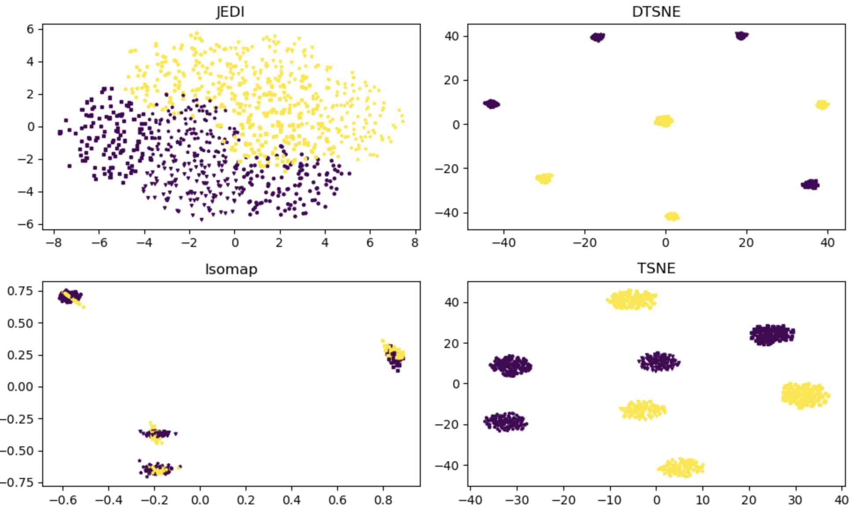
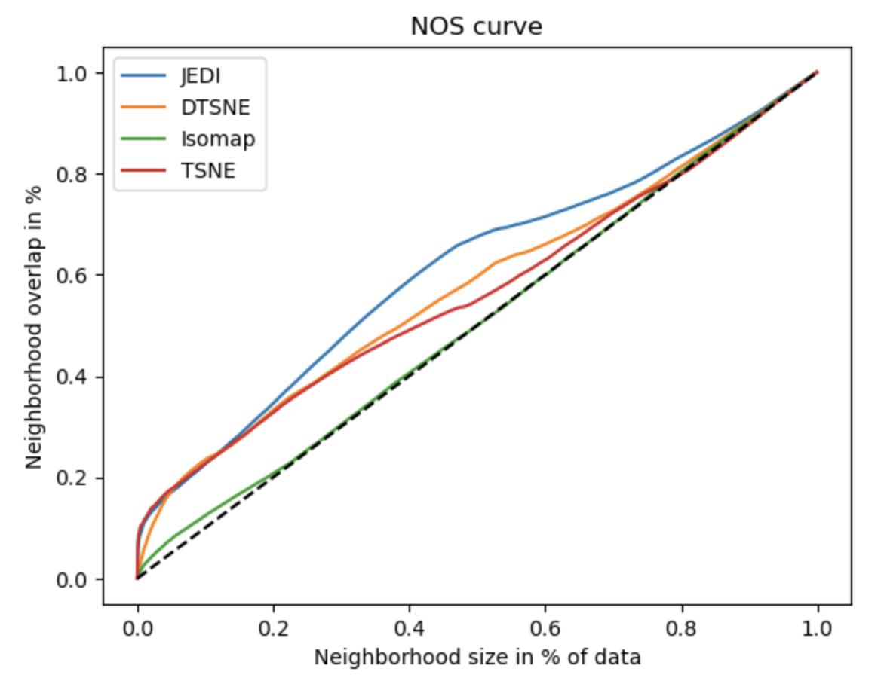
Experiments, JEDI
Dataset with 4 clusters in first four dimensions and 2 clusters in 5-6 dimensions.
Information from first dimensions is prior knowledge
Done by Zelentsov Aleksei

Slide 10
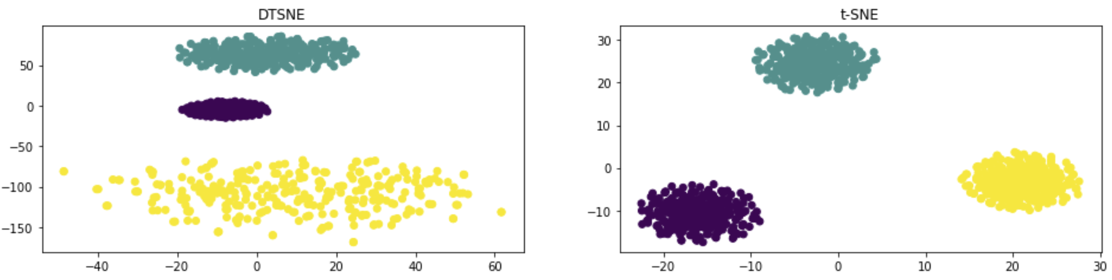
Experiments, dtSNE, #1
50 dims, 3 Gaussian clusters, 3×300 points
The spread is scaled by 2, 4, 8 respectively
Done by Mumladze Maximelian

Slide 11
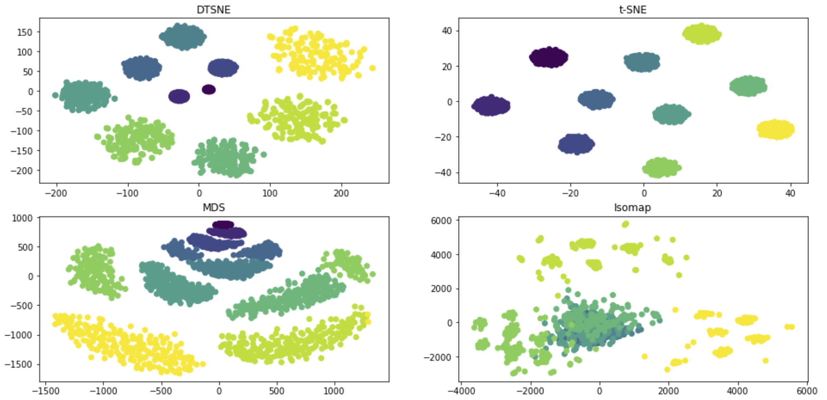
Experiments, dtSNE, #2
150 dims, 10 Gaussian clusters, 10×200 points
The spread is scaled by range(1, 11) respectively
Done by Mumladze Maximelian

Slide 12
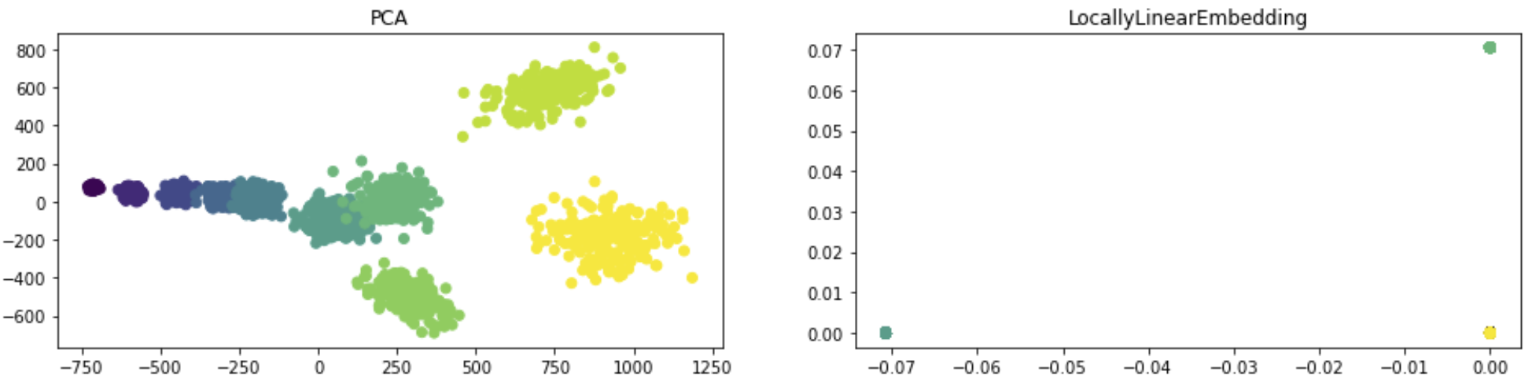
Experiments, dtSNE, #2
150 dims, 10 Gaussian clusters, 10×200 points
The spread is scaled by range(1, 11) respectively
Done by Mumladze Maximelian

Slide 13
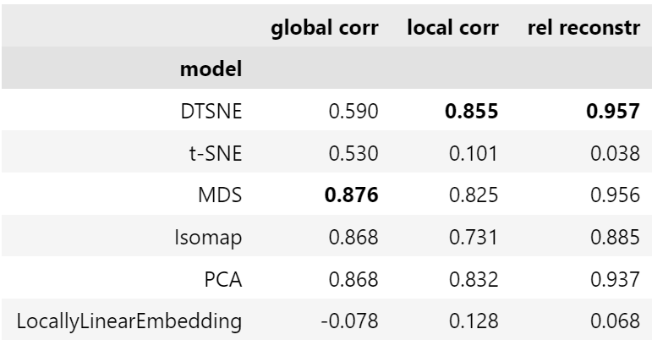
Experiments, dtSNE, #2, Metrics
global corr – spearman rank correlation between all high- and low-dimensional distances
local corr – correlation between high- and low-dimensional distances of each point with its 100 closest neighbors
rel reconstr - correlation between radii of balls enclosing the 100 neighbors of each point in high- and low-dimensional space
Done by Mumladze Maximelian

Slide 14
Conclusion
We showed improved low-dimensional embeddings of high-dimensional data using two modifications tSNE: JEDI and dtSNE.
Through our experiments, we demonstrated that JEDI is useful for structured and unstructured data analysis when prior knowledge is available, and dtSNE is effective in preserving cluster sizes and densities in the embedding.
We compared our results with other well-known low-dimensional embedding techniques, such as tSNE, MDS, ISOMAP, PCA, and LocallyLinearEmbedding, and showed that JEDI and dtSNE outperform these techniques in certain metrics.

