Slide 1
ADME/Tox Predictor
AI-powered Early-Stage Drug ADME/Tox Screening
Investor Pitch | July 2026
MVP ready • 3 ADME/Tox properties • Exceeded target metrics
Streamlit UI • Validation on known drugs • Harvard Dataverse data

Slide 2
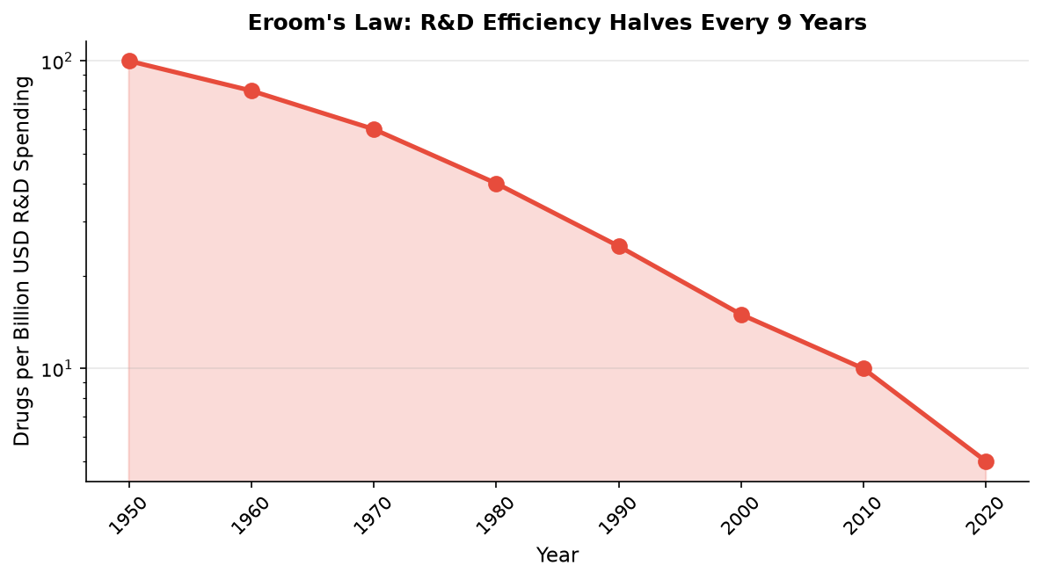
90% fail rate — primary cause: poor ADME/Tox
$2.23B average drug development cost
Eroom's Law: R&D efficiency halves every 9 years
60% of budget wasted on wrong molecules
Traditional screening: slow, expensive, low throughput
The Problem
Why 90% of drug candidates fail in clinical trials

Slide 3
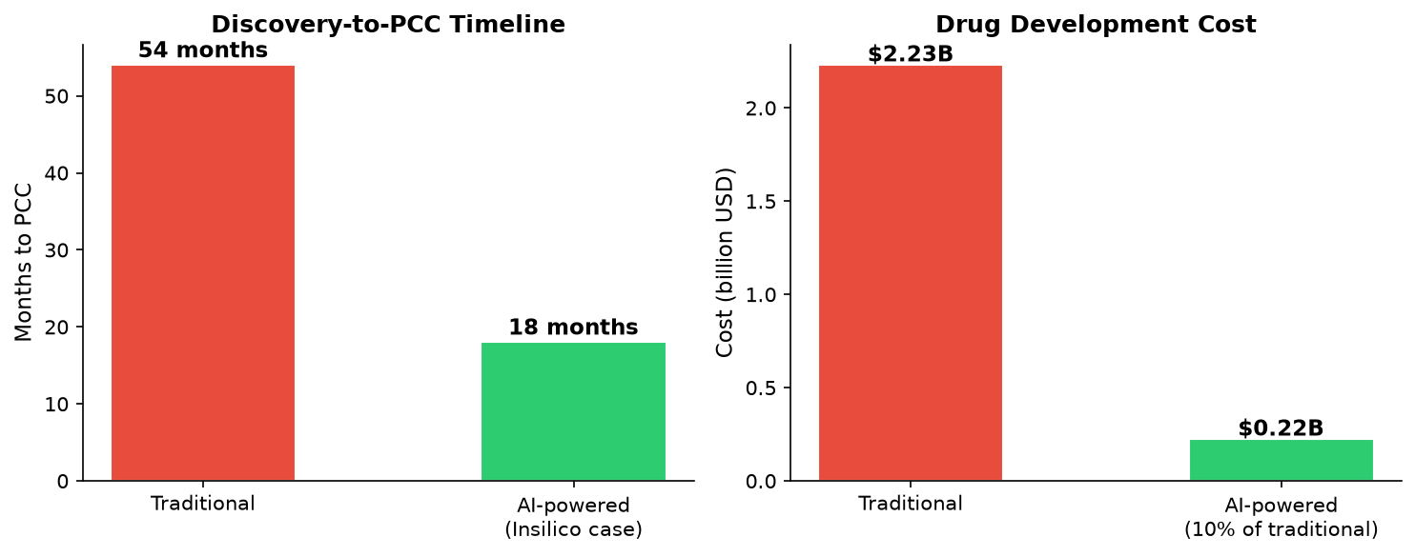
The Solution
<1 sec prediction per molecule on CPU
54mo -> 18mo discovery timeline
$2.23B -> ~$220M development cost
5-10x fewer molecules to synthesize
Validated on known drugs (Aspirin, Ibuprofen, etc.)
AI-powered ADME/Tox prediction before synthesis

Slide 4
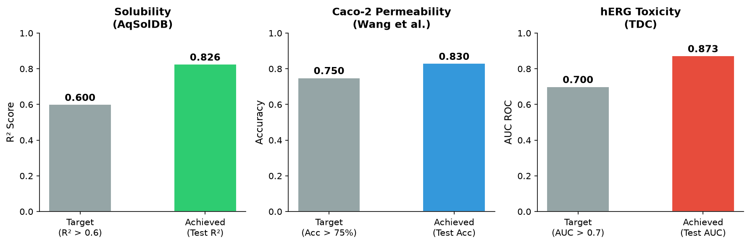
Model Performance
MVP metrics across 3 ADME/Tox properties
Property
Dataset
Size
Model
Target
Achieved
Status
Solubility (logS)
AqSolDB
9,982
LightGBM reg.
R² > 0.6
R² = 0.826
Exceeded
Caco-2 Permeability
Wang et al.
910
LightGBM cls.
Acc > 75%
Acc = 83.0%
Exceeded
hERG Toxicity
TDC
655
LightGBM cls.
AUC > 0.7
AUC = 0.873
Exceeded

Slide 5
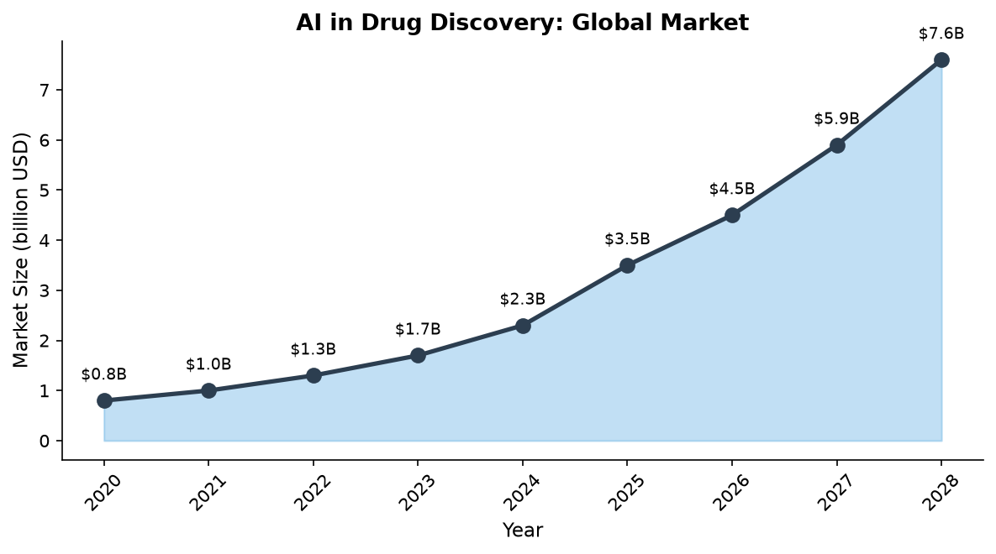
Market Opportunity
TAM: $3.5B (2025) -> $7.6B (2028)
CAGR: 30% driven by pharma AI adoption
Target: ADME/Tox niche — underserved
Clients: CROs, biotech, pharma R&D
Business model: SaaS/API $10K-50K/yr
AI in Drug Discovery: $3.5B in 2025, growing at 30% CAGR

Slide 6
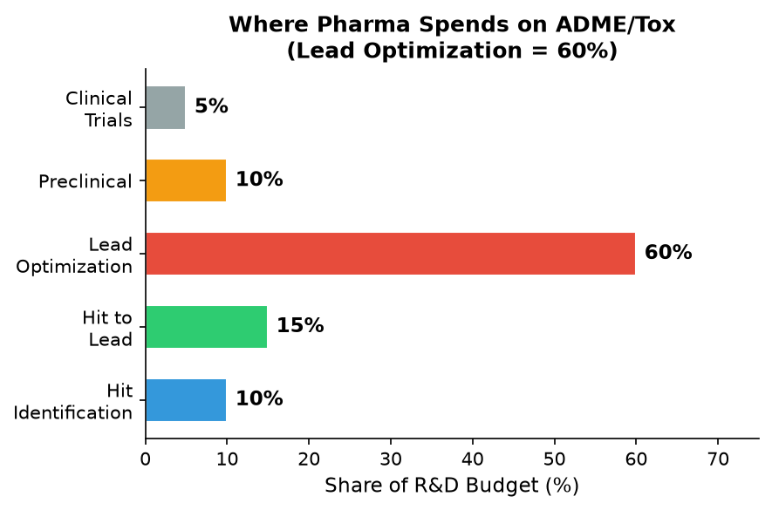
Why ADME/Tox?
60% of pharma R&D = lead optimization
Molecules with poor ADME/Tox screened out
Our model: 5-10x fewer syntheses needed
ROI for client: 10x-50x on subscription
Savings: $1-5M per drug program
60% of R&D budget goes to Lead Optimization — our target

Slide 7
Roadmap
MVP (Done)
Pilot
Scale
2-4 weeks
2-3 months
6-12 months
From MVP to Enterprise SaaS
GNN +5-10% improvement
API development
Pilot with 1-2 CRO partners
5+ ADME/Tox properties
Enterprise SaaS platform
Proprietary data pipeline
3 LightGBM models (solubility, Caco-2, hERG)
Streamlit web UI
Validation on 10 known drugs

Slide 8
Funding Ask
Goal: pilot with 2-3 pharma/CRO partners
Target close: Q4 2026
Next round: Series A at $5-10M valuation
Seed round: $200K - $500K
Fine-tuning on corporate data: $100K
Hiring (2-3 specialists): $150K
Cloud GPU + data infra: $50K
Marketing & sales: $50-100K

Slide 9
Why Now?
Market growing: $3.5B -> $7.6B in 3 years
Data is available: TDC, ChEMBL, PubChem
Insilico proved the model: Rentosertib in Phase IIa
Eroom's Law makes AI a necessity, not a luxury
MVP is already running with exceeded metrics
Low capital requirement to reach pilot stage
The perfect storm for AI in drug discovery

Slide 10
ADME/Tox Predictor
Thank you
MVP ready | Open to pilot projects | Looking for partners
D:\AI\biotech\adme_proto

