Slide 1
Variational Autoencoders for Brain Tumor Prograssion
Sptember , 1st

Slide 2
Outlines
Why Autoencoders (Variational Autoencoders)?
Autoencoders
Network model
Objective function
Applications
Variational Autoencoders
Network model
Objective function
Why VAE is a candidade model for our work?

Slide 3
Why Autoencoders (Variational Autoencoders)?
In many real world data (Image, audio, text) the underline factors which represents the data can be much simpler.
Machine Learning (ML) algorithms transform (non-linear) high dimensional data into a smaller representation.
One of the techniques are Autoencoders (Variational Autoencoders).
Why?
Discover useful representations
Not just for current task but unknown tasks (future tasks)
Ignores irrelevant information or redudant information

Slide 4

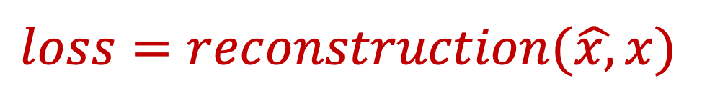

Autoencoders -> learn the underlying manifold
Takes higher dimensional data and runs it into a neural network.
It does that with 2 components
Encoder -> higher dimension to lower representation
Decoder -> reconstruct lower representation back to input
Bottleneck -> specify the dimension of compression (number of variables)
Network Model
Input:
Output:
$$x$$
$$\hat{x}$$
Bottleneck
(latent representation)
Encoder
Decoder
Objective Function
$$loss=reconstruction(\hat{x,}x)$$
Notes:
Bottleneck -> Increasing the size of the dimension allow more information to pass, resulting in better reconstruction
For example if 2 variables (dimension) the output might be fuzzy, because we force entire information to go through 2 single variables
The loss function we compute by looking at output and compare pixel to pixel difference

Slide 5


Remarks on Autoencoders
Network Model
Input:
Output:
$$x$$
$$\hat{x}$$
Bottleneck
(latent representation)
Encoder
Decoder
How does feature learning or dimension reduction happen if the result is the same as the input?
The transformation from input -> latent representation -> output allow us learn relevant properties of the dataset.
Notes:
how does feature learning or dimension reduction happen if the end result is the same as the input?
The assumption behind autoencoders is that the transformation “input –> hidden –> input“ will help us learn important properties of the dataset.

Slide 6




Remarks on Autoencoders
When compressing the data we want to keep the main structure that well describe the data.
Dog
Bird
Plane
Car
living
living
flying
Bottleneck
(latent representation)
1 dimension
Encoder
Input features
2 dimensions

Slide 7
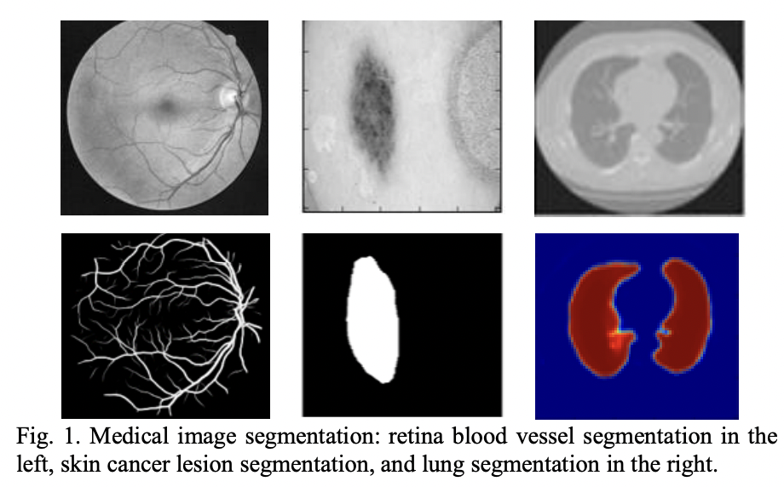
Applications of Autoencoders
Image segmentation
Instead of reconstruction the input, we target the label (mask).
Alom et al.
Notes:
https://arxiv.org/pdf/1802.06955v5.pdf

Slide 8
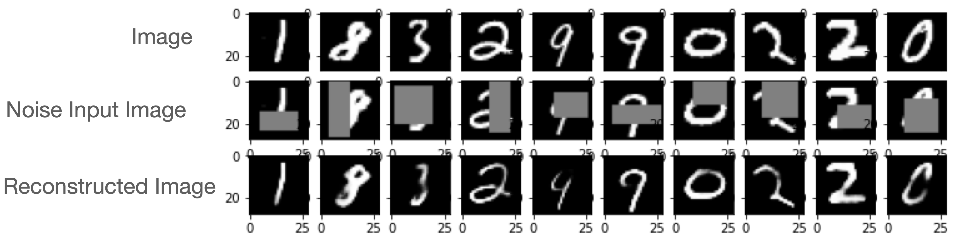
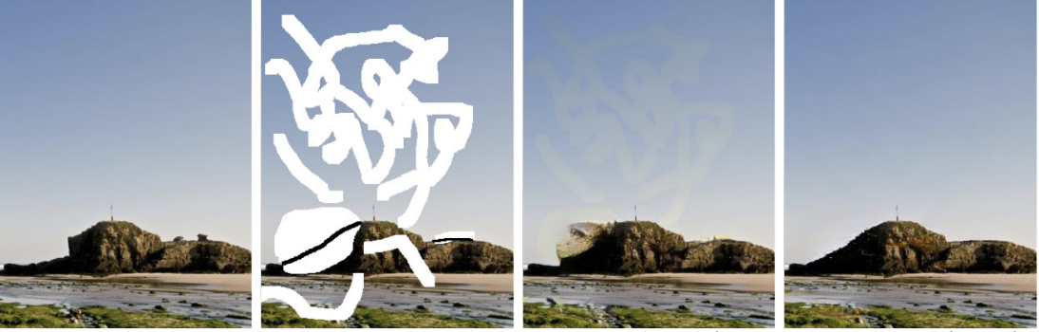
Applications of Autoencoders - Denoising Image/image inpainting
Image Denoising
Image Impainting - [Yu et al.]
During training, we encourage the model to learn a clean image
For the model to be able to reconstruct clean image has to learn higher level semantics of the data.
Notes:
Inpainting refers to the art of restoring lost parts of an image and reconstructing them based on the background information
https://arxiv.org/pdf/1806.03589.pdf
Image impainting is used in automatic scene editing
Restoring old photos and videos

Slide 9
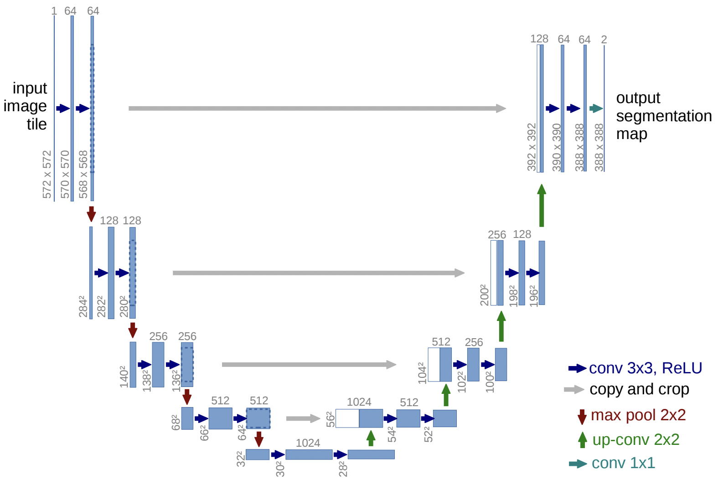
U-net architecture [Image Segmentation]
Encoder
Decoder

Slide 10
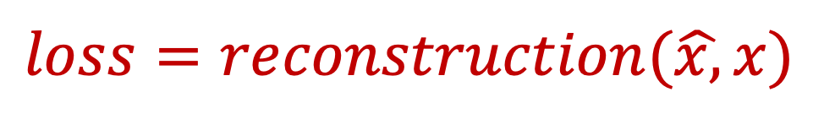
Limitations of Autoencoders
The latent representation is not well structured (no regularization on latent representation).
The loss function is not optimized to enforce a regular latent space.
It lacks two main properties for generation.
Continuity (smooth interpolation)
Completeness
Close points in the z are not similar at image space
Meaningless image
$$loss=reconstruction(\hat{x,}x)$$

Slide 11



Variational Autoencoders
Modern version of Autoencoders
We map an input to a distribution instead of a vector space as in AE.
Network Model
$$μ$$
Input:
Output:
$$x$$
$$\hat{x}$$
latent representation:z
$$σ$$
Encoder
Decoder
$Loss=reconstruction\left(\hat{x},x\right)−{KL}_{D}(posterior[N(μ$, $σ) | prior(0,I))$
Reconstruction -> Pixel difference between input and output (MSE)
KL divergence -> Regularize the latent representation (to have desired structure) for generation
Notes:
Kld -> desired structure is aligned with the target task

Slide 12
Why VAE is a candidade model for our work?
Learn a powerful feature representation (manifold learning)
For instance in our case:
For the model to be able to do a smooth interpolation, it has to learn the object localization, size and shape variability.
Fill the missing parts
Generative capability
Easily we can transfer the knowledge learned to a new domain.
Notes:
shape is a statistically significant predictor for various clinical studies

Slide 13
What can be Learned
The relationship between the hidden manifold and the clinical parameters.
How the tumour develop in certain:
Ages,
Gender,
Location
Notes:
Shape is the most statistical predictor

Slide 14
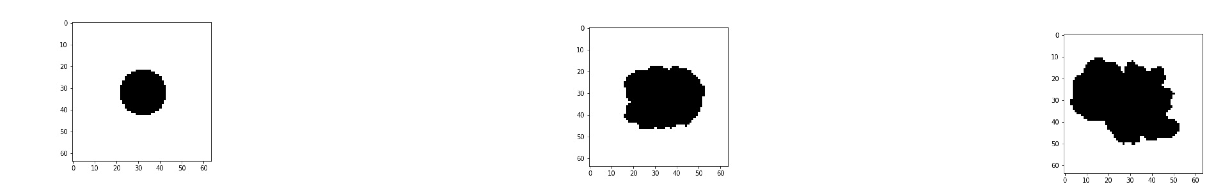
Front Propagation (Dataset)
Intially, we are working with toy dataset
1st Time Stamp
2nd Time Stamp
3rd Time Stamp
Objective
Predict the progression of the front at specific time stamp knowing the first and second time stamp

Slide 15
The Model is based on VAE
The objective is to control the latent space representations.
We aim to have a latent manifold that allow smoth linear interpolation and extrapolation.
Linear Interpolation of two blues points generates a purple one.
Linear Extrapolation generates a red point
Prediction
2nd Time Stamp
1st Time Stamp
Latent Data Manifold

Slide 16
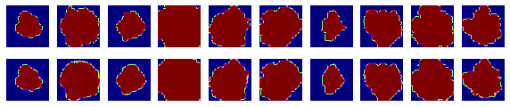
Results on Toy Dataset - Reconstruction
Goal: Reconstruct the initial input data
This is just a sanity check to evaluate if the model learned the structure (geometry) of the data.
Input Image
Reconstruted
Image

Slide 17
Image Extrapolation [ main objective]
Linear Extrapolation
Img1*alpha + img2(1-alpha)
For smaller displacement between (img1,img2) it looks fine [1st row].
However, for large one does not give good results
Intial front 0
Intial front1
Extrapolation
Intial front 2

Slide 18
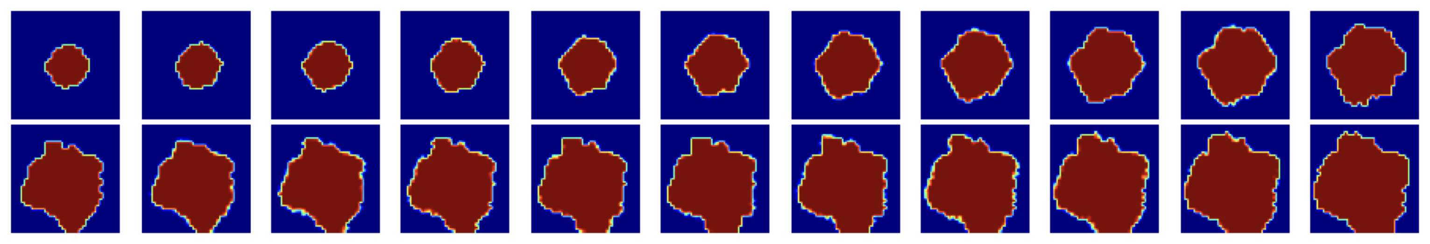
Image Interpolation [ sanity check]
Intial front
Propagation
Final front

Slide 19
Future work
Work with actual brain tumor image [The dataset sample is in pdf file]

