Slide 1

React Web Development Workshop
Instructors:
Clarence
WeiHong

Slide 2
Let me tell you a story …

Slide 3

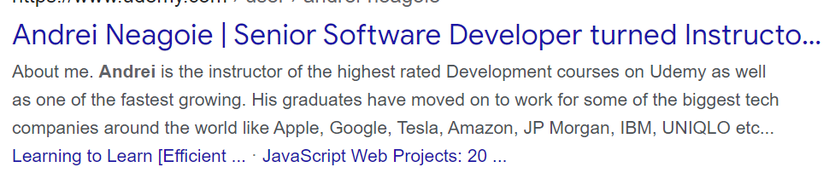
This is AnDREI Neagoie

Slide 4
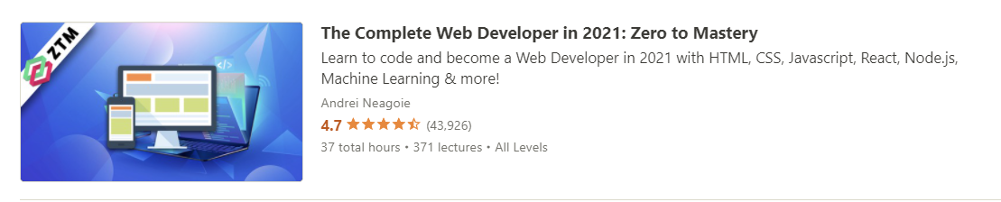
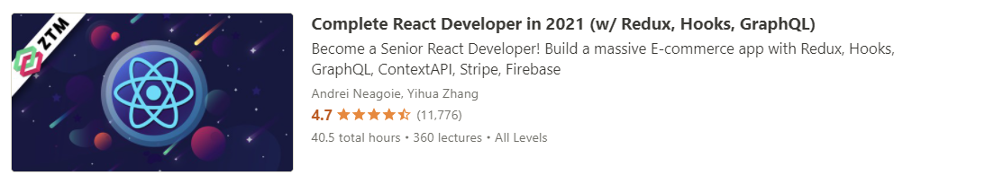
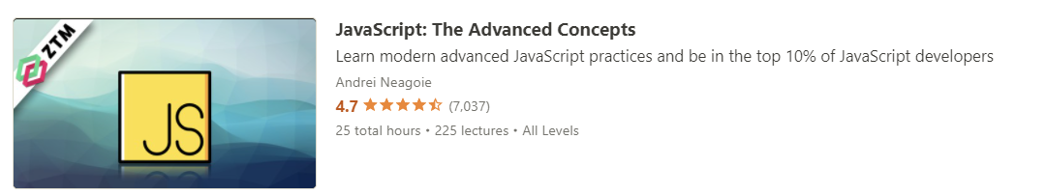
AnDREI Neagoie Teaches many online courses

Slide 5
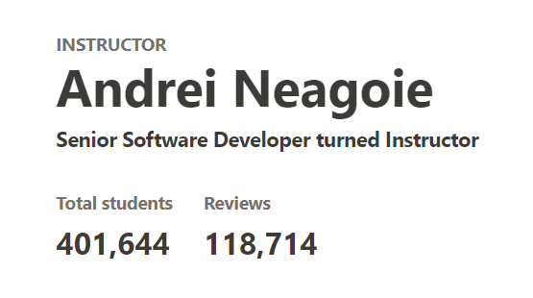
AnDREI Neagoie is successful

Slide 6

This is clarence

Slide 7
This is clarence
Clarence is Not successful

Slide 8
This is clarence
Clarence is Not successful
Clarence is also teaching you now

Slide 9
We all make mistakes in our lives

Slide 10
We all make mistakes in our lives
But the important thing is to learn from your mistakes

Slide 11
We all make mistakes in our lives
But the important thing is to learn from your mistakes
I am your mistake

Slide 12






KINGs of the web at the moment
React
Angular
Vue

Slide 13
100 seconds of React
https://www.youtube.com/watch?v=Tn6-PIqc4UM

Slide 14
Things talked about in the video
Components as functions
Passing in data by props
State using useState hook
React will react

Slide 15
Lets go on to create a new react application
https://github.com/Reckonzz/ReactWorkshop_cookerino_student_version

Slide 16
Fundamentals of javascript

Slide 17
Defining variables: giving names to things
var
let
const

Slide 18
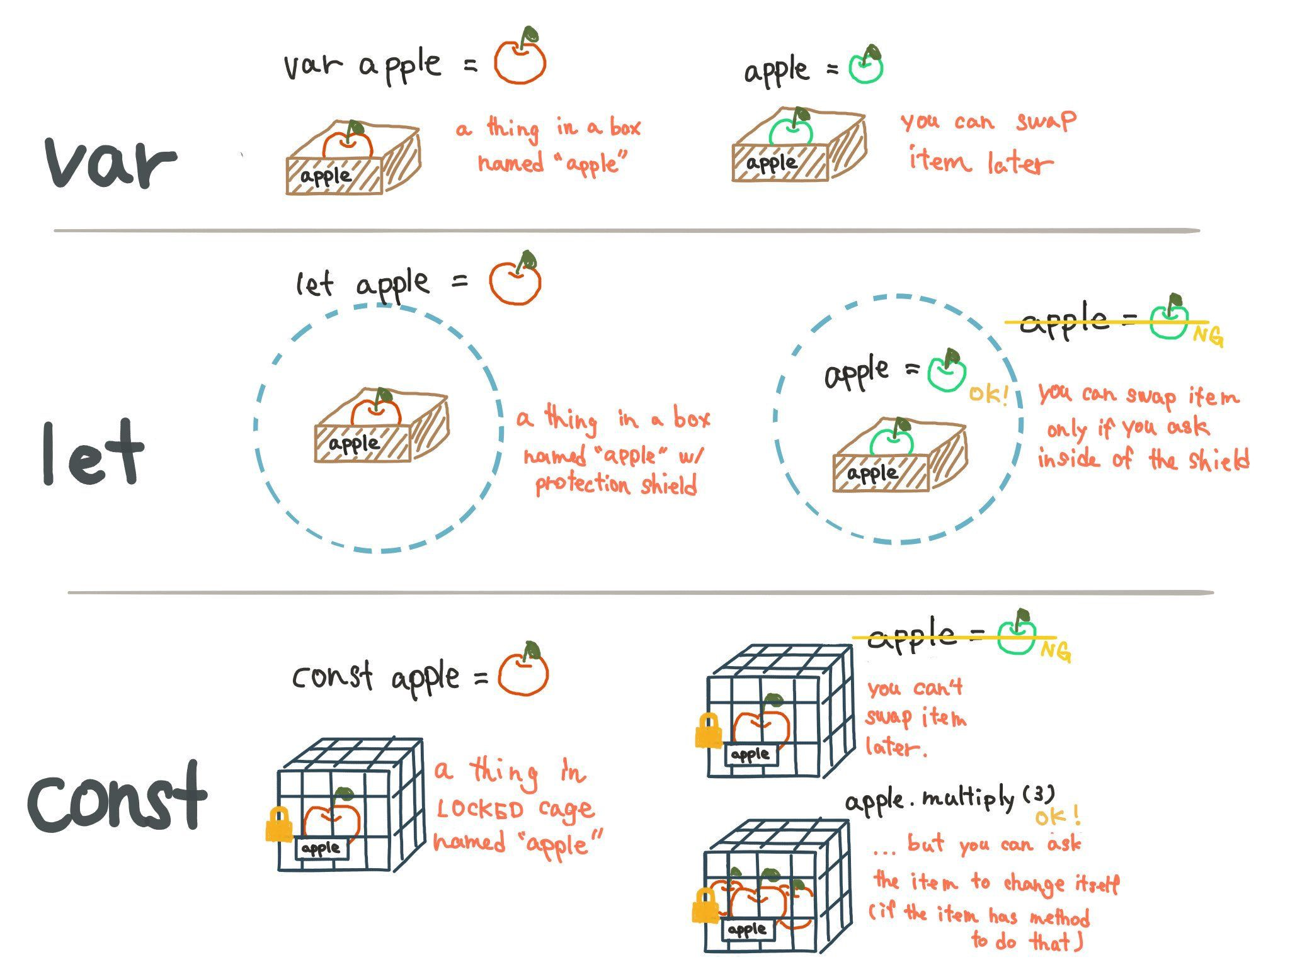

Slide 19
Javascript syntax to know: arrays
An array lets you store multiple values (similar to a list in python)
let someArray = [1,2,3,4]
Square brackets

Slide 20
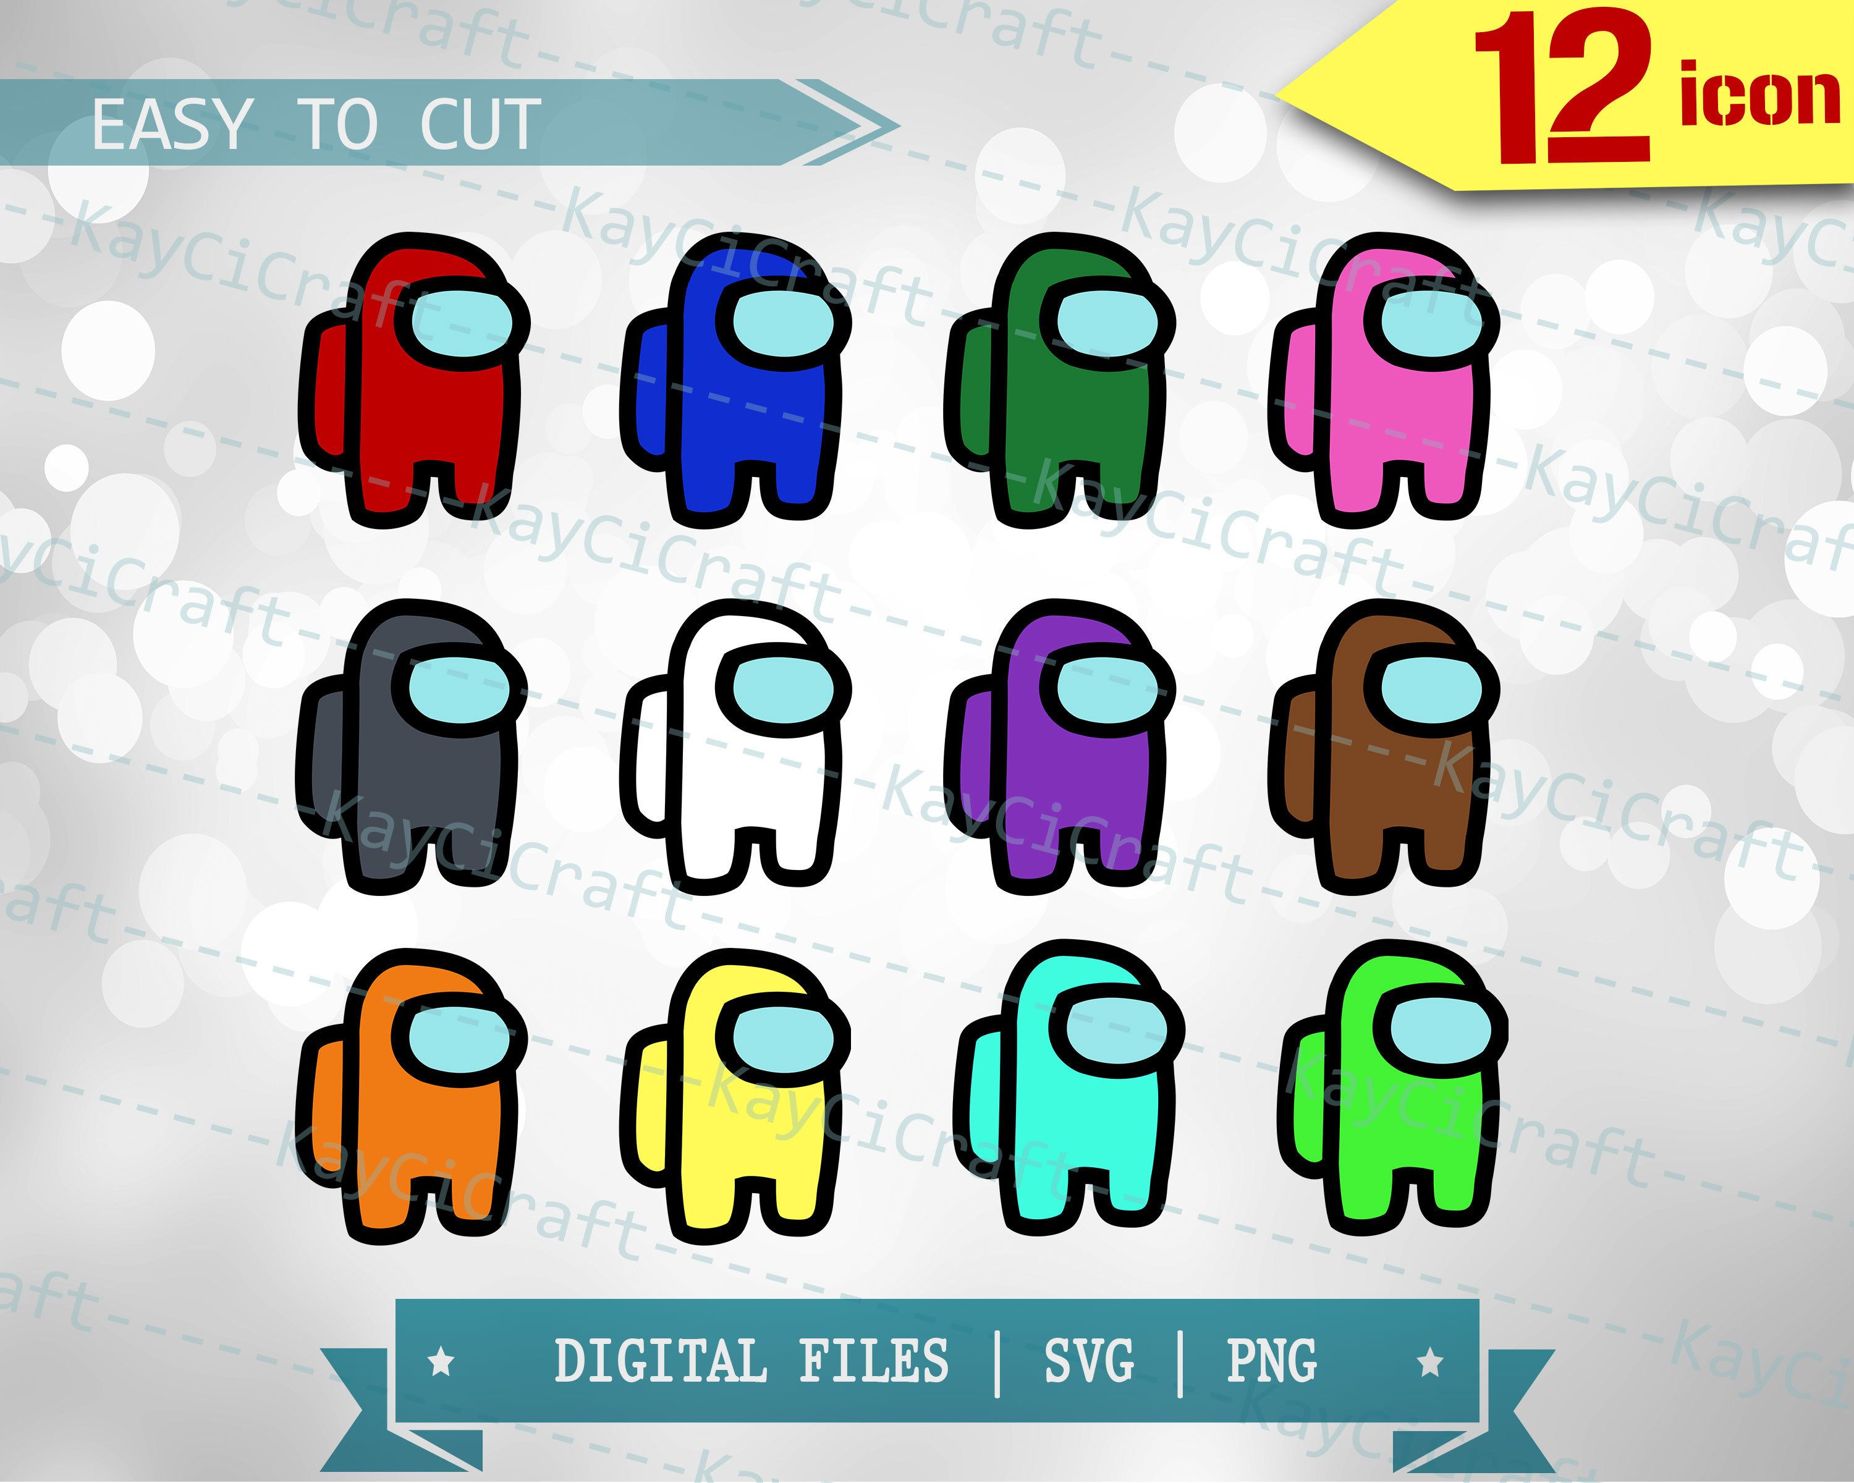
Arrays are among us
(define variable) let amongUsArray =
elements
index
0
1
2
3
4

Slide 21
Javascript syntax to know: functions
javascript uses arrow functions
let aFunction = (parameters) =>{
// do something here
}
3 parts:
- Declare the function
- What are the parameters
- What do I do in this function

Slide 22
Example Function
Uses an arrow function
Takes in a character as an input or parameter
Encloses in curly bracket for function with more than one line
const addHat = (amongUsCharacter) => {
let partyAnimal = amongUsCharacter.add(hat)
return partyAnimal
}
Add a hat to the character and assign it to a new variable
return this new excitable character as an output

Slide 23
Javascript syntax to know: map
Runs through all elements in an array and applies a function to each one of them, returns a new array
let someArray = [1,2,3,4]
let mappedArray = someArray.map( el => el*2)
mappedArray// [2,4,6,8]

Slide 24
Tying it all together(recap our among Us array)
(define variable) let amongUsArray =
0
1
2
3
4

Slide 25
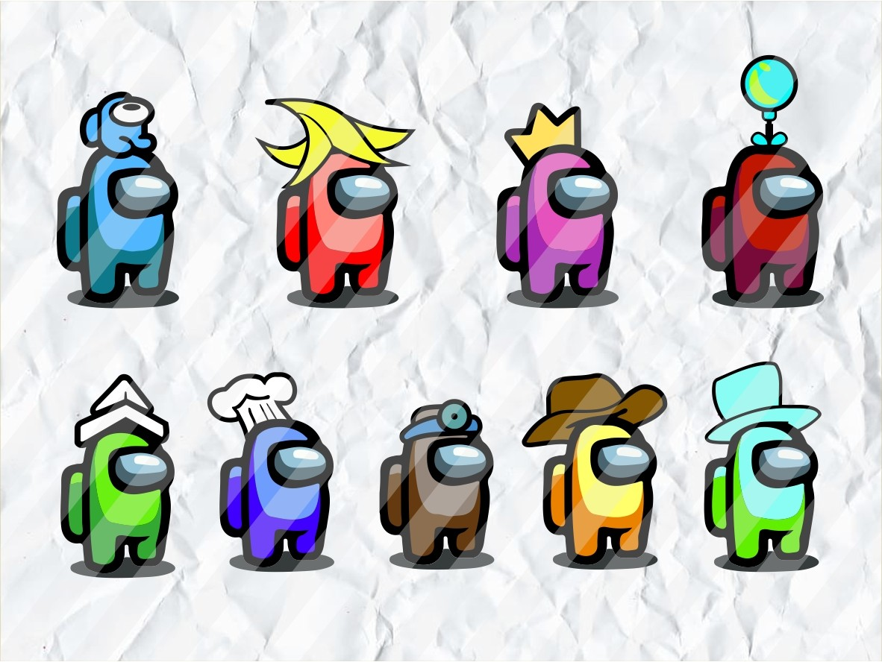
Tying it all together(using map and functions )
Let newPartyAnimals = amongUsArray.map(amongUsChar => addHat(amongUsChar))
0
1
2
3
4

Slide 26
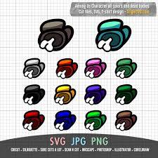
Another example: tying it all together
Let theDead = amongUsArray.map(theInnocent => kill(theInnocent))
0
1
2
3
4

Slide 27
Some other syntax you have to know: printing to console
let message = “Hello SUTD”
console.log(message)

Slide 28
Javascript syntax to know: template literals
`${variable}`

Slide 29
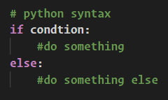
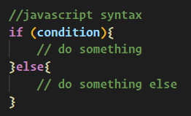

Javascript syntax to know: Ternary operator
Usually in programming languages you have if statements that look something like this,
in javascript you have the option to write an if statement using the ternary operator
If condition is true take value1, else take value2
Condition False
Condition True

Slide 30

Imagining state flow

