Slide 1
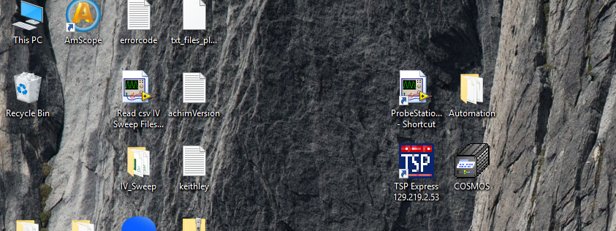
Start the program
Double Click

Slide 2
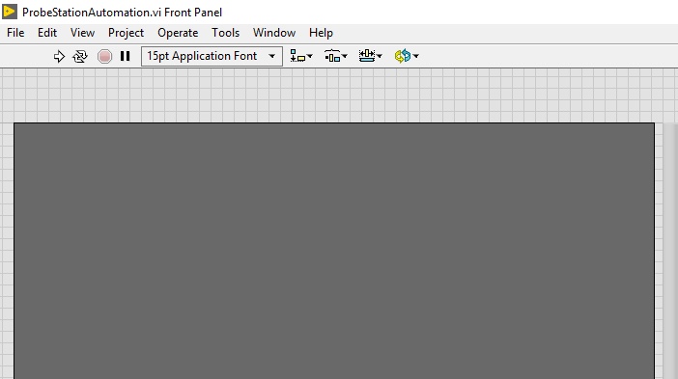
Start Labview
Single Click

Slide 3
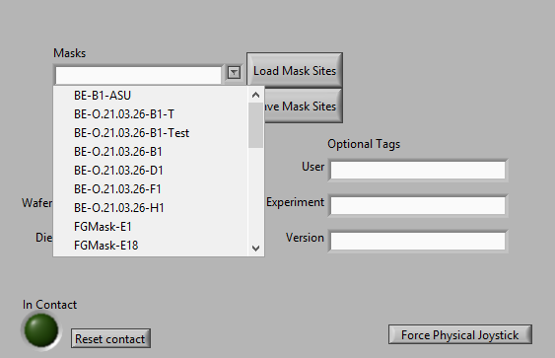
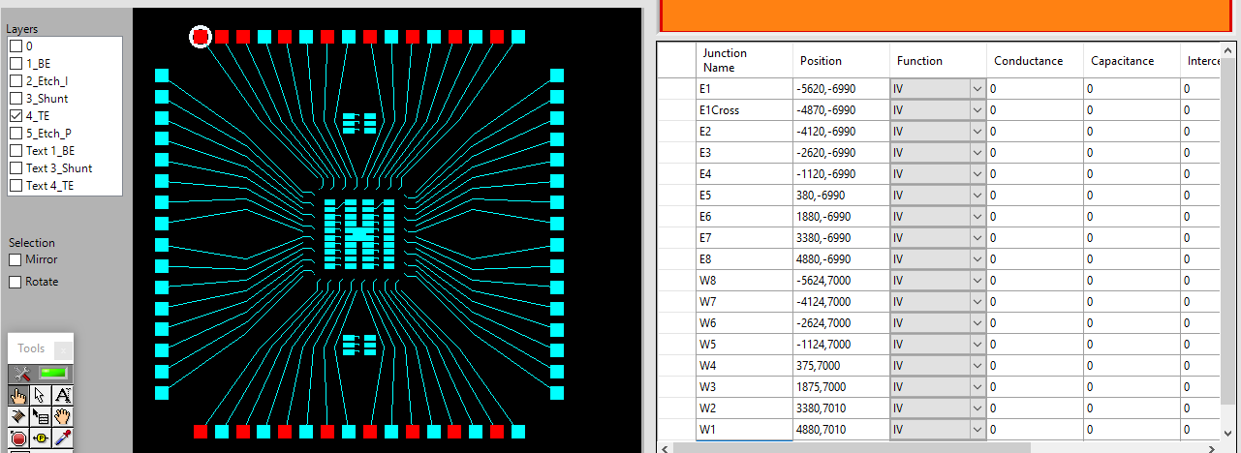
Load Mask
1. Click Arrow
Load Mask
Select Mask
Mask Appears and Grid populates

Slide 4
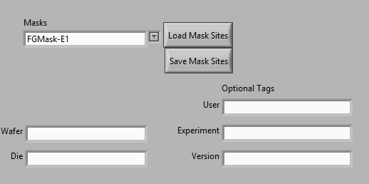
Name Data
Fill in information needed to uniquely identify the dataset

Slide 5
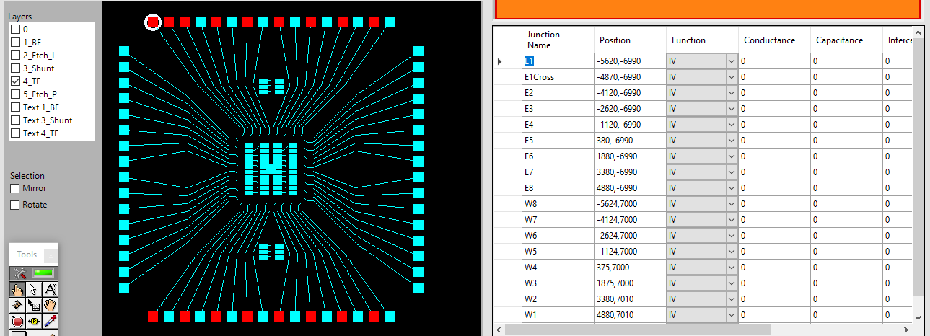
Custom Paths
Click twice to name junction
Click pads to deselect/select

Slide 6
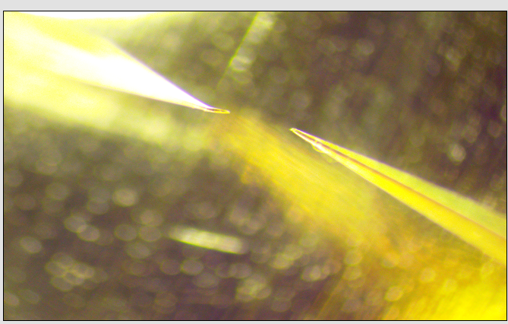
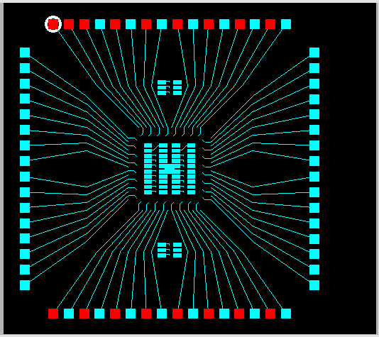
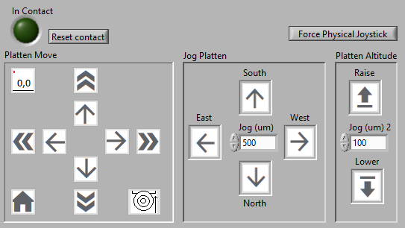
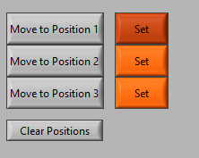
Align 1
To move left needle to location circled on mask
Use Physical Joy stick
Move needle to contact
Then mark position
Or Virtual Joy stick

Slide 7
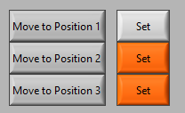
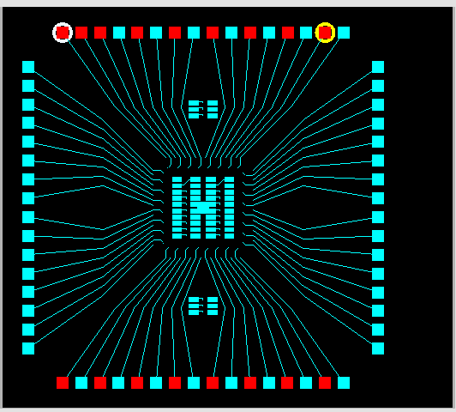
Align 2
3. Use joystick to touch needle to pad
1. Click Move to position 2 to get auto align
2. Align left needle with selected pad
Set the position

Slide 8
Align 3
3. Use joystick to touch needle to pad
1. Click Move to position 2 to get auto align
2. Align left needle with selected pad
Set the position

Slide 9
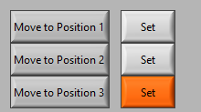
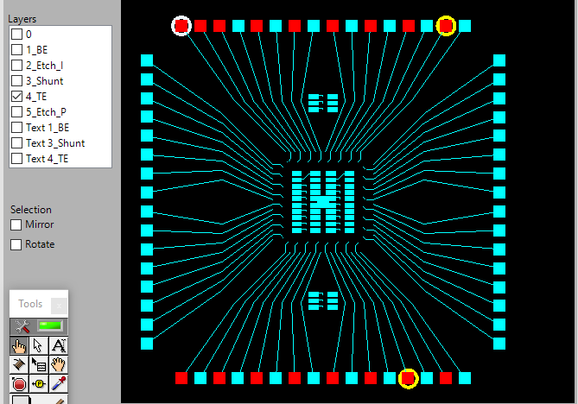
Align 2
3. Use joystick to touch needle to pad
1. Click Move to position 3 to get auto align
2. Align left needle with selected pad
Set the position

Slide 10
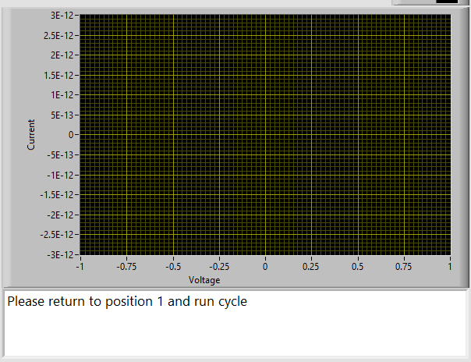
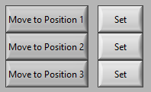
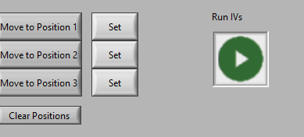
Run Program
Check to make sure no errors appear and Keithley is happy
Return to Position 1
Run Program

Slide 11
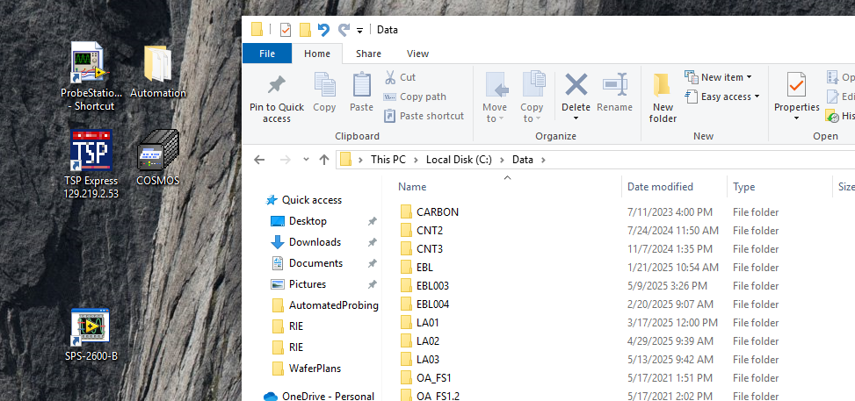
Data AutoSave
Data is saved to C:\Data for analysis ( accessible as \\biod1792\data from other computers)

Slide 12
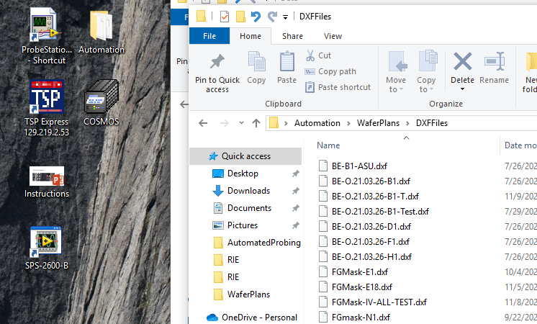
Mask Creation
Add dxf file to %%desktop\Automation\Waferplans\DXFFiles

Slide 13
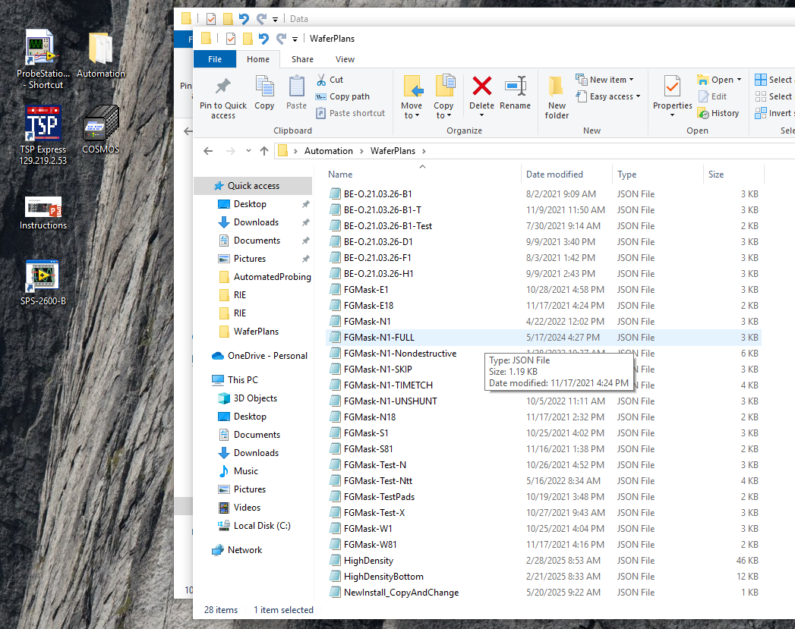
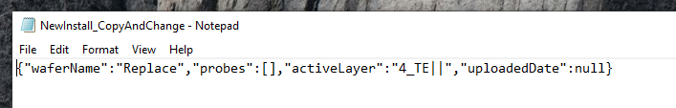


Create Wafer Definition
Use text editor (notepad) to open C:\Users\User\Desktop\Automation\WaferPlans\NewInstall_CopyAndChange.json
Change Replace to name of dxf file (no .dxf)
Save with same name as dxf file (.json extension)

Slide 14
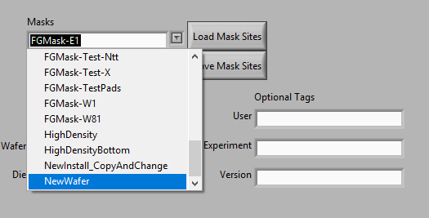
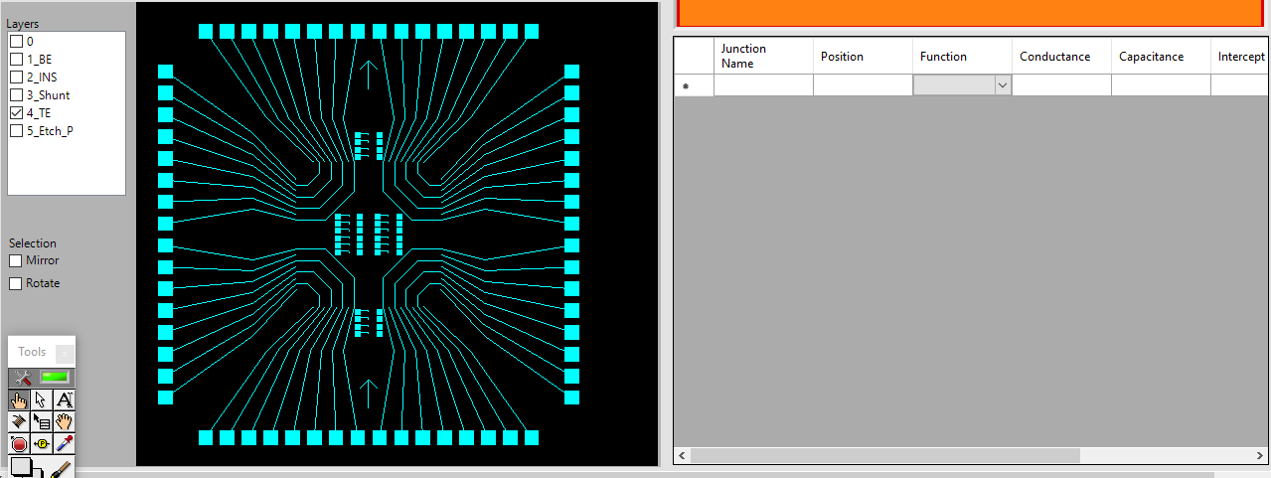
Load new plan
1. Restart program. (Close and hit red X)
3. Select Active dxf layer
Click on measure pad (left needle only)
2. Load new dxf file

Slide 15
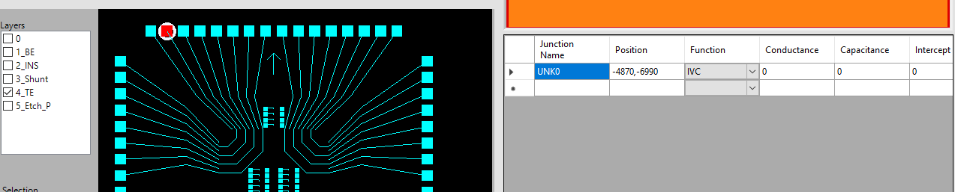
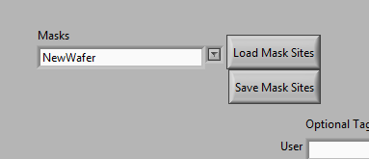
Name Junctions
Name Junctions for files
Save Mask when finished

