Slide 1
Ransomware Detection Using Machine Learning
Logistic Regression (Baseline) vs Random Forest (Ensemble) Miguel Guadalupe | FIU
Notes:
Today I will present a machine learning approach for ransomware detection. I compare a baseline classifier, Logistic Regression, with an ensemble model, Random Forest, to evaluate which model performs better at detecting ransomware behavior.

Slide 2

🚨 LIVE ATTACK: Ransomware in Action
Notes:
“Imagine this happens to you while doing homework—your files are locked, your screen shows a ransom note, and the attacker demands payment.”

Slide 3
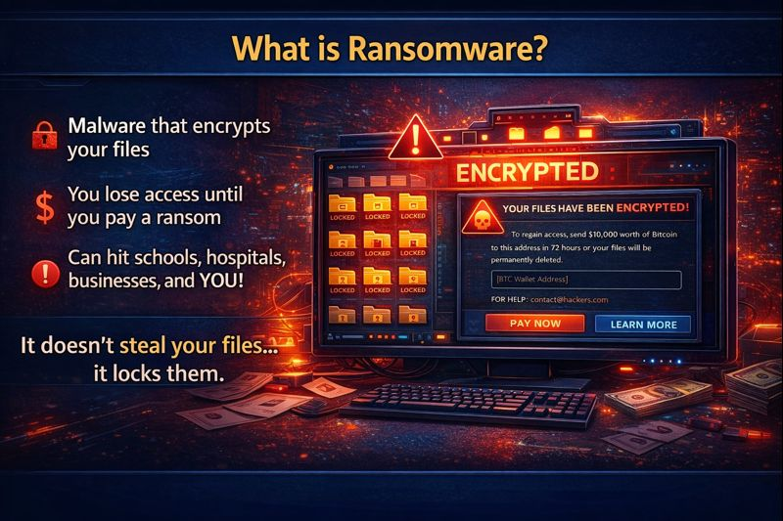
What is Ransomware?
Locks your files using encryption
Demands money (ransom) to unlock them
Result: You lose access to your own data.
Notes:
Ransomware is malware that locks your files using encryption. Once encrypted, you can’t open your files anymore. The attacker then demands a ransom payment for the decryption key. The result is simple: you lose access to your own data unless you have backups or stop the attack early. That’s why prevention and early detection matters.”

Slide 4
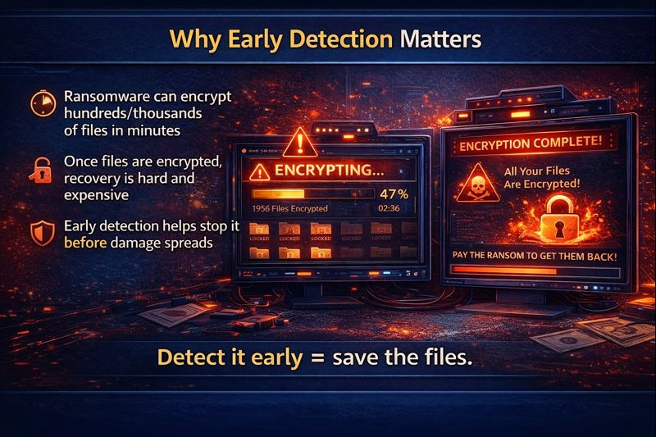
Why Early Detection Matters
Ransomware can encrypt hundreds of files in minutes
Once encrypted, recovery is hard and expensive
Early detection can stop the attack before it spreads
Notes:
Ransomware spreads quickly and can encrypt hundreds or even thousands of files in minutes. Once the files are encrypted, recovery becomes difficult and expensive. That is why early detection is important—it can stop the attack before the damage spreads further.

Slide 5
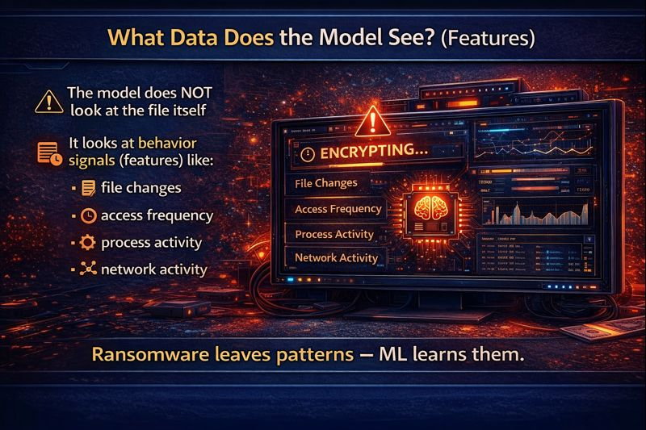
What Data Does the Model See? (Features)
The model does not read the file contents
It learns from behavior signals (features) such as:
File changes
Access frequency
Process activity
Network activity
Notes:
The model does not read the file contents directly. Instead, it learns from behavior signals, also called features. These include file changes, access frequency, process activity, and network activity. Ransomware creates patterns in these behaviors, and machine learning can learn to recognize them.

Slide 6
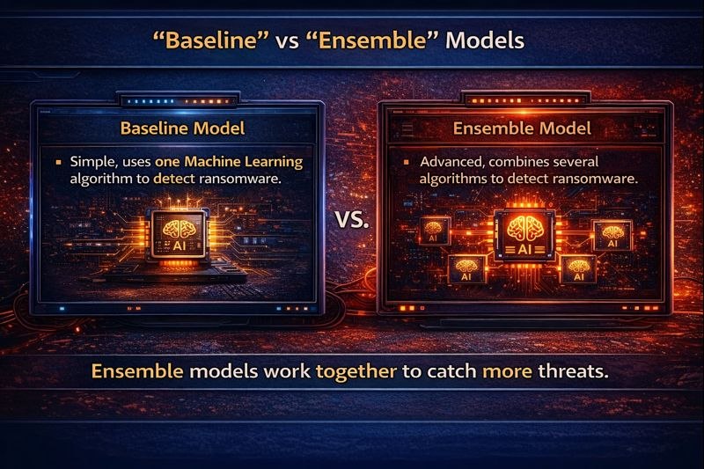
“Baseline” vs “Ensemble” Models
Baseline Model
Simple: uses one ML algorithm
Good starting point
Example: Logistic Regression
Ensemble Model
Combines multiple models (many trees)
More accurate + more stable
Example: Random Forest
Notes:
This project compares two supervised machine learning classifiers. Logistic Regression is used as a simple baseline model. Random Forest is an ensemble model that combines multiple decision trees using voting, which usually leads to stronger detection performance.

Slide 7
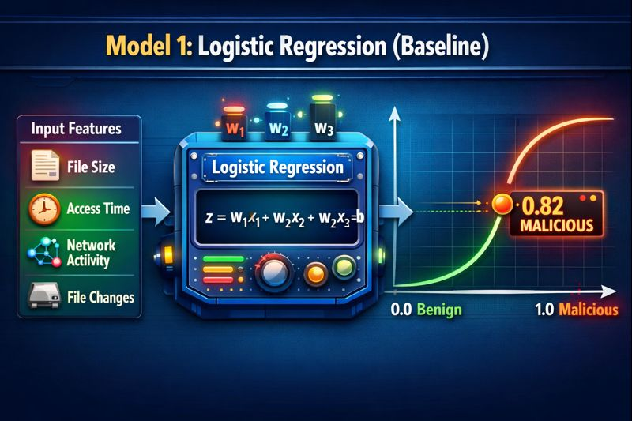
Model 1: Logistic Regression (Baseline)
What it does
Supervised learning classifier
Outputs a probability
0 → Benign
1 → Malicious
Why we use it
Simple + fast baseline
Good starting point for comparison
Notes:
Logistic Regression is our baseline model. It is a supervised learning classifier that outputs a probability between 0 and 1. Based on a threshold, it predicts whether behavior is benign or malicious. It is fast and provides a strong baseline for comparing more advanced models.

Slide 8
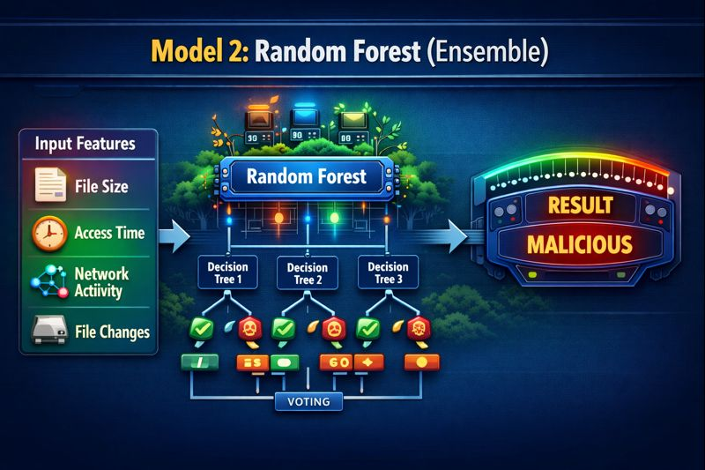
Model 2: Random Forest (Ensemble)
What it does
Builds many decision trees
Each tree predicts:
✅ Benign or 🚨 Malicious
Final result = majority vote
Why it’s stronger
Handles complex ransomware behavior
More accurate + more stable than one model
Notes:
Random Forest is an ensemble classifier that builds many decision trees. Each tree makes a prediction, and the final decision is based on majority voting. Because it combines multiple trees, it captures complex ransomware patterns better and usually performs more accurately than a simple baseline model.

Slide 9

Results: Which Model Performs Better?
Logistic Regression (Baseline)
Simple + fast baseline
Can miss complex patterns
(higher false negatives)
Random Forest (Ensemble)
Better detection overall
Catches more ransomware cases
(higher recall)
Random Forest is the clear winner.
Notes:
In the results comparison, Logistic Regression works well as a baseline model, but it can miss more complex ransomware patterns. Random Forest performs better overall because it uses many decision trees and majority voting, which improves detection and helps catch more ransomware cases.

Slide 10
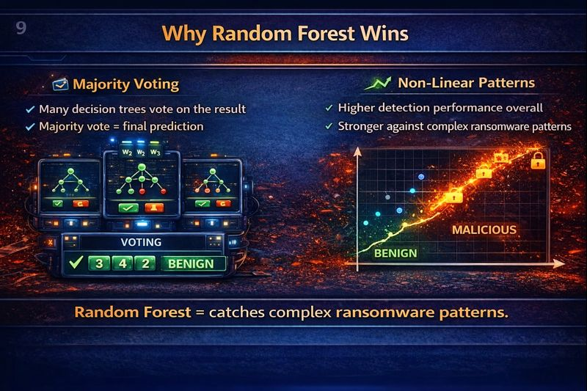
Why Random Forest Wins
Majority Voting
Many trees vote on the outcome
Majority vote = final prediction
Non-Linear Patterns
Captures complex ransomware behavior
Simple models may miss these patterns
Many trees + voting = stronger detection.
Notes:
Random Forest is stronger because it uses majority voting—many decision trees make predictions and the final result is the most common vote. This reduces errors from any single tree. It also handles non-linear and complex ransomware behaviors better than Logistic Regression, which is more limited in what patterns it can capture.

Slide 11
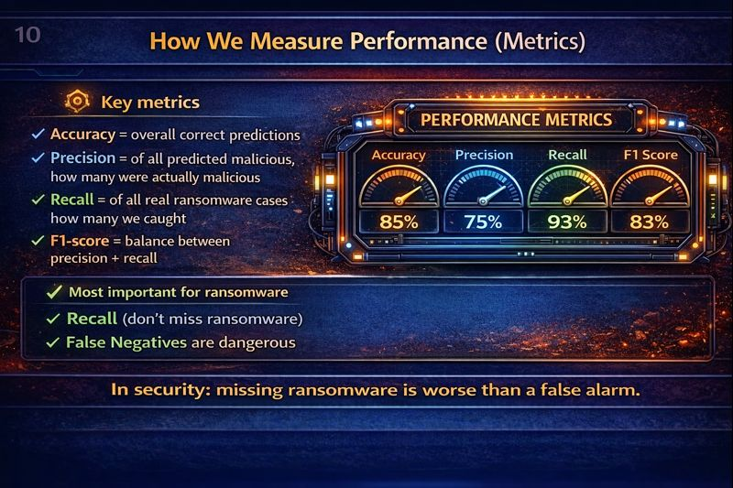
How We Measure Performance (Metrics)
Key Metrics
Accuracy = overall correct predictions
Precision = predicted malicious that are truly malicious
Recall = ransomware cases correctly detected
F1-score = balance of precision + recall
Most Important in Security
Recall matters most (don’t miss ransomware)
False negatives are dangerous
Missing ransomware is worse than a false alarm.
Notes:
We evaluate model performance using accuracy, precision, recall, and F1-score. Accuracy measures overall correctness, precision tells us how many detected threats are truly malicious, and recall tells us how many real ransomware cases we successfully catch. For security, recall is especially important because false negatives mean ransomware can slip through undetected.

Slide 12
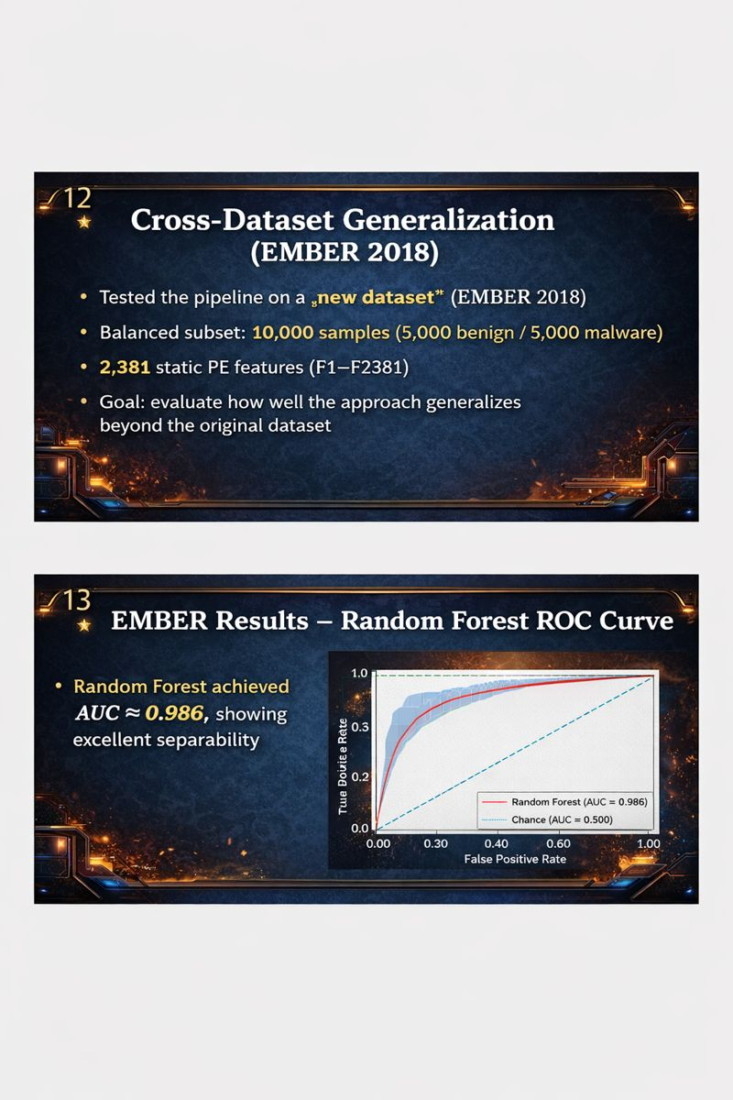
Cross-Dataset Generalization (EMBER 2018)

Slide 13
EMBER Results – Random Forest ROC Curve

Slide 14
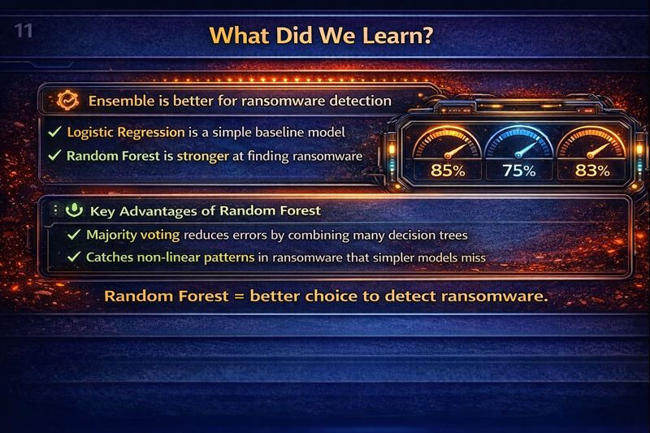
What Did We Learn? (Key Takeaways)
Machine learning can detect ransomware using behavior features
Logistic Regression is a good baseline, but can miss complex attacks
Random Forest performed best due to voting + stronger pattern detection
In security, Recall is critical
missing ransomware (false negatives) is dangerous
Ensemble models improve detection and reduce missed attacks.
Notes:
We learned that machine learning can detect ransomware behavior patterns. Logistic Regression provides a strong baseline, but Random Forest performs better because it uses ensemble voting and captures complex ransomware behavior. For security tasks, recall is critical because false negatives allow ransomware to slip through.

Slide 15
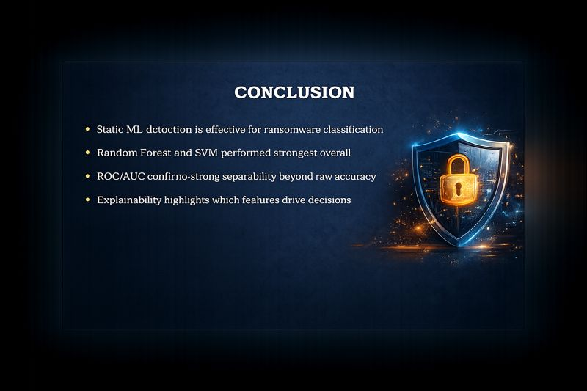

Slide 16
