Slide 1
Lecture 18 Input Capture with MC9S12C128
Real Time Control Issues
Automotive Applications
Real Time Interrupt
Input Capture with MC9S12C128
Input Capture Software Checklist
Input Capture to Measure Period on Channel 1
Pulse Accumulator on PT7 (Counter)

Slide 2
Real Time Control with A Microcontroller
Direct interrupts
IRQ, XIRQ, STRA
Able to generate output signals at specific time instants
output compare
Able to capture external events when they occur
measure the width of a pulse: input capture
count the number of occurrences: pulse accumulator
Able to generate a periodic signal
real time interrupt (RTI)
Able to generate pulse-width modulated signals
Able to understand analog signals: A/D converter

Slide 3
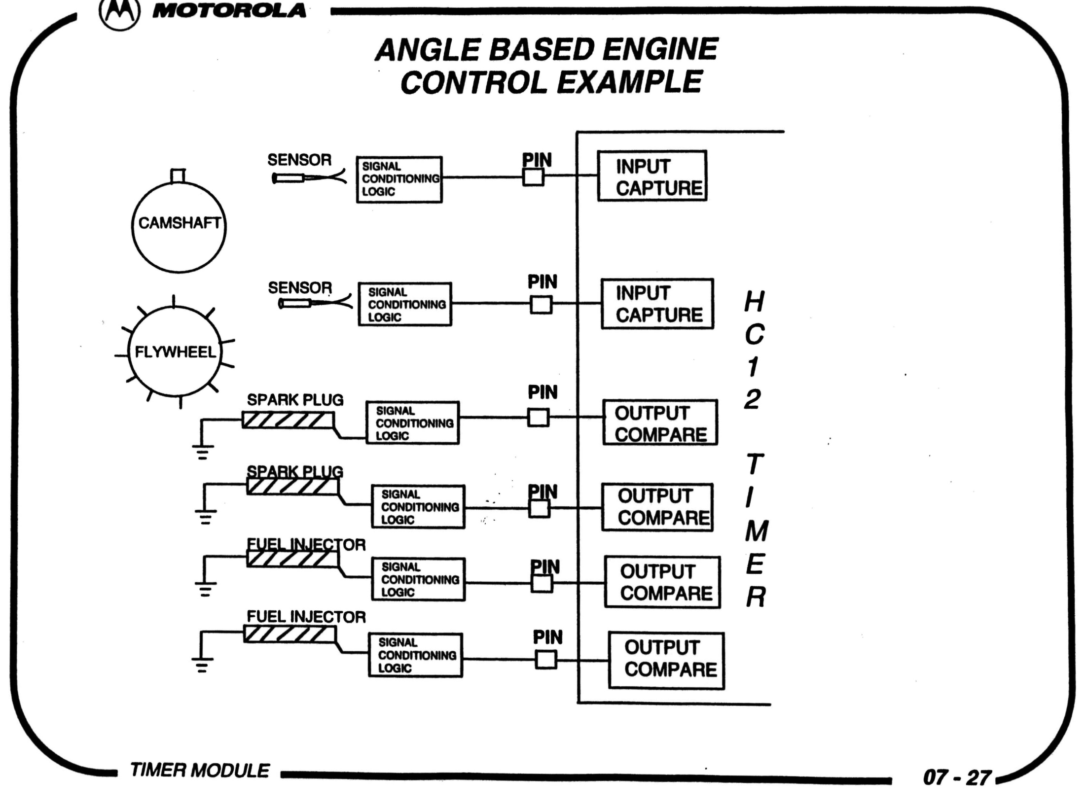

Slide 4
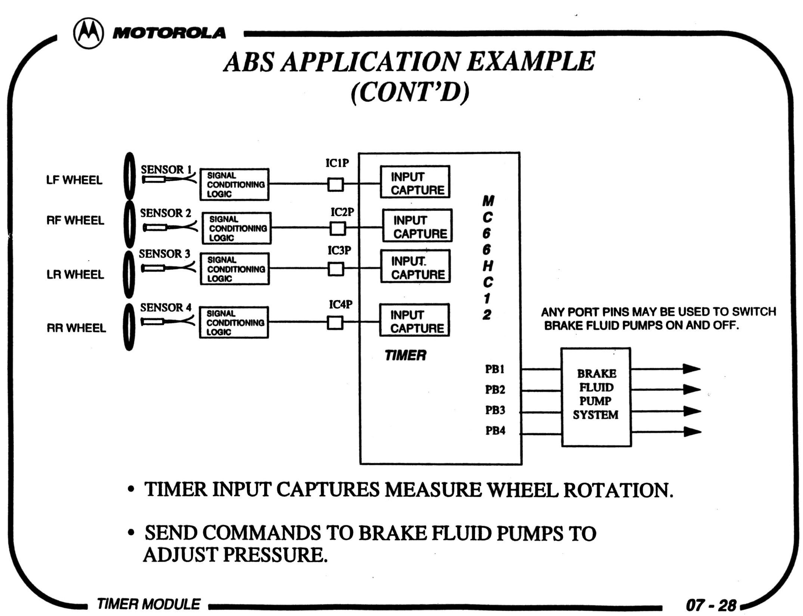

Slide 5
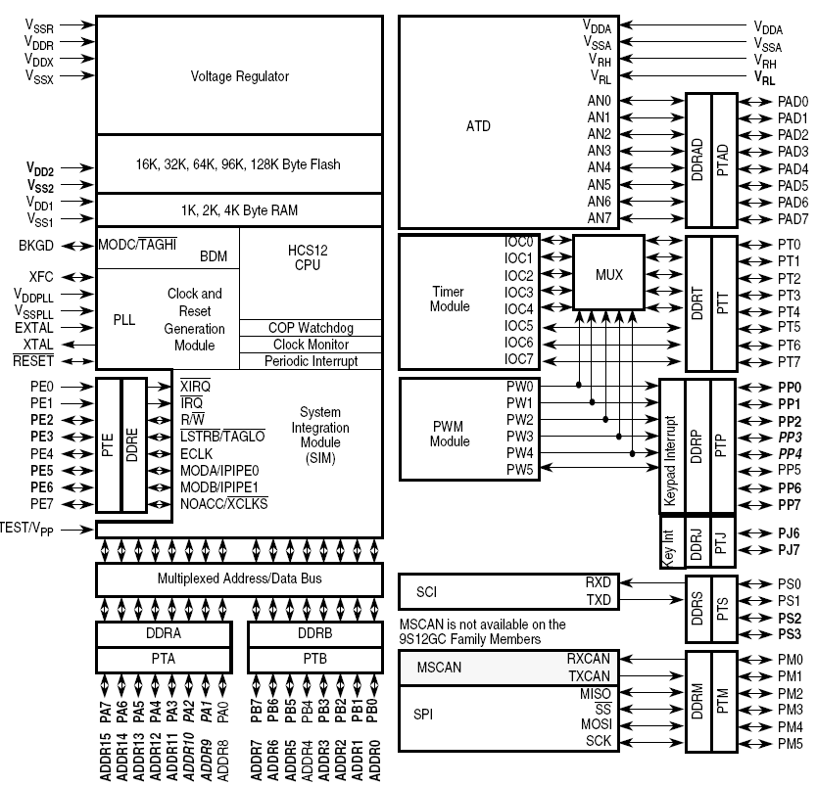

Slide 6
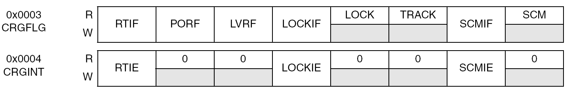
Real-Time Interrupt RTI to Generate Periodic Interrupt
Enable bit RTIE in CRGINT Register
Flag bit RTIF in CRGFLG Register
RTR[6:4] prescale rate in RTICTL
RTR[3:0] modulus counter in RTICTL
A new RTI time-out period starts automatically
Writing to the RTICTRL will restart the period
In Clock and Reset Generation Module (CRGV4)

Slide 7
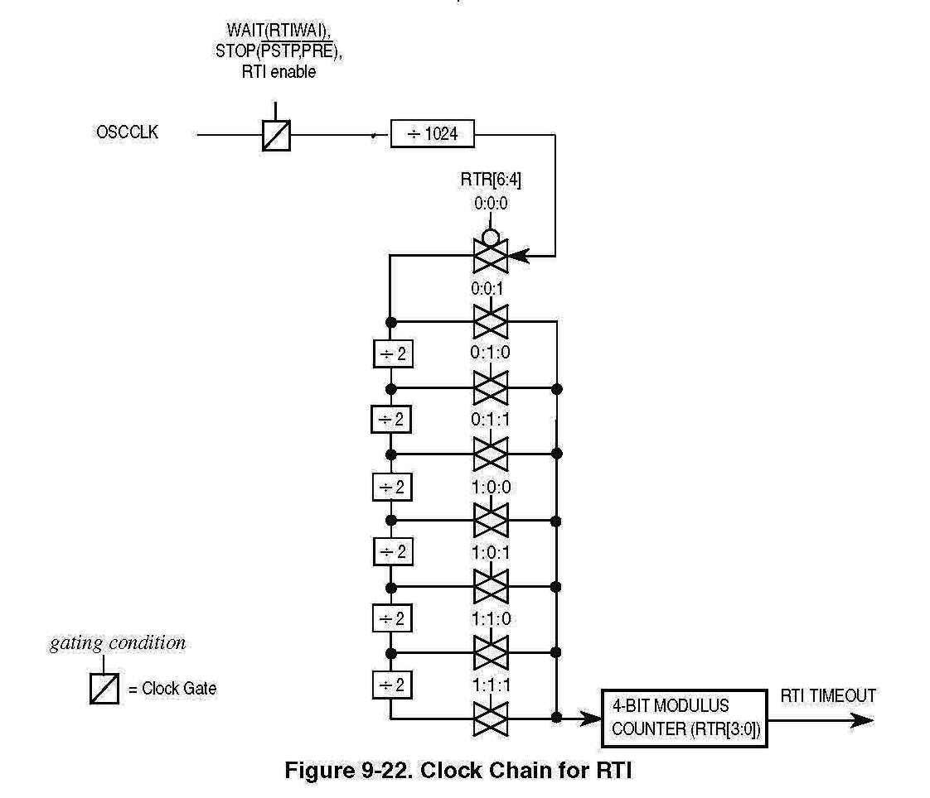
Real-Time Interrupt RTI Clock Chain in RTICTL Register

Slide 8
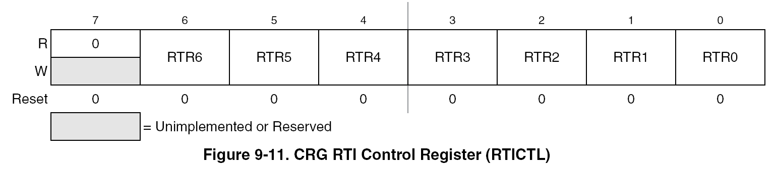

Slide 9
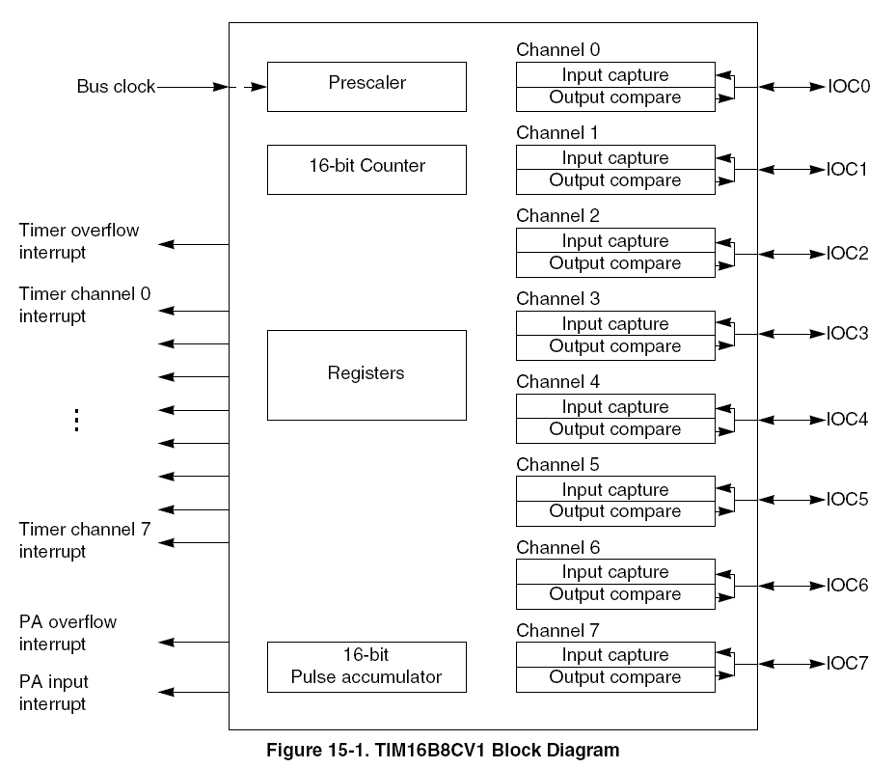
Eight Timer Channels: Output Compare & Input Capture
A channel can be either output compare or input capture. The same count registers TCi are used.

Slide 10
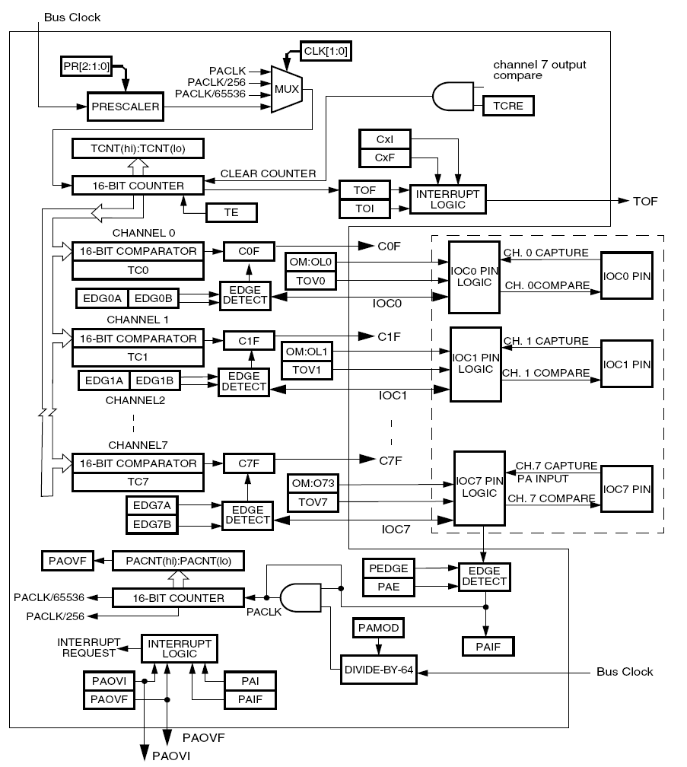

Slide 11
Input Capture
To measure the width of a pulse
Positive pulse, negative pulse or period
Store free running time TCNT into Timer Counter Registers on positive or negative or both edges
Smallest pulse width possible is one bus clock period
Largest pulse width is (2¹⁶-1) x timer clock period

Slide 12
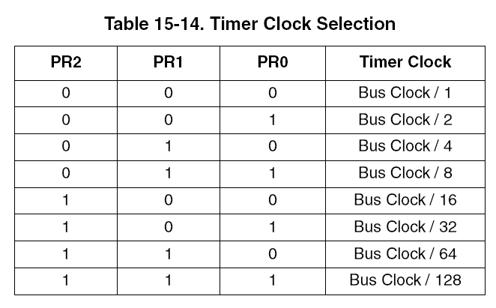
The Resolution and Range of Input Capture
The smallest time interval for one count is the bus clock period.
The largest time interval for one count is the bus clock period times the largest prescaler value of 128.
The TNCT is 16 bits long and therefore the largest count is 2¹⁶=65536
The largest time interval that can be measured is therefore
(Bus Clock Period)*128*65535
128*65535*1/2MHz=4.19 seconds

Slide 13
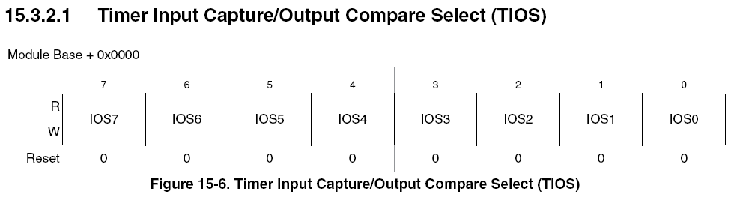
Input Capture Selection
TIOS register
IOSi=0 for Input Capture IOSi=1 for Output Compare
Precise measurement of a time internal
Capture events on pins PT7, ..., PT0 on PORT T, PTT
events can be rising, falling or both edges in TCTL3 & TCTL4
Timer counts are stored in TC registers

Slide 14
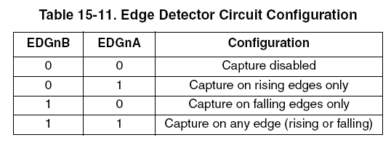
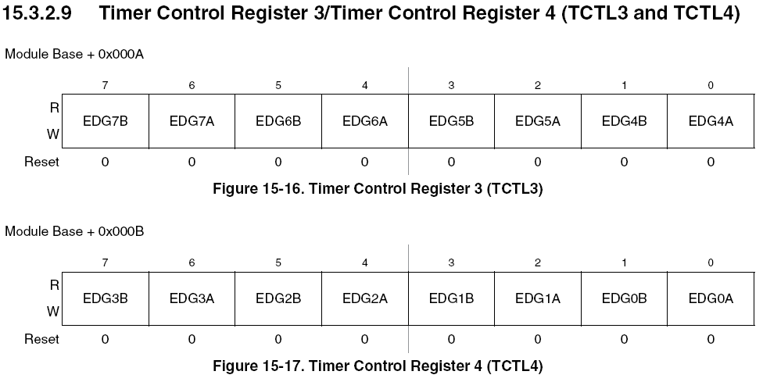
Input Capture Edge Action Options

Slide 15
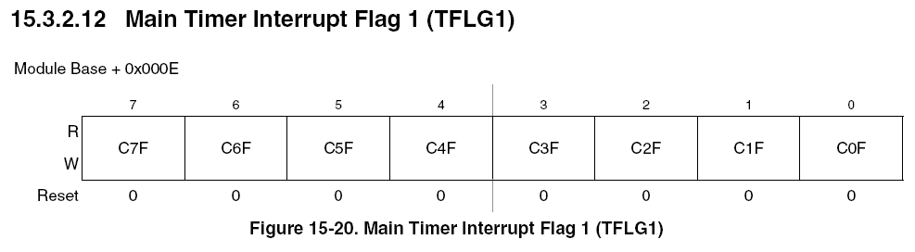
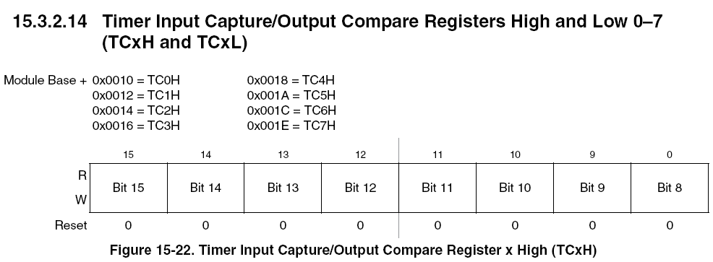
Flags and Count Storage
Input Capture Status Bits are Set When An Event Occurs
Input Capture Count Storage: two 8-bit registers TCiH and TCiL

Slide 16
Input Capture Software Checklist
Initialize interrupt vectors if necessary
Set Bit-7 (TEN) in TSCR to enable timer
Reset bits in TIOS to enable input capture channels
Initialize EDGnB and EDGnA in TCTL3 and/or TCTL4 for triggering edges
Reset flags in TFLG1
Enable local interrupt bits in TMSK1
Enable global interrupt in code condition register
Poll flags to check actively or let interrupts occur
Get captured count value in TCn registers
Clear flags in TFLG1
* Page 323, Software and Hardware Engineering, F.M. Cady and J.M. Sibigtroth, Oxford University Press, 2000

Slide 17
Input Capture Example on Channel 1 (IOC1) on PT1
TSCR
Timer system control register
0 - disable timer 1 - enable timer
TEN
TMSK1
Timer interrupt mask register 1
0 - no interrupt 1 - hardware interrupt request
C1I
TIOS
Timer select register
0 - input capture 1 - output compare
IOS1
TCTL4
Timer control register 4
EDG1B
EDG1A
TCNT
16-bit timer count register
Input edge
captured
00 - disabled 01 - rising edges only
10 - falling edges only
11 - both edges
TC1
16-bit timer input capture/Output compare register 1
TFLG1
Timer interrupt flag register 1
C1F
0 - no 1 - input captured

Slide 18
Input Capture with Channel 1 on Port T Pin 1: Initialization
InputPin: EQU %00000010 ; pin 1 selected
EdgeA: EQU mTCTL4_EDG1A
EdgeB: EQU mTCTL4_EDG1B
CapturedValue: EQU TC1
DataSec: SECTION
First: DS 2
SignalPeriod: DS 2
CodeSec: SECTION
Initialize_Get_Period:
BSET TSCR1,mTSCR1_TEN ; Enable the timer system
BCLR TIOS,InputPin ; enable pin InputPin for input capture
RTS

Slide 19
Input Capture with Channel 1 on Port T Pin 1: Get Period
Get_Period:
BSET TCTL4,EdgeA ; Initialize edge action for rising edge
BCLR TCTL4,EdgeB
BSET TFLG1,InputPin ; Clear Flag
; Wait for the first rising edge when IC1 Flag is set
spin1: BRCLR TFLG1,InputPin,spin1
; Now get the count that was latched
LDD CapturedValue
STD First ;Save it
BSET TFLG1,InputPin
; Wait for the second rising edge
spin2: BRCLR TFLG1,InputPin,spin2
LDD CapturedValue ; Get the ending count

Slide 20
Input Capture with Channel 1 on Port T Pin 1: Get Period
CPD First
BHI SKIP ; no 2's complement if Second is greater than first
; Take 2's complement of First and add it to the second input capture.
COM First
COM First+1
LDX First ; 2's complement of the first count
INX
STX First
ADDD First
BRA RETURN
SKIP:
SUBD First ; Calculate the period
RETURN:
STD SignalPeriod
RTS
end

Slide 21
Input Capture with Channel 1 on Port T Pin 1: main()
void SetOscillatorSpeed(void);
void SetLedindicator(void);
void Initialize_Get_Period(void);
void Get_Period(void);
extern unsigned int SignalPeriod;
void main (void)
{
uchar returned_value; unsigned int CalculatedPeriod;
Initialize_Get_Period();
while(1) {
Get_Period();
CalculatedPeriod = SignalPeriod*PRESCALER/PLLClock;
(void) printf("\n\r%s%i", "Signal Period in microseconds is ", CalculatedPeriod);
} //end while
}// end main

Slide 22
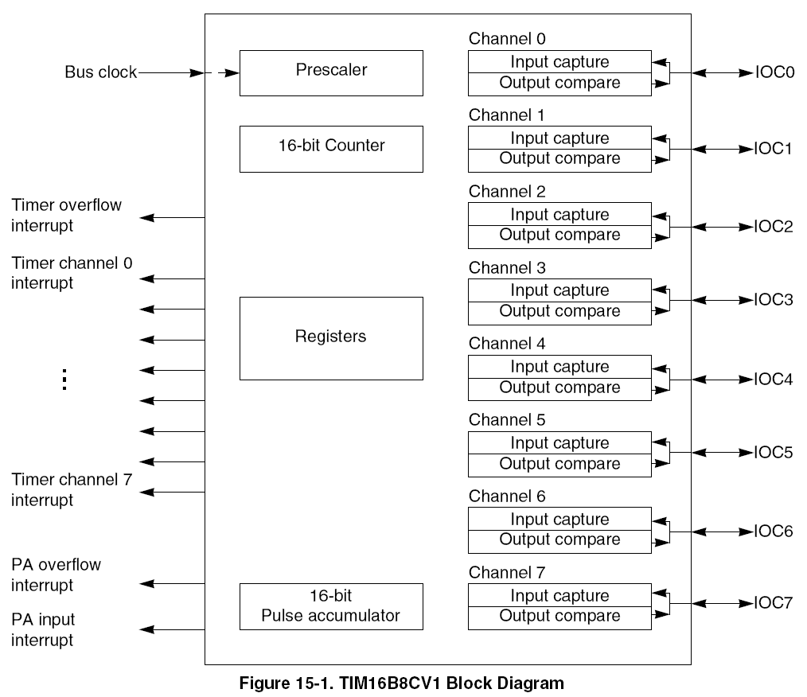
Pulse Accumulator on PT7 (Counter)

Slide 23
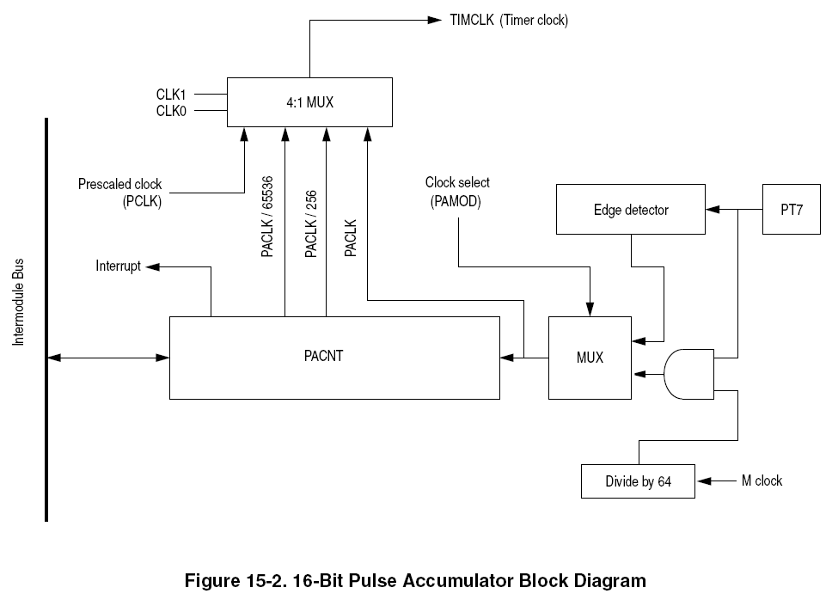

Slide 24
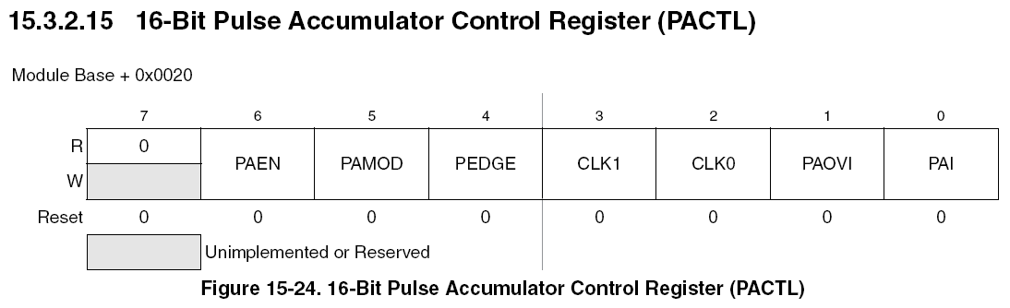
Pulse Accumulator Control Register PACTL
Two modes
event-counting on PA7 (PAMOD=0) - pieces on an assembly line
Gated time accumulation (PAMOD=1) - duration of a pulse
Edge detection
PEDGE = 0 for falling edges and PEDGE=1 for rising edges

Slide 25
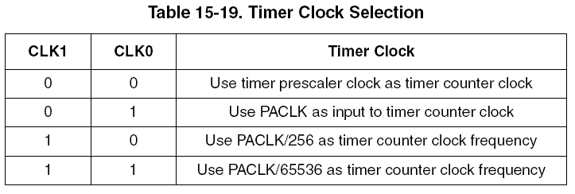
Timer Clock Selection

Slide 26
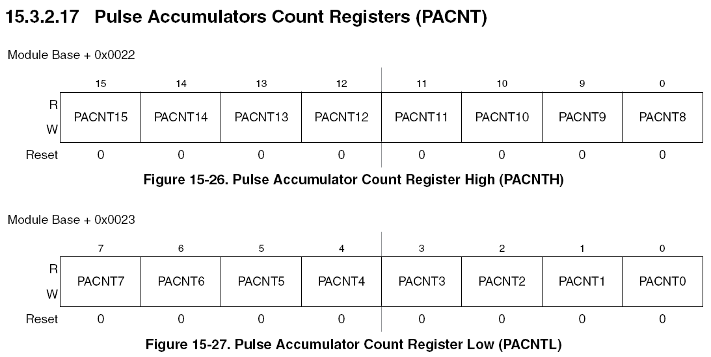
Pulse Accumulator Count Register (PACNT)

