Slide 1
Lecture 20 Freescale’s MSCAN Module
Freescale’s CAN Modules
MScan12 Module
MScan12 Control Registers
MScan12 Data Buffer
An example

Slide 2
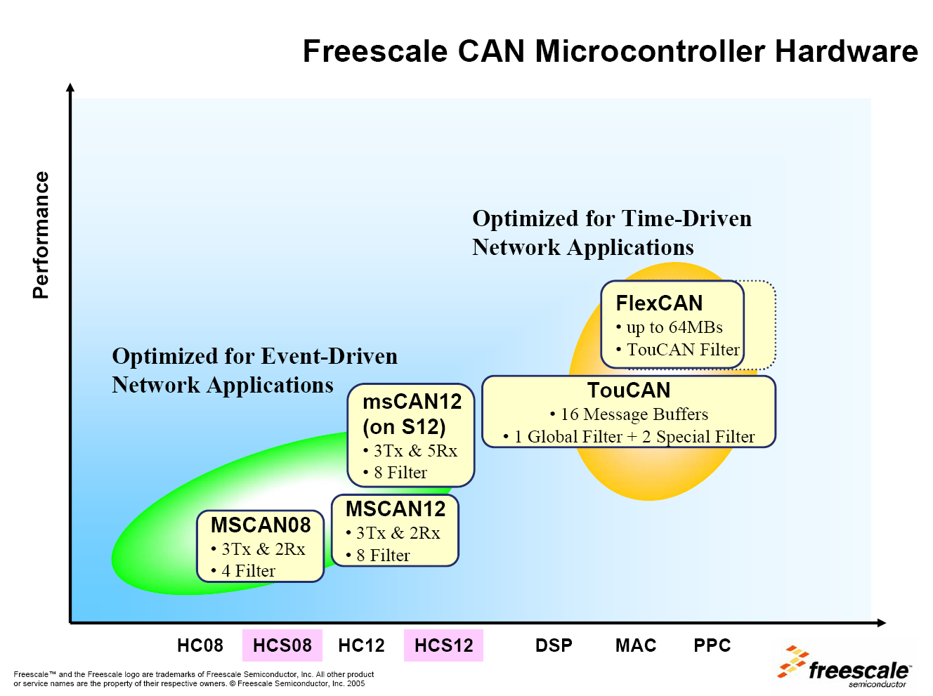

Slide 3
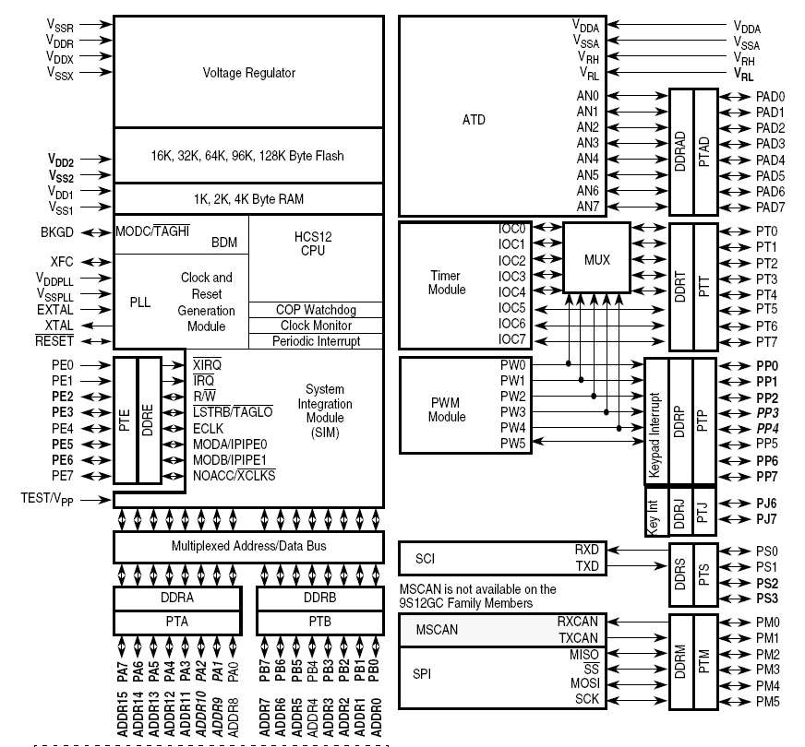

Slide 6
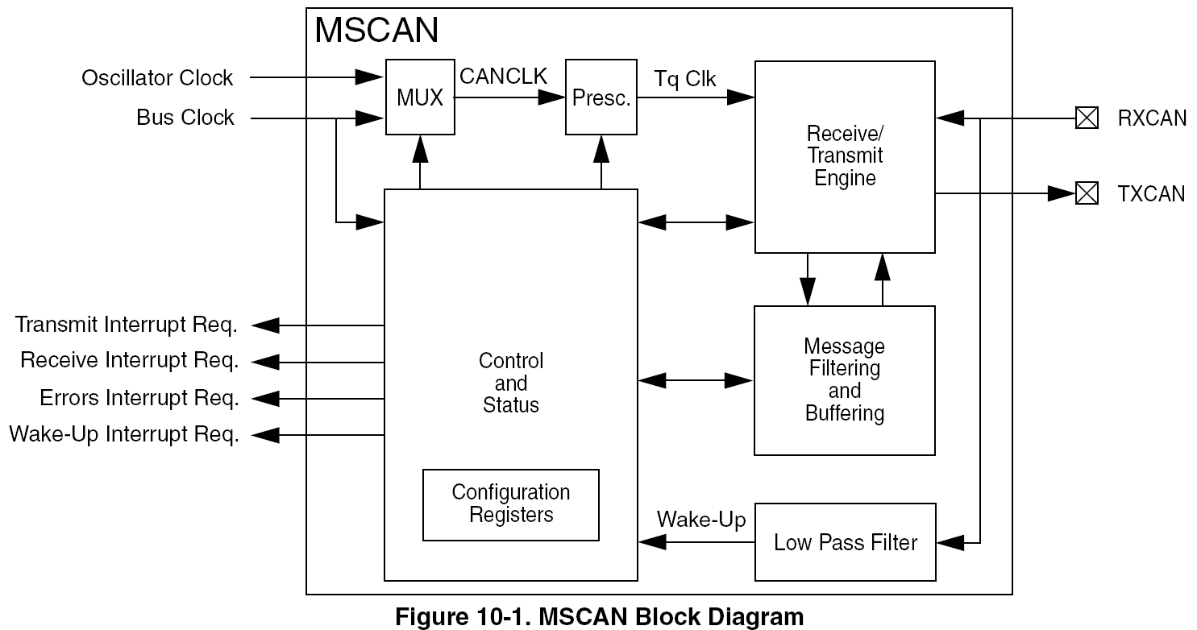
MSCAN Block Diagram

Slide 7
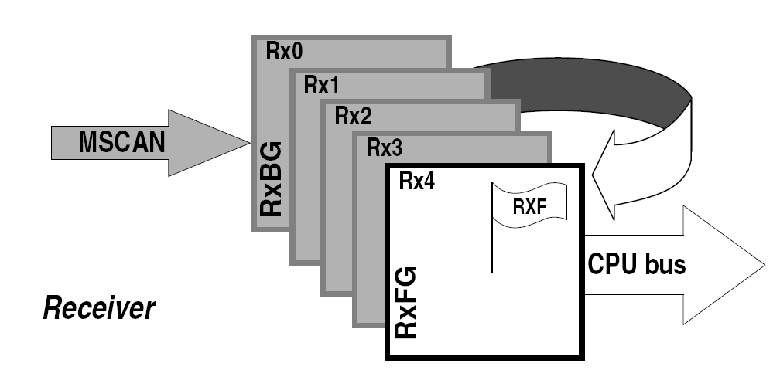
MSCAN Receiver

Slide 8
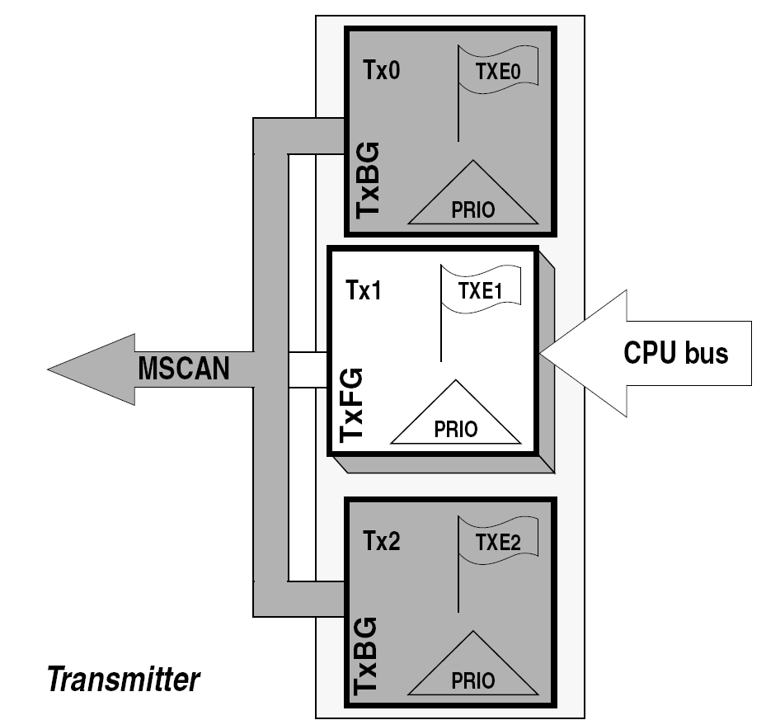
MSCAN Transmitter

Slide 9
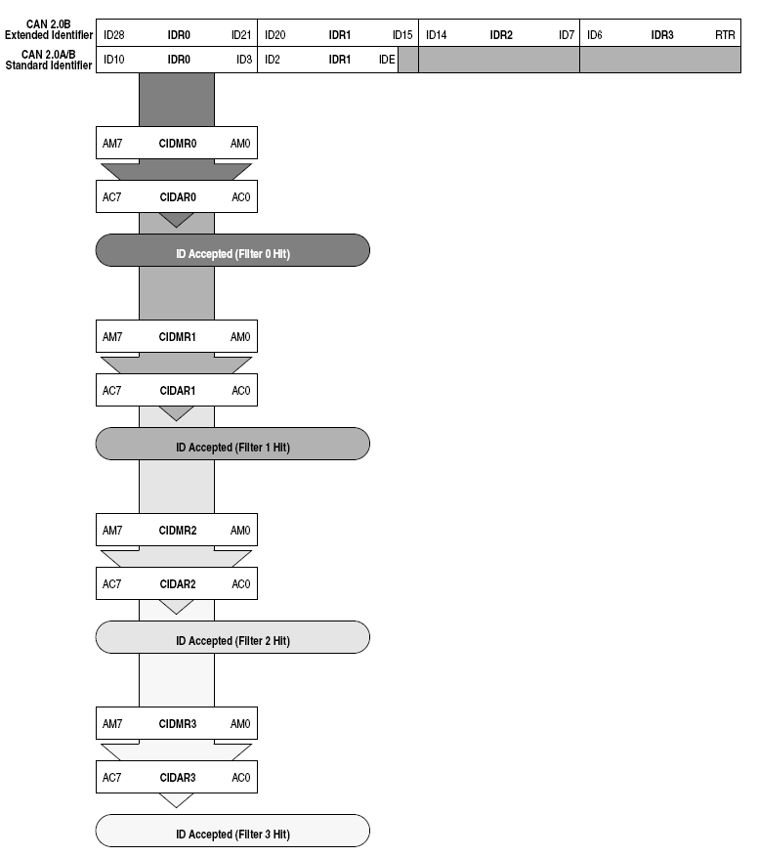
8-Bit Maskable Identifier Acceptance Filters
Accept four sets of Identifiers

Slide 10
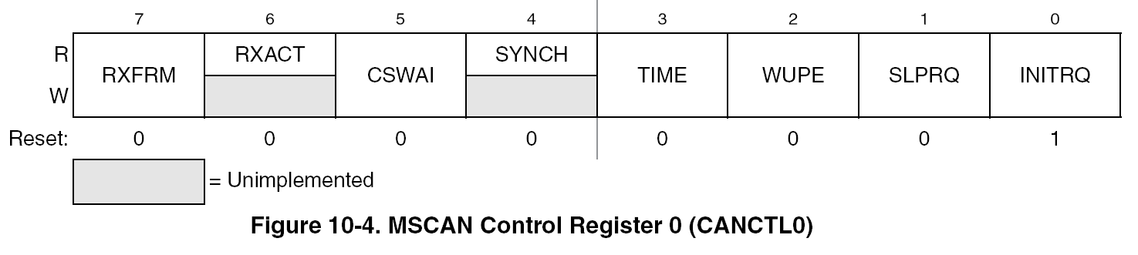
MSCAN Control Register 0 (CANCTL0)
RSFRM – “1” means that a new valid frame is received.
SYNCH – “1” means that MSCAN is synchronized with the CAN bus
INITRQ – “1” means that MSCAN is in initialization mode

Slide 11
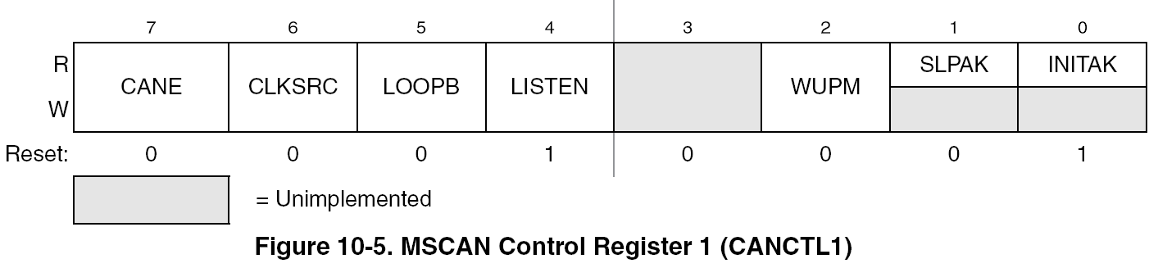
MSCAN Control Register 1 (CANCTL1)
CANE – “1” means MSCAN is enabled.
CLKSRC – “1” bus clock “0” oscillator clock
LISTEN – “1” Listen-silently-only mode. “0” Normal mode
INITAK – “1” initialization mode active “0” initialization over

Slide 12
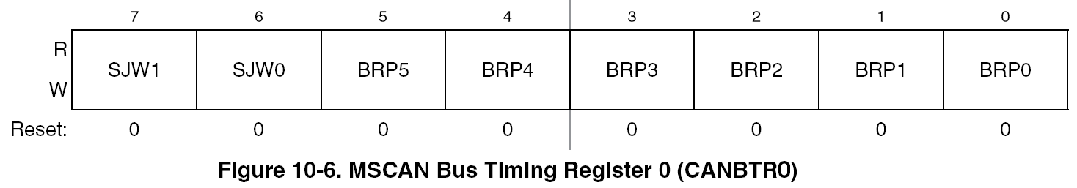
MSCAN Bus Timing Register 0 (CANBTR0)
SJW[1:0]
The synchronization jump width defines the maximum number of time quanta (Tq) clock cycles a bit can be shortened or lengthened to achieve resynchronization to data transitions on the CAN bus.
BRP[5:0] – Baud Rate Prescaler

Slide 13
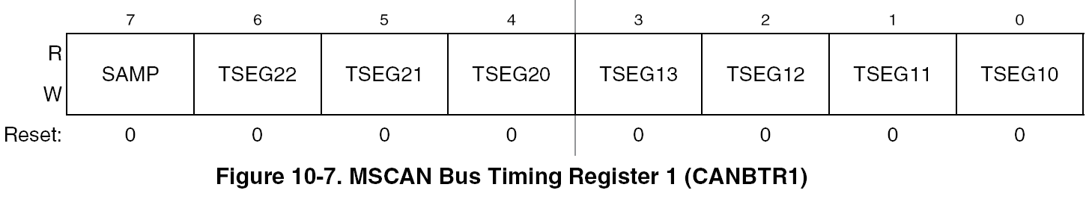
MSCAN Bus Timing Register 1 (CANBTR1)
SAMP - the number of CAN bus samples taken per bit time.
“0” one sample “1” three samples with majority voting
TSEG2[2:0] – Time segment 2 in number of time quotas T_{q}
TSEG1[3:0] – Time segment 1 in number of time quotas T_{q}

Slide 14
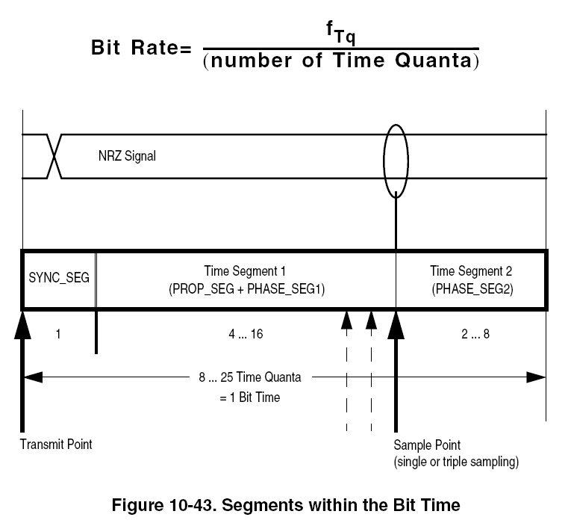
MSCAN Bus Timing Segments

Slide 15
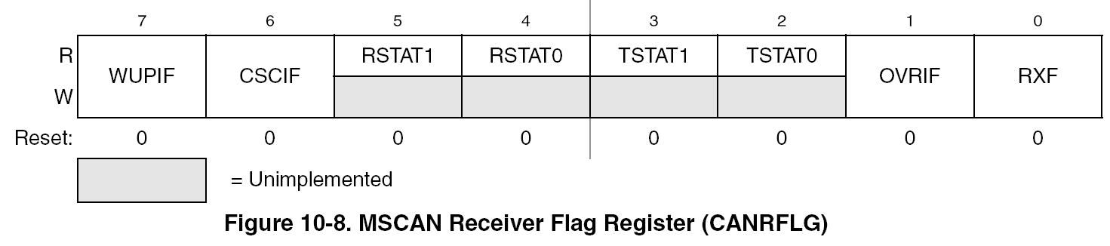
MSCAN Bus Receiver Flag Register 1 (CANRFLG)
OVRIF – “1” A data overrun detected “0” no data overrun
RXF – “1” New message available “0” no new message

Slide 16
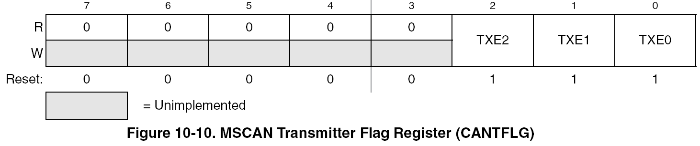
MSCAN Bus Transmitter Flag Register 1 (CANTFLG)
TXE2 – “1” Transmit buffer empty “0” Transmit buffer full
RXF – “1” New message available “0” no new message

Slide 17
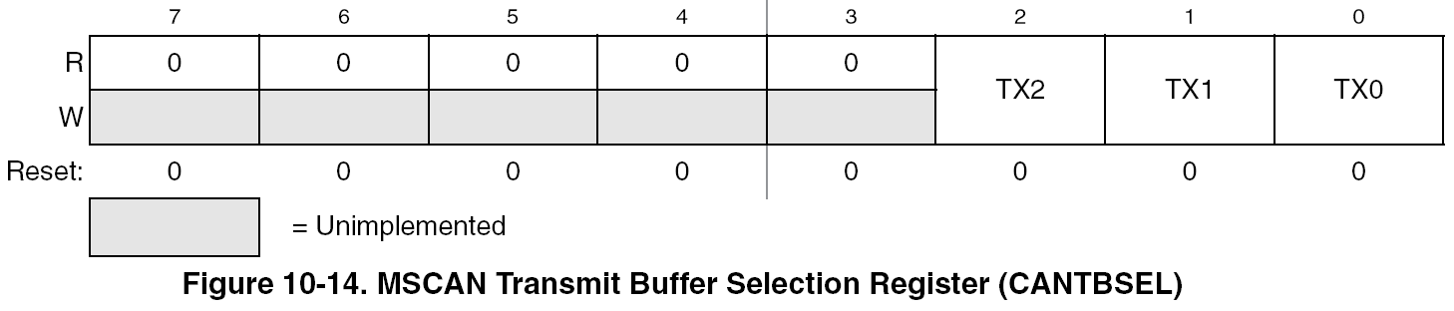
MSCAN Transmit Buffer Selection Register (CANBSEL)
TX[2:0] – Select the lowered numbered buffer.
TX[2:0] = 0b110 will select Buffer 1
TX[2:0] = 0b111 will select Buffer 0

Slide 18
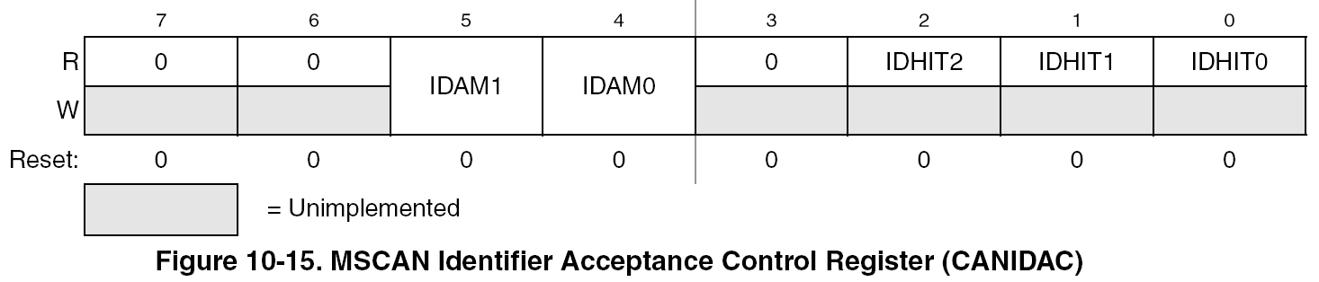
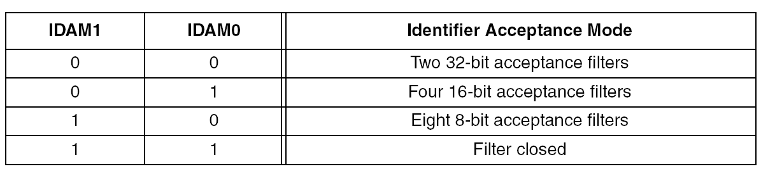
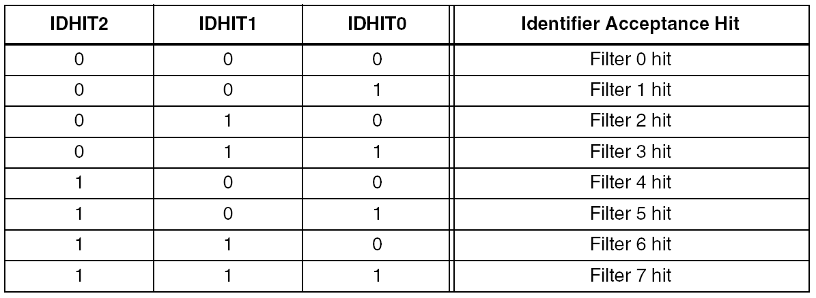
MSCAN Identifier Acceptance Control Register (CANIDAC)

Slide 19
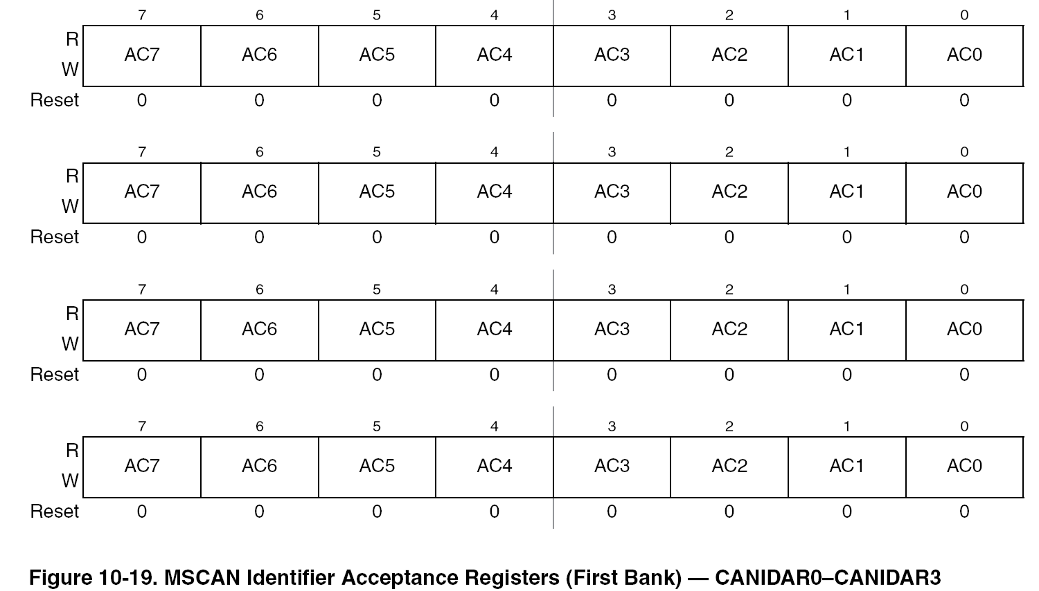
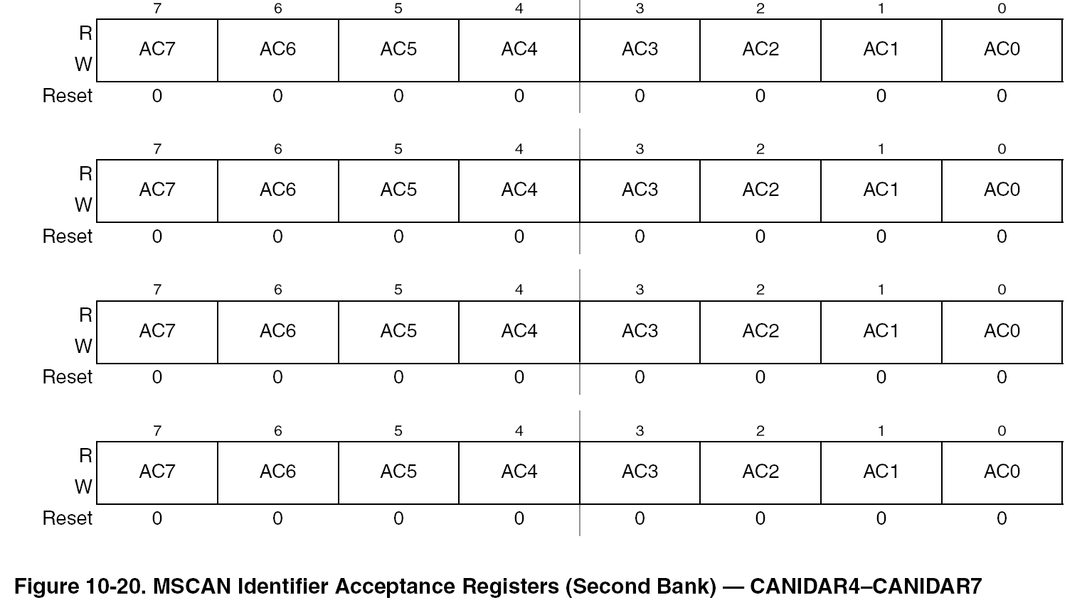
8 MSCAN Identifier Acceptance Registers (CANIDAR0-7)

Slide 20
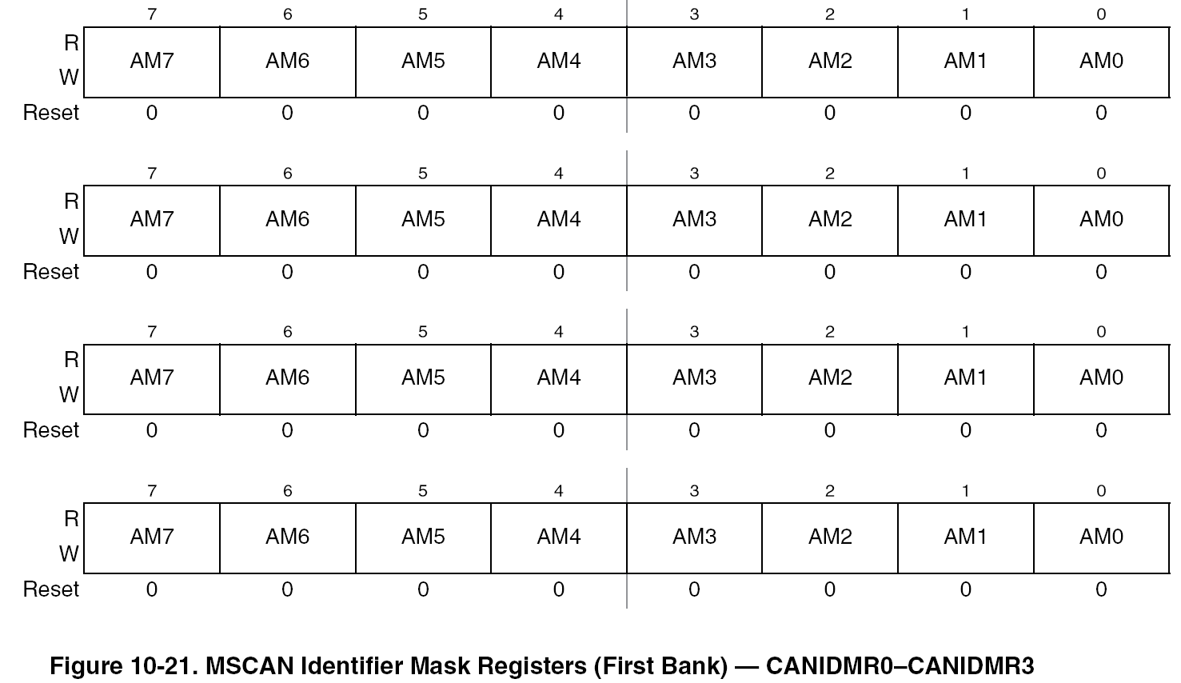
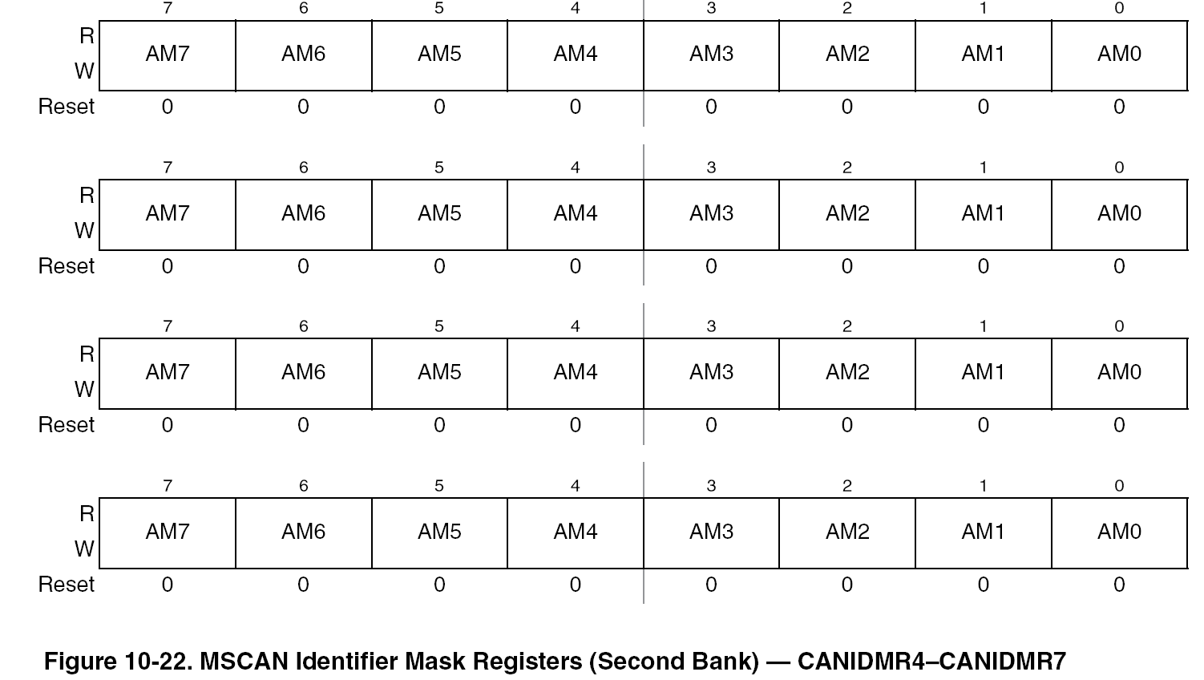
8 MSCAN Identifier Mask Registers (CANIDMR0-7)

Slide 21
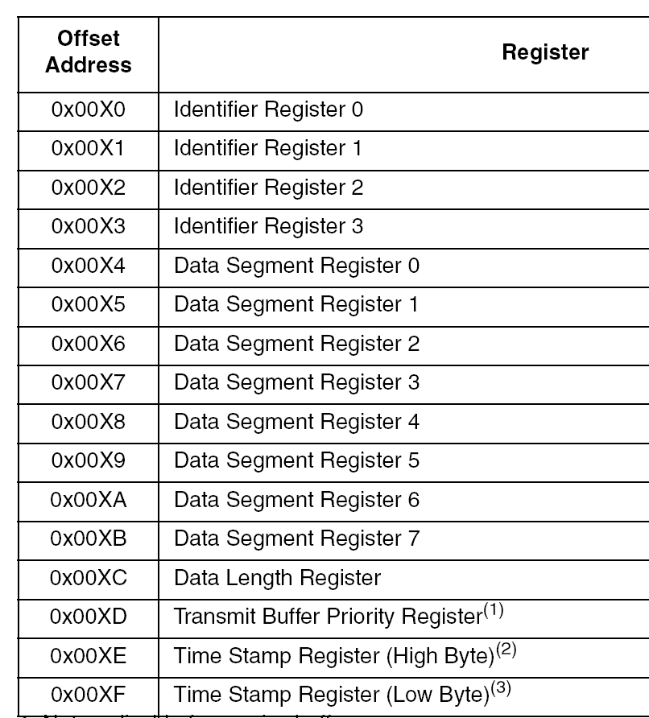
MSCAN Message Buffer

Slide 22
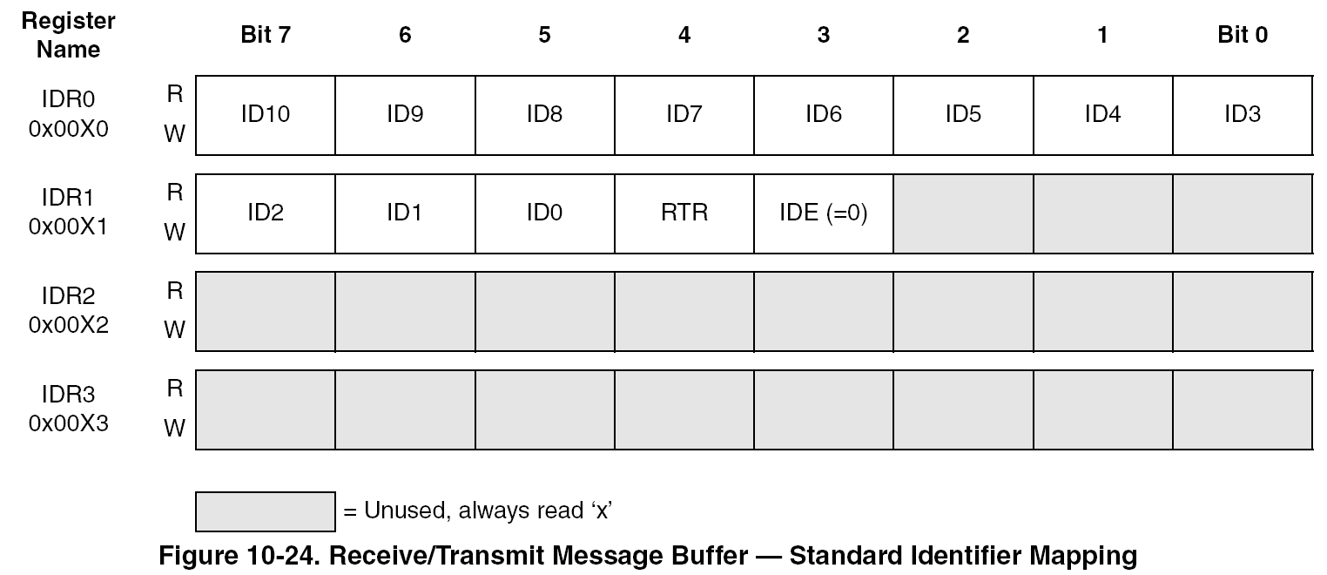
MSCAN Message Buffer – Standard Identifier Mapping

Slide 23
MSCAN Initialization Example
void can_initialize(void){
Can0.canctl1.bit.cane = 1; //enable MSCAN module
while (Can0.canctl1.bit.initak==0) Can0.canctl0.bit.initrq = 1; //make initialization mode request
Can0.canctl1.bit.listen = 0; //turn off listen mode
Can0.canctl1.bit.clksrc = 1; //use bus clock
Can0.canbtr0.byte=0b11111111;
Can0.canbtr1.byte=0b11111111; //can bit timing
Can0.canidac.bit.idam1=1;
Can0.canidac.bit.idam0=0; //eight 18 bit acceptance filters
Can0.canid[0].canidmr.b[0] = 0x00; // check all bits
Can0.canid[0].canidmr.b[1] = 0x00; //check all bits
Can0.canid[0].canidmr.b[2] = 0x00; Can0.canid[0].canidmr.b[3] = 0x00;
Can0.canid[1].canidmr.b[0] = 0x00; Can0.canid[1].canidmr.b[1] = 0x00;
Can0.canid[1].canidmr.b[2] = 0x00; Can0.canid[1].canidmr.b[3] = 0x00;
Can0.canid[0].canidar.b[0] = LEDLight1ID; // standard 11 bit ID
Can0.canid[0].canidar.b[1] =0x00;
Can0.canid[0].canidar.b[2] = MasterNodeID; Can0.canid[0].canidar.b[3] = 0x00;
Can0.canid[1].canidar.b[0] = LEDLight1ID; Can0.canid[1].canidar.b[1] = 0x00;
Can0.canid[1].canidar.b[2] = 0xFF; Can0.canid[1].canidar.b[3] = 0xFF;
// get out of initialization mode
while (Can0.canctl1.bit.initak==1) { Can0.canctl0.bit.initrq=0; };
Can0.canctl1.bit.cane = 1; //enable MSCAN module
while ((Can0.canctl0.byte & SYNCH) ==0) { }; // wait until the module is synchronized with the CAN bus
}; // end of initialize_can()

Slide 24
MSCAN Send Message Example
uchar can_send_message(uchar NodeID, uchar message){
// wait for synch
while ((Can0.canctl0.byte & SYNCH) ==0) {
};
// select transmit buffer 0
Can0.cantbsel.bit.tx=0b001;
//set up transmit buffer
Can0.txbuf.id.b[0]=NodeID; // ID
// bit 3 is IDE=0 for standard 11 bit ID
// bit 4 RTR =0 for data message
Can0.txbuf.id.b[1]=0x00; // 11 bit ID, Bits 3 and 4 are RTR and IDE
Can0.txbuf.id.b[2]=0xFF; //this is ignored
Can0.txbuf.id.b[3]=0xFE; // this is ignored for 11 bit ID
Can0.txbuf.dsr[0]= message;
Can0.txbuf.dlr = 1; //one byte data
Can0.txbuf.tbpr = 1; //priority register. lowest priority number wins
while(Can0.cantflg.bit.txe==0b110) {
}// wait for previos transmission to be over
Can0.cantflg.bit.txe = 0b001; //set the flag to clear it to start tranmission
return(1);
};

Slide 25
MSCAN Receive Message Example
void can_receive_message(uchar *messageID, uchar *message){
uint timestamp;
while ((Can0.canctl0.byte & SYNCH) ==0) {
};
while(Can0.canrflg.bit.rxf==0) {
} //wait until Receive Buffer is full
*messageID = Can0.rxbuf.id.b[0]; // the highest three bits contain message ID
*message = Can0.rxbuf.dsr[0];
timestamp = Can0.txbuf.tsr; //get time stamp
Can0.canrflg.bit.rxf=1; //clear the flag
return;
};

