Slide 1
Convolutional neural networks for image classification
By Johnny Rivera, Jimmy Ngo, Andres Colon, & Tyler Solarz

Slide 2
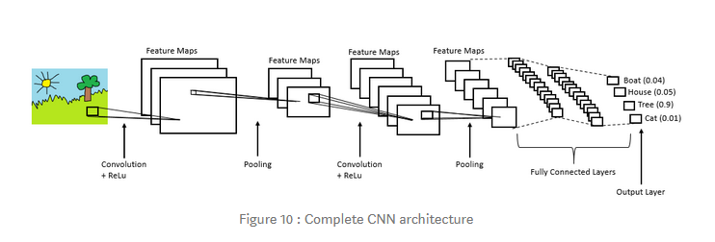
Outline
Introduction
About our project
Purpose of it
Why we choose it
The code
Performance Benchmark
Demonstration
Conclusion

Slide 3
Introduction
CNN(convolution neural network) is a type of deep learning that uses processing of specific data in order to reach a desired output, in most cases classification
To code a CNN that can process an image and then determine the speed and accuracy
We will compare the performance of running a CNN on a PYNQ-Z1 board and a standard laptop/desktop CPU, then determine which is most optimal

Slide 4

Purpose
Machine Learning a very interesting topic, and a CNN is a good starting point to learn about the concept.
A CNN is commonly used in visual classification and a recognized example of this is Google Lens

Slide 5
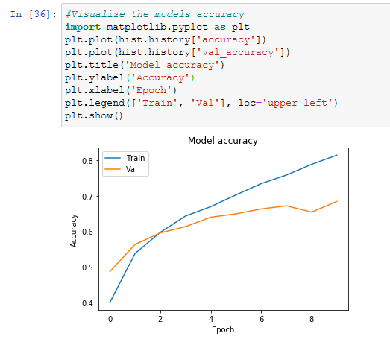
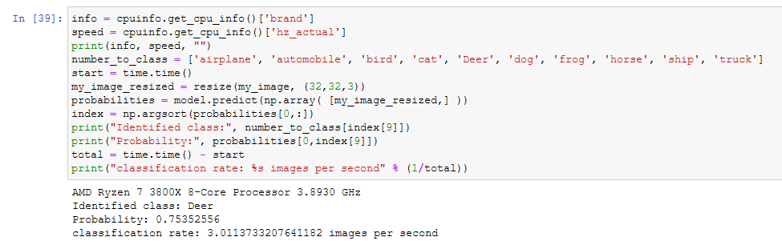
The Code
This program uses Python to train and run a CNN to recognize objects from an image and is based on the CIFAR-10 dataset

Slide 6
Performance
Comparing the purely software based CNN, and using the PYNQ-Z1 board to run a similar model on FPGA.
Table below shows benchmark comparison
Implementation | Clock Rate (GHz) | Max Power (W) | Images per Second | Accuracy (%)
Ryzen 7 3800X | 3.893 | 200 | 3.01 | 75.35
Intel i7-8550U | 1.494 | 15 | 0.93 | 72.31
PYNQ-Z1 ARM | 0.650 | 2.5 | 0.63 | n/a
PYNQ-Z1 FPGA | 0.525 | 2.5 | 632.11 | 79.22

Slide 7
Demonstration of Code

Slide 8
Conclusion
Things learned from this project; PYNQ-Z1 uses and advantages, what is a CNN and how to use it, and some python code.
Convolutional Neural Networks are a vast area of deep learning that has numerous applications in the real world, such as image recognition, video analysis, anomaly detection, etc.
This project was an example of image recognition, a vastly improving system, that can be used to classify almost any image.

Slide 9
Thank You,
Any Questions ?

