Slide 1
H.264 Video Compression with PYNQ-Z1
Team Pleb: Christine Duong, Michael Hicks, Edward Hwang, Cory Kim, Jaemin Kim, Ryan Toeung

Slide 2
Overview
Introduction
Goals for the project
Equipment used
Video Compression Tests
Test Results
Current Status and Future Work

Slide 3
Introduction
Video compression is used decrease a file by removing repetitive frames and compressing data
H.264 was chosen algorithm
A industry standard that aimed to attain higher quality video at a lower bit rate
A block-oriented motion-compensation-based video compression
Focus on testing performance metrics on hardware

Slide 4
Goals of the Project
To evaluate the performance of the H.264 codec on an FPGA, specifically the PYNQ-Z1
Test both video compression and decompression
Understand the differences of on-board (ARM) performance vs. FPGA overlay architecture
To evaluate the performance differences of a PYNQ-Z1 vs. a Raspberry Pi 3

Slide 5
Software and Equipment
PYNQ-Z1
Utilize the 650MHz dual-core Cortex-A9 ARM processor with the onboard Linux.
Open H.264 compression algorithm from Cisco.
Standard Windows 10 (Personal Computer)
Virtualbox - Virtual Machine (Didn’t work)
PuTTY was installed and used to access the linux from Windows 10 to the onboard PYNQ Linux system.

Slide 6
Video Compression Tests
Testing .yuv files and compressing them to .264
Focused on:
Time taken to encode
Frames encoded per second
Output file size

Slide 7
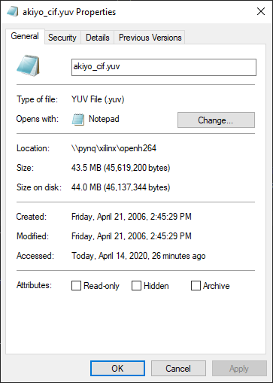

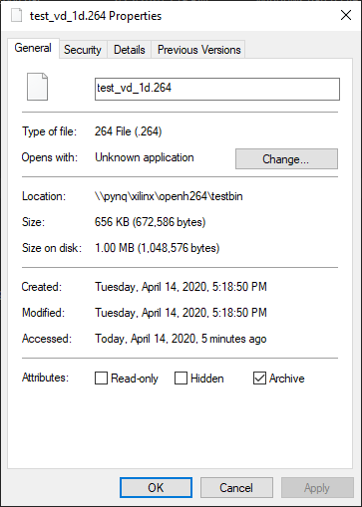
Test Results
Old File Size = 43.5 MB
New File Size = 656 KB

Slide 8
Current Status and Future Work
Currently
Working H.264 video compression algorithm on PYNQ-Z1
Analyzed data & tests from different videos
Future expectations
Use a Raspberry Pi for performance comparison against PYNQ - Z1
Improve performance with overlay architecture
Implement decoding algorithms and testing

Slide 9
Works Cited
https://www.vcodex.com/an-overview-of-h264-advanced-video-coding/
https://www.sciencedirect.com/science/article/pii/S1319157818301101
https://link.springer.com/chapter/10.1007%2F978-81-8489-989-4_51
https://link.springer.com/article/10.1007/s11554-018-0792-x
https://www.xilinx.com/products/intellectual-property/nav-audio-video-and-image-processing/nav-compression.html
https://www.sciencedirect.com/topics/physics-and-astronomy/discrete-cosine-transform
http://citeseerx.ist.psu.edu/viewdoc/download?doi=10.1.1.19.9782&rep=rep1&type=pdf
https://pdfs.semanticscholar.org/974d/c6916ae89eb01e1d4984978e2fe091657308.pdf

